Slide 1
Starter
Can you name these types of angles?
90°
Right angle
Acute
Obtuse
Reflex

Slide 2
Angles around a point
A full turn is $360°$

Slide 3
Angles around a point
$$d$$
$$c$$
$$a$$
$$b$$
A full turn is $360°$
Angles around a point add up to $360°$
$$a+b+c+d=360°$$

Slide 4
Angles on a straight line
$b$
$a$
A straight line is a half turn.
Angles on a straight line add up to $180°$
$$a+b=180°$$

Slide 5
Angles in a triangle
$$b$$
$$a$$
$$c$$
Angles in a triangle add up to $180°$
$$a+b+c=180°$$

Slide 6
Vertically opposite angles
$$a$$
$$b$$
$$d$$
$$c$$
Vertically opposite angles are equal
$a=c$ and $b=d$

Slide 7
Extension: Complete the exam questions

Slide 9
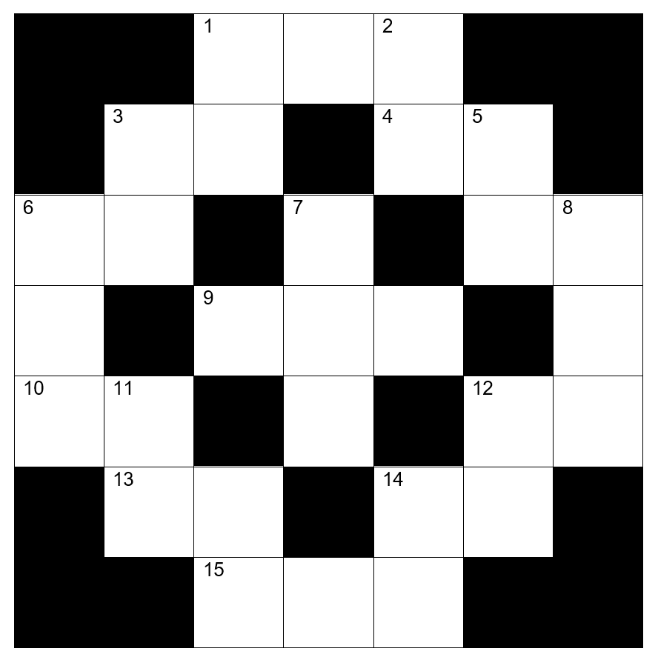
Angles Cross-Number
Use the clues inside the booklet to fill in the across and down numbers.
Only enter one digit per box.
None of the diagrams are drawn accurately.

Slide 10
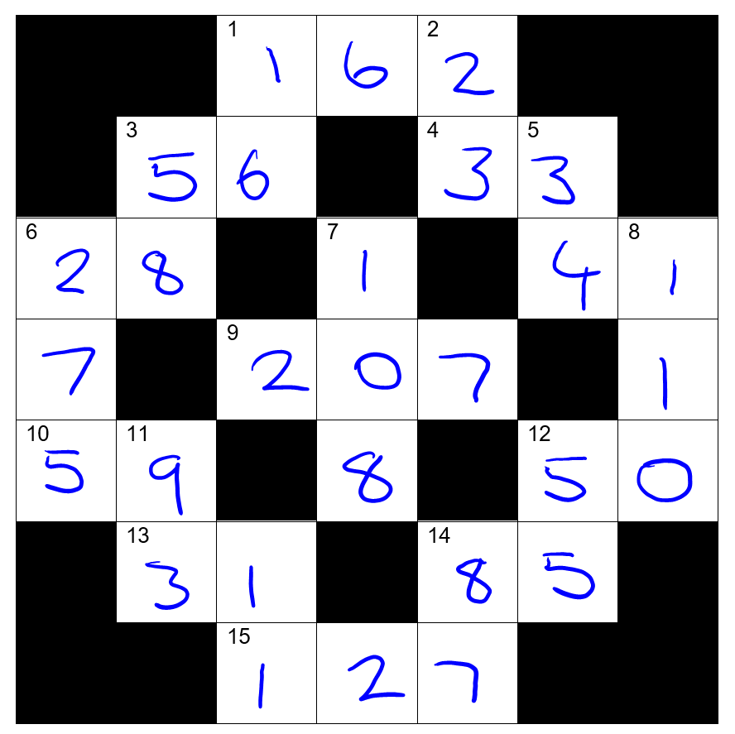
Answers

Slide 11
Plenary
Compose a text to an absent friend (160 characters) telling them all they need to know about today’s lesson.

