Slide 1
Given an equation for a graph that is not horizontal or vertical, we can sketch its graph using its gradient and y-intercept. Generally:
Starter
For each of the equations below, write down the gradient and $y$-intercept.
a) $y=3x+5$ b) $y=\frac{1}{2}x−3$ c) $y=4−2x$
d) $2y=6x+8$ e) $3y=2x−7$ f) $3x+4y+12=0$
$$y=mx+c$$
$m$ is the gradient, or the slope of the graph
$c$ is the $y$-intercept, or where the graph cuts the $y$-axis

Slide 2
Answers
For each of the equations below, write down the gradient and $y$-intercept.
a) $y=3x+5$ b) $y=\frac{1}{2}x−3$ c) $y=4−2x$
Gradient → $3$ Gradient → $\frac{1}{2}$ Gradient → $−2$
$y$-intercept → $5$ $y$-intercept→ $−3$ $y$-intercept → $4$
d) $2y=6x+8$ e) $3y=2x−7$ f) $3x+4y+12=0$
$y=3x+4$ $y=\frac{2}{3}x−\frac{7}{3}$ $4y=−3x−12$
Gradient → $3$ Gradient → $\frac{2}{3}$ $y=−\frac{3}{4}x−3$
$y$-intercept → $4$ $y$-intercept → $−\frac{7}{3}$ Gradient → $−\frac{3}{4}$
$y$-intercept → $−3$

Slide 3
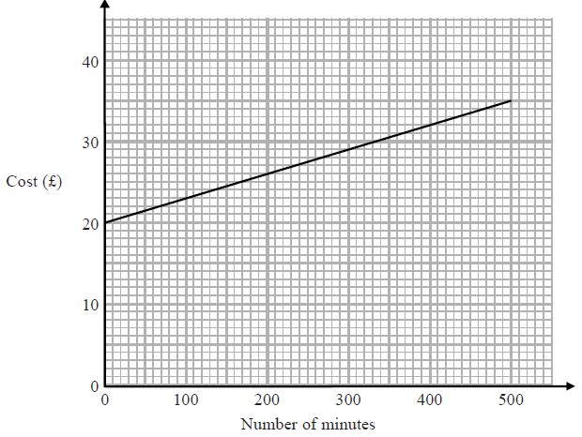
The graph shows the cost of using a mobile phone for one month for different numbers of minutes of calls made.
Write down everything you can determine from the graph, using the key words below.
Gradient
$y$-intercept
Fixed charge
Cost per minute
Total cost for 200 minutes
$$15$$
$$500$$
$y$-intercept
Gradient $=\frac{\text{rise}}{\text{run}}$
Gradient $=\frac{\text{rise}}{\text{run}}=\frac{15}{500}=0.03$
Fixed charge is £20
3p per minute
200 minutes would cost £26

Slide 4
The graph shows the cost of using a mobile phone for one month for different numbers of minutes of calls made.
The cost includes a fixed rental charge of £20 and a charge for each minute of calls made.
Work out the charge for each minute of calls made.
(Total 2 marks)
$$15$$
$$500$$
Gradient $=\frac{\text{rise}}{\text{run}}$
Gradient $=\frac{\text{rise}}{\text{run}}=\frac{15}{500}=0.03$
3p per minute

Slide 5
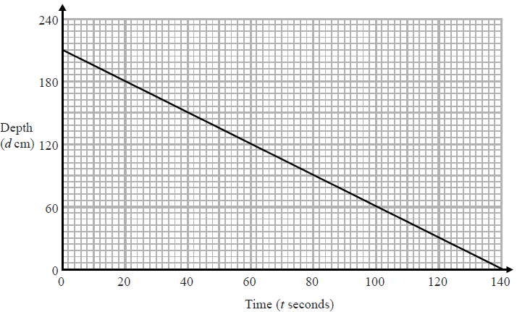
The graph shows the depth, $d$ cm, of water in a tank after $t$ seconds.
Write down everything you can determine from the graph, using the key words below.
Gradient
$y$-intercept
Starting depth
Decrease per second
Tank is empty
$$140$$
$y$-intercept
Gradient $=\frac{\text{rise}}{\text{run}}$
Gradient $=\frac{\text{rise}}{\text{run}}=\frac{−210}{140}=−1.5$
1.5 cm decrease per second
$$210$$
Starting depth is 210 cm
Tank is empty after 140 seconds

Slide 6
The graph shows the depth, $d$ cm, of water in a tank after $t$ seconds.
(a) Find the gradient of this graph.
(2)
(b) Explain what this gradient represents.
(1)
(Total 3 marks)
$$140$$
Gradient $=\frac{\text{rise}}{\text{run}}$
Gradient $=\frac{\text{rise}}{\text{run}}=\frac{−210}{140}=−1.5$
1.5 cm decrease per second
$$210$$

Slide 7
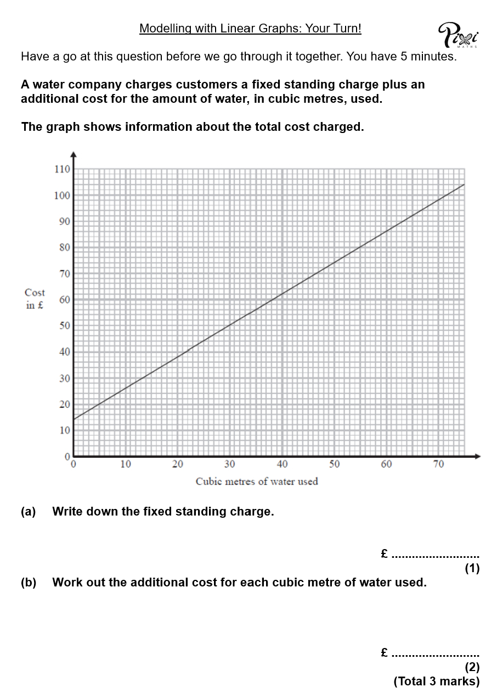
Your Turn!
You have 5 minutes to complete these questions.
Think carefully about the examples we’ve just completed together.
Hints:
$y$-intercept
gradient

Slide 8
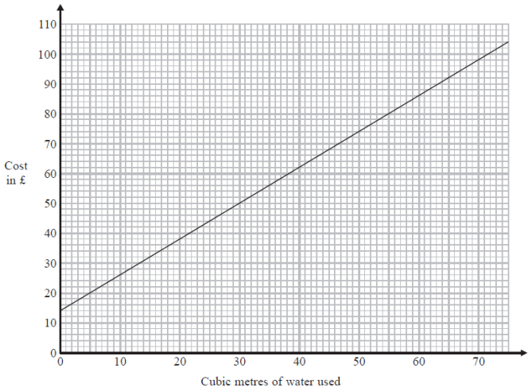
A water company charges customers a fixed standing charge plus an additional cost for the amount of water, in cubic metres, used.
The graph shows information about the total cost charged.
(a) Write down the fixed standing charge.
(1)
(b) Work out the additional cost for each cubic metre of water used.
(2)
(Total 3 marks)
£14
Be accurate!

Slide 9
A water company charges customers a fixed standing charge plus an additional cost for the amount of water, in cubic metres, used.
The graph shows information about the total cost charged.
(a) Write down the fixed standing charge.
(1)
(b) Work out the additional cost for each cubic metre of water used.
(2)
(Total 3 marks)
Gradient $=\frac{\text{rise}}{\text{run}}$
Gradient $=\frac{\text{rise}}{\text{run}}=\frac{90}{75}=1.2$
£14
$$90$$
£1.20
$$75$$

Slide 10
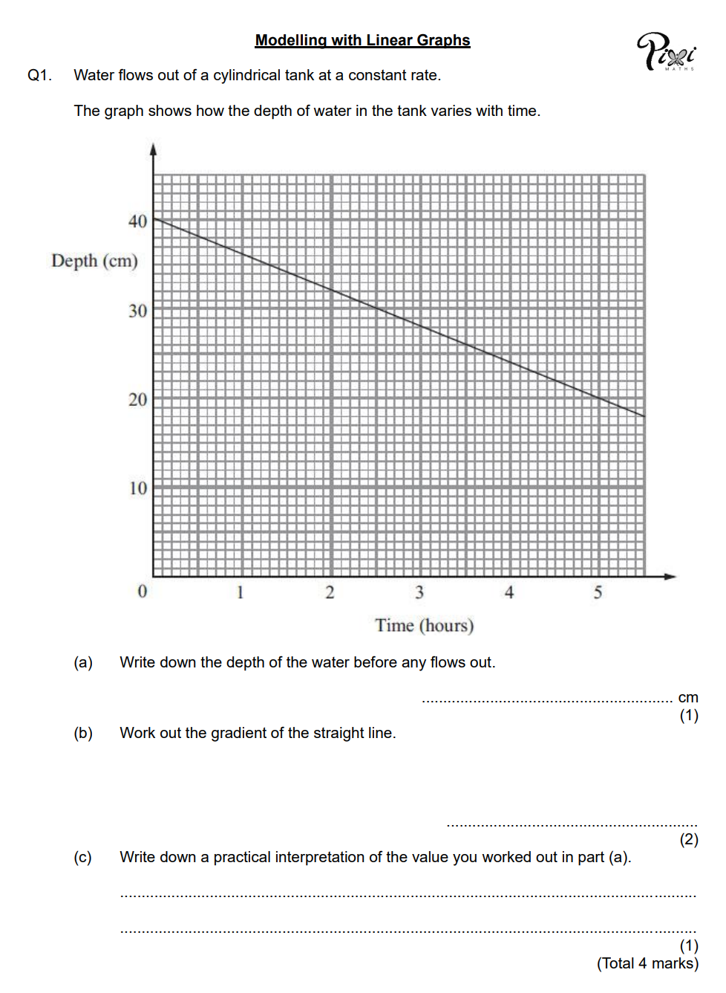
Task
Complete the worksheet, showing your working out as you go.
Draw graphs and gradient triangles to help you.
Read each scale carefully – ensure you count units, not squares.

