Slide 1
Starter
Copy and complete the pairs of equivalent fractions.
$\frac{1}{2}=\frac{4}{ }$ $\frac{3}{4}=\frac{ }{20}$
$\frac{2}{ }=\frac{6}{9}$ $\frac{1}{5}=\frac{ }{35}$
$$15$$
$$8$$
$$7$$
$$3$$

Slide 2
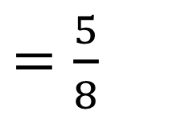
Adding Fractions
$\frac{3}{8}$ $+$ $\frac{2}{8}$
The denominator doesn’t change because we are still talking about eighths.
$=\frac{5}{8}$

Slide 3
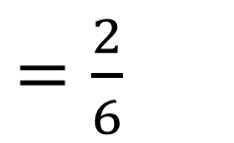
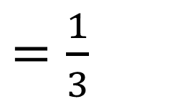
Subtracting Fractions
$\frac{3}{6}$ $−$ $\frac{1}{6}$
$=\frac{2}{6}$
$=\frac{1}{3}$
The denominator doesn’t change because we are still talking about sixths.
Remember to simplify your answer if you can.

Slide 4
Checkpoint
1) $\frac{1}{4}+\frac{2}{4}$ 2) $\frac{2}{7}+\frac{3}{7}$ 3) $\frac{5}{9}−\frac{3}{9}$
4) $\frac{8}{11}−\frac{6}{11}$ 5) $\frac{2}{10}+\frac{7}{10}$ 6) $\frac{5}{9}+\frac{4}{9}$
Extension
$\frac{1}{2}+\frac{1}{4}$ $\frac{2}{3}−\frac{1}{4}$

Slide 5
Answers
1) $\frac{1}{4}+\frac{2}{4}$ $=\frac{3}{4}$ 2) $\frac{2}{7}+\frac{3}{7}$ $=\frac{5}{7}$ 3) $\frac{5}{9}−\frac{3}{9}$ $=\frac{2}{9}$
4) $\frac{8}{11}−\frac{6}{11}$ $=\frac{2}{11}$ 5) $\frac{2}{10}+\frac{7}{10}$ $=\frac{9}{10}$ 6) $\frac{5}{9}+\frac{4}{9}$ $=\frac{9}{9}=1$
Extension
$\frac{1}{2}+\frac{1}{4}$ $=\frac{3}{4}$ $\frac{2}{3}−\frac{1}{4}$ $=\frac{5}{12}$

Slide 6
Step by Step Guide
Find a common denominator (lowest common multiple)
Find equivalent fractions with that common denominator
Add or subtract
Simplify

Slide 7

Example
$\frac{2}{5}+\frac{1}{4}$
$\frac{ }{20}+\frac{ }{20}$
$\frac{13}{20}$
Find a common denominator (lowest common multiple)
$$×4$$
$$×5$$
$$8$$
$$5$$
Find equivalent fractions with that common denominator
Add or subtract
Simplify

Slide 8

Example
$\frac{2}{3}−\frac{3}{8}$
$\frac{ }{24}−\frac{ }{24}$
$\frac{7}{24}$
Find a common denominator (lowest common multiple)
$$×8$$
$$×3$$
$$16$$
$$9$$
Find equivalent fractions with that common denominator
Add or subtract
Simplify

Slide 10

Answers
$\frac{7}{10}$ $\frac{7}{12}$
$\frac{2}{35}$ $\frac{11}{15}$
$\frac{2}{21}$ $\frac{22}{45}$
$\frac{54}{55}$ $\frac{43}{90}$
$\frac{46}{63}$ $\frac{19}{40}$

