Slide 1
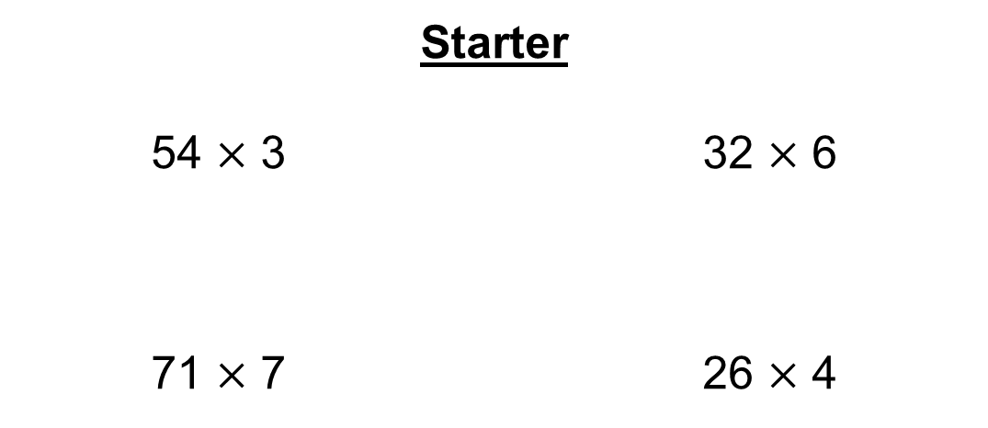
Starter
54 $×$ 3 32 $×$ 6
71 $×$ 7 26 $×$ 4
= 162
= 192
= 497
= 104

Slide 2
$$252÷4$$
$$62$$ | $$63$$
$$64$$ | $$65$$
A
B
C
D

Slide 3
$$252÷4$$
$$62$$ | $$63$$
$$64$$ | $$65$$
A
B
C
D

Slide 4
$$445÷5$$
$$86$$ | $$87$$
$$88$$ | $$89$$
A
B
C
D

Slide 5
$$445÷5$$
$$86$$ | $$87$$
$$88$$ | $$89$$
A
B
C
D

Slide 6
$$81÷3$$
$$27$$ | $$28$$
$$29$$ | $$30$$
A
B
C
D

Slide 7
$$81÷3$$
$$27$$ | $$28$$
$$29$$ | $$30$$
A
B
C
D

Slide 8
$$182÷7$$
$$23$$ | $$24$$
$$25$$ | $$26$$
A
B
C
D

Slide 9
$$182÷7$$
$$23$$ | $$24$$
$$25$$ | $$26$$
A
B
C
D

Slide 10
$$288÷9$$
$$30$$ | $$31$$
$$32$$ | $$33$$
A
B
C
D

Slide 11
$$288÷9$$
$$30$$ | $$31$$
$$32$$ | $$33$$
A
B
C
D

Slide 12
$$\frac{3}{4}$$
This is the numerator.
This is how many of the equal parts we’re interested in.
This is the denominator.
This is how many equal parts the shape/quantity is split into.

Slide 13
Example
Calculate $\frac{2}{5}$ of £20
Start by splitting the amount into 5 equal parts.
£4
£4
£4
£4
£4

Slide 14
Example
Calculate $\frac{2}{5}$ of £20
£4
£4
£4
£4
£4
We are interested in 2 of these parts.
£8

Slide 15

Examples
Calculate $\frac{3}{7}$ of £49
Calculate $\frac{5}{9}$ of 108 ml
£7
£7
£7
£7
£7
£7
£7
£21
12 ml
12 ml
12 ml
12 ml
12 ml
12 ml
12 ml
12 ml
12 ml
60 ml

Slide 16
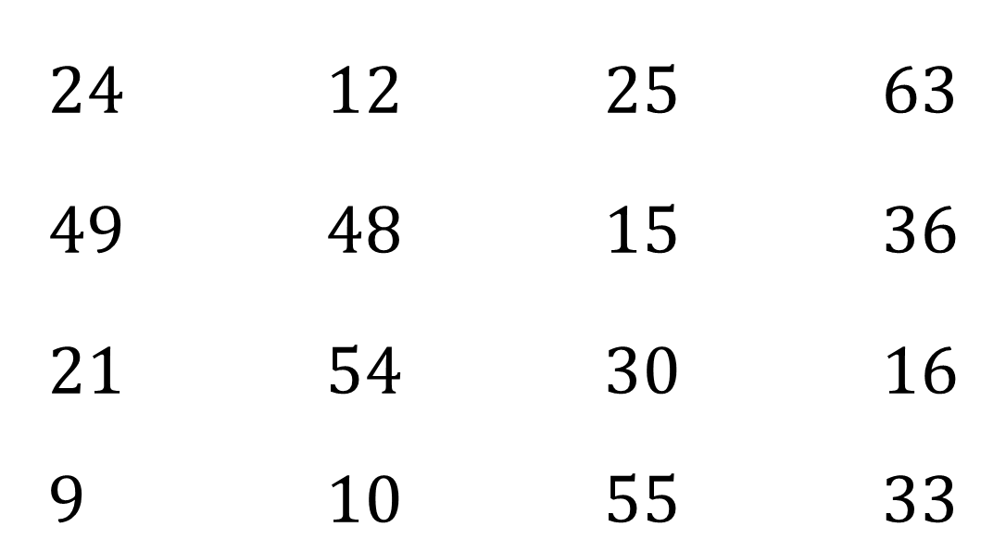
Fractions of Amounts Bingo
Use any of these numbers in your grid (NO REPEATS)
$24$ $12$ $25$ $63$
$49$ $48$ $15$ $36$
$21$ $54$ $30$ $16$
$9$ $10$ $55$ $33$

Slide 17
Work out $\frac{1}{3}$ of $36$

Slide 18
Work out $\frac{1}{2}$ of $48$

Slide 19
Work out $\frac{3}{4}$ of $12$

Slide 20
Work out $\frac{1}{2}$ of $110$

Slide 21
Work out $\frac{4}{5}$ of $60$

Slide 22
Work out $\frac{1}{4}$ of $64$

Slide 23
Work out $\frac{1}{2}$ of $42$

Slide 24
Work out $\frac{1}{5}$ of $150$

Slide 25
Work out $\frac{3}{4}$ of $84$

Slide 26
Work out $\frac{7}{10}$ of $70$

Slide 27
Work out $\frac{1}{6}$ of $90$

Slide 28
Work out $\frac{2}{7}$ of $35$

Slide 29
Work out $\frac{9}{10}$ of $40$

Slide 30
Work out $\frac{2}{3}$ of $81$

Slide 31
Work out $\frac{5}{6}$ of $30$

Slide 32
Work out $\frac{1}{3}$ of $99$

Slide 33
12 is the answer. What was the question?
Explain to the person next to you HOW to calculate a fraction of an amount

Slide 35
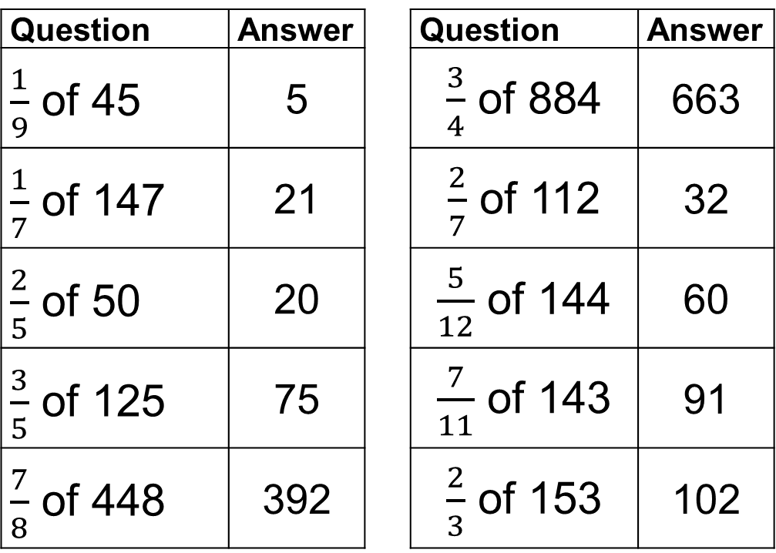
Question | Answer |  | Question | Answer
$\frac{1}{9}$ of 45 | 5 |  | $\frac{3}{4}$ of 884 | 663
$\frac{1}{7}$ of 147 | 21 |  | $\frac{2}{7}$ of 112 | 32
$\frac{2}{5}$ of 50 | 20 |  | $\frac{5}{12}$ of 144 | 60
$\frac{3}{5}$ of 125 | 75 |  | $\frac{7}{11}$ of 143 | 91
$\frac{7}{8}$ of 448 | 392 |  | $\frac{2}{3}$ of 153 | 102

