Slide 1
Starter
Fill in the missing boxes to show the completed calculation
(multiplication or division).
a) 10 = 100
b) 200 = 2
c) 3000 = 3
d) 0.04 = 40
e) 0.5 = 0.005
×

Slide 2
Answers
a) 10 = 100
b) 200 = 2
c) 3000 = 3
d) 0.04 = 40
e) 0.5 = 0.005
×
10
÷
100
÷
1000
×
1000
÷
100

Slide 3
200 metres
2 km | 0.2 km
0.02 km | 20 km
A
B
C
D

Slide 4
200 metres
2 km | 0.2 km
0.02 km | 20 km
A
B
C
D

Slide 5
3 centimetres
3 mm | 300 mm
30 mm | 0.03 mm
A
B
C
D

Slide 6
3 centimetres
3 mm | 300 mm
30 mm | 0.03 mm
A
B
C
D

Slide 7
5 millimetres
0.5 cm | 500 cm
50 cm | 0.05 cm
A
B
C
D

Slide 8
5 millimetres
0.5 cm | 500 cm
50 cm | 0.05 cm
A
B
C
D

Slide 9
75 centimetres
0.075 m | 0.75 m
750 m | 7.5 m
A
B
C
D

Slide 10
75 centimetres
0.075 m | 0.75 m
750 m | 7.5 m
A
B
C
D

Slide 11
6000 millimetres
0.06 m | 0.6 m
6 m | 60 m
A
B
C
D

Slide 12
6000 millimetres
0.06 m | 0.6 m
6 m | 60 m
A
B
C
D

Slide 13
8500 cm
85 km | 0.85 km
8.5 km | 0.085 km
A
B
C
D

Slide 14
8500 cm
85 km | 0.85 km
8.5 km | 0.085 km
A
B
C
D

Slide 15
0.07 km
70 m | 700 m
7 m | 0.7 m
A
B
C
D

Slide 16
0.07 km
70 m | 700 m
7 m | 0.7 m
A
B
C
D

Slide 17
Area is measured in units squared
(e.g. m², cm², mm²)
To convert between different units of area, multiply or divide by the square of the ‘length’ conversion factor.
Volume is measured in units cubed
(e.g. m³, cm³, mm³)
To convert between different units of volume, multiply or divide by the cube of the ‘length’ conversion factor.

Slide 18
What are the dimensions of this square in cm?
1 m²
1 m
100 cm
1 m
100 cm
1 m² = 10 000 cm²

Slide 19
What about in mm?
1 m²
1 m²
1 m
1000 mm
1 m
1 m
1 m
1000 mm
1 m² = 10 000 cm²
1 m² = 1 000 000 mm²

Slide 20
Consider a square centimetre…
1 cm²
1 cm
10 mm
1 cm
10 mm
1 m² = 10 000 cm²
1 m² = 1 000 000 mm²
1 cm² = 100 mm²

Slide 21
What are the dimensions of this cube in cm?
1 m³
1 m
100 cm
1 m
1 m
100 cm
1 m³ = 1 000 000 cm³
100 cm

Slide 22
What about in mm?
1 m³
1 m
1000 mm
1 m
1 m
1000 mm
1 m³ = 1 000 000 cm³
1000 mm
1 m³ = 1 000 000 000 mm³

Slide 23
Consider a cubic centimetre…
1 cm³
1 cm
10 mm
1 cm
1 cm
10 mm
1 m³ = 1 000 000 cm³
10 mm
1 m³ = 1 000 000 000 mm³
1 cm³ = 1000 mm³

Slide 24
Area Conversions
1 m² = 10 000 cm²
1 m² = 1 000 000 mm²
1 cm² = 100 mm²
You won’t get given these in an exam…
But you don’t need to learn them either…
Just draw quick sketches like we have just done!
Volume Conversions
1 m³ = 1 000 000 cm³
1 m³ = 1 000 000 000 mm³
1 cm³ = 1000 mm³

Slide 25
Example 1
Convert an area of 0.06 m² to cm²
0.06 × 10 000
= 600 cm²
1 m² = 10 000 cm²
Example 2
Convert a volume of 382 000 cm³ to m³
382 000 ÷ 1 000 000
= 0.382 m³
1 m³ = 1 000 000 cm³

Slide 26
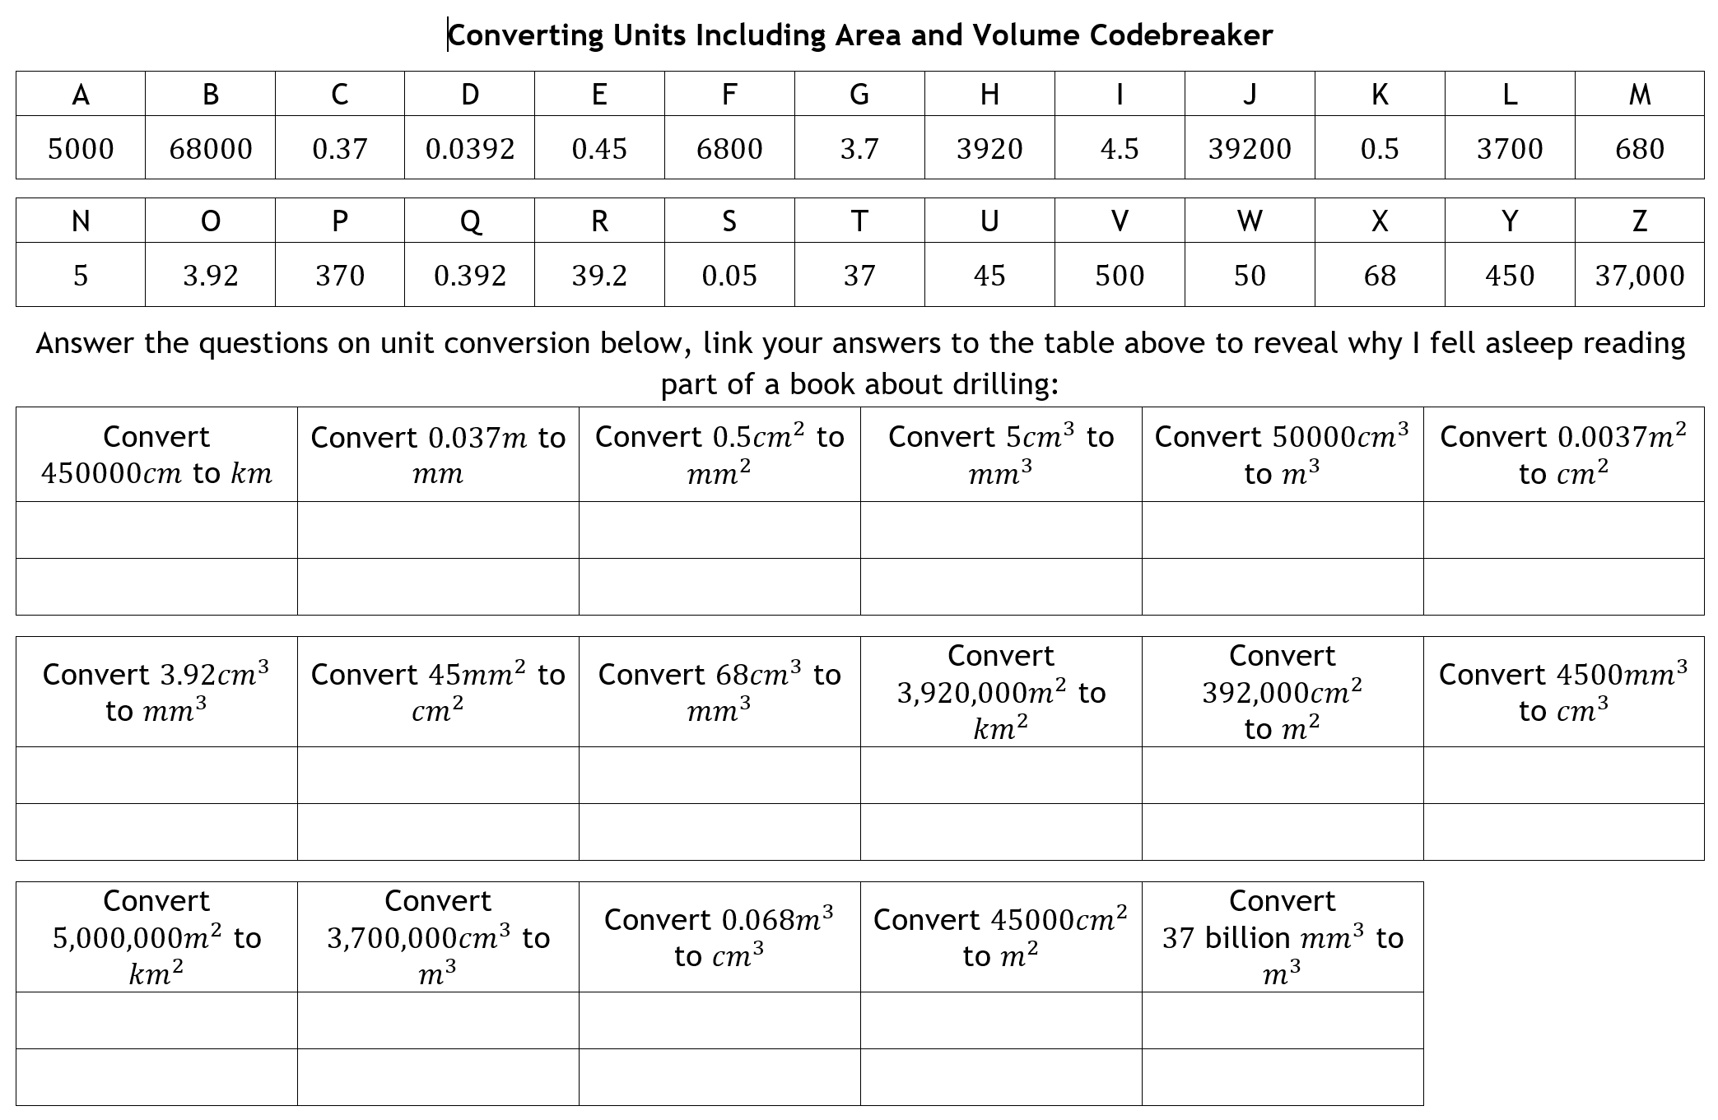
Pair Activity
Decipher the punch line to the joke using the code!
Notes:
Source: ALutwyche on TES

Slide 27
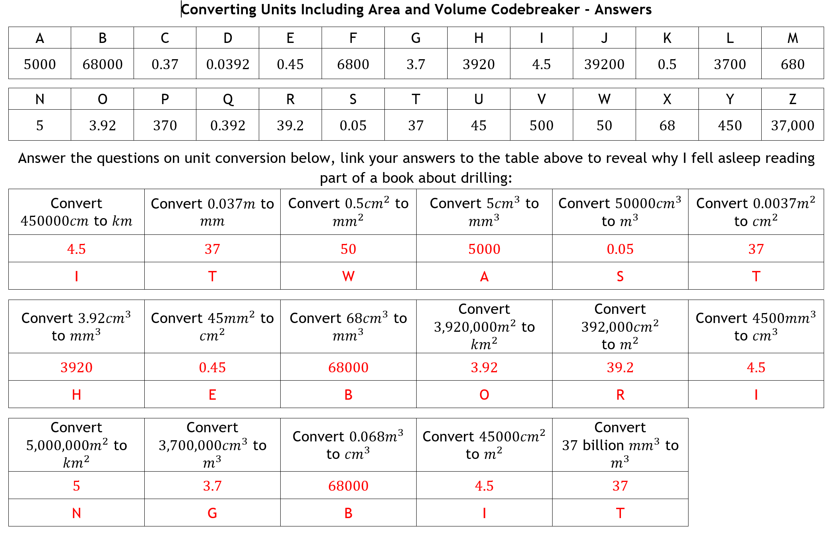
Answer
Notes:
Source: ALutwyche on TES

Slide 28
How confident do you feel with this topic?
Write red, amber or green in your book!
Complete the corresponding activity ☺

Slide 29
Answers
1) 0.84 cm²
2) 0.175 m²
3) 290 cm²
4) 3.15 km²
5) 85 cm²
6) 0.17 m²
7) 1 000 000 m³
8) 15 000 mm³
9) 200 000 cm³
10) 435 000 000 m³
11) 1 200 000 mm²
12) 10 000 000 cm²
13) 50 m²
14) 0.0673 km²
15) 5 000 000 mm²
16) 0.0605 m²
17) 0.000 003 km³
18) 600 mm³
19) 0.000 000 999 km³
20) 0.000 017 44 m³
21) 33.24 m²
22) a) 1 125 000 000 m² b) 1 125 000 litres

Slide 30
Plenary
1 question about today’s topic
2 things you learnt today
3 things you knew already

