Slide 1
Starter
Fill in the gaps for the following pairs of equivalent ratios:
4 : 5 = __ : 10 3 : 4 = __ : 2 4 : 10 = 1 : __
7 : 5 = __ : 1 __ : 2 = 9 : 3 1.5 : 6 = 2 : __

Slide 2
Answers
4 : 5 = __ : 10 3 : 4 = __ : 2 4 : 10 = 1 : __
7 : 5 = __ : 1 __ : 2 = 9 : 3 1.5 : 6 = 2 : __
8
1.5
2.5
1.4
6
8

Slide 3
The Unitary Method
Finding the value of one unit to work out the base cost.
For example: 1 can of coke
1 g of butter
1 ml of milk
We can use this method to solve direct proportion questions.

Slide 4
The Unitary Method
3 cakes cost 36p. How much does 1 cake cost?
9 pencils cost £1.80. How much does 1 pencil cost?
5 sweets cost 25p. How much does 1 sweet cost?
7 bananas cost £2.80. How much does 1 banana cost?
2 packs of candles cost £3.50. How much does 1 pack cost?
36p ÷ 3 = 12p
£1.80 ÷ 9 = 20p
25p ÷ 5 = 5p
£2.80 ÷ 7 = 40p
£3.50 ÷ 2 = £1.75

Slide 5
The Unitary Method
3 cakes cost 36p. How much do 2 cakes cost?
9 pencils cost £1.80. How much do 4 pencils cost?
5 sweets cost 25p. How much do 12 sweets cost?
7 bananas cost £2.80. How much do 4 bananas cost?
2 packs of candles cost £3.50. How much do 5 packs cost?
36p ÷ 3 = 12p
£1.80 ÷ 9 = 20p
25p ÷ 5 = 5p
£2.80 ÷ 7 = 40p
£3.50 ÷ 2 = £1.75
12p × 2 = 24p
20p × 4 = 80p
5p × 12 = 60p
40p × 4 = £1.60
£1.75 × 5 = £8.75
These are all monetary examples but we can do a similar thing in other situations!

Slide 6
Direct Proportion
Example 1
Bob the builder can build a wall 4 feet high in 2 hours. How long would it take Bob to build a wall that is 7 feet high?
1 foot high: 2 hours ÷ 4 = 30 minutes
7 feet high: 30 minutes $×$ 7 = 3 hours, 30 minutes
Example 2
750 ml of water in a kettle can make 3 cups of tea. How much water would be needed for 5 cups of tea?
1 cup: 750 ml $÷$ 3 = 250 ml
5 cups: 250 ml $×$ 5 = 1250 ml or 1.25 L
What assumptions have you made?

Slide 7
Task
Complete the direct proportion worksheet.
Extension: write down any assumptions that you have made for these questions!

Slide 8
Answers
1. 1 hour 5. 10.5 kg
2. £12.60 6. 56 litres
3. £6.50 7. 7 pens
4. 2 hours, 40 minutes 8. 45.5 cm

Slide 9
Inverse Proportion
Example 1
One house was built by a team of 6 builders in 24 days. How long would it take a team of 12 builders to build the same house?
Example 2
It takes 14 hours for a tap with a flow of 18 litres per minute to fill a reservoir with water. How long would it take if the flow was reduced to 6 litres per minute?
$×$ 2
$÷$ 2
12 days
$×$ 3
What assumptions have you made?
42 hours
$÷$ 3

Slide 10
Task
Complete the inverse proportion worksheet.
Extension: write down any assumptions that you have made for these questions!

Slide 11
Answers

Slide 12
Answers
1. 3 days 5. 25 people
2. 1 day 6. 140 days
3. 9 minutes 7. 4 hours, 10 minutes
4. 15 minutes 8. 30 builders

Slide 13
Proportion Tables
Sometimes you may be given proportion questions out of context, for example in a table.
You need to know:
$∝$ (alpha) means ‘in proportion to’
Direct proportion looks like $y∝x$ or $y=kx$
Inverse proportion looks like $y∝\frac{1}{x}$ or $y=\frac{k}{x}$
Start by finding $k$, the proportion constant, then complete the table

Slide 14


Direct Proportion
Example 1
$y∝x$
$y=kx$
$24=k×8$
$k=3$
$y=3x$
Example 2
$q∝p$
$q=kp$
$42=k×7$
$k=6$
$q=6p$
$$x$$ | 8 | 10 | 15 | 22
$$y$$ | 24
$$p$$ | 5 | 7 | 9 | 11
$$q$$ |  | 42
30
45
66
30
54
66

Slide 15
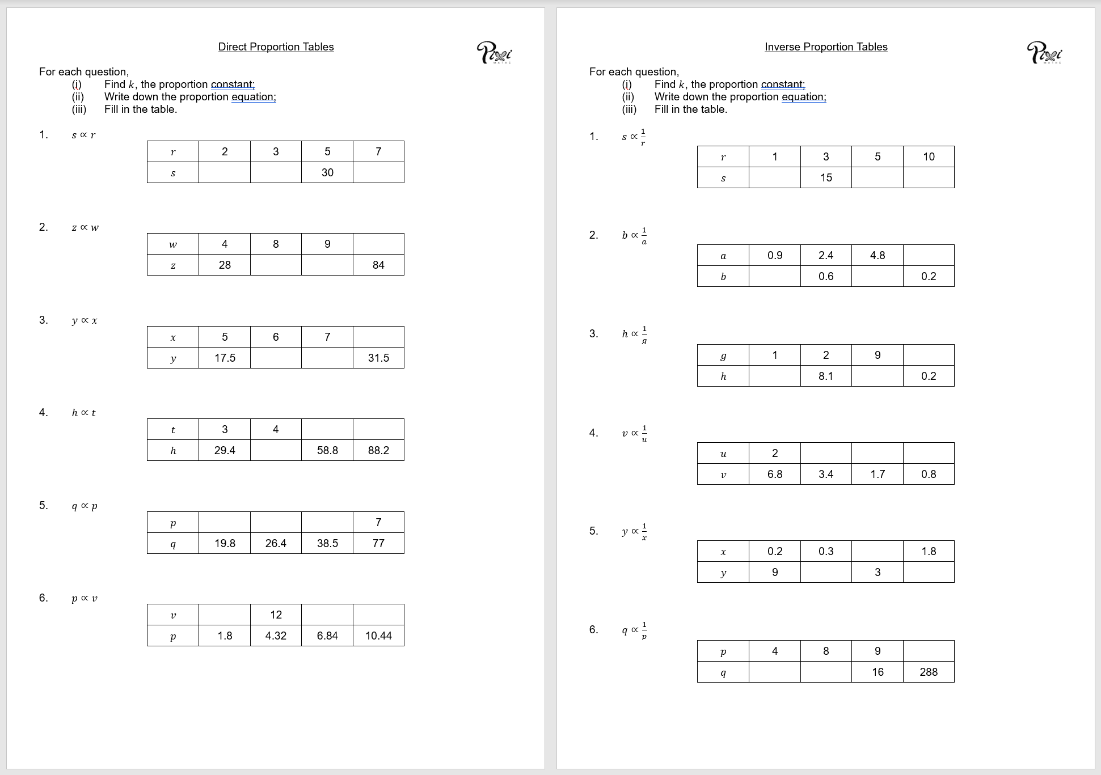
Task
Complete the direct proportion worksheet.

Slide 16
Answers

Slide 17


Inverse Proportion
Example 1
$y∝\frac{1}{x}$
$y=\frac{k}{x}$
$10=\frac{k}{10}$
$k=100$
$y=\frac{100}{x}$
Example 2
$q∝\frac{1}{p}$
$q=\frac{k}{p}$
$2=\frac{k}{32}$
$k=64$
$q=\frac{64}{p}$
$$x$$ | 10 | 20 | 25 | 50
$$y$$ | 10
$$p$$ | 32 | 8 | 4 | 0.5
$$q$$ | 2
5
4
2
8
16
128

Slide 18
Task
Complete the inverse proportion worksheet.

Slide 19
Answers

