Slide 1
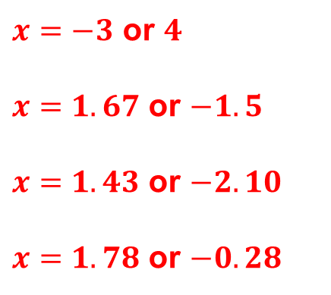
Starter
Solve the following, giving you answers correct to 2 decimal places:
a) $x²−x−12=0$
b) $6x²−x−15=0$
c) $3x²+2x−9=0$
d) $4x²−6x−2=0$
$x=−3$ or $4$
$x=1.67$ or $−1.5$
$x=1.43$ or $−2.10$
$x=1.78$ or $−0.28$

Slide 2
Example: where one is linear and one is a quadratic
Linear graph
Quadratic
graph
Solutions
Will there always be two distinct solutions?

Slide 3
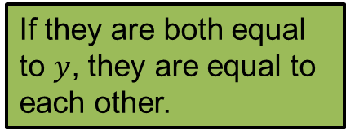
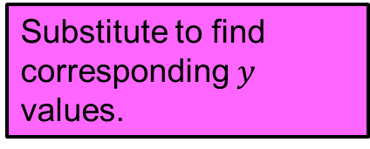
Example: where one is linear and one is a quadratic
Solve $y=2x^{2}+6x+4$
$y=−9x−24$
If they are both equal to $y$, they are equal to each other.
$$−9x−24=2x²+6x+4$$
$$0=2x²+15x+28$$
$$0=(2x+7)(x+4)$$
Manipulate equation so it equals $0$.
$x=−\frac{7}{2}$ or $−4$
Solve to find $x$.
$y=−9x−24$
$y=−9x−24$
Substitute to find corresponding $y$ values.
$y=\frac{63}{2}−24$
$y=36−24$
$y=\frac{15}{2}$
$y=12$
Write as coordinates.
$\left(−\frac{7}{2}, \frac{15}{2}\right)$ and $(−4, 12)$

Slide 4
Example: where one is linear and one is a circle
Linear graph
Circle
Solutions
Will there always be two distinct solutions?

Slide 5
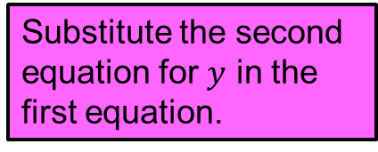
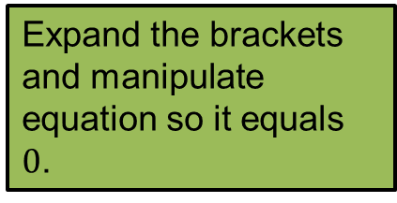
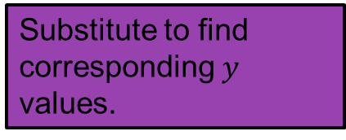
Example: where one is linear and one is a quadratic
Solve $x^{2}+y^{2}=16$
$y=2x−5$
Give your answers correct to 2 decimal places.
Substitute the second equation for $y$ in the first equation.
$$x²+(2x−5)²=16$$
$$x²+4x²−20x+25−16=0$$
Expand the brackets and manipulate equation so it equals $0$.
$$5x²−20x+9=0$$
Use the quadratic formula
$x=3.48$ or $0.52$
Solve to find $x$.
$y=2x−5$
$y=2x−5$
Substitute to find corresponding $y$ values.
$y=2×ANS−5$
$y=2×ANS−5$
$y=1.96$
$y=−3.96$
Write as coordinates.
$(3.48, 1.96)$ and $(0.52, −3.96)$

Slide 6
Extension: Can you use tables of values to sketch the graphs and show the solutions graphically?

Slide 7
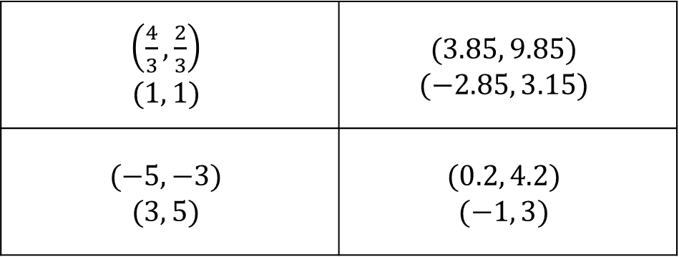
Answers
$\left(\frac{4}{3}, \frac{2}{3}\right)$ $$(1, 1)$$ | $$(3.85, 9.85)$$ $$(−2.85, 3.15)$$
$$(−5, −3)$$ $$(3, 5)$$ | $$(0.2, 4.2)$$ $$(−1, 3)$$

