Slide 1
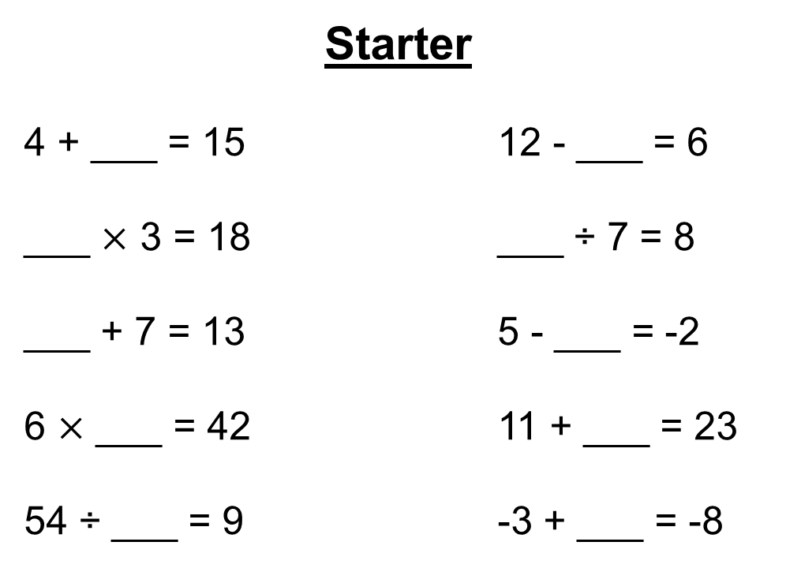
Starter
4 + ___ = 15 12 - ___ = 6
___ $×$ 3 = 18 ___ ÷ 7 = 8
___ + 7 = 13 5 - ___ = -2
6 $×$ ___ = 42 11 + ___ = 23
54 ÷ ___ = 9 -3 + ___ = -8
11
6
6
56
6
7
7
12
6
-5

Slide 2
Hi, I’m the Really Awesome Function Machine Operator, but you can call me R.A.F.M.O.- Blue for short.
+
My fellow robots and I are very good at working out calculations. We just need to be given numbers.

Slide 3
Each of us can only do just one of the main operations. Us Blues are responsible for addition.
+
I’ll let the others introduce themselves.

Slide 4
Hello, I’m R.A.F.M.O.- Red. Us Reds are responsible for subtraction.
–
We make it look easy when it comes to taking numbers away.

Slide 5
Hello, I’m R.A.F.M.O.- Yellow. Us Yellows are responsible for multiplication.
$×$
We’re experts when it comes to doing our times tables.

Slide 6
Hello, I’m R.A.F.M.O.- Green. Us Greens are responsible for division.
÷
We’re pros when it comes to being fair and sharing numbers out equally.

Slide 7
Here’s how a function machine works.
+ 4

Slide 8
Numbers go in called inputs.
1
3
+ 4
?

Slide 9
We then work on those inputs to produce outputs.
1
5
3
?
+ 4
?
9

Slide 10
Sometimes even us experts have a bad day. We could really use your help to fill in the blanks.
1
5
3
?
+ 4
?
9

Slide 11
Sometimes even us experts have a bad day. We could really use your help to fill in the blanks.
1
5
3
?
7
+ 4
?
5
9

Slide 12

We even work together from time to time.
3
7
- 2
$×$ 5
?

Slide 13
We even work together from time to time.
3
1
7
?
- 2
$×$ 5
?
8

Slide 14
We even work together from time to time.
Could you help us out again by filling in the blanks?
3
1
5
7
5
25
?
?
- 2
$×$ 5
10
?
8
40

Slide 16
Answers
10 45
22 37
40 54
2 26
4 57
65 27
76
39
21
24
50
89
9 69
6 23
20 41
16 49
70 80
51 44
8
7
11
1
5
0

Slide 17

Plenary
Can you solve the following:
$5a+3=38$
$2b−4=26$
$\frac{c+3}{5}=4$

