Slide 1
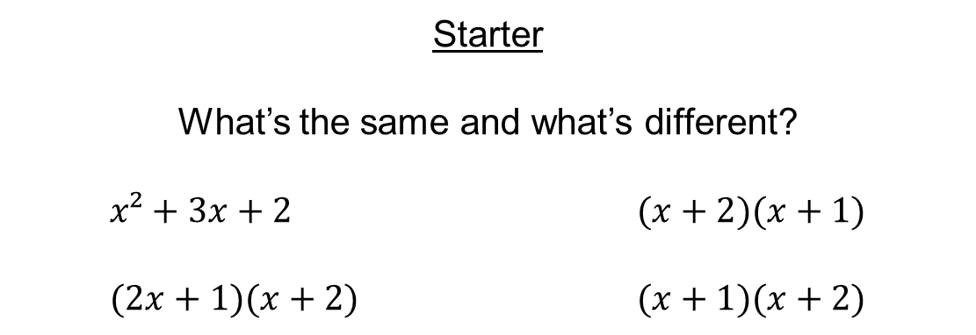
Starter
What’s the same and what’s different?
$x²+3x+2$ $(x+2)(x+1)$
$(2x+1)(x+2)$ $(x+1)(x+2)$

Slide 2
Solving quadratic equations by factorising
Definitions
Sum → the answer when two numbers are added together.
Product → the answer when two numbers are multiplied together.

Slide 3
On your mini whiteboards (no shouting out!)
I think of two numbers…
Sum: 5
Product: 6
3
2

Slide 4
On your mini whiteboards (no shouting out!)
I think of two numbers…
Sum: 6
Product: 7
6
1

Slide 5
On your mini whiteboards (no shouting out!)
I think of two numbers…
Sum: 10
Product: 16
8
2

Slide 6
On your mini whiteboards (no shouting out!)
I think of two numbers…
Sum: 13
Product: 36
9
4

Slide 7
On your mini whiteboards (no shouting out!)
I think of two numbers…
Sum: 1
Product: -30
6
-5

Slide 8
On your mini whiteboards (no shouting out!)
I think of two numbers…
Sum: -3
Product: -54
6
-9

Slide 9
On your mini whiteboards (no shouting out!)
I think of two numbers…
Sum: -15
Product: 56
-7
-8

Slide 10
On your mini whiteboards (no shouting out!)
I think of two numbers…
Sum: -18
Product: 72
-12
-6

Slide 11
On your mini whiteboards (no shouting out!)
I think of two numbers…
Sum: 18
Product: 56
14
4

Slide 12
On your mini whiteboards (no shouting out!)
I think of two numbers…
Sum: -5
Product: -66
-11
6

Slide 13
On your mini whiteboards (no shouting out!)
I think of two numbers…
Sum: -19
Product: 78
-6
-13

Slide 14


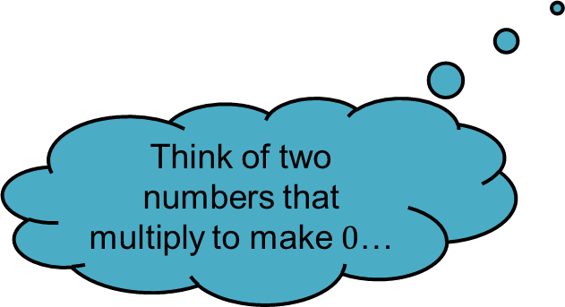
Examples
Factorise and solve $x^{2}+15x+44=0$
$(x+11)(x+4)=0$
$x=−11$ or $−4$
Factorise and solve $x^{2}−8x+16=0$
$(x−4)(x−4)$ $=0$
$x=4$
Factorise and solve $x^{2}−2x−63=0$
$(x−9)(x+7)=0$
$x=9$ or $−7$
The sum is 15 and the product is 44
Does it matter which way around the brackets are?
The sum is -8 and the product is 16
Think of two numbers that multiply to make $0$…
If $x+11=0$, then $x=−11$
The sum is -2 and the product is -63

Slide 16
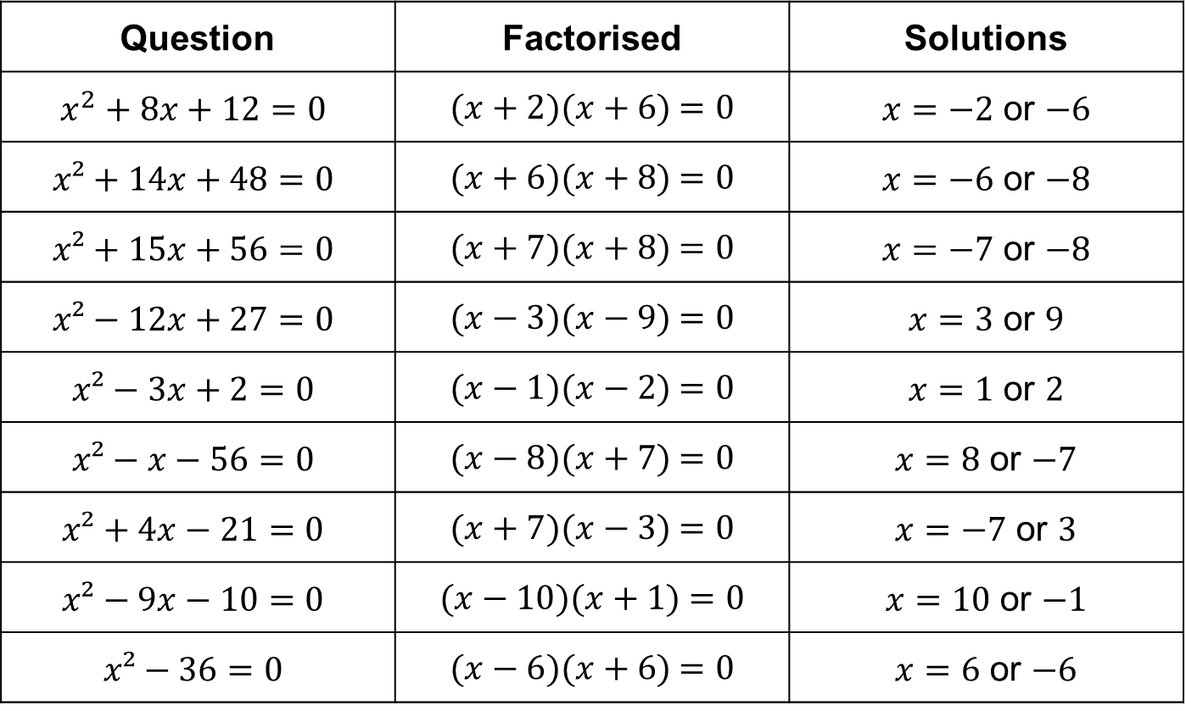
Question | Factorised | Solutions
$$x^{2}+8x+12=0$$ | $(x+2)(x+6)$ $=0$ | $x=−2$ or $−6$
$$x²+14x+48=0$$ | $(x+6)(x+8)$ $=0$ | $x=−6$ or $−8$
$$x²+15x+56=0$$ | $(x+7)(x+8)$ $=0$ | $x=−7$ or $−8$
$$x²−12x+27=0$$ | $(x−3)(x−9)$ $=0$ | $x=3$ or $9$
$$x²−3x+2=0$$ | $(x−1)(x−2)$ $=0$ | $x=1$ or $2$
$$x²−x−56=0$$ | $(x−8)(x+7)$ $=0$ | $x=8$ or $−7$
$$x²+4x−21=0$$ | $(x+7)(x−3)$ $=0$ | $x=−7$ or $3$
$$x²−9x−10=0$$ | $(x−10)(x+1)$ $=0$ | $x=10$ or $−1$
$$x²−36=0$$ | $(x−6)(x+6)$ $=0$ | $x=6$ or $−6$

Slide 17


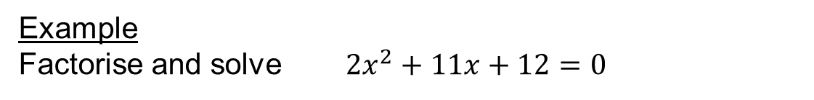









Example
Factorise and solve $2x^{2}+11x+12=0$
The sum is 11 and the product is 24
$$24$$
$$×$$
 | $$2x^{2}$$
 |  | $$+12$$
$$x$$
$$+4$$
Find the HCF of the top row, then fill in the rest!
$$2x$$
$$+8x$$
$$+3$$
$$+3x$$
Check this box!
$$\left(2x+3\right)\left(x+4\right)=0$$
If $\left(2x+3\right)=0$, then $x=−\frac{3}{2}$
If $\left(x+4\right)=0$, then $x=−4$

Slide 18


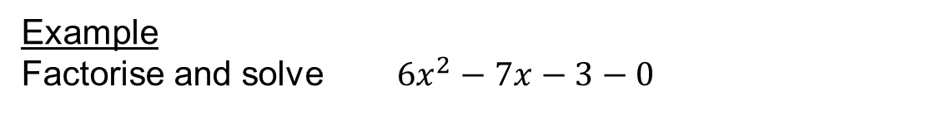









Example
Factorise and solve $6x^{2}−7x−3−0$
The sum is -7 and the product is -18
$$−18$$
$$×$$
 | $$6x^{2}$$
 |  | $$−3$$
$$2x$$
$$−3$$
Find the HCF of the top row, then fill in the rest!
$$3x$$
$$−9x$$
$$+1$$
$$+2x$$
Check this box!
$$(3x+1)(2x−3)$$
If $\left(3x+1\right)=0$, then $x=−\frac{1}{3}$
If $\left(2x−3\right)=0$, then $x=\frac{3}{2}$

Slide 20
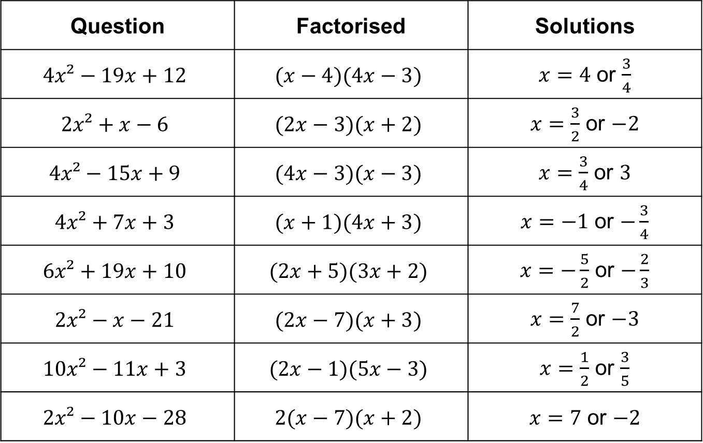
Question | Factorised | Solutions
$$4x²−19x+12$$ | $$(x−4)(4x−3)$$ | $x=4$ or $\frac{3}{4}$
$$2x²+x−6$$ | $$(2x−3)(x+2)$$ | $x=\frac{3}{2}$ or $−2$
$$4x²−15x+9$$ | $$(4x−3)(x−3)$$ | $x=\frac{3}{4}$ or $3$
$$4x²+7x+3$$ | $$(x+1)(4x+3)$$ | $x=−1$ or $−\frac{3}{4}$
$$6x²+19x+10$$ | $$(2x+5)(3x+2)$$ | $x=−\frac{5}{2}$ or $−\frac{2}{3}$
$$2x²−x−21$$ | $$(2x−7)(x+3)$$ | $x=\frac{7}{2}$ or $−3$
$$10x²−11x+3$$ | $$(2x−1)(5x−3)$$ | $x=\frac{1}{2}$ or $\frac{3}{5}$
$$2x²−10x−28$$ | $$2(x−7)(x+2)$$ | $x=7$ or $−2$

Slide 21
Solving quadratic equations using the quadratic formula

Slide 22
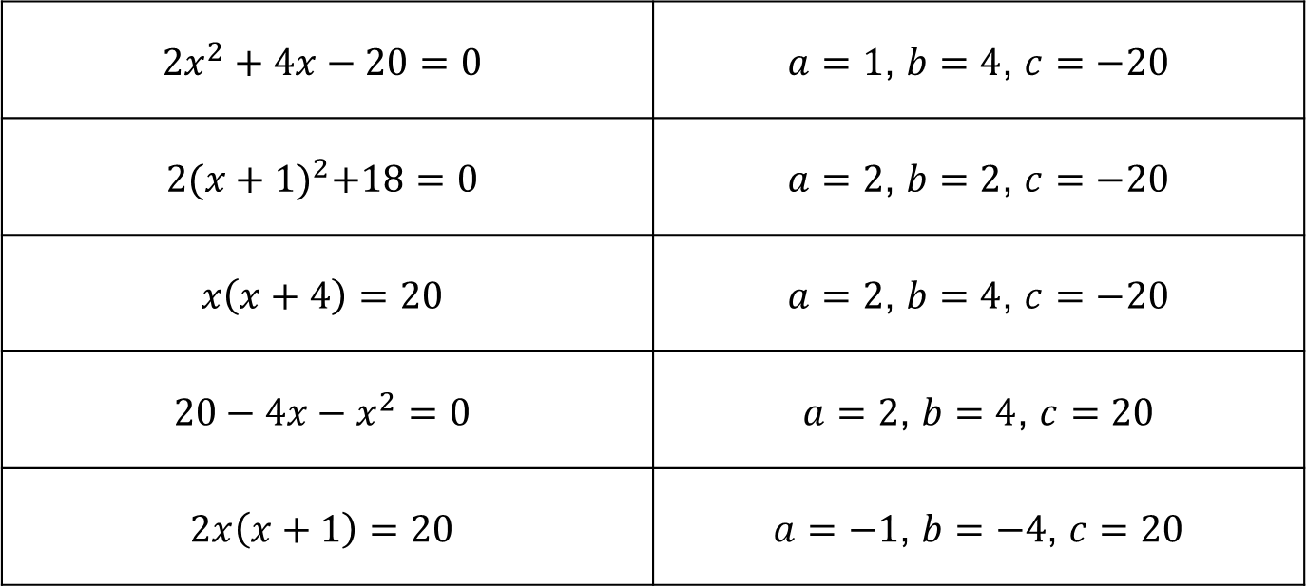

Starter
Match the equation to its values of a, b and c for
$$ax^{2}+bx+c=0$$
$${2x}^{2}+4x−20=0$$ | $a=1$, $b=4$, $c=−20$
$$2{(x+1)}^{2}+18=0$$ | $a=2$, $b=2$, $c=−20$
$$x\left(x+4\right)=20$$ | $a=2$, $b=4$, $c=−20$
$$20−4x−x^{2}=0$$ | $a=2$, $b=4$, $c=20$
$$2x\left(x+1\right)=20$$ | $a=−1$, $b=−4$, $c=20$

Slide 23
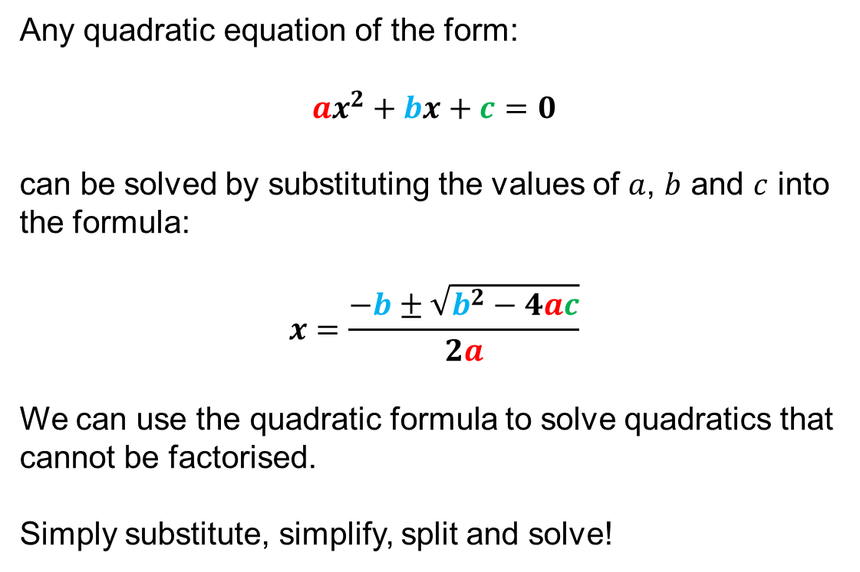
Any quadratic equation of the form:
$$ax^{2}+bx+c=0$$
can be solved by substituting the values of $a$, $b$ and $c$ into the formula:
$$x=\frac{−b±\sqrt{b^{2}−4ac}}{2a}$$
We can use the quadratic formula to solve quadratics that cannot be factorised.
Simply substitute, simplify, split and solve!

Slide 24

Example
Solve $x^{2}−7x+8=0$, giving your answers correct to 3 significant figures.
$1x^{2}−7x+8=0$
$x=\frac{−b±\sqrt{b^{2}−4ac}}{2a}$
$x=\frac{−(−7)±\sqrt{{(−7)}^{2}−4×1×8}}{2×1}$
$x=\frac{7±\sqrt{49−32}}{2}$
$x=\frac{7+\sqrt{17}}{2}$ or $x=\frac{7−\sqrt{17}}{2}$
$x=5.56$ or $x=1.44$
Substitute!
Simplify!
Split!
Solve!

Slide 25

Example
Solve $2x^{2}+5x−1=0$, giving your answers correct to 2 decimal places.
$2x^{2}+5x−1=0$
$x=\frac{−b±\sqrt{b^{2}−4ac}}{2a}$
$x=\frac{−5±\sqrt{5^{2}−4×2×−1}}{2×2}$
$x=\frac{−5±\sqrt{25+8}}{4}$
$x=\frac{−5+\sqrt{33}}{4}$ or $x=\frac{−5−\sqrt{33}}{4}$
$x=0.19$ or $x=−2.69$
Substitute!
Simplify!
Split!
Solve!

Slide 26
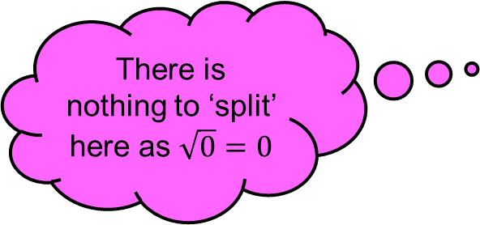

Example
Solve $9x^{2}−12x+4=0$, giving your answers correct to 3 significant figures.
$9x^{2}−12x+4=0$
$x=\frac{−b±\sqrt{b^{2}−4ac}}{2a}$
$x=\frac{−(−12)±\sqrt{{(−12)}^{2}−4×9×4}}{2×9}$
$x=\frac{12±\sqrt{144−144}}{18}$
$x=\frac{12+\sqrt{0}}{18}$
$x=0.667$
Substitute!
Simplify!
There is nothing to ‘split’ here as $\sqrt{0}=0$
Solve!

Slide 27
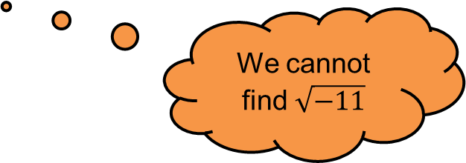

Example
Solve $x^{2}+x+3=0$, giving your answers correct to 2 decimal places.
$1x^{2}+1x+3=0$
$x=\frac{−b±\sqrt{b^{2}−4ac}}{2a}$
$x=\frac{−1±\sqrt{1^{2}−4×1×3}}{2×1}$
$x=\frac{−1±\sqrt{1−12}}{2}$
$x=\frac{−1+\sqrt{−11}}{2}$ or $x=\frac{−1−\sqrt{−11}}{2}$
No solutions!
Substitute!
Simplify!
Split!
We cannot find $\sqrt{−11}$

Slide 28

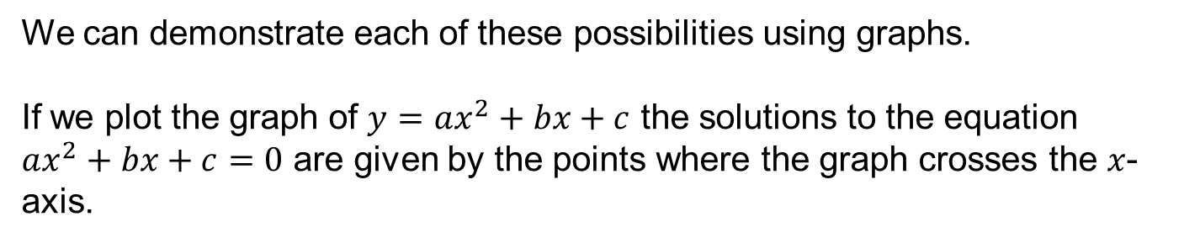


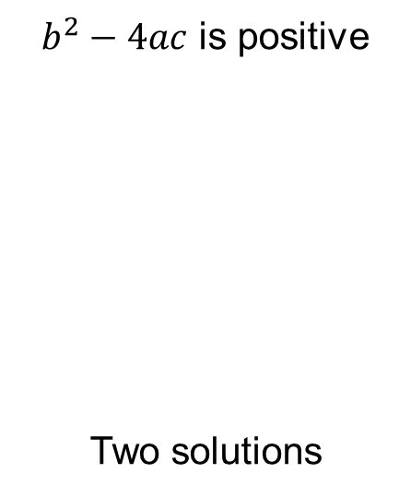

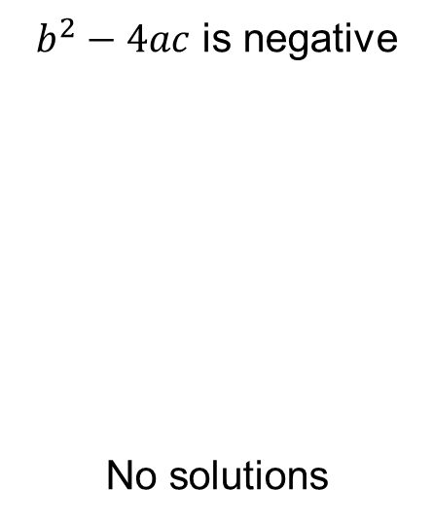

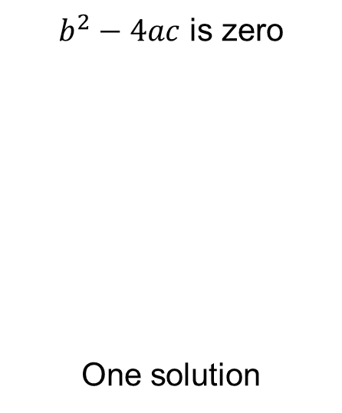

We can demonstrate each of these possibilities using graphs.
If we plot the graph of $y=ax^{2}+bx+c$ the solutions to the equation $ax^{2}+bx+c=0$ are given by the points where the graph crosses the $x$-axis.
$b^{2}−4ac$ is positive
Two solutions
$b^{2}−4ac$ is zero
One solution
$b^{2}−4ac$ is negative
No solutions
$$y$$
$$y$$
$$y$$
$$x$$
$$x$$
$$x$$

Slide 29
True/Never/Sometimes
There will be at least one solution
There will be one positive solution
Both solutions are the same

Slide 31

Answers
$x=−0.63$ or $−2.37$
$x=1.5$ or $0.33$
$x=0.19$ or $−2.69$
$x=−0.27$ or $−3.73$
$x=1$ or $0$
$x=−0.5$
$x=6.70$ or $0.30$
No solutions

Slide 32
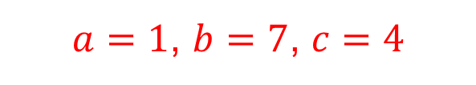
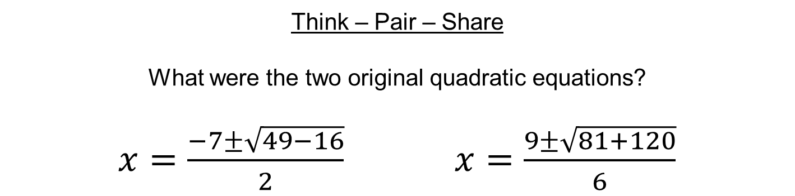

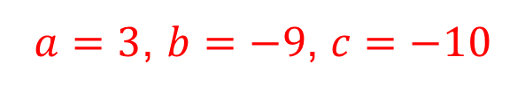

Think – Pair – Share
What were the two original quadratic equations?
$x=\frac{−7±\sqrt{49−16}}{2}$ $x=\frac{9±\sqrt{81+120}}{6}$
$a=1$, $b=7$, $c=4$
$a=3$, $b=−9$, $c=−10$
$x²+7x+4=0$
$$3x²−9x−10=0$$

Slide 33

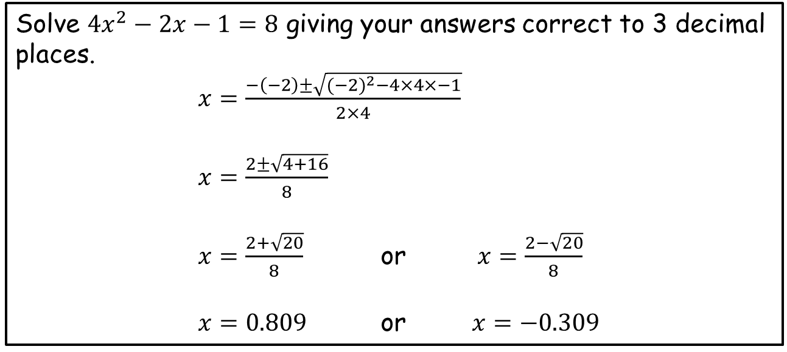
Think – Pair – Share
What’s wrong with the following answer? Can you correct it?
Solve $4x^{2}−2x−1=8$ giving your answers correct to 3 decimal places.
$x=\frac{−\left(−2\right)±\sqrt{{(−2)}^{2}−4×4×−1}}{2×4}$
$x=\frac{2±\sqrt{4+16}}{8}$
$x=\frac{2+\sqrt{20}}{8}$ or $x=\frac{2−\sqrt{20}}{8}$
$x=0.809$ or $x=−0.309$
$x=1.771$ or $x=1.271$

Slide 34

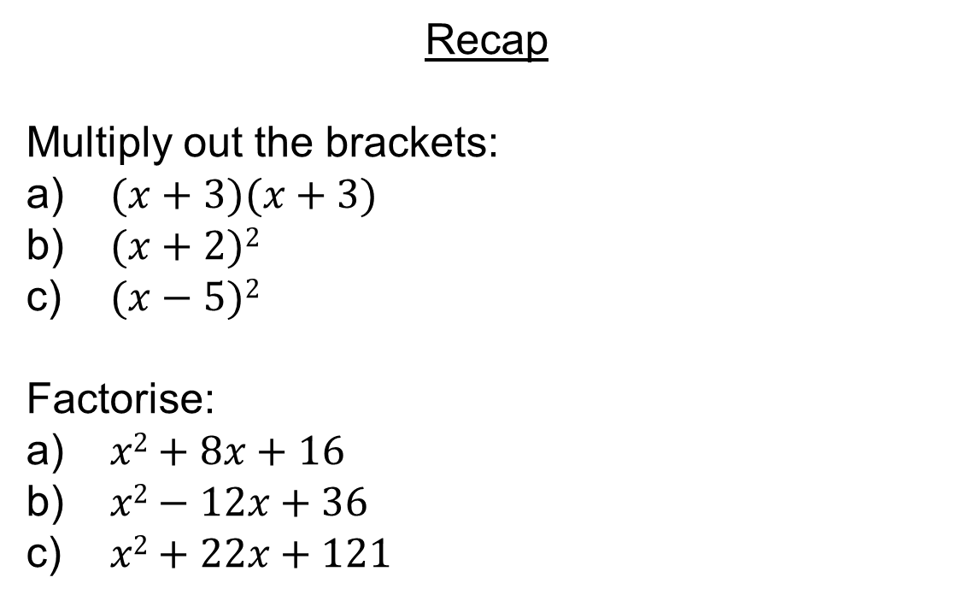
Recap
Multiply out the brackets:
$(x+3)(x+3)$
$(x+2)2$
$(x−5)2$
Factorise:
$x2+8x+16$
$x2−12x+36$
$x2+22x+121$
$=x2+6x+9$
$=x2+4x+4$
$=x2−10x+25$
$=(x+4)²$
$=(x−6)²$
$=(x+11)²$

Slide 35
Solving quadratic equations by completing the square

Slide 36
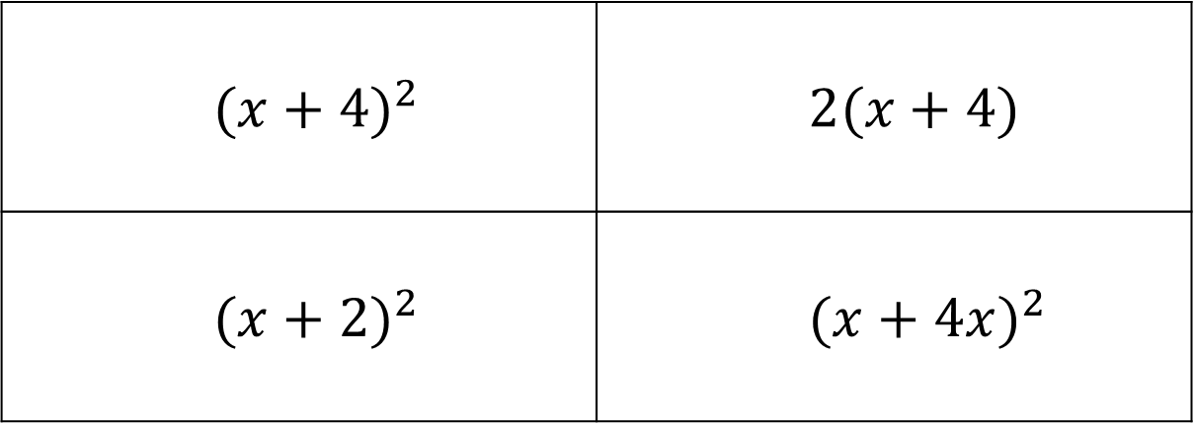

$$x^{2}+4x+4$$
${(x+4)}^{2}$ | $2(x+4)$
${(x+2)}^{2}$ | ${(x+4x)}^{2}$
A
B
C
D

Slide 37
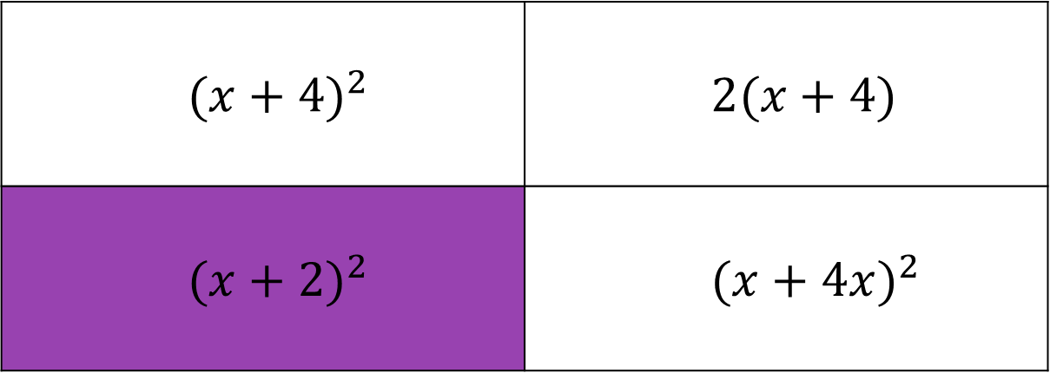
$$x^{2}+4x+4$$
${(x+4)}^{2}$ | $2(x+4)$
${(x+2)}^{2}$ | ${(x+4x)}^{2}$
A
B
C
D

Slide 38
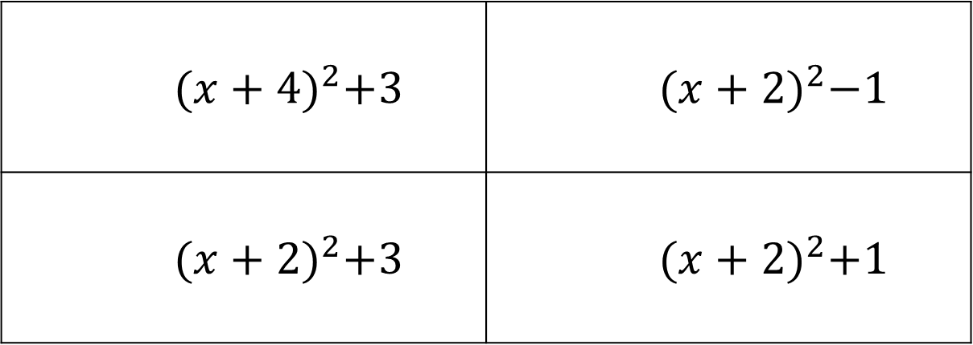

$$x^{2}+4x+3$$
${(x+4)}^{2}+3$ | ${(x+2)}^{2}−1$
${(x+2)}^{2}+3$ | ${(x+2)}^{2}+1$
A
B
C
D

Slide 39
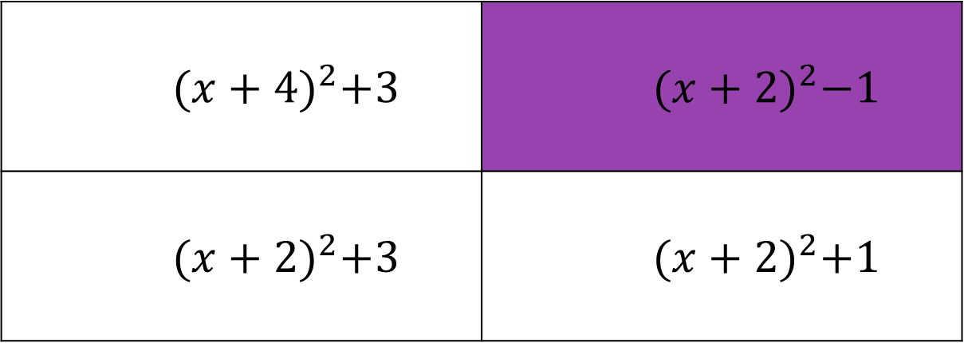
$$x^{2}+4x+3$$
${(x+4)}^{2}+3$ | ${(x+2)}^{2}−1$
${(x+2)}^{2}+3$ | ${(x+2)}^{2}+1$
A
B
C
D

Slide 40
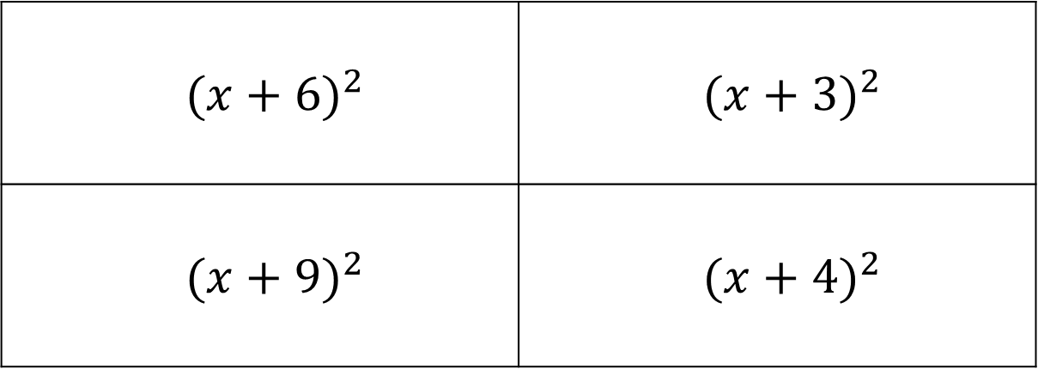

$$x^{2}+6x+9$$
${(x+6)}^{2}$ | ${(x+3)}^{2}$
${(x+9)}^{2}$ | ${(x+4)}^{2}$
A
B
C
D

Slide 41
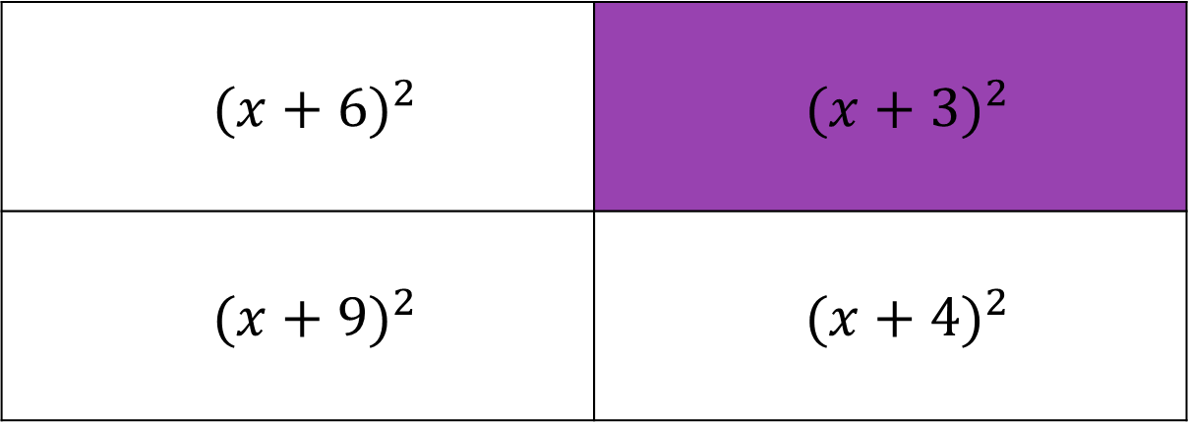
$$x^{2}+6x+9$$
${(x+6)}^{2}$ | ${(x+3)}^{2}$
${(x+9)}^{2}$ | ${(x+4)}^{2}$
A
B
C
D

Slide 42
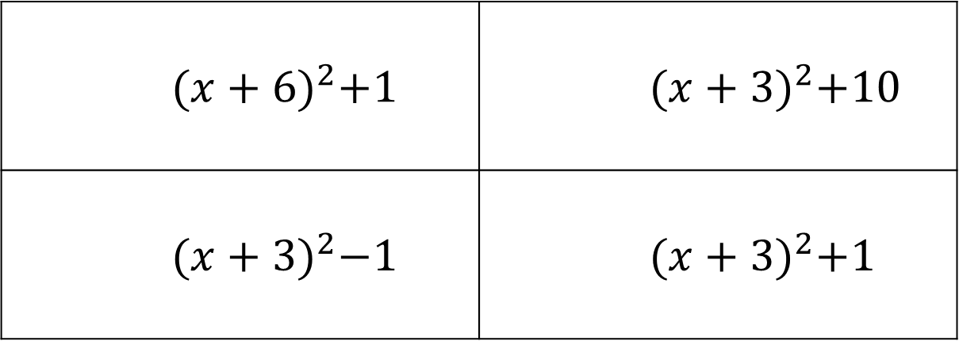

$$x^{2}+6x+10$$
${(x+6)}^{2}+1$ | ${(x+3)}^{2}+10$
${(x+3)}^{2}−1$ | ${(x+3)}^{2}+1$
A
B
C
D

Slide 43
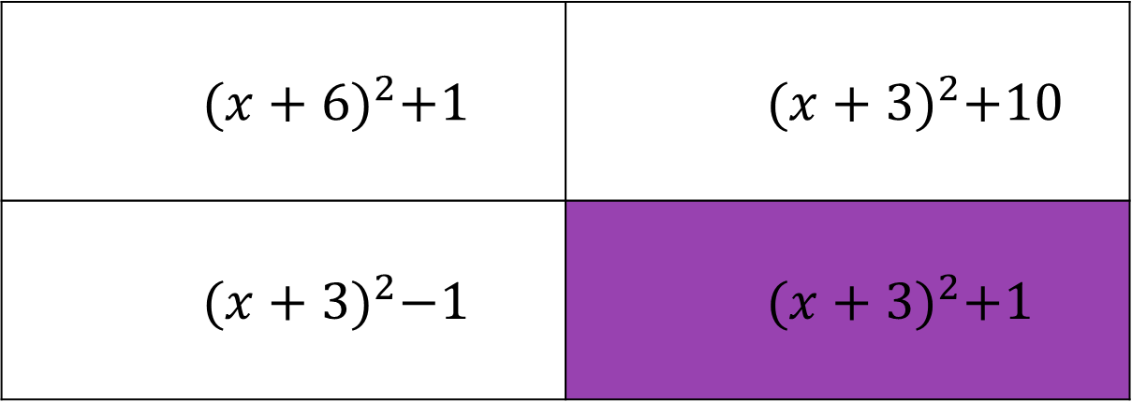
$$x^{2}+6x+10$$
${(x+6)}^{2}+1$ | ${(x+3)}^{2}+10$
${(x+3)}^{2}−1$ | ${(x+3)}^{2}+1$
A
B
C
D

Slide 44
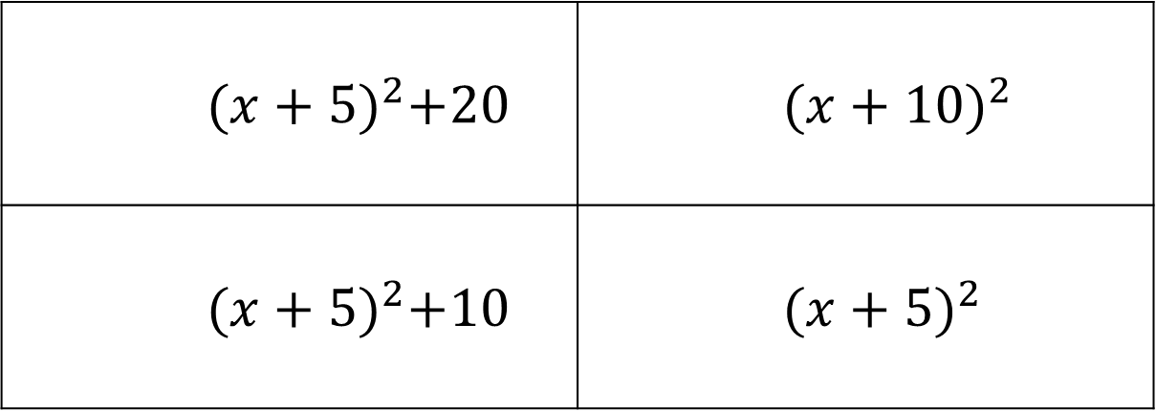

$$x^{2}+10x+25$$
${(x+5)}^{2}+20$ | ${(x+10)}^{2}$
${(x+5)}^{2}+10$ | ${(x+5)}^{2}$
A
B
C
D

Slide 45
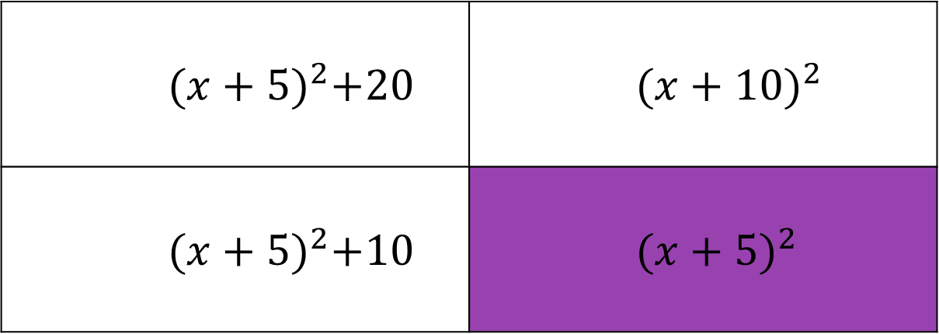
$$x^{2}+10x+25$$
${(x+5)}^{2}+20$ | ${(x+10)}^{2}$
${(x+5)}^{2}+10$ | ${(x+5)}^{2}$
A
B
C
D

Slide 46
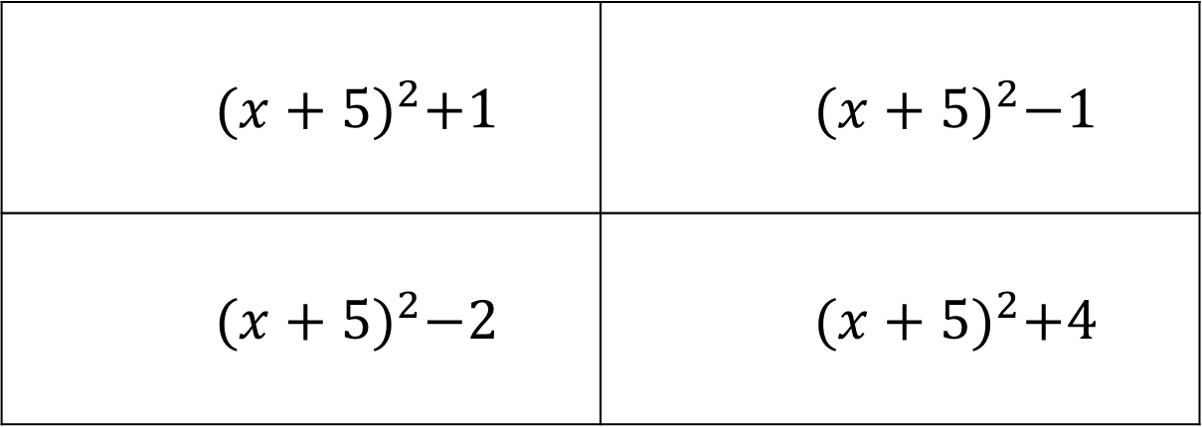

$$x^{2}+10x+24$$
${(x+5)}^{2}+1$ | ${(x+5)}^{2}−1$
${(x+5)}^{2}−2$ | ${(x+5)}^{2}+4$
A
B
C
D

Slide 47
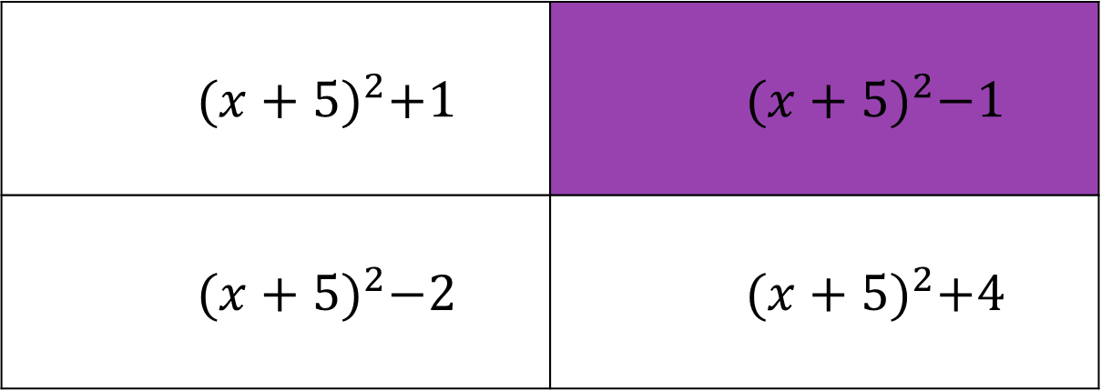
$$x^{2}+10x+24$$
${(x+5)}^{2}+1$ | ${(x+5)}^{2}−1$
${(x+5)}^{2}−2$ | ${(x+5)}^{2}+4$
A
B
C
D

Slide 48
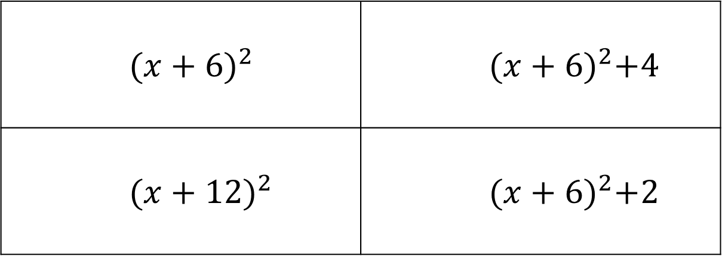

$$x^{2}+12x+36$$
${(x+6)}^{2}$ | ${(x+6)}^{2}+4$
${(x+12)}^{2}$ | ${(x+6)}^{2}+2$
A
B
C
D

Slide 49
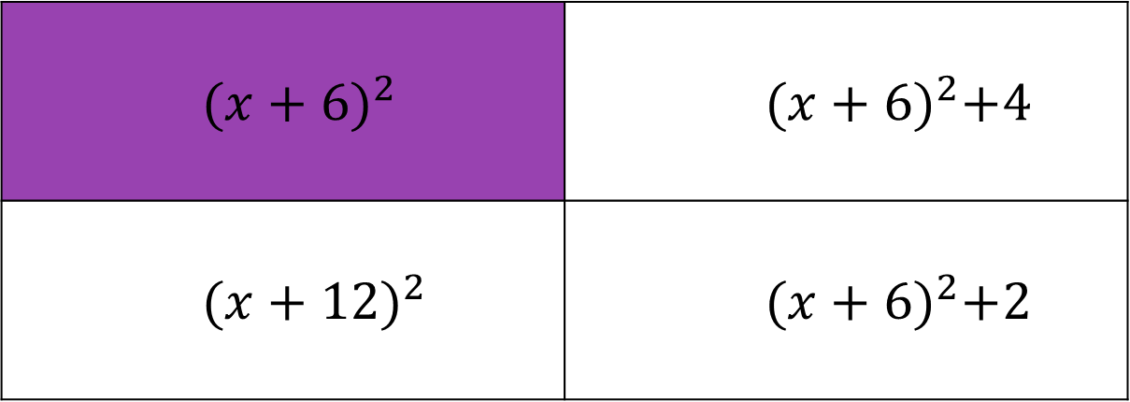
$$x^{2}+12x+36$$
${(x+6)}^{2}$ | ${(x+6)}^{2}+4$
${(x+12)}^{2}$ | ${(x+6)}^{2}+2$
A
B
C
D

Slide 50
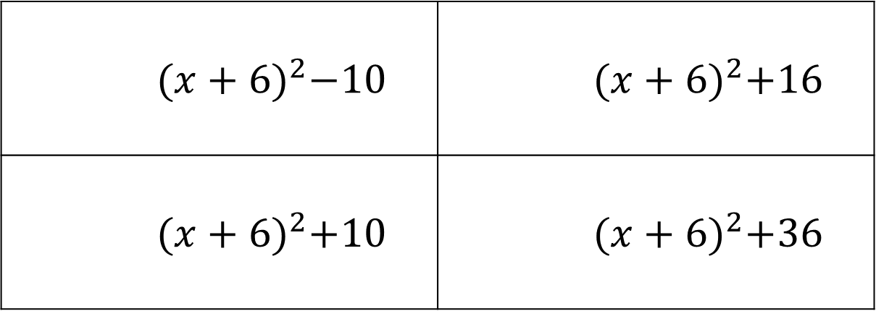

$$x^{2}+12x+46$$
${(x+6)}^{2}−10$ | ${(x+6)}^{2}+16$
${(x+6)}^{2}+10$ | ${(x+6)}^{2}+36$
A
B
C
D

Slide 51
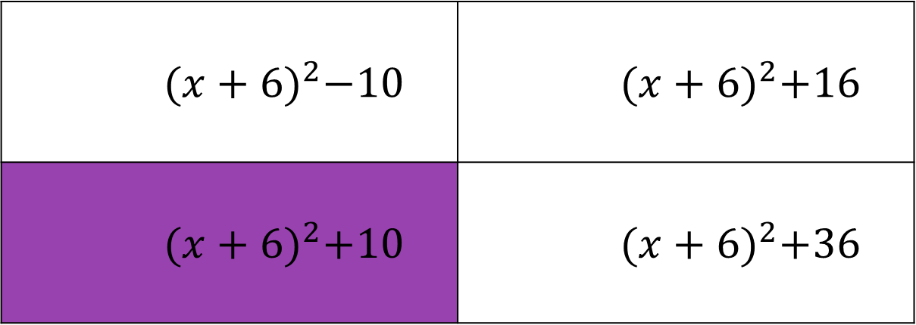
$$x^{2}+12x+46$$
${(x+6)}^{2}−10$ | ${(x+6)}^{2}+16$
${(x+6)}^{2}+10$ | ${(x+6)}^{2}+36$
A
B
C
D

Slide 52
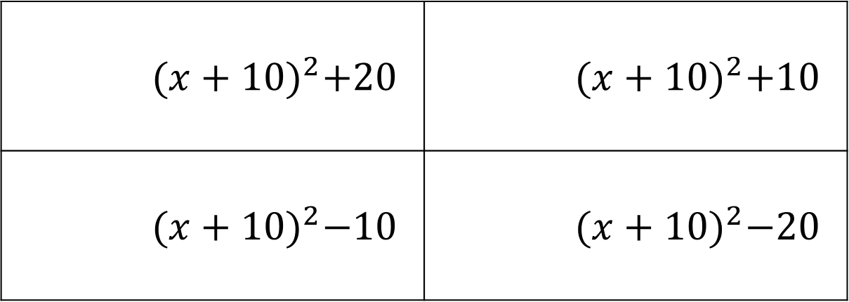

$$x^{2}+20x+80$$
${(x+10)}^{2}+20$ | ${(x+10)}^{2}+10$
${(x+10)}^{2}−10$ | ${(x+10)}^{2}−20$
A
B
C
D

Slide 53
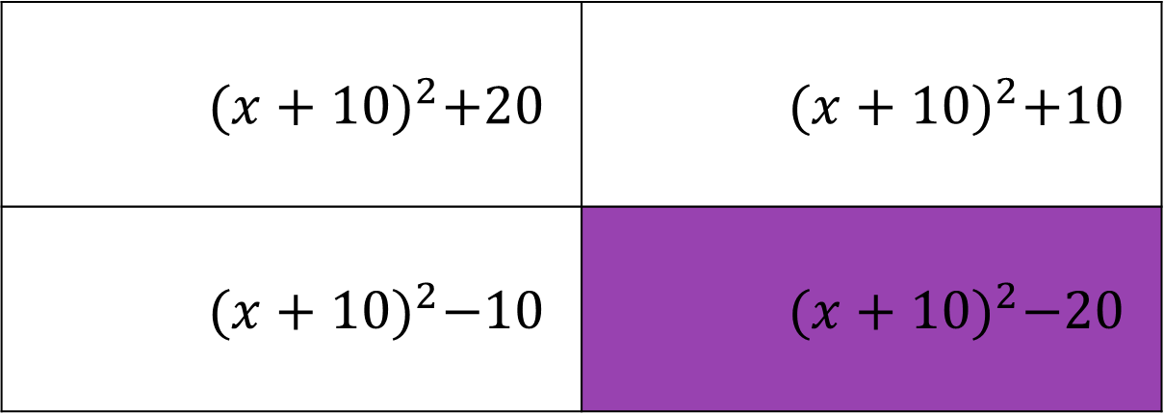
$$x^{2}+20x+80$$
${(x+10)}^{2}+20$ | ${(x+10)}^{2}+10$
${(x+10)}^{2}−10$ | ${(x+10)}^{2}−20$
A
B
C
D

Slide 54
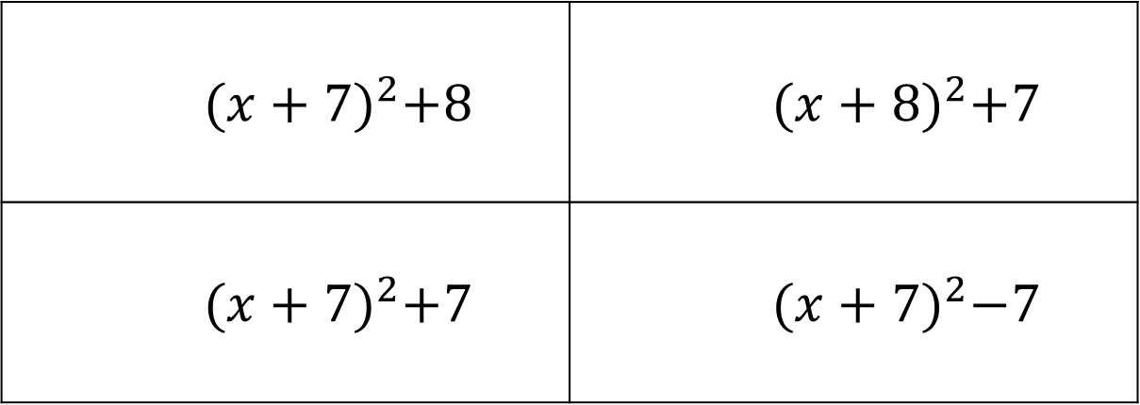

$$x^{2}+14x+56$$
${(x+7)}^{2}+8$ | ${(x+8)}^{2}+7$
${(x+7)}^{2}+7$ | ${(x+7)}^{2}−7$
A
B
C
D

Slide 55

$$x^{2}+14x+56$$
${(x+7)}^{2}+8$ | ${(x+8)}^{2}+7$
${(x+7)}^{2}+7$ | ${(x+7)}^{2}−7$
A
B
C
D

Slide 56

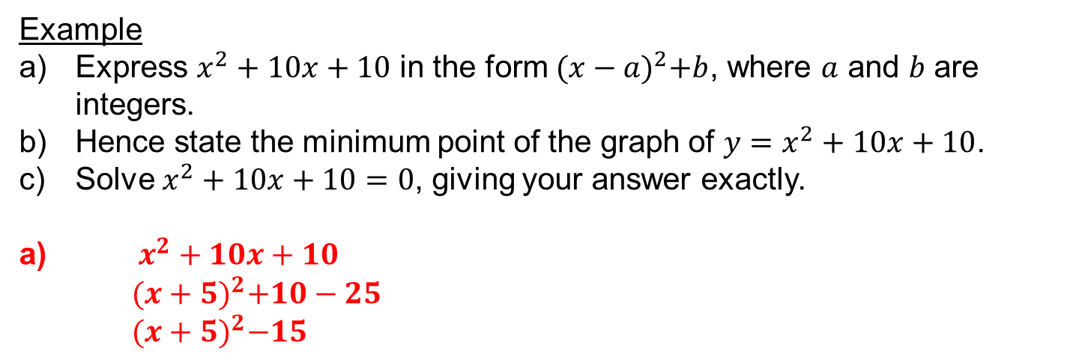
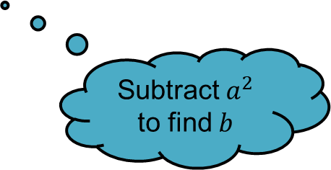
Example
Express $x^{2}+10x+10$ in the form ${(x−a)}^{2}+b$, where $a$ and $b$ are integers.
Hence state the minimum point of the graph of $y=x^{2}+10x+10$.
Solve $x^{2}+10x+10=0$, giving your answer exactly.
a) $x^{2}+10x+10$
${(x+5)}^{2}+10−25$
${(x+5)}^{2}−15$
Half the coefficient of $x$ to find $a$
Subtract $a^{2}$ to find $b$

Slide 57


Example
Express $x^{2}+10x+10$ in the form ${(x−a)}^{2}+b$, where $a$ and $b$ are integers.
Hence state the minimum point of the graph of $y=x^{2}+10x+10$.
Solve $x^{2}+10x+10=0$, giving your answer exactly.
a) $x^{2}+10x+10$
${(x+5)}^{2}+10−25$
${(x+5)}^{2}−15$
b) Minimum point at $(−5, −15)$
The graph $y={(x−a)}^{2}+b$ has a minimum point at $\left(a, b\right)$

Slide 58

Example
Express $x^{2}+10x+10$ in the form ${(x−a)}^{2}+b$, where $a$ and $b$ are integers.
Hence state the minimum point of the graph of $y=x^{2}+10x+10$.
Solve $x^{2}+10x+10=0$, giving your answer exactly.
a) $x^{2}+10x+10$
${(x+5)}^{2}+10−25$
${(x+5)}^{2}−15$
b) Minimum point at $(−5, −15)$
c) Solve:
${(x+5)}^{2}−15=0$
${(x+5)}^{2}=15$
$x+5=±\sqrt{15}$
$x=−5±\sqrt{15}$

Slide 59

Example
Express $x^{2}−8x+5$ in the form ${(x−a)}^{2}+b$, where $a$ and $b$ are integers.
Hence state the minimum point of the graph of $y=x^{2}−8x+5$.
Solve $x^{2}−8x+5=0$, giving your answer exactly.
a) $x^{2}−8x+5$
${(x−4)}^{2}+5−16$
${(x−4)}^{2}−11$
Half the coefficient of $x$ to find $a$
Subtract $a^{2}$ to find $b$

Slide 60

Example
Express $x^{2}−8x+5$ in the form ${(x−a)}^{2}+b$, where $a$ and $b$ are integers.
Hence state the minimum point of the graph of $y=x^{2}−8x+5$.
Solve $x^{2}−8x+5=0$, giving your answer exactly.
a) $x^{2}−8x+5$
${(x−4)}^{2}+5−16$
${(x−4)}^{2}−11$
b) Minimum point at $(4, −11)$
The graph $y={(x−a)}^{2}+b$ has a minimum point at $\left(a, b\right)$

Slide 61

Example
Express $x^{2}−8x+5$ in the form ${(x−a)}^{2}+b$, where $a$ and $b$ are integers.
Hence state the minimum point of the graph of $y=x^{2}−8x+5$.
Solve $x^{2}−8x+5=0$, giving your answer exactly.
a) $x^{2}−8x+5$
${(x−4)}^{2}+5−16$
${(x−4)}^{2}−11$
b) Minimum point at $(4, −11)$
c) Solve:
${(x−4)}^{2}−11=0$
${(x−4)}^{2}=11$
$x−4=±\sqrt{11}$
$x=4±\sqrt{11}$

Slide 62




Example
Express $2x^{2}−6x−3$ in the form $a{(x−b)}^{2}+c$, where $a$, $b$ and $c$ are integers.
Hence state the minimum point of the graph of $y=2x^{2}−6x−3$.
Solve $2x^{2}−6x−3=0$, giving your answer exactly.
a) $2x^{2}−6x−3$
$2\left(x^{2}−3x\right)−3$
$2{\left(x−\frac{3}{2}\right)}^{2}−3−\frac{9}{2}$
$2{\left(x−\frac{3}{2}\right)}^{2}−\frac{15}{2}$
Factorise out the coefficient of $x^{2}$ from the first two terms to find $a$
Half the new coefficient of $x$ to find $b$
Subtract $ab^{2}$ to find $c$
Fractions are easier to square than decimals!

Slide 63


Example
Express $2x^{2}−6x−3$ in the form $a{(x−b)}^{2}+c$, where $a$, $b$ and $c$ are integers.
Hence state the minimum point of the graph of $y=2x^{2}−6x−3$.
Solve $2x^{2}−6x−3=0$, giving your answer exactly.
a) $2x^{2}−6x−3$
$2\left(x^{2}−3x\right)−3$
$2{\left(x−\frac{3}{2}\right)}^{2}−3−\frac{9}{2}$
$2{\left(x−\frac{3}{2}\right)}^{2}−\frac{15}{2}$
b) Minimum point at $\left(\frac{3}{2}, −\frac{15}{2}\right)$
The graph $y=a{(x−b)}^{2}+c$ has a minimum point at $\left(b, c\right)$

Slide 64

Example
Express $2x^{2}−6x−3$ in the form $a{(x−b)}^{2}+c$, where $a$, $b$ and $c$ are integers.
Hence state the minimum point of the graph of $y=2x^{2}−6x−3$.
Solve $2x^{2}−6x−3=0$, giving your answer exactly.
a) $2x^{2}−6x−3$
$2\left(x^{2}−3x\right)−3$
$2{\left(x−\frac{3}{2}\right)}^{2}−3−\frac{9}{2}$
$2{\left(x−\frac{3}{2}\right)}^{2}−\frac{15}{2}$
b) Minimum point at $\left(\frac{3}{2}, −\frac{15}{2}\right)$
c) Solve:
$2{\left(x−\frac{3}{2}\right)}^{2}−\frac{15}{2}=0$
$2{\left(x−\frac{3}{2}\right)}^{2}=\frac{15}{2}$
${\left(x−\frac{3}{2}\right)}^{2}=\frac{15}{4}$
$x−\frac{3}{2}=±\sqrt{\frac{15}{4}}$
$x=\frac{3}{2}±\sqrt{\frac{15}{4}}$

Slide 66

Answers
Question 1
a) ${(x+3)}^{2}−13$ b) $(−3, −13)$ c) $x=3±\sqrt{13}$
Question 2
a) ${(x−2)}^{2}−2$ b) $(2, −2)$ c) $x=2±\sqrt{2}$
Question 3
a) ${\left(x+\frac{5}{2}\right)}^{2}−\frac{21}{4}$ b) $\left(−\frac{5}{2}, −\frac{21}{4}\right)$ c) $x=−\frac{5}{2}±\sqrt{\frac{21}{4}}$
Question 4
a) $3{\left(x+1\right)}^{2}−5$ b) $(−1, −5)$ c) $x=−1±\sqrt{\frac{5}{3}}$

