Slide 1
Can you label these place value columns?
 |  | Tens |  | Tenths
Hint: there are some keywords below…

Slide 2
Can you label these place value columns?
Thousands | Hundreds | Tens | Units | Tenths | Hundredths | Thousandths
Hint: there are some keywords below…

Slide 3
Is 37 nearer to 30 or 40?
30
31
32
33
34
35
36
37
38
39
40
40

Slide 4
Is 34 nearer to 30 or 40?
30
31
32
33
34
35
36
37
38
39
40
30

Slide 5
Is 35 nearer to 30 or 40?
30
31
32
33
34
35
36
37
38
39
40
It’s in the middle!

Slide 6
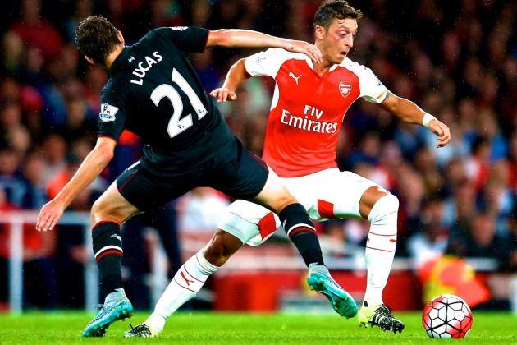
5 is in the middle… so we could go up or down. But we need a method that everyone agrees to.
So think about sport: we should have the same number of players on each team, right?
0, 1, 2, 3 and 4 are on team “down”.
5, 6, 7, 8 and 9 are on team “up”.

Slide 7
Round 35 to the nearest 10
30
31
32
33
34
35
36
37
38
39
40
40

Slide 8
Round 83 to the nearest 10
80
90
A
B

Slide 9
Round 83 to the nearest 10
80
90
A
B

Slide 10
Round 241 to the nearest 100
240
250
A
B

Slide 11
Round 241 to the nearest 100
240
250
A
B

Slide 12
Round 29 to the nearest 10
20
30
A
B

Slide 13
Round 29 to the nearest 10
20
30
A
B

Slide 14
Round 649 to the nearest 100
600
700
A
B

Slide 15
Round 649 to the nearest 100
600
700
A
B

Slide 16
Round 250 to the nearest 100
200
300
A
B

Slide 17
Round 250 to the nearest 100
200
300
A
B

Slide 18
Round 95 to the nearest 10
90
100
A
B

Slide 19
Round 95 to the nearest 10
90
100
A
B

Slide 20
Round 13 to the nearest 100
0
100
A
B

Slide 21
Round 13 to the nearest 100
0
100
A
B

Slide 22
Round 218 to the nearest 10
210
220
A
B

Slide 23
Round 218 to the nearest 10
210
220
A
B

Slide 24
Round 554 to the nearest 10
550
560
A
B

Slide 25
Round 554 to the nearest 10
550
560
A
B

Slide 26
Round 999 to the nearest 10
990
1000
A
B

Slide 27
Round 999 to the nearest 10
990
1000
A
B

Slide 28
Rounding Code Breaker
Read each section carefully to help uncover the secret message!
https://www.tes.com/teaching-resource/rounding-code-breaker-to-nearest-10-100-1000-6363634

Slide 29
Round 8.2 to the nearest whole number
8
8.1
8.2
8.3
8.4
8.5
8.6
8.7
8.8
8.9
9
8

Slide 30
Round 8.6 to the nearest whole number
8
8.1
8.2
8.3
8.4
8.5
8.6
8.7
8.8
8.9
9
9

Slide 31
Round 8.5 to the nearest whole number
8
8.1
8.2
8.3
8.4
8.5
8.6
8.7
8.8
8.9
9
9
Remember, 5 is on team “up”!

Slide 33
Answers
Question 1
a) 5 b) 4
c) 9 d) 10
e) 4 f) 18
g) 13 h) 342
i) -2 j) 0
Question 3
9.9
Question 4
7.24
Question 2
4.7 4.3 5.9 5.2 5.49 4.932
98.7 80 97.9 97.5 98.4 98.05
43.78 43.12 43.11 43.3 42.93
12.13 11.51 11.49 12.51 12.65

Slide 34
Pair Activity
Hopefully you feel like you’re pretty good at rounding now!
Work with the person next to you on the “Rounding to One Decimal Place” jigsaw.
Keep thinking about which numbers are on each team!

