Slide 1
Measuring Angles GREEN

Slide 2
Measuring Angles AMBER
Remember to trace your finger to zero

Slide 3
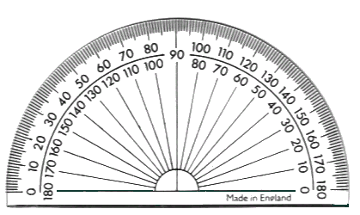
Measuring Angles RED
Remember to trace your finger to zero

