Slide 1
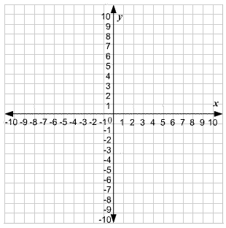
Starter
Calculate the gradients of the following linear graphs.
Remember, gradient = $\frac{rise}{run}$
6
2
2
4
6
2
= 3
-2
4
= - ½

Slide 2
Definitions
Velocity → speed with direction
Acceleration → increasing velocity
Deceleration → decreasing velocity
Recap
a
h
h
h
b
b
b
Area of triangle = ½ x b x h
Area of trapezium = ½ h (a + b)

Slide 3
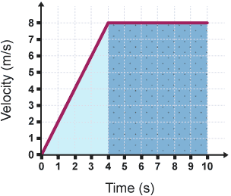
Gradients
In general, the gradient of a line tells you the rate of change of the
$y$-variable in relation to the rate of change of the $x$-variable
Gradient = Acceleration (in m/s²)
Gradient = Change in money over time (in £/year)
Gradient = Speed or Velocity (in m/s)

Slide 4
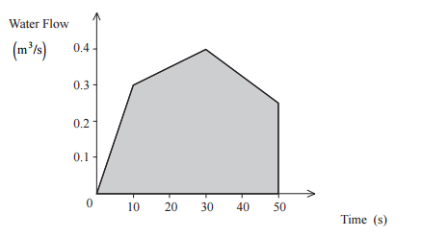
Area Under the Graph
In general, the area under the graph tells you the product of the two units on the two axes
Area = $\frac{m}{s}×s$
= metres → i.e. distance!
Area = $\frac{m^{3}}{s}×s$
= $m^{3}$ → i.e. volume of water!

Slide 5
Velocity-Time Graphs
For a velocity-time graph:
Gradient = acceleration
Area = distance travelled
a) What was the acceleration in the first 4 seconds?
b) How far was travelled in the first 10 seconds?
rise
run
= 8
4
= 2
m/s²
Area of triangle = ½ x base x height
= ½ x 4 x 8
= 16 m
Area of rectangle = base x height
= 6 x 8
= 48 m
Total area
= 16 + 48
= 64 m

Slide 6
Velocity-Time Graphs
The graph on the right shows the speed of a car approaching some traffic lights.
a) What is happening between 4 and 8 seconds?
b) Calculate the rate of deceleration between 4 and 8 seconds. State your units in your answer.
c) Calculate the distance travelled.
Deceleration
rise
run
= -10
4
= 2.5 m/sˉ²
Area of rectangle = base x height
= 4 x 10
= 40 m
Area of triangle = ½ x base x height
= ½ x 4 x 10
= 20 m
Total area
= 40 + 20
= 60 m

Slide 7
Velocity-Time Graphs
The graph on the right shows the speed of a train for part of its journey.
a) What is happening between 0 and 3 seconds?
b) Calculate the rate of acceleration between 3 and 5 seconds. State your units in your answer.
c) Calculate the distance travelled.
Constant speed
(seconds)
rise
run
= 3
2
= 1.5 min/s²
3 x 2
= 6 m
3 x 5
= 15 m
Area of trapezium = ½ (a + b) h
= ½ x (2 + 5) x 2
= 7 m
Total area
= 6 + 15 + 7
= 28 m

Slide 8
What is the difference between speed and velocity?
What are the units of speed and acceleration?
How do you calculate acceleration from a velocity-time graph?
How to you calculate distance travelled from a velocity-time graph?

Slide 10
Answers
1a. 0.6 m/s²
b. 50 m
2a. 0.3 m/s²
b. 58.5 m
3a. 1 m/s²
b. 18 + 24 = 42 m
4a. 3 m/s²
b. 54 + 13.5 = 67.5 m
5a. 2 m/s²
b. 9 + 30 = 39 m
6a. 1 m/s²
b. 21 + 4.5 = 25.5 m
7a. 3 m/s²
b. 10 + 10 + 8 = 28 m
8a. 3.5 m/s²
b. 20 + 28.5 + 16 + 7 = 71.5 m

