Slide 1
Starter
Copy and continue…
x | x² | x³
1 | 1 | 1
2 | 4 | 8
3 | 9 | …
4 | … | …
… | … | …

Slide 2
What are Indices?
Indices provide a way of writing numbers in a more convenient form
Indices is the plural of Index
An Index is often referred to as a power

Slide 3
5 x 5 x 5
= 5³
2 x 2 x 2 x 2
= 2⁴
7 x 7 x 7x 7 x 7
= 7⁵
5 is the INDEX
7 is the BASE NUMBER
7⁵ & 2⁴ are numbers in INDEX FORM

Slide 4
Combining numbers
5 x 5 x 5
x 2 x 2 x 2 x 2
= 5³
x 2⁴
We can not write this any more simply
We can ONLY do this if the BASE NUMBERS are the same

Slide 5
Rule 1 : Multiplication
2⁶ x 2⁴
= 2¹⁰
2⁴ x 2²
= 2⁶
3⁵ x 3⁷
= 3¹²
General Rule
a^{m} x a^{n} = a^{m+n}

Slide 6
Rule 2 : Division
2⁶ ÷ 2⁴
= 2²
2⁵ ÷ 2²
= 2³
3⁵ ÷ 3⁷
= 3⁻²
General Rule
a^{m} ÷ a^{n} = a^{m-n}

Slide 7
Rule 3 : Brackets
(2⁶)²
= 2⁶ x 2⁶
= 2¹²
(3⁵)³
= 3⁵ x 3⁵ x 3⁵
= 3¹⁵
General Rule
(a^{m})^{n} = a^{m x n}

Slide 8
Rule 4 : Index of 0
How could you get an answer of 3⁰?
3⁵ ÷ 3⁵
= 3⁵⁻⁵
= 3⁰
3⁰ =
1
General Rule
a⁰ = 1

Slide 9
Rule 5 : Negative indices
2³ =
2² =
2¹ =
2⁰ =
2⁻¹ =
2⁻² =
2⁻³ =
8
4
2
1
½
¼
1/8
General Rule
a^{-m} = 1
a^{m}

Slide 10
Rule 5 : Negative indices
The reciprocal of a number n is $\frac{1}{n}$
Example: the reciprocal of 5 is $\frac{1}{5}$
Any number multiplied by its reciprocal is always equal to 1
Example: 5 x $\frac{1}{5}$ = 1

Slide 11
2⁶ x 2⁴
2³
= 2¹⁰
2³
= 2⁷
3⁵ x 3⁷
3⁴
= 3¹²
3⁴
= 3⁸
2⁵ x 2³
2⁴ x 2²
= 2⁸
2⁶
= 2²

Slide 12
a⁶ x a⁴
= a¹⁰
b⁵ x b⁷
= b¹²
c⁵ x c³
c⁴
= c⁸
c⁴
= c⁴
a⁵ x a³
a⁴ x a⁶
= a⁸
a¹⁰
= a⁻²

Slide 13
2a³ x 3a⁴
= 2 x 3 x a³ x a⁴
= 6a⁷
8a⁶ ÷ 4a⁴
= (8 ÷ 4) x (a⁶ ÷ a⁴)
= 2a²
2
8a⁶
4a⁴
2

Slide 15

Answers
1a. 4⁵ b. 7⁴ c. a⁴
d. f² x g³
2a. 9 b. 32 c. 1000
d. 5 e. 1 f. 1
3a. 3¹³ b. 2⁹ c. m⁹
d. 4⁴ e. 3⁵ f. h²
g. 6¹² h. b¹⁰ i. 9⁰ = 1
j. 8⁴ k. y⁴ l. r⁷
4a. $\frac{1}{3}$ b. $\frac{1}{4^{2}}$ c. $\frac{1}{f^{4}}$
d. $\frac{1}{5^{3}}$ e. $\frac{1}{g^{2}}$ f. $\frac{1}{y^{12}}$

Slide 16

Answers
5a. 2 b. 3 c. 5
d. 0 e. 3 f. 4
6a. 4 b. 3 c. 3
7a. 3⁶ b. 2¹⁴ c. 7⁰ = 1
d. 2⁻² = $\frac{1}{2^{2}}$
8a. 10a⁷ b. 12y⁰ = 12
c. 7g d. 4r⁴
e. 10d⁻¹ = $\frac{10}{d}$ f. 12c⁰ = 12

Slide 17
Indices Bingo
Aim: Full House
Grid: 9 Grid
Play: Calculate answer & cross it off

Slide 18
Use any of these numbers in your grid (NO REPEATS)
10 -32 4 9
7 13 -12 23
6 4 -2 5
0 25 18 -3

Slide 19
a²
a⁴

Slide 20
(a²)⁹

Slide 21
a⁵xa¹⁰
a²xa³

Slide 22
a²xa⁻³xa⁻⁶
a⁵

Slide 23
a³xa³xa⁻⁶

Slide 24
(a^{0.5})¹²

Slide 25
a²xa²

Slide 26
a³xa³xa³

Slide 27
a²xa⁻⁵

Slide 28
a⁻⁶
a⁻¹⁰

Slide 29
(a⁻⁵)⁻⁵

Slide 30
a²xa³

Slide 31
a⁵xa³xa²xa³

Slide 32
a⁵xa³xa³
a³xa

Slide 33
a³xa¹⁰xa¹⁰

Slide 34
a⁻¹⁶
a¹⁶

Slide 35
What’s the same? What’s different?
(2²)³ | 4 x 4²
2² x 2⁴ | 2¹⁹ ÷ 2¹³

Slide 36
What’s the same? What’s different?
3² | 3⁻²
_1_ 3² | _1_ 3⁻²

Slide 37
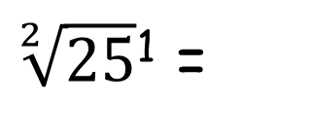
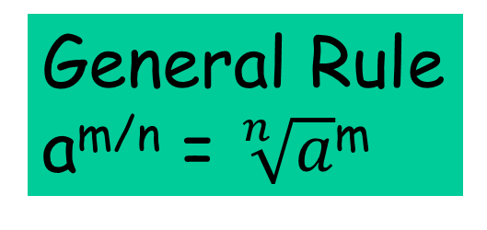
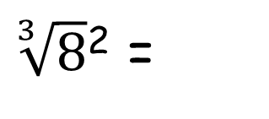
Rule 6 : Fractional indices
25^{1/2} =
$\sqrt[2]{25}$¹ =
5¹ =
5
$\sqrt[3]{8}$² =
4
8^{2/3} =
2² =
General Rule
a^{m/n} = $\sqrt[n]{a}$^{m}

Slide 39
ANSWERS

Slide 40
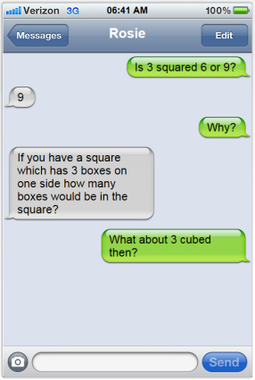
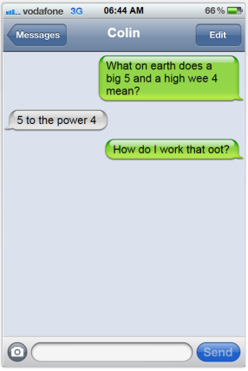
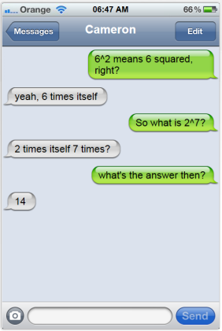
Discuss within your group.
How would you help Rosie, Colin and Cameron out?
What common misconceptions can you spot?
Any other observations about the conversations?

