Slide 1
Starter
Mr Khan asked the 22 students in his class what activity they wanted to do on a school trip. Here are the results. Complete the frequency table.
Bowling Swimming Roller Skating Swimming
Swimming Bowling Roller Skating Roller Skating
Roller Skating Swimming Roller Skating Swimming
Swimming Cinema Bowling Cinema
Cinema Roller Skating Swimming Swimming
Swimming Bowling
Activity | Tally | Frequency
Bowling
Swimming
Roller Skating
Cinema
|||| 4
|||| |||| 9
|||| | 6
||| 3

Slide 2
1. Make sure that you include a title to tell the reader what your pictogram is about.
A pictogram showing pupils favourite colours
3. Use an appropriate picture to represent your data.
Red
Blue
Yellow
4. Make sure that you include a key to explain what each of the pictures represents.
Green
White
2. Put the answers or groups down one side of the page and then draw a line.
Each face represents 2 pupils

Slide 3
Method of Travel | Tally | Frequency
Walk | |||| |||| | 9
Bike | ||| | 3
Car | |||| | | 6
Bus | |||| |||| || | 12
WALK
BIKE
= 2 people
CAR
BUS

Slide 4
Age of Children | Frequency
7
8
9
10
11
12
7
10
13
10
6
14
7 years
8 years
9 years
= 2 people
10 years
11 years
12 years

Slide 5
Pictogram Bingo!

Slide 6
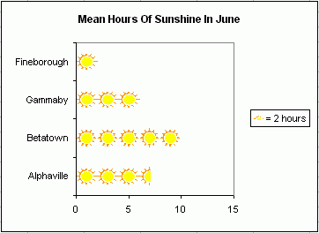
How many hours of sunshine were there in Betatown?

Slide 7
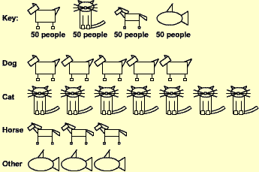
How many people prefer cats?

Slide 8
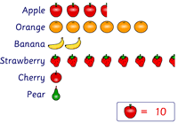
How many cherries were sold?

Slide 9
How many people prefer dogs?

Slide 10
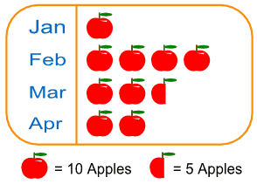
How many apples were sold in February?

Slide 11
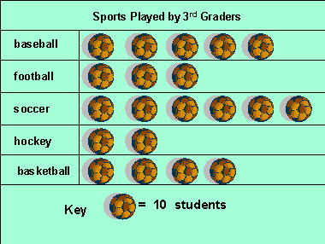
How many students play soccer?

Slide 12
How many apples were sold?

Slide 13
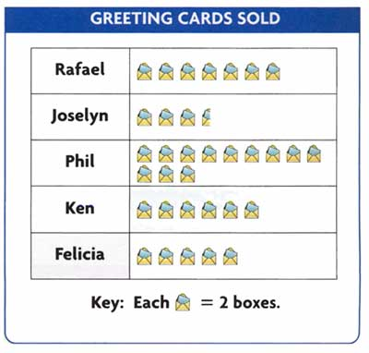
How many greetings cards were sold by Joselyn?

Slide 14
How many hours of sunshine were there in Gammaby?

Slide 15
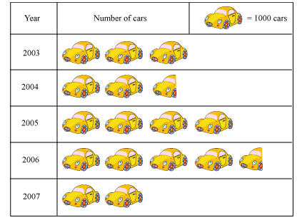
How many cars were sold in 2006?

Slide 16
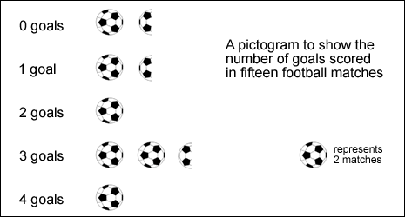
In how many matches were 2 goals scored?

Slide 17
How many bananas were sold?

Slide 18
How many pupils prefer pizza?

Slide 19
How many students play football?

Slide 20
In how many matches were 3 goals scored?

Slide 21
How many pupils prefer breakfast?

Slide 22
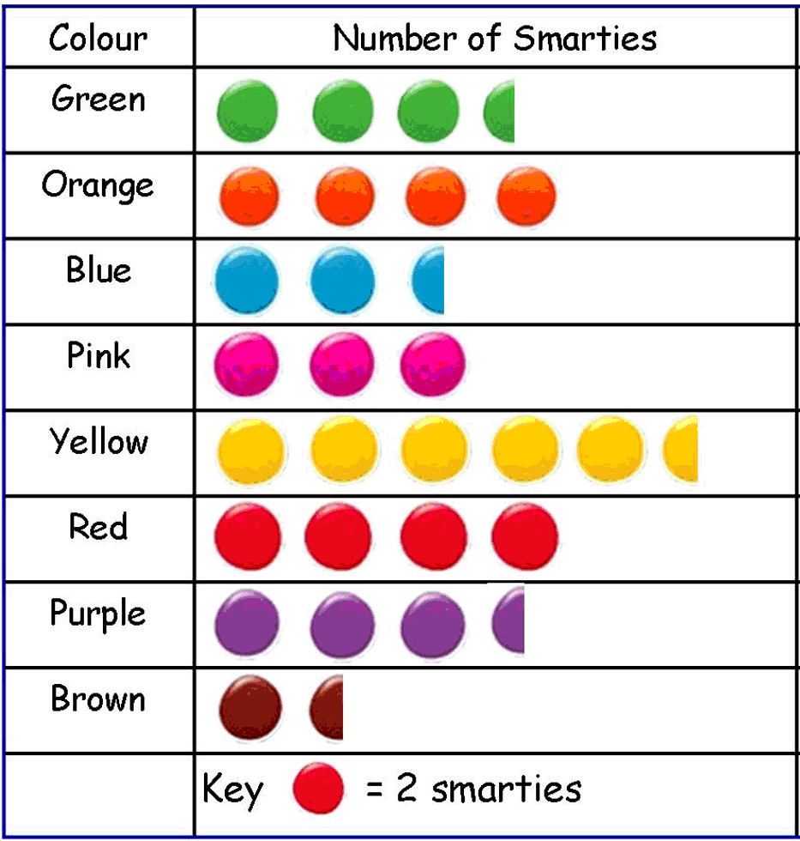
How many green smarties were in the pack?

Slide 23
How many hours of sunshine were there in Alphaville?

Slide 24
How many students play baseball?

Slide 25
How many greetings cards were sold by Felicia?

Slide 26
How many purple smarties were in the pack?

Slide 27
How many strawberries were sold?

Slide 28
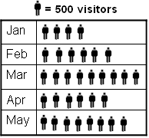
How many visitors were there in January?

Slide 29
How many blue smarties were in the pack?

Slide 30
How many hours of sunshine were there in Fineborough?

Slide 31
How many apples were sold in March?

Slide 32
How many visitors were there in February?

Slide 33
How many people prefer horses?

Slide 34
How many apples were sold in April?

Slide 35
How many brown smarties were in the pack?

Slide 36
How many visitors were there in May?

Slide 37
How many apples were sold in January?

Slide 38
How many pupils prefer chicken nuggets?

Slide 39
How many cars were sold in 2004?

Slide 40
In how many matches were 0 goals scored?

Slide 41
How many yellow smarties were in the pack?

Slide 42
How many cars were sold in 2003?

Slide 43
How many visitors were there in March?

Slide 44
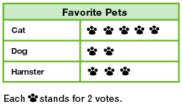
How many votes were there for dogs?

Slide 45
How many cars were sold in 2005?

Slide 46
How many greetings cards were sold by Phil?

Slide 47
In how many matches were 4 goals scored?

Slide 48
How many cars were sold in 2007?

Slide 49
How many visitors were there in April?

Slide 50
How many oranges were sold?

Slide 51
How many students play hockey?

Slide 52
How many votes were there for cats?

Slide 53
How many red smarties were in the pack?

Slide 54
How many greetings cards were sold by Rafael?

Slide 55
In how many matches were 1 goals scored?

Slide 56
How many students play basketball?

Slide 57
How many pears were sold?

Slide 58
How many votes were there for hamsters?

Slide 59
How many greetings cards were sold by Ken?

