Slide 1
Starter
80 children went on a school trip. They went to London or to York. 23 boys and 19 girls went to London. 14 boys went to York. How many girls went to York?
We could spend a while working this out and get there eventually… but the working out would probably be messy and unordered…
There is an easier way!

Slide 2
Bivariate Data is data collected for two variables. Examples include:
Height and Weight
Age and reaction time
Gender and test results
Bivariate data can be summarised in a two-way table.

Slide 3
Example
80 children went on a school trip. They went to London or to York. 23 boys and 19 girls went to London. 14 boys went to York. How many girls went to York?
London
York
Total
Boys
23
14
37
Girls
19
24
43
Total
42
38
80

Slide 4
 |  | Eye colour
 |  | Brown | Green | Blue | Total
Hair colour | Brown | 4 | 4 |  | 16
 | Fair | 3 |  | 4
 | Red |  | 1 | 1 | 4
 | Total | 9 | 8 |  | 30
8
3
10
2
13
Copy and complete the table
Which eye colour was most common?
Which hair colour was least common?
What fraction of the people had blue eyes?
Blue
Red
$\frac{13}{30}$

Slide 5
Your Turn!
90 people were asked whether they preferred Soaps, Drama or Crime shows.
12 men said they liked Dramas
33 people in total said they liked Soaps, and 27 of these were women.
25 people in total liked Dramas best.
Only 10 women liked Crime shows.
Draw a two-way table to represent the above.
Steps:
1. READ through everything first.
2. Find the CATEGORIES of information.
3. Create your TABLE.
4. FILL IN what you can.

Slide 6
Your Turn!
90 people were asked whether they preferred Soaps, Drama or Crime shows.
12 men said they liked Dramas
33 people in total said they liked Soaps, and 27 of these were women.
25 people in total liked Dramas best.
Only 10 women liked Crime shows.
Draw a two-way table to represent the above.
 | Soaps | Crimes | Dramas | Total
Men | 6 | 22 | 12 | 40
Women | 27 | 10 | 13 | 50
Total | 33 | 32 | 25 | 90

Slide 8
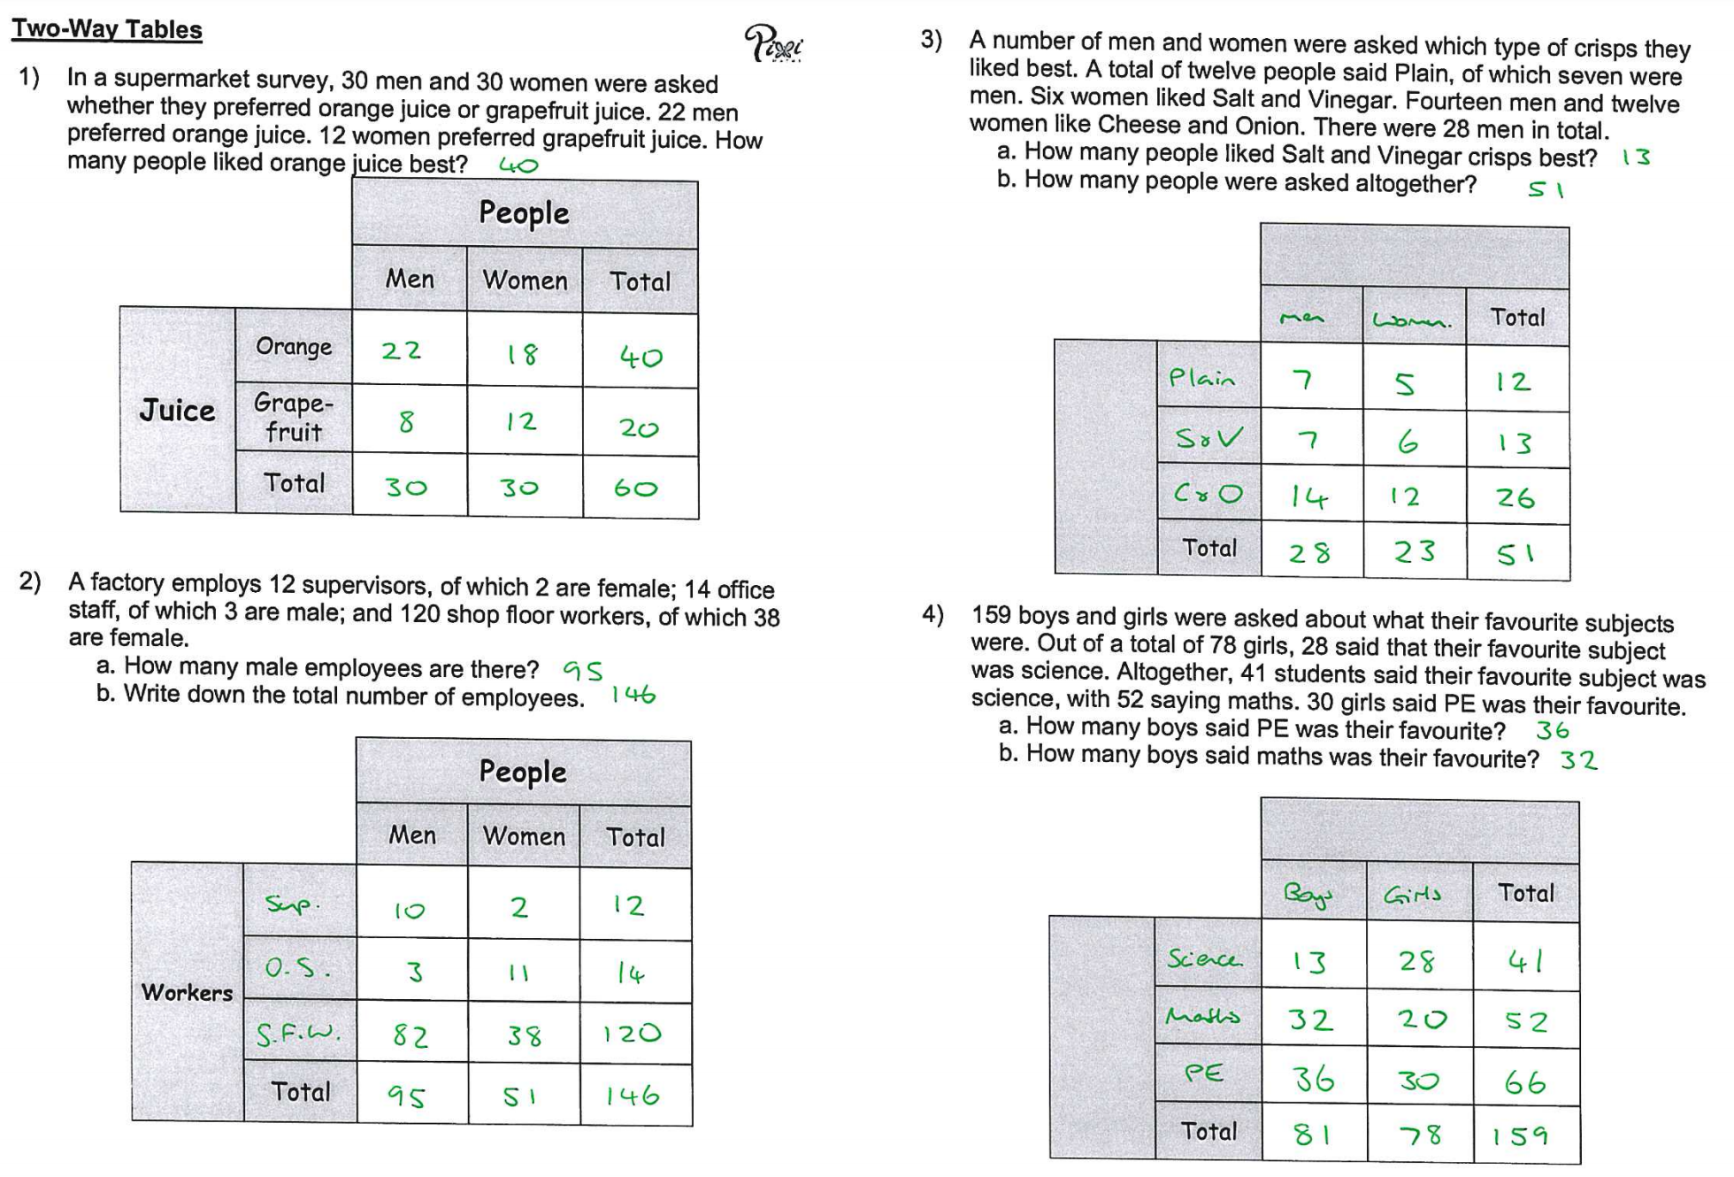

Slide 9
Group Activity
Use the statements to draw and complete a two-way table, then use your two-way table to answer the questions.

