Slide 1
A
B
C
D
F
E
G
I
H
Which shapes are congruent to shape B?
Extension: define congruent.

Slide 2
Translation is a type of transformation.
A translation moves an object. The size, shape and orientation stay exactly the same.
We describe translations with a left or right movement ($x$), followed by an up or down movement ($y$).

Slide 3
Vectors
We can use column vectors to describe translations.
For example:
$\left(\begin{matrix}2 \\ −3\end{matrix}\right)$
This is the $x$ value which tells us the left or right movement.
This is the $y$ value which tells us the up or down movement.

Slide 4
Vectors
We can use column vectors to describe translations.
For example:
$\left(\begin{matrix}2 \\ −3\end{matrix}\right)$
$$y$$
$$x$$
Picture axes to help you understand the directions.

Slide 5
Vectors
We can use column vectors to describe translations.
For example:
$\left(\begin{matrix}x \\ y\end{matrix}\right)$
$$y$$
$$x$$
Picture axes to help you understand the directions.

Slide 6
Describe the translation that maps $P$ onto $Q$.
a) In words
b) As a vector
6
5
$$Q$$
3 right and 2 up
4
$\left(\begin{matrix}3 \\ 2\end{matrix}\right)$
3
$$P$$
2
1
0
1
2
3
4
5
6

Slide 7
Describe the translation that maps $X$ onto $Y$.
a) In words
b) As a vector
6
5
$$X$$
3 right and 3 down
4
$\left(\begin{matrix}3 \\ −3\end{matrix}\right)$
3
2
$$Y$$
1
0
1
2
3
4
5
6

Slide 8
Translate this triangle by the vector $\left(\begin{matrix}4 \\ 3\end{matrix}\right)$
Pick a vertex to begin with.
Translate the vertex by the given column vector.

Slide 9
Translate this triangle by the vector $\left(\begin{matrix}4 \\ 3\end{matrix}\right)$
Translate the other vertices by the same vector.

Slide 10
Translate this triangle by the vector $\left(\begin{matrix}4 \\ 3\end{matrix}\right)$
Join the vertices to create the translated shape.

Slide 11
Extension: What word do the translations make?

Slide 12
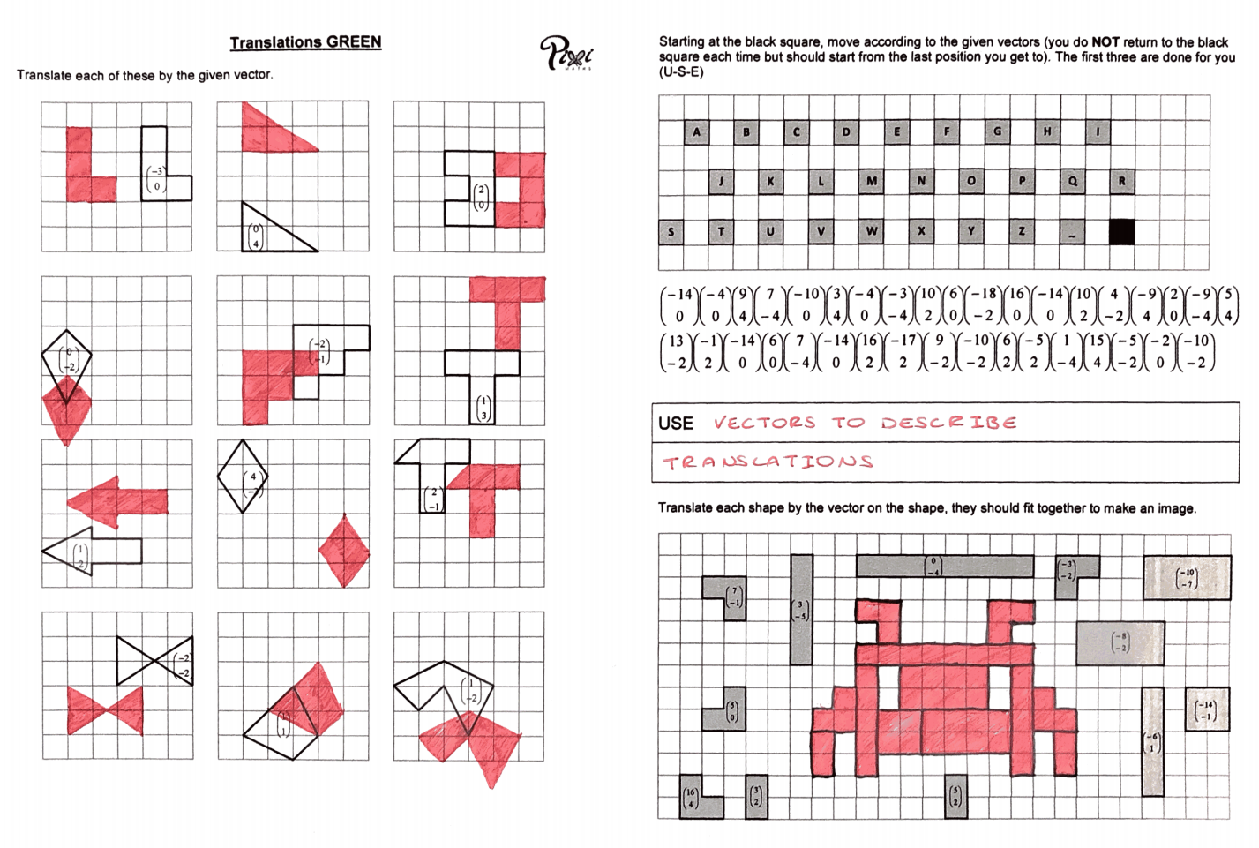
Answers

Slide 13
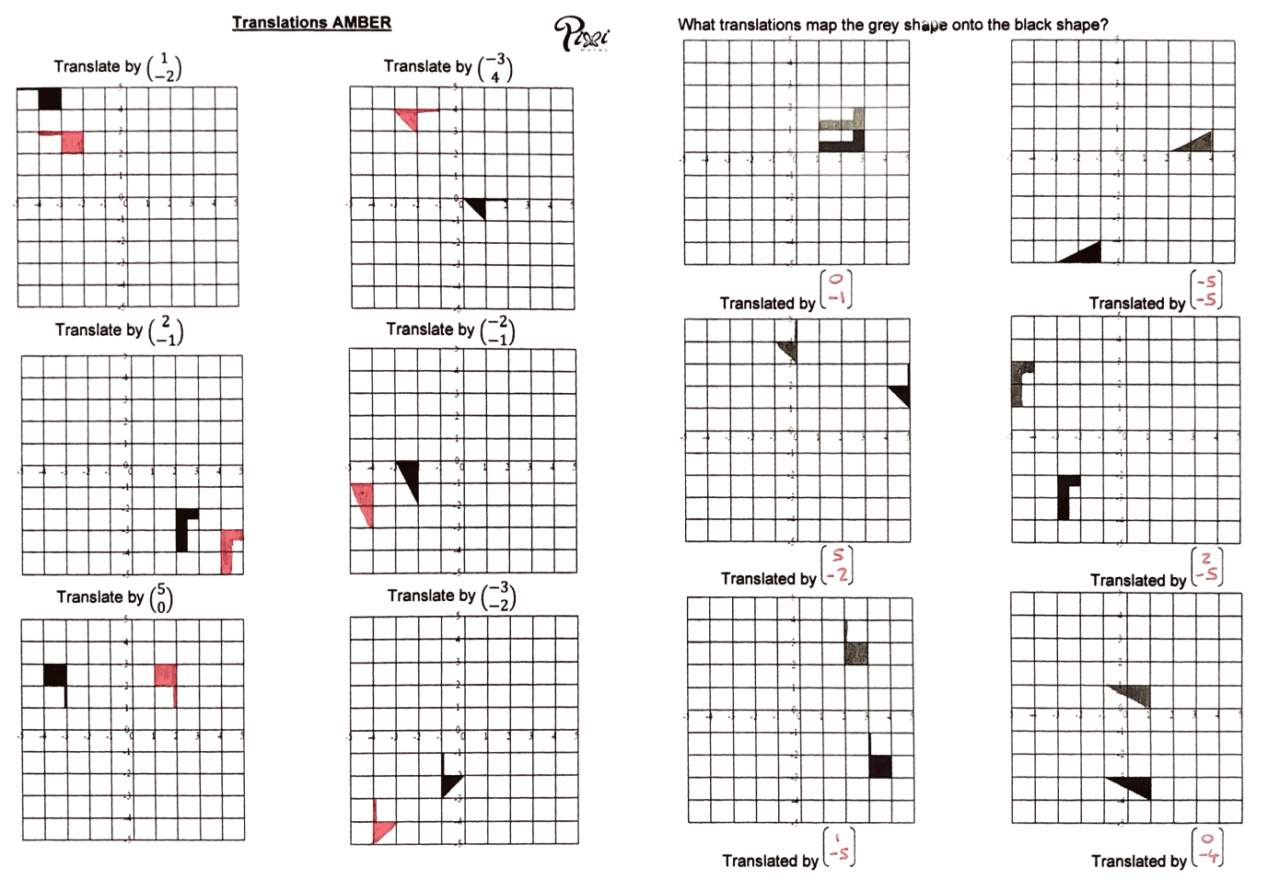
Answers

Slide 14
Vectors Snakes and Ladders
Roll the dice and move your counter the number of squares shown on the dice.
If you land on a blank numbered square, that ends your go.
If you land on a vector, follow it.
Then it is the end of your go.
The winner is the first person to get to the finish in the exact number of moves.
Notes:
Printed in DGLs shape box

Slide 15
True or false?
The transformation from A to B is a translation by vector $\left(\begin{matrix}−6 \\ −1\end{matrix}\right)$
B
4
True
6
A
(
)
Translation
6
Unsure
4
False
Notes:
15

Slide 16
True or false?
The transformation from A to B is a translation by vector $\left(\begin{matrix}−5 \\ −3\end{matrix}\right)$
5
A
3
B
True
(
)
Translation
-5
Unsure
-3
False
Notes:
16

Slide 17
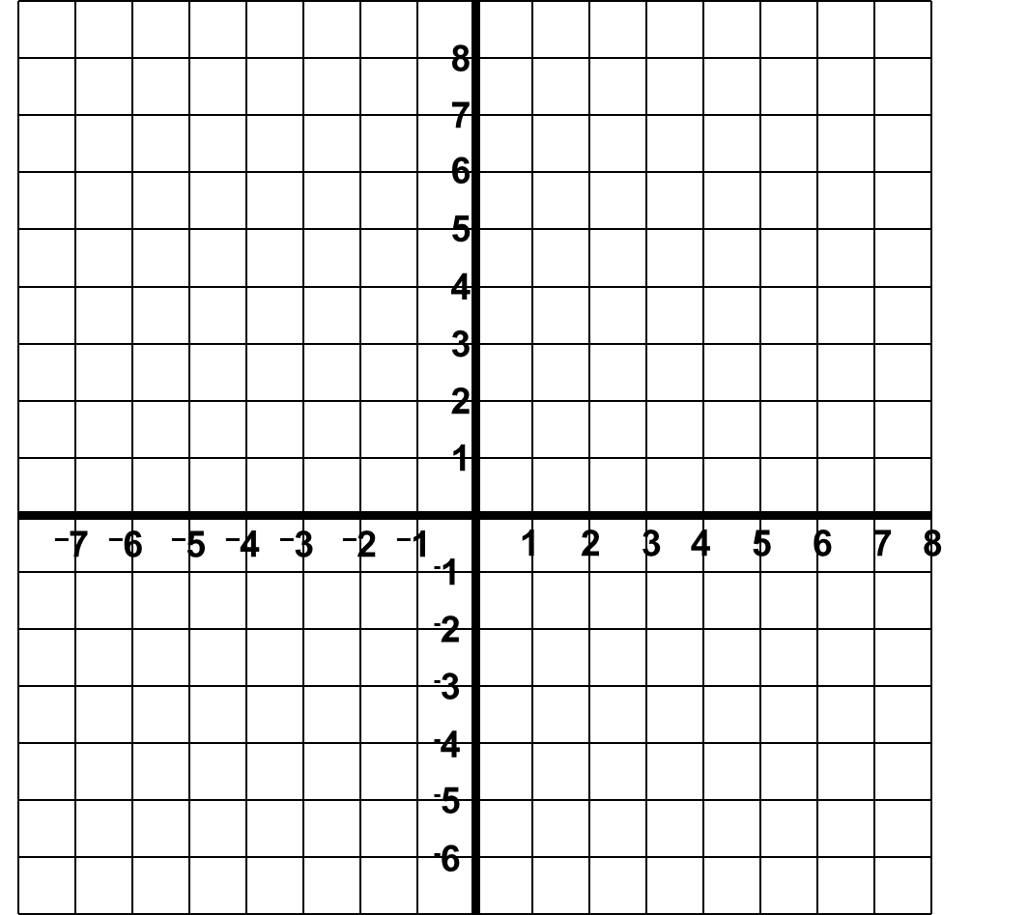
True or false?
The transformation from A to B is a translation by vector $\left(\begin{matrix}−8 \\ 0\end{matrix}\right)$
A
True
(
)
Translation
0
8
-8
Unsure
B
False
Notes:
17

Slide 18
True or false?
The transformation from A to B is a translation by vector $\left(\begin{matrix}−6 \\ 0\end{matrix}\right)$
6
B
A
True
Unsure
(
)
Translation
-6
0
False
Notes:
18

