Slide 1
Starter
How many of the buttons do you know already?
Extension: Do you know what any of the yellow functions do?

Slide 2
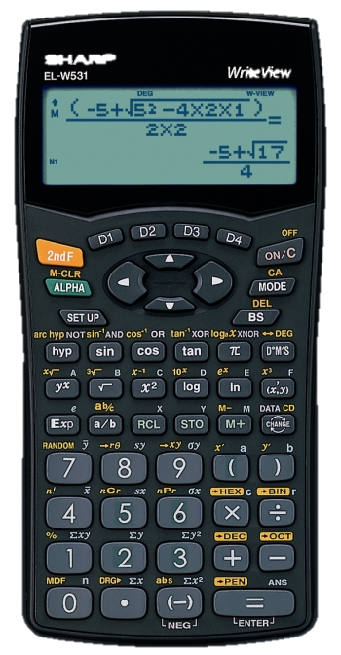
Resetting
Normal mode
Before using your calculator, check the display looks like this:
MODE
0
If it doesn’t look like this, follow these steps.

Slide 3
Resetting
Normal mode
Before using your calculator, check the display looks like this:
MODE
0
DEG
SET UP
0
0
If it doesn’t look like this, follow these steps.

Slide 4
D-pad
The directional pad allows you to navigate around and adjust any calculation you have typed in.
Up
Right
Left
Down

Slide 5
Back Space
Use the D-pad to navigate and press BS to delete any unwanted digits or operations.
The back space button allows you to edit any calculation you have typed in.

Slide 6
Change
Try entering 7 ÷ 3 into your calculator.
You calculator is programmed to display answers as fractions where possible so that no accuracy is lost. However, sometimes a decimal will be more useful to you.
Did you get this?
Press CHANGE and you should get this:
And this:
Try this: Write the answer to 7 ÷ 9 as a decimal to 2dp.
= 0.78

Slide 7
Second Function
Like pressing SHIFT on a computer keyboard, the second function button allows buttons to have an alternative use.
The first functions are written on the buttons.

Slide 8
Second Function
Like pressing SHIFT on a computer keyboard, the second function button allows buttons to have an alternative use.
The first functions are written on the buttons.
The second functions are above the buttons in yellow.

Slide 9
Second Function
Press the 2ndF button, followed by the button you require the second function of.
Like pressing SHIFT on a computer keyboard, the second function button allows buttons to have an alternative use.
The first functions and written on the buttons.
The second functions are above the buttons in yellow.
Do not hold down the 2ndF button or it will not work.

Slide 10
Circles
Let’s calculate the circumference of a circle with a diameter of 10 cm.
When calculating with circles you will encounter pi. The symbol of pi is π.
π
x
1
0
For example, the circumference (perimeter) or a circle is πd (π x diameter).
You should get:
CHANGE
Try this: Write the answer to π x 14 as a decimal to 2dp.
= 43.98

Slide 11
Indices
5²
Indices is the plural of index. It is another word for power. Examples are 5², 8³ and 2⁹. The index number tells you how many times the base number has been multiplied by itself. There are several buttons we can use for indices.
Enter this into your calculator as:
5
x²
Did you get this?
Try this: What is 72²?
= 5184

Slide 12
Indices
8³
Indices is the plural of index. It is another word for power. Examples are 5², 8³ and 2⁹. The index number tells you how many times the base number has been multiplied by itself. There are several buttons we can use for indices.
Enter this into your calculator as:
8
2ndF
(x,y)
Did you get this?
Try this: What is 11³?
= 1331

Slide 13
Indices
2⁹
Indices is the plural of index. It is another word for power. Examples are 5², 8³ and 2⁹. The index number tells you how many times the base number has been multiplied by itself. There are several buttons we can use for indices.
Enter this into your calculator as:
2
y^{x}
9
Did you get this?
Try this: What is 3⁶?
= 729

Slide 14
Roots
√16
Roots are also indices but we can use different buttons for these. Examples of roots are √16, ³√343 and ⁷√128. Roots are the opposite of positive integer powers.
Enter this into your calculator as:
√
1
6
Did you get this?
Try this: What is √361?
= 19

Slide 15
Roots
³√343
Roots are also indices but we can use different buttons for these. Examples of roots are √16, ³√343 and ⁷√128. Roots are the opposite of positive integer powers.
Enter this into your calculator as:
2ndF
√
3
4
3
Did you get this?
Try this: What is ³√216?
= 6

Slide 16
Roots
⁷√128
Roots are also indices but we can use different buttons for these. Examples of roots are √16, ³√343 and ⁷√128. Roots are the opposite of positive integer powers.
Enter this into your calculator as:
7
2ndF
y^{x}
1
2
8
Did you get this?
Try this: What is ⁵ √59049?
= 9

Slide 17
Fractions
Try putting $\frac{2}{7}$ + $\frac{1}{4}$ into your calculator. You will have to use the D-pad to navigate.
These calculators are great because the fraction button allows you to type questions in exactly as they appear on your page.
a/b
2

7
➢
+
a/b
1

4
Did you get this?
Try this: What is $\frac{8}{9}$ ÷ $\frac{2}{5}$?
= $\frac{22}{45}$

Slide 18
Fractions
Enter $1 \frac{3}{4}$ x $3 \frac{2}{9}$ into your calculator. Type:
These calculators are great because the fraction button allows you to type questions in exactly as they appear on your page.
1
2ndF
a/b
3

4
➢
x
3
2ndF
a/b
2

9
Did you get this?
= 1 $\frac{1}{2}$
Try this: What is 4 $\frac{1}{3}$ - 2 $\frac{5}{6}$?

Slide 19
Fractions
You should know enough about calculator buttons by now to enter the calculation shown on this display. Try it!
These calculators are great because the fraction button allows you to type questions in exactly as they appear on your page.

Slide 20
Trig Functions
sin 30°
There are 3 of these buttons:
Enter this into your calculator as:
‘sin’ is short for sine
sin
3
0
‘cos’ is short for cosine
Did you get this?
‘tan’ is short for tangent
They represent graphical functions and are used for angle calculations.
Try this: What is cos 60 + tan 180?
= ½

Slide 21
Inverse Trig Functions
Sin⁻¹ 0.6
Enter this into your calculator as:
Sometimes we need to use the inverse trigonometry functions.
These require the 2nd function button.
2ndF
sin
0
.
6
Did you get this?
= 25.6 (1 dp)
Try this: What is tan⁻¹ 0.478?

Slide 22
Using the ANS button
To solve this calculation:
cos θ = 4
7
To prevent losing accuracy through rounding too early, your calculator can store the previous answer in its memory.
we need to do it in two parts.
4
÷
7
Should get you:
2ndF
cos
ALPHA
=

Slide 23
Putting it all together
Now try this one:
$\frac{\sqrt[4]{678} + {2.34}^{5} × \tan{37}}{\frac{2}{3} − \sqrt{12} + {4.1}^{3}}$
Did you manage to get 0.877 (3d.p.)?
If so, well done! If not, have another go...

Slide 24
Mini Plenary
Use a green pen to complete the starter activity.
Hopefully you’ll know what all of these buttons do now ☺

Slide 25
Pair Activity
Complete the jigsaw.
Make sure the calculator display looks exactly like the question before pressing the equals button.

