Slide 1
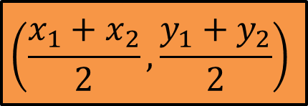
Starter
The midpoint of a line AB with coordinates A(x₁, y₁) and B(x₂, y₂) can be found using the formula:
$$\left(\frac{x_{1}+x_{2}}{2}, \frac{y_{1}+y_{2}}{2}\right)$$
Use this formula to calculate the midpoints of the following pairs of coordinates:
(2, 5) and (8, 7)
(0, 6) and (12, 2)
(7, -4) and (-3, 6)
(-5, -5) and (-11, 8)
(6a, 4b) and (2a, -4b)
(4√2, 1) and (2√2, 7)
(4, 6)
(6, 4)
(2, 1)
(-8, 1.5)
(4a, 0)
(3√2, 4)

Slide 2
Draw axes from -10 to 10, then copy and complete the table below, to sketch a graph for x² + y² = 25.
x | -5 | -4 | -3 | 0 | 3 | 4 | 5
$$y_{1}$$ |  |  |  |  | 4
$$y_{2}$$ |  |  |  |  | - 4
3² + y² = 25
9 + y² = 25
y² = 25
y = √16
y = 4 or -4

Slide 3
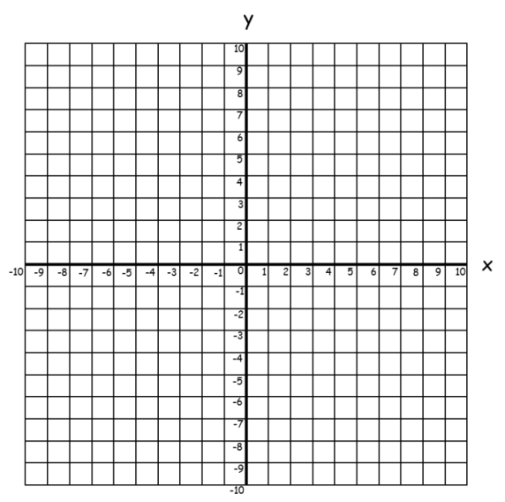
x | -5 | -4 | -3 | 0 | 3 | 4 | 5
$$y_{1}$$ | 0 | 3 | 4 | 5 | 4 | 3 | 0
$$y_{2}$$ |  | -3 | -4 | -5 | - 4 | -3
x² + y² = 25
x
What is the radius of the circle?
x
x
x
x
x
5 units
x
√25 = 5
x
x
x
x
x

Slide 4
General Equation of a Circle
x² + y² = r²
Radius r, centre (0, 0)
(x – a)² + (y – b)² = r²
Radius r, centre (a, b)
x
x
x
x
x
x
x
x
x
x
x
x
x² + y² = 25

Slide 5
Can you write an equation that will produce a circle radius 6?
Can you write an equation that will produce a circle radius 2?
Can you write another equation that will produce a circle radius 2?
Write an equation that gives a circle with centre (3, 9)?
Write an equation that gives a circle with centre (3,9) AND has a radius of 9?

Slide 6
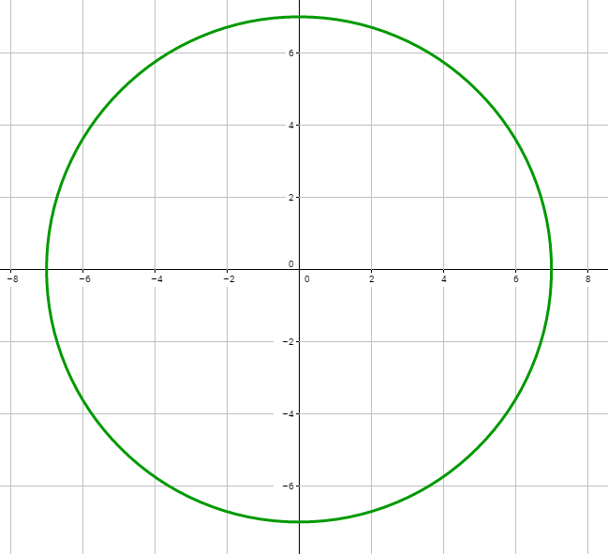
Give the equation of this circle.

Slide 7
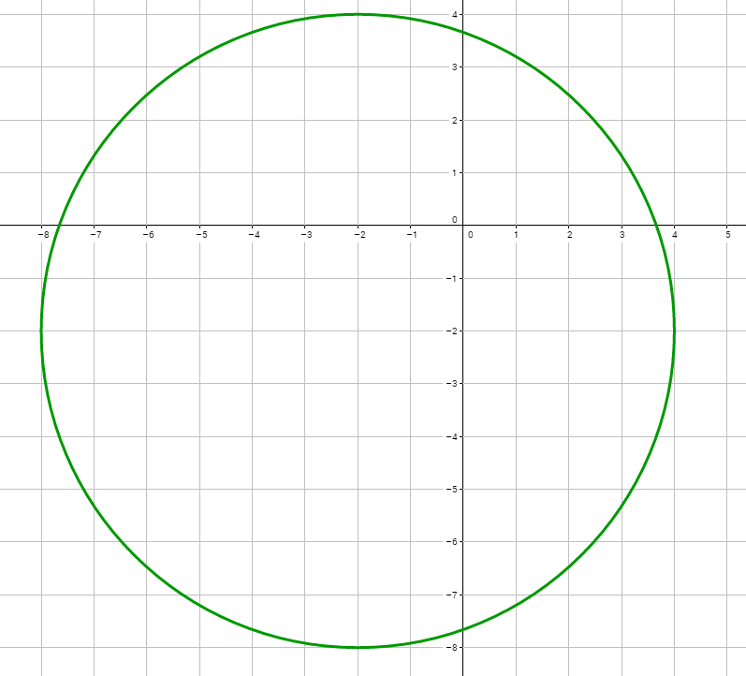
Give the equation of this circle.

Slide 8
Worksheet
 | Centre (0, 0) | Centre (3, 4) | Centre (-1, 5) | Centre (___, ___)
Radius 4
Radius 6
Radius ___ |  |  | (x + 1)² + (y – 5)² = 49
Radius 5 |  |  |  | (x + 2)² + (y + 1)² = 25
Radius ___ | x² + y² = 1
Extension: Can you sketch these circles? Make sure your axes are an appropriate size ☺

Slide 9
Answers
 | Centre (0, 0) | Centre (3, 4) | Centre (-1, 5) | Centre (___, ___)
Radius 4 | x² + y² = 16 | (x – 3)² + (y – 4)² = 16 | (x + 1)² + (y – 5)² = 16 | (x + 2)² + (y + 1)² = 16
Radius 6 | x² + y² = 36 | (x – 3)² + (y – 4)² = 36 | (x + 1)² + (y – 5)² = 36 | (x + 2)² + (y + 1)² = 36
Radius 7 | x² + y² = 49 | (x – 3)² + (y – 4)² = 49 | (x + 1)² + (y – 5)² = 49 | (x + 2)² + (y + 1)² = 49
Radius 5 | x² + y² = 25 | (x – 3)² + (y – 4)² = 25 | (x + 1)² + (y – 5)² = 25 | (x + 2)² + (y + 1)² = 25
Radius 1 | x² + y² = 1 | (x – 3)² + (y – 4)² = 1 | (x + 1)² + (y – 5)² = 1 | (x + 2)² + (y + 1)² = 1

Slide 10
Find the centre and the radius of the circle with the equation x² + y² - 14x + 16y – 12 = 0
You need to start by completing the square for x and for y
x² - 14x + y² + 16y – 12 = 0
(x – 7)² – 49 + (y + 8)² – 64 – 12 = 0
(x – 7)² + (y + 8)² = 125
Centre = (7, -8)
Radius = √125 = 5√5

Slide 11
Find the centre and the radius of the circle with the equations:
x² + y² - 2x + 8y – 8 = 0
x² + y² + 12x - 4y = 9
x² + y² - 6y = 22x - 40
x² + y² + 5x – y + 4 = 2y + 8
Centre (1, -4), radius 5
Centre (-6, 2), radius 7
Centre (11, 3), radius 3√10
Centre (-⁵/₂, ³/₂), radius ^{5√2}/₂

Slide 12
Reminder
The equation of a linear graph is given by:
y = mx + c
m is the gradient, or the slope of the graph
c is the y-intercept, or where the graph cuts the y-axis
Gradients of perpendicular graphs sum to -1.
Gradients of parallel graphs are equal.

Slide 13
Reminder
A tangent is perpendicular to a radius.

Slide 14
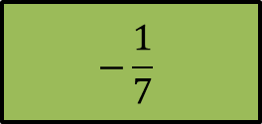
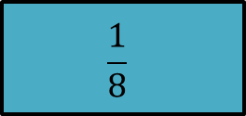
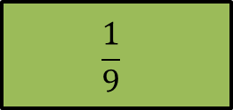
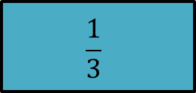
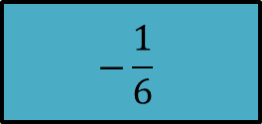
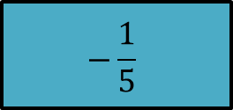
Gradient of line
Gradient of its perpendicular line
5
$$\frac{1}{3}$$
6
$$7$$
- 3
$$−9$$
- 8
$$−\frac{1}{6}$$
$$\frac{1}{9}$$
$$\frac{1}{8}$$
$$−\frac{1}{7}$$
$$−\frac{1}{5}$$

Slide 15
Example
Find the equation of the tangent to the circle at the point (3, 4).
Gradient of radius = rise
run
= ⁴/₃
Gradient of tangent
= -1 ÷ ⁴/₃
= -³/₄
y – y₁ = m(x – x₁)
y – 4 = -³/₄(x – 3)
x
y = -³/₄x + ²⁵/₄

Slide 17
Answers
y = x + 10 | y = -3x + 3 4 | y = -4x + 22 3 3 | y = -4x + 9 3
y = 4x – 40 3 3 | y = 3 | y = -9x – 145 8 8 | y = 12x + 12 5

Slide 18
Reminder
The angle in a semicircle is always a right-angle.

Slide 19
Glossary
A triangle consists of three point called vertices.
It is always possible to draw a unique circle through the three vertices of any triangle.
This circle is called the circumcircle of the triangle.
The centre of the circle is called the circumcentre of the triangle and is the point where the perpendicular bisectors of each side intersect.

Slide 20
To find the centre of a circle given any three points of the circumference:
Find the equations of the perpendicular bisectors of two different chords.
Find the coordinates of the point of intersection of the perpendicular bisectors.

Slide 21
The points A(-8, 1), B(4, 5) and C(-4, 9) lie on the circumference of a circle.
a) Show that AB is a diameter of the circle.
b) Find the equation of the circle.
If AB is a diameter, ACB will be a right-angle (AC and CB will have perpendicular gradients)
= ⁸/₄
Gradient AC =
9 – 1_
-4 - -8
= 2
= -⁴/₈
Gradient CB =
9 - 5
-4 - 4
= -¹/₂
2 x -¹/₂ = -1
Therefore ACB is a right-angle and AB is a diameter

Slide 22
The points A(-8, 1), B(4, 5) and C(-4, 9) lie on the circumference of a circle.
a) Show that AB is a diameter of the circle.
b) Find the equation of the circle.
For equation of a circle, we need length of radius and centre point
Length of radius = length of diameter ÷ 2
= $\frac{\sqrt{{(4 −−8)}^{2}+{(5−1)}^{2}}}{2}$
= $\frac{\sqrt{144+16}}{2}$
= $2\sqrt{10}$
Centre of circle = midpoint of diameter
= $\left(\frac{−8+4}{2}, \frac{1+5}{2}\right)$
= $\left(−2, 3\right)$
Equation of circle =
$${(x+2)}^{2} +{ (y −3)}^{2}= {\left(2\sqrt{10}\right)}^{2}$$
= ${(x+2)}^{2} + {(y −3)}^{2}=40$

Slide 23
We can use the intersection of perpendicular bisectors to find the centre
The points P(3, 16), Q(11, 12) and R(-7, 6) lie on the circumference of a circle. Work out the equation of the circle.
For equation of a circle, we need length of radius and centre point
Gradient PQ =
12 – 16
11 - 3
= -¹/₂
Midpoint PQ =
= $\left(\frac{3+11}{2}, \frac{16+12}{2}\right)$
= $\left(7, 14\right)$
y – 14 = 2(x – 7)
y = 2x
Gradient QR =
6 – 12
-7 - 11
= ¹/₃
The length of the radius will be the distance from the centre to any vertex of the triangle
Midpoint PQ =
= $\left(\frac{11−7}{2}, \frac{12+6}{2}\right)$
= $\left(2, 9\right)$
y – 9 = -3(x – 2)
y = -3x + 15

Slide 24
We can use the intersection of perpendicular bisectors to find the centre
The points P(3, 16), Q(11, 12) and R(-7, 6) lie on the circumference of a circle. Work out the equation of the circle.
For equation of a circle, we need length of radius and centre point
Perpendicular bisector of PQ → y = 2x
Perpendicular bisector of QR → y = -3x + 15
2x = -3x + 15
5x = 15
x = 3
Centre (3, 6)
y = 6
Radius =
$\sqrt{{(3−3)}^{2}+{(16−6)}^{2}}$
= 10
The length of the radius will be the distance from the centre to any vertex of the triangle
Equation of circle =
$${(x−3)}^{2} +{ (y −6)}^{2 }=100$$

Slide 26
Answers
1. a) UV and UW are perpendicular
b) (x – 2)² + (y – 3)² = 41
2. (x – 3)² + (y + 4)² = 50
3. a) AB and BC are perpendicular
b) (x + 2)² + (y – 5)² = 125
c) D(8, 0) satisfies the equation of the circle
4. a) Centre (-1, 12), radius = √169 = 13
b) Midpoint is centre of circle OR length is twice radius
c) C(-6, 0)

