Slide 1
Starter
What’s the same and what’s different?
$$\frac{1}{2}$$ | $$\frac{4}{8}$$
$$\frac{10}{20}$$ | $$\frac{2}{3}$$

Slide 2
Multiplying Fractions
$\frac{1}{2}×\frac{3}{4}$ means “one half of three quarters”.
Here is $\frac{3}{4}$ of a rectangle:
Let’s halve the blue part…
So $\frac{1}{2}×\frac{3}{4}=\frac{3}{8}$

Slide 3
Multiplying Fractions
Example
Work out $\frac{1}{2}×\frac{3}{4}$
$=\frac{1×3}{2×4}$
$=\frac{3}{8}$
Multiply the numerators and multiply the denominators together
Simplify if possible!

Slide 4

Multiplying Fractions
Example
Work out $\frac{3}{5}×\frac{4}{9}$
$=\frac{3×4}{5×9}$
$=\frac{12}{45}$
$=\frac{4}{15}$
Multiply the numerators and multiply the denominators together
Simplify if possible!

Slide 5

Multiplying Fractions
Example
Work out $\frac{30}{49}×\frac{21}{24}$
$=\frac{30×21}{49×24}$
$=\frac{5×3}{7×4}$
$=\frac{15}{28}$
For questions involving bigger numbers, it’s easier to simplify before multiplying
$$5$$
$$3$$
$$7$$
$$4$$

Slide 6
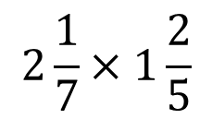
Multiplying Fractions
1) $\frac{1}{5}×\frac{2}{5}$ 2) $\frac{1}{2}×\frac{3}{7}$ 3) $\frac{1}{4}×\frac{3}{5}$
4) $\frac{1}{5}×\frac{2}{9}$ 5) $\frac{1}{6}×\frac{5}{8}$ 6) $\frac{1}{7}×\frac{2}{5}$
1) $\frac{2}{3}×\frac{4}{5}$ 2) $\frac{2}{5}×\frac{2}{3}$ 3) $\frac{4}{7}×\frac{3}{5}$
4) $\frac{3}{4}×\frac{7}{8}$ 5) $\frac{6}{11}×\frac{4}{7}$ 6) $\frac{5}{9}×\frac{2}{7}$
1) $\frac{2}{3}×\frac{6}{7}$ 2) $\frac{3}{4}×\frac{8}{11}$ 3) $\frac{15}{17}×\frac{4}{5}$
4) $\frac{1}{2}×\frac{14}{15}$ 5) $\frac{11}{21}×\frac{3}{4}$ 6) $\frac{2}{5}×\frac{20}{21}$
Extension
$$2\frac{1}{7}×1\frac{2}{5}$$

Slide 7
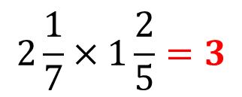
Answers
1) $\frac{1}{5}×\frac{2}{5}=\frac{2}{25}$ 2) $\frac{1}{2}×\frac{3}{7}$ $=\frac{3}{14}$ 3) $\frac{1}{4}×\frac{3}{5}$ $=\frac{3}{20}$
4) $\frac{1}{5}×\frac{2}{9}$ $=\frac{2}{45}$ 5) $\frac{1}{6}×\frac{5}{8}$ $=\frac{5}{48}$ 6) $\frac{1}{7}×\frac{2}{5}$ $=\frac{2}{35}$
1) $\frac{2}{3}×\frac{4}{5}$ $=\frac{8}{15}$ 2) $\frac{2}{5}×\frac{2}{3}$ $=\frac{4}{15}$ 3) $\frac{4}{7}×\frac{3}{5}=\frac{12}{35}$
4) $\frac{3}{4}×\frac{7}{8}$ $=\frac{21}{32}$ 5) $\frac{6}{11}×\frac{4}{7}$ $=\frac{24}{77}$ 6) $\frac{5}{9}×\frac{2}{7}$ $=\frac{10}{63}$
1) $\frac{2}{3}×\frac{6}{7}$ $=\frac{12}{21}$ 2) $\frac{3}{4}×\frac{8}{11}$ $=\frac{6}{11}$ 3) $\frac{15}{17}×\frac{4}{5}$ $=\frac{12}{17}$
4) $\frac{1}{2}×\frac{14}{15}$ $=\frac{7}{15}$ 5) $\frac{11}{21}×\frac{3}{4}$ $=\frac{11}{28}$ 6) $\frac{2}{5}×\frac{20}{21}$ $=\frac{8}{21}$
Extension
$$2\frac{1}{7}×1\frac{2}{5}=3$$

Slide 8

Example: $\frac{2}{3}×\frac{3}{2}=1$
Task – Find the reciprocals of the following numbers:
1. $\frac{1}{2}$ 2. $\frac{1}{3}$ 3. $6$
4. $\frac{3}{4}$ 5. $5$ 6. $1$
$$→2$$
$$→3$$
$→\frac{1}{6}$
$→\frac{4}{3}$
$→\frac{1}{5}$
$$→1$$

Slide 9
Dividing Fractions
$\frac{1}{2}÷\frac{1}{8}$ means “how many eighths are there in one half?”
Here is $\frac{1}{2}$ of a rectangle:
Let’s split the rectangle into eighths…
So $\frac{1}{2}÷\frac{1}{8}=4$

Slide 10
Dividing Fractions
Example
Work out $\frac{1}{2}÷\frac{1}{8}$
$=\frac{1}{2}×\frac{8}{1}$
$=\frac{4}{1}$
$=4$
Multiply by the reciprocal of the divisor
$$4$$
$$1$$

Slide 11
Dividing Fractions
Example
Work out $\frac{2}{3}÷\frac{1}{4}$
$=\frac{2}{3}×\frac{4}{1}$
$=\frac{8}{3}$
Multiply by the reciprocal of the divisor

Slide 12
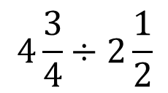
Dividing Fractions
1) $\frac{2}{3}÷\frac{5}{7}$ 2) $\frac{3}{4}÷\frac{2}{5}$ 3) $\frac{4}{5}÷\frac{1}{3}$
4) $\frac{4}{7}÷\frac{3}{4}$ 5) $\frac{5}{6}÷\frac{2}{5}$ 6) $\frac{3}{4}÷\frac{2}{9}$
1) $\frac{2}{3}÷\frac{5}{9}$ 2) $\frac{4}{7}÷\frac{8}{11}$ 3) $\frac{3}{4}÷\frac{6}{7}$
4) $\frac{6}{7}÷\frac{9}{10}$ 5) $\frac{3}{10}÷\frac{4}{25}$ 6) $\frac{7}{12}÷\frac{13}{20}$
1) $\frac{4}{5}÷\frac{8}{15}$ 2) $\frac{3}{4}÷\frac{9}{20}$ 3) $\frac{8}{9}÷\frac{2}{3}$
4) $\frac{35}{48}÷\frac{7}{8}$ 5) $\frac{8}{15}÷\frac{12}{25}$ 6) $\frac{9}{10}÷\frac{39}{40}$
Extension
$$4\frac{3}{4}÷2\frac{1}{2}$$

Slide 13
Answers
1) $\frac{2}{3}÷\frac{5}{7}$ $=\frac{14}{15}$ 2) $\frac{3}{4}÷\frac{2}{5}$ $=\frac{15}{8}$ 3) $\frac{4}{5}÷\frac{1}{3}$ $=\frac{12}{5}$
4) $\frac{4}{7}÷\frac{3}{4}$ $=\frac{16}{21}$ 5) $\frac{5}{6}÷\frac{2}{5}$ $=\frac{25}{12}$ 6) $\frac{3}{4}÷\frac{2}{9}$ $=\frac{27}{8}$
1) $\frac{2}{3}÷\frac{5}{9}$ $=\frac{6}{5}$ 2) $\frac{4}{7}÷\frac{8}{11}$ $=\frac{11}{14}$ 3) $\frac{3}{4}÷\frac{6}{7}$ $=\frac{7}{8}$
4) $\frac{6}{7}÷\frac{9}{10}$ $=\frac{20}{21}$ 5) $\frac{3}{10}÷\frac{4}{25}$ $=\frac{15}{8}$ 6) $\frac{7}{12}÷\frac{13}{20}$ $=\frac{35}{39}$
1) $\frac{4}{5}÷\frac{8}{15}$ $=\frac{3}{2}$ 2) $\frac{3}{4}÷\frac{9}{20}$ $=\frac{5}{3}$ 3) $\frac{8}{9}÷\frac{2}{3}$ $=\frac{4}{3}$
4) $\frac{35}{48}÷\frac{7}{8}$ $=\frac{5}{6}$ 5) $\frac{8}{15}÷\frac{12}{25}$ $=\frac{10}{9}$ 6) $\frac{9}{10}÷\frac{39}{40}$ $=\frac{12}{13}$
Extension
$$4\frac{3}{4}÷2\frac{1}{2}=1\frac{9}{10}$$

Slide 14
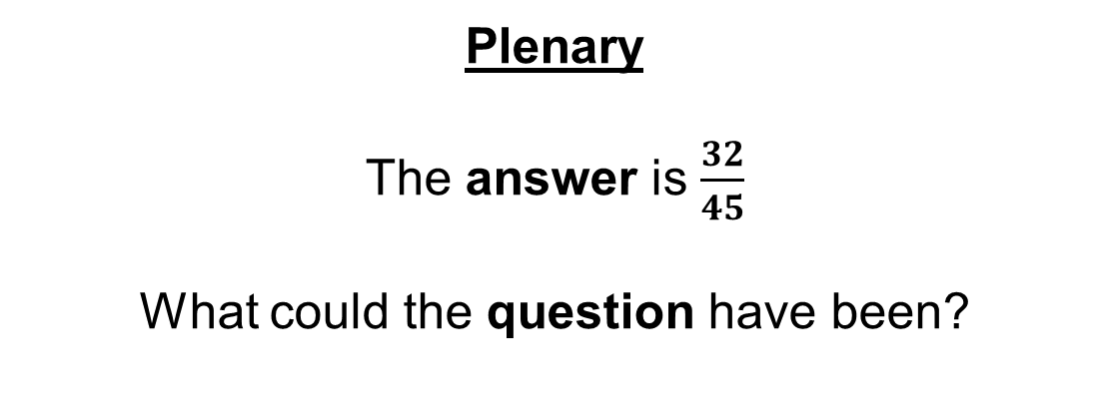
Plenary
The answer is $\frac{32}{45}$
What could the question have been?

