Slide 1
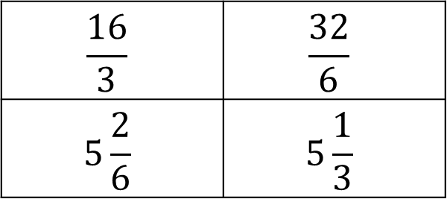
Starter
What’s the same and what’s different?
$$\frac{16}{3}$$ | $$\frac{32}{6}$$
$$5\frac{2}{6}$$ | $$5\frac{1}{3}$$

Slide 2
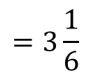
Example
Convert $\frac{19}{6}$ to a mixed number.
$19÷6$
Remember this means $19÷6$
$=3$ remainder $1$
$$=3\frac{1}{6}$$
The denominator stays the same

Slide 3

Checkpoint
Convert these improper fractions to mixed numbers:
1) $\frac{27}{4}$ 2) $\frac{13}{2}$ 3) $\frac{16}{3}$
4) $\frac{10}{7}$ 5) $\frac{18}{5}$ 6) $\frac{21}{4}$

Slide 4

Answers
1) $\frac{27}{4}=6\frac{3}{4}$ 2) $\frac{13}{2}=6\frac{1}{2}$ 3) $\frac{16}{3}=5\frac{1}{3}$
4) $\frac{10}{7}$ $=1\frac{3}{7}$ 5) $\frac{18}{5}=3\frac{3}{5}$ 6) $\frac{21}{4}$ $=5\frac{1}{4}$

Slide 5
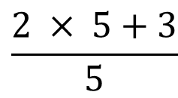
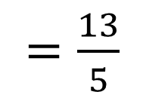
Example
Convert $2\frac{3}{5}$ to an improper fraction.
How many 5ths are in one whole?
$$\frac{2 × 5+3}{5}$$
$=\frac{13}{5}$
The denominator stays the same

Slide 6

Checkpoint
Convert these mixed numbers to improper fractions:
1) $1\frac{2}{7}$ 2) $3\frac{2}{9}$ 3) $2\frac{5}{8}$
4) $3\frac{5}{6}$ 5) $5\frac{7}{12}$ 6) $4\frac{8}{9}$

Slide 7

Answers
1) $1\frac{2}{7}$ $=\frac{9}{7}$ 2) $3\frac{2}{9}$ $=\frac{29}{9}$ 3) $2\frac{5}{8}$ $=\frac{23}{8}$
4) $3\frac{5}{6}$ $=\frac{23}{6}$ 5) $5\frac{7}{12}$ $=\frac{67}{12}$ 6) $4\frac{8}{9}$ $=\frac{44}{9}$

Slide 8
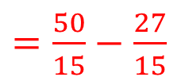
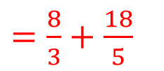
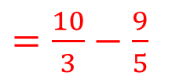
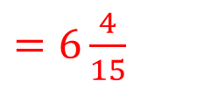

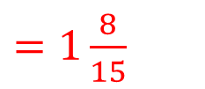
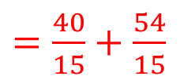

Examples
$2\frac{2}{3}+3\frac{3}{5}$ $3\frac{1}{3}−1\frac{4}{5}$
$=\frac{8}{3}+\frac{18}{5}$
$=\frac{10}{3}−\frac{9}{5}$
$=\frac{40}{15}+\frac{54}{15}$
$=\frac{50}{15}−\frac{27}{15}$
$=\frac{94}{15}$
$=\frac{23}{15}$
$=6\frac{4}{15}$
$=1\frac{8}{15}$

Slide 9
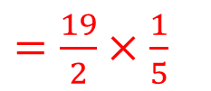
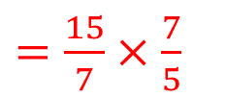
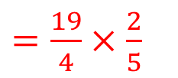
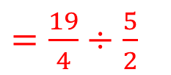
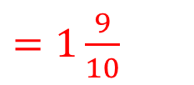
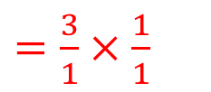

Examples
$2\frac{1}{7}×1\frac{2}{5}$ $4\frac{3}{4}÷2\frac{1}{2}$
$=\frac{15}{7}×\frac{7}{5}$
$=\frac{19}{4}÷\frac{5}{2}$
$=\frac{3}{1}×\frac{1}{1}$
$=\frac{19}{4}×\frac{2}{5}$
$=3$
$=\frac{19}{2}×\frac{1}{5}$
$=\frac{19}{10}$
$=1\frac{9}{10}$

Slide 10
Extension: Work in pairs to complete the Tarsia jigsaw.

Slide 11
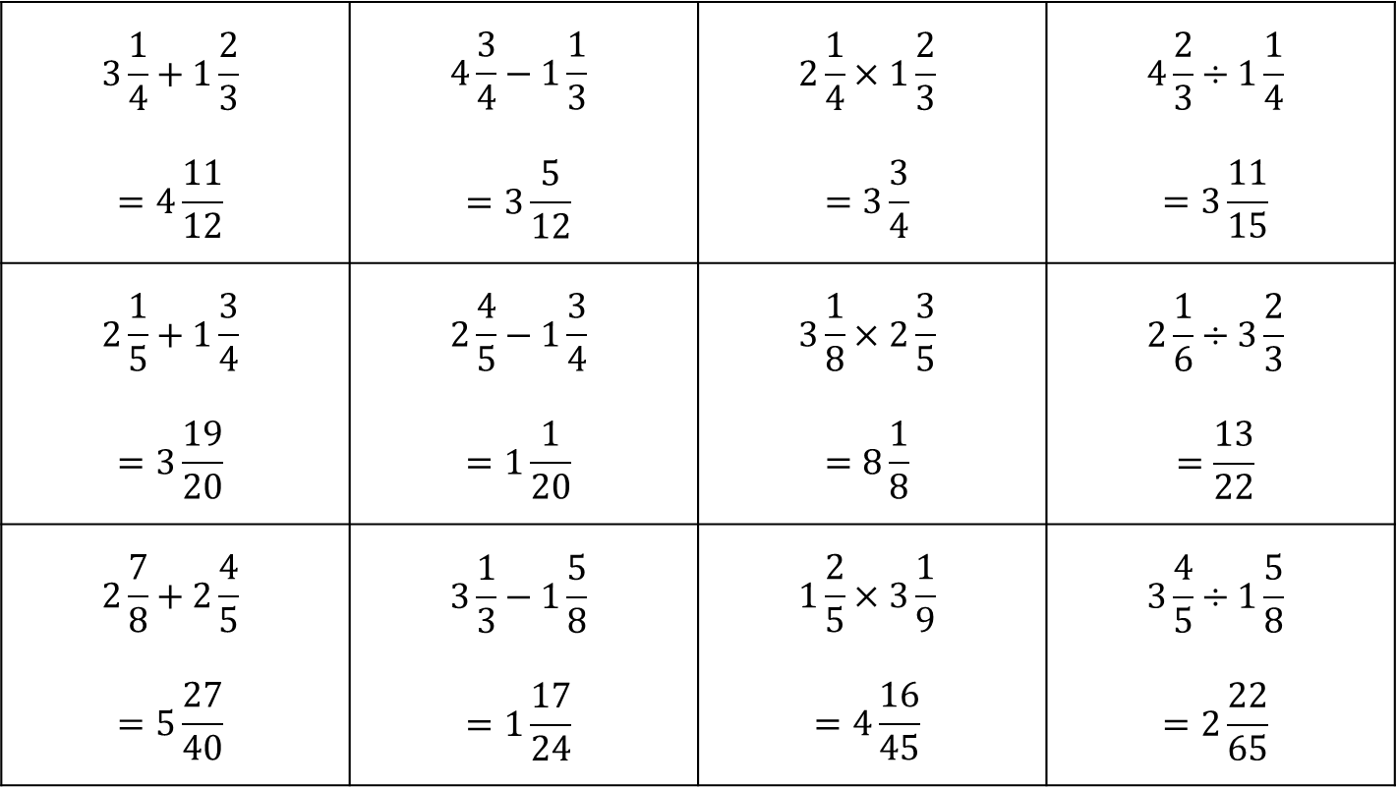
Answers
$$3\frac{1}{4}+1\frac{2}{3}$$ $$=4\frac{11}{12}$$ | $$4\frac{3}{4}−1\frac{1}{3}$$ $$=3\frac{5}{12}$$ | $$2\frac{1}{4}×1\frac{2}{3}$$ $$=3\frac{3}{4}$$ | $$4\frac{2}{3}÷1\frac{1}{4}$$ $$=3\frac{11}{15}$$
$$2\frac{1}{5}+1\frac{3}{4}$$ $$=3\frac{19}{20}$$ | $$2\frac{4}{5}−1\frac{3}{4}$$ $$=1\frac{1}{20}$$ | $$3\frac{1}{8}×2\frac{3}{5}$$ $$=8\frac{1}{8}$$ | $$2\frac{1}{6}÷3\frac{2}{3}$$ $$=\frac{13}{22}$$
$$2\frac{7}{8}+2\frac{4}{5}$$ $$=5\frac{27}{40}$$ | $$3\frac{1}{3}−1\frac{5}{8}$$ $$=1\frac{17}{24}$$ | $$1\frac{2}{5}×3\frac{1}{9}$$ $$=4\frac{16}{45}$$ | $$3\frac{4}{5}÷1\frac{5}{8}$$ $$=2\frac{22}{65}$$

