Slide 1
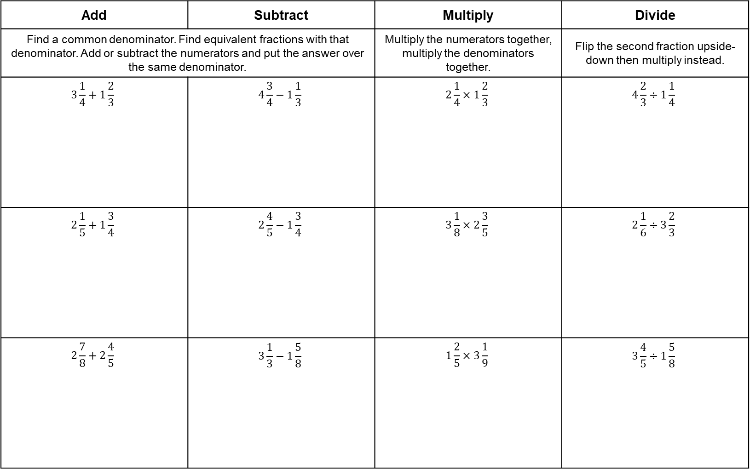
Mixed Numbers Calculations RED
Don’t forget to change the mixed numbers to improper fractions first then simplify your answers at the end!
Add | Subtract | Multiply | Divide
Find a common denominator. Find equivalent fractions with that denominator. Add or subtract the numerators and put the answer over the same denominator. |  | Multiply the numerators together, multiply the denominators together. | Flip the second fraction upside-down then multiply instead.
$$3\frac{1}{4}+1\frac{2}{3}$$ | $$4\frac{3}{4}−1\frac{1}{3}$$ | $$2\frac{1}{4}×1\frac{2}{3}$$ | $$4\frac{2}{3}÷1\frac{1}{4}$$
$$2\frac{1}{5}+1\frac{3}{4}$$ | $$2\frac{4}{5}−1\frac{3}{4}$$ | $$3\frac{1}{8}×2\frac{3}{5}$$ | $$2\frac{1}{6}÷3\frac{2}{3}$$
$$2\frac{7}{8}+2\frac{4}{5}$$ | $$3\frac{1}{3}−1\frac{5}{8}$$ | $$1\frac{2}{5}×3\frac{1}{9}$$ | $$3\frac{4}{5}÷1\frac{5}{8}$$

Slide 2
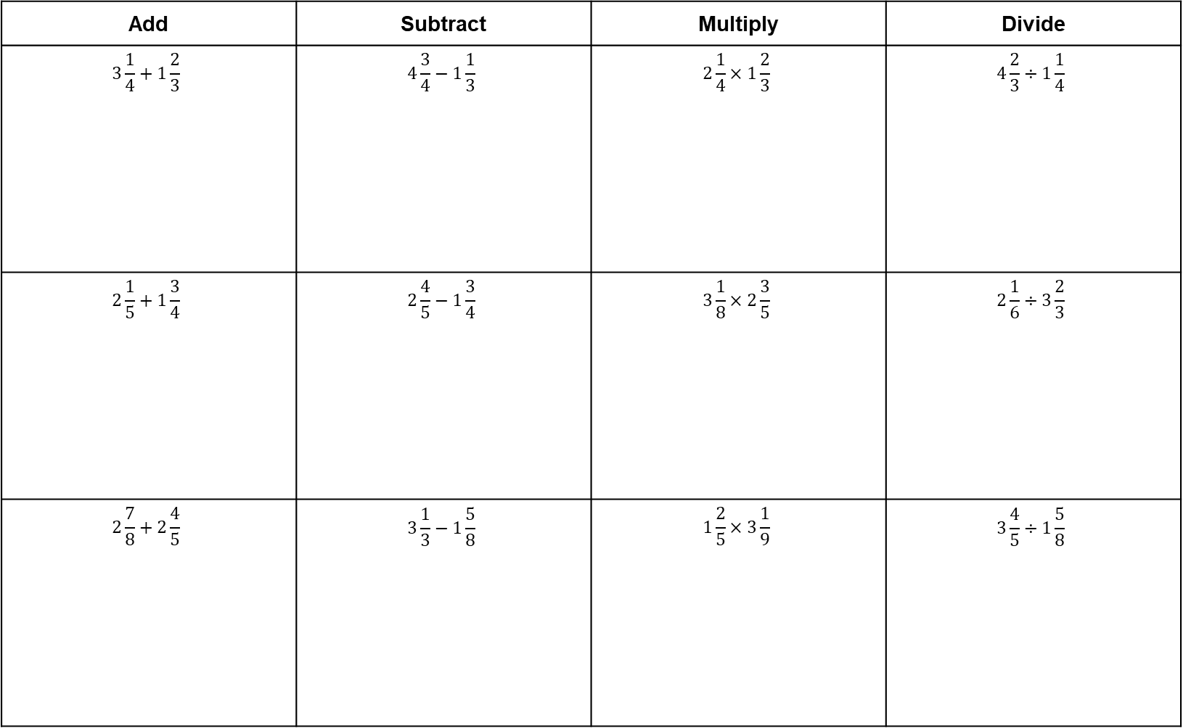
Mixed Numbers Calculations AMBER
Don’t forget to change the mixed numbers to improper fractions first then simplify your answers at the end!
Add | Subtract | Multiply | Divide
$$3\frac{1}{4}+1\frac{2}{3}$$ | $$4\frac{3}{4}−1\frac{1}{3}$$ | $$2\frac{1}{4}×1\frac{2}{3}$$ | $$4\frac{2}{3}÷1\frac{1}{4}$$
$$2\frac{1}{5}+1\frac{3}{4}$$ | $$2\frac{4}{5}−1\frac{3}{4}$$ | $$3\frac{1}{8}×2\frac{3}{5}$$ | $$2\frac{1}{6}÷3\frac{2}{3}$$
$$2\frac{7}{8}+2\frac{4}{5}$$ | $$3\frac{1}{3}−1\frac{5}{8}$$ | $$1\frac{2}{5}×3\frac{1}{9}$$ | $$3\frac{4}{5}÷1\frac{5}{8}$$

Slide 3
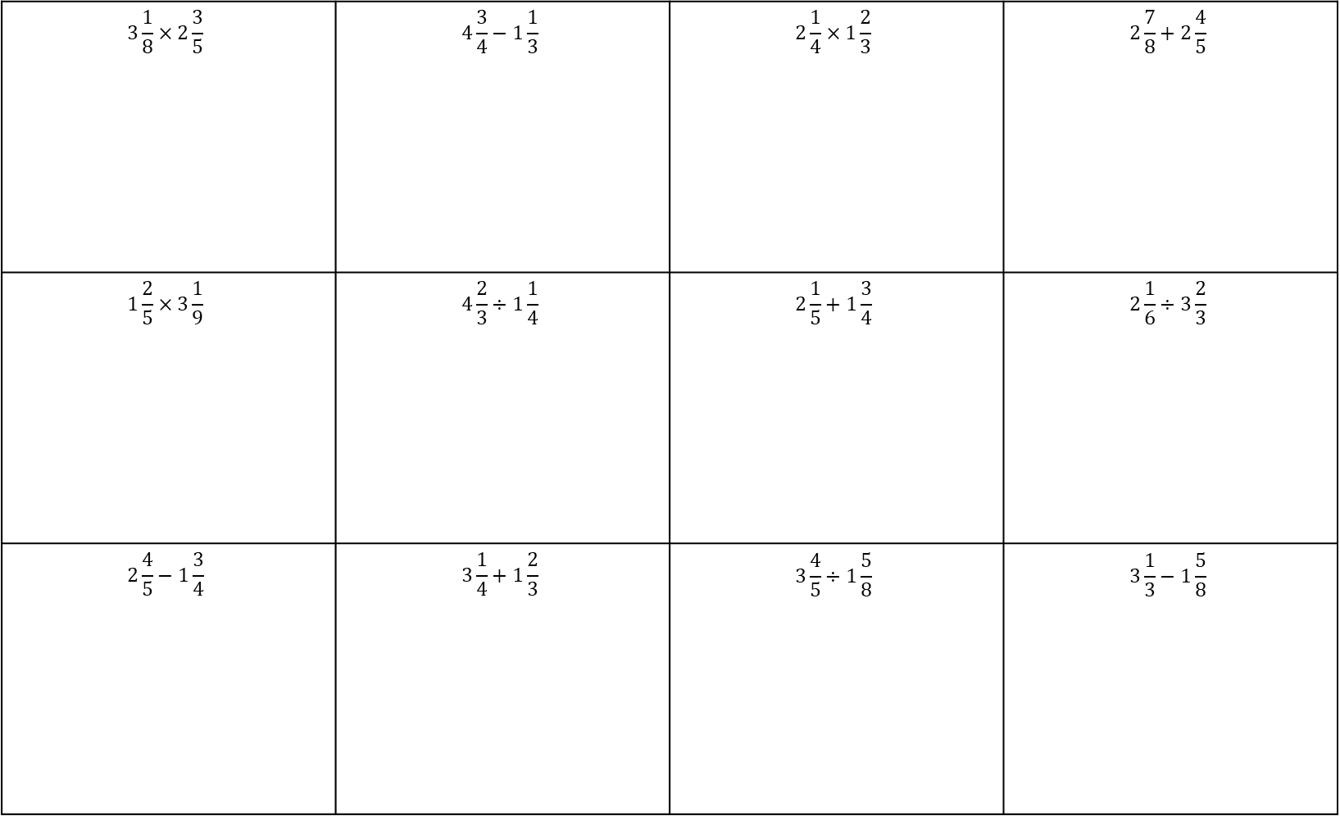
Mixed Numbers Calculations GREEN
Don’t forget to change the mixed numbers to improper fractions first then simplify your answers at the end!
$$3\frac{1}{8}×2\frac{3}{5}$$ | $$4\frac{3}{4}−1\frac{1}{3}$$ | $$2\frac{1}{4}×1\frac{2}{3}$$ | $$2\frac{7}{8}+2\frac{4}{5}$$
$$1\frac{2}{5}×3\frac{1}{9}$$ | $$4\frac{2}{3}÷1\frac{1}{4}$$ | $$2\frac{1}{5}+1\frac{3}{4}$$ | $$2\frac{1}{6}÷3\frac{2}{3}$$
$$2\frac{4}{5}−1\frac{3}{4}$$ | $$3\frac{1}{4}+1\frac{2}{3}$$ | $$3\frac{4}{5}÷1\frac{5}{8}$$ | $$3\frac{1}{3}−1\frac{5}{8}$$

