Slide 1
Instructions
Five rounds of five questions
Combination of maths and Christmas (Christmaths?)
Oh go on then, seeing as it’s Christmas, you can use a calculator.
Think of a (sensible) team name and write it at the top of your answer sheet
Write your answers clearly in the correct places
Have fun!

Slide 2
Round 1
(Fairly easy)

Slide 3
R1 Q1
Simplify:
$$\frac{{3x}^{3} ×4x^{5}}{{2x}^{6}}$$

Slide 4
R1 Q2
Round $0.007482$ to two significant figures

Slide 5
R1 Q3
Calculate the length of the missing side:
10 cm
6 cm
?

Slide 6
R1 Q4
A set of five numbers has:
a median of 10
a mode of 7
a range of 7
a mean of 10
What are the five numbers?

Slide 7
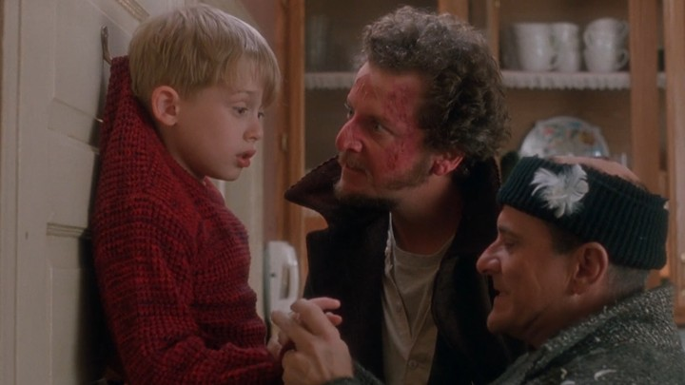
R1 Q5
Name the movie:

Slide 8
Round 1 Answers
Swap your answer sheet with a neighbouring team!
Q1: $6x^{2}$
Q2: $0.0075$
Q3: 8 cm
Q4: 7, 7, 10, 12, 14
Q5: Home Alone
Swap back to see how you did ☺

Slide 9
Round 2
(Not too bad)

Slide 10
R2 Q1
Miriam bought a coat in the sale. The coat had been reduced by 25%. Miriam paid £30 for the coat.
What was the pre-sale price of the coat?

Slide 11
R2 Q2
The table shows the heights of Amy’s friends.
Calculate an estimate for the mean height.
Height ($h$ cm) | Frequency
$$90≤h<110$$ | $$4$$
$$110≤h<130$$ | $$9$$
$$130≤h<150$$ | $$8$$
$$150≤h<170$$ | $$2$$

Slide 12
R2 Q3
Use the quadratic formula to solve
$$3x^{2}+4x−15=0$$

Slide 13
R2 Q4
Calculate the area of the sector:
$$6 cm$$
$$74°$$

Slide 14
R2 Q5
Name the song featuring the lyrics:
“When you first took my hand
On a cold Christmas Eve
You promised me
Broadway was waiting for me”

Slide 15
Round 2 Answers
Swap your answer sheet with a neighbouring team!
Q1: £40
Q2: 127 cm
Q3: $\frac{5}{3}$ and $−3$
Q4: 23.2 cm²
Q5: Fairytale of New York
Swap back to see how you did ☺

Slide 16
Round 3
(A little tricky)

Slide 17
R3 Q1
Alex wants to find out how many ducks there are in a park.
One day he puts a tag on each of 30 of the ducks.
The next day he catches 40 ducks.
8 of these ducks have tags on them.
Work out an estimate for the number of ducks in the park.

Slide 18
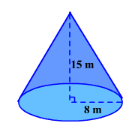
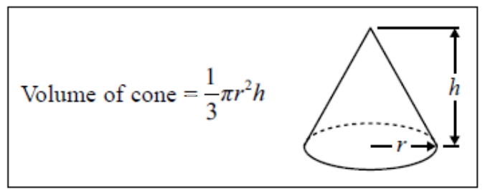
R3 Q2
Calculate the volume of the cone.

Slide 19
R3 Q3
Simplify fully
$$\frac{{2x}^{2}−5x−12}{x^{2}−16}$$

Slide 20
R3 Q4
$$ε=\left\{1,2,3,4,5,6,7,8,9,10\right\}$$
$$A=\left\{odd numbers\right\}$$
$$B=\left\{prime numbers\right\}$$
Calculate the probability of $A∩B$
Hint: draw a Venn diagram…

Slide 21
R3 Q5
Who voiced the Grinch in the 2000 movie The Grinch Who Stole Christmas?

Slide 22
Round 3 Answers
Swap your answer sheet with a neighbouring team!
Q1: 150
Q2: 1005.3 m³
Q3: $\frac{2x+3}{x+4}$
Q4: $\frac{3}{10}$ or 0.3
Q5: Jim Carey
Swap back to see how you did ☺

Slide 23
Round 4
(Pretty tough)

Slide 24
R4 Q1
$G$ is directly proportional to the cube of $H$ and when $G=54$, $H=3$.
Find $G$ when $H=2$.

Slide 25
R4 Q2
Calculate the value of $θ$.
$$58°$$
$$θ°$$

Slide 26
R4 Q3
Jack’s room is $2.2 m$ wide to the nearest $10 cm$, and $3.4 m$ long to the nearest $10 cm$.
What is the lower bound for the floor area of Jack’s room?

Slide 27
R4 Q4
There are 8 sweets in a bag.
Three sweets are red, three sweets are blue and two sweets are green.
Two sweets are selected at random without replacement.
Calculate the probability that the sweets are not the same colour.

Slide 28
R4 Q5
Can you name all eight reindeer?

Slide 29
Round 4 Answers
Swap your answer sheet with a neighbouring team!
Q1: 16
Q2: $116°$
Q3: 7.2025 m²
Q4: $\frac{42}{56}$ or $\frac{3}{4}$
Q5: Dasher, Dancer, Prancer, Vixen, Comet, Cupid, Donner and Blitzen
Swap back to see how you did ☺

Slide 30
Round 5
(Hard as nails)

Slide 31
R5 Q1
Rationalise the denominator
$$\frac{3+\sqrt{2}}{\sqrt{2}−1}$$

Slide 32
R5 Q2
Calculate the n^{th} term of this quadratic sequence:
5 9 17 29 45

Slide 33
R5 Q3
Calculate the area of the triangle:
$$8 cm$$
$$82°$$
Hint: start by using the sine rule
$$15 cm$$

Slide 34
R5 Q4
Solve the simultaneous equations
$$x^{2}+y^{2}=20$$
$$x+y=6$$

Slide 35
R5 Q5
In the film ‘It’s a Wonderful Life!’, what does Clarence the angel get at the end?

Slide 36
Round 5 Answers
Swap your answer sheet with a neighbouring team!
Q1: $4\sqrt{2}+5$
Q2: $2n^{2}−2n+5$
Q3: 54.9 cm²
Q4: $(4,2)$ and $(2,4)$
Q5: His wings
Swap back to see how you did ☺

