Slide 1


Starter
Solve:
a) $4x=−16$
b) $x+5=−6$
c) $2x−3=11$
d) $8−6x=26$
Substitute $x=−1$ and $y=5$
e) $3x+2y$
f) $4y–6x$
$x=−4$
$x=−11$
$x=7$
$x=−3$
$−3+10=7$
$20+6=26$

Slide 2
How much do the burgers cost?
How much do the chips cost?
+
+
= £5
+
= £4
What method did you use?

Slide 3
How much do the burgers cost?
How much do the chips cost?
+
+
+
= £5.50
+
= £2.50
What method did you use?

Slide 4
How much do the burgers cost?
How much do the chips cost?
+
+
= £7
+
= £5
What method did you use?

Slide 5
How to Solve Linear Simultaneous Equations by Elimination
Scale up each term in one or both equations to make the coefficients the same for either the $x$ terms or the $y$ terms.
Identify the common coefficients.
Subtract if the signs in front of these are the same.
Add if the signs in front of these are the different.

Slide 6
No need to scale up in this case
$5x+y=20$
$2x+y=11$
-
Add or subtract (to eliminate)
$$3x$$
$$=9$$
Solve the equation to find the value of the first unknown
$$x$$
$$=3$$
$5x+y=20$
Substitute and solve to find the value of the second unknown
$15+y=20$
$$y=5$$

Slide 7
No need to scale up in this case
$7x+2y=32$
$3x−2y=8$
$$+$$
Add or subtract (to eliminate)
$$10x$$
$$=40$$
Solve the equation to find the value of the first unknown
$$x$$
$$=4$$
$7x+2y=32$
Substitute and solve to find the value of the second unknown
$28+2y=32$
$$2y=4$$
$$y=2$$

Slide 8
How much do the burgers cost?
How much do the chips cost?
+
+
+
+
= £9
+
= £3.50
What method did you use?

Slide 9
$$×1$$
Scale up to create common coefficients
$12x−2y= 8$
$5x + y=18$
$$×2$$
Add or subtract (to eliminate)
$12x−2y= 8$
$10x+2y=36$
$$+$$
Solve the equation to find the value of the first unknown
$$22x$$
$$=44$$
$$x$$
$$=2$$
Substitute and solve to find the value of the second unknown
$12x−2y=8$
$24−2y=8$
$$−2y=−16$$
$$y=8$$

Slide 10
$$×2$$
Scale up to create common coefficients
$7x−3y=29$
$2x+5y=20$
$$×7$$
Add or subtract (to eliminate)
$14x− 6y= 58$
$14x+35y=140$
$$−$$
Solve the equation to find the value of the first unknown
$$−41y$$
$$=−82$$
$$y$$
$$=2$$
Substitute and solve to find the value of the second unknown
$7x−3y=29$
$7x−6=29$
$$7x=35$$
$$x=5$$

Slide 12
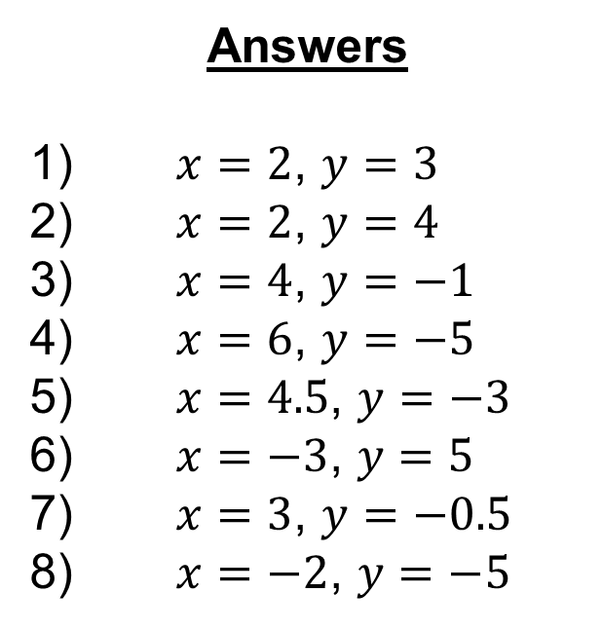
Answers
1) $x=2$, $y=3$
2) $x=2$, $y=4$
3) $x=4$, $y=−1$
4) $x=6$, $y=−5$
5) $x=4.5$, $y=−3$
6) $x=−3$, $y=5$
7) $x=3$, $y=−0.5$
8) $x=−2$, $y=−5$

Slide 13
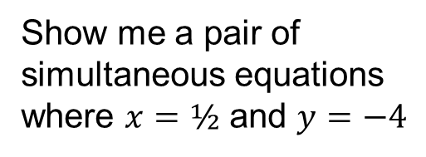
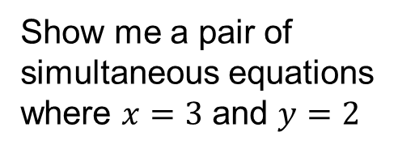
Show me a pair of simultaneous equations where $x=3$ and $y=2$
Show me a pair of simultaneous equations where $x=½$ and $y=−4$

Slide 14
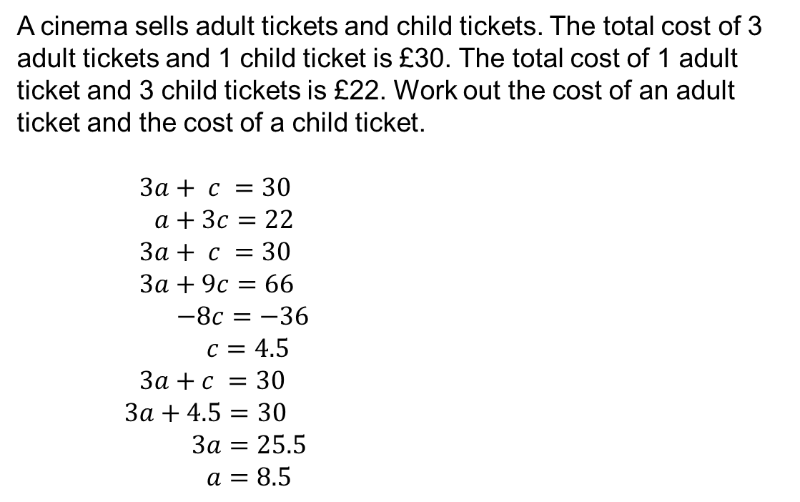

A cinema sells adult tickets and child tickets. The total cost of 3 adult tickets and 1 child ticket is £30. The total cost of 1 adult ticket and 3 child tickets is £22. Work out the cost of an adult ticket and the cost of a child ticket.
$3a+ c =30$
$a+3c=22$
$3a+ c =30$
$3a+9c=66$
$−8c=−36$
$c=4.5$
$3a+c =30$
$3a+4.5=30$
$3a=25.5$
$a=8.5$
It doesn’t matter which letters you use; $x$ and $y$ would give you the same result
$$×1$$
$$×3$$
An adult ticket costs £8.50
A child ticket costs £4.50

Slide 15
Task
Solve the worded simultaneous equations.
For each of the questions:
Set up a pair of simultaneous equations;
Solve the simultaneous equations algebraically; and
Make sure you’ve completely answered the question before moving on!
Show your working fully in your book.

Slide 16
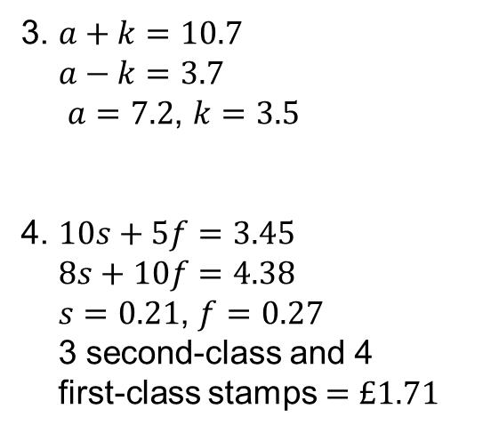
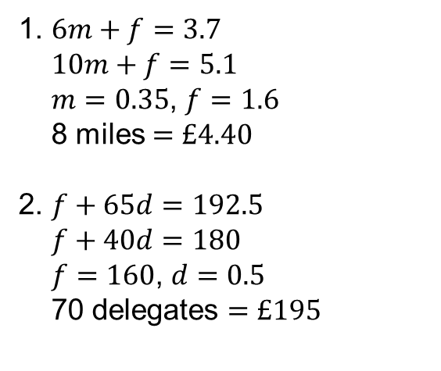
Answers
1. $6m+f=3.7$
$10m+f=5.1$
$m=0.35$, $f=1.6$
8 miles $=£4.40$
2. $f+65d=192.5$
$f+40d=180$
$f=160$, $d=0.5$
70 delegates $=£195$
3. $a+k=10.7$
$a−k=3.7$
$a=7.2$, $k=3.5$
4. $10s+5f=3.45$
$8s+10f=4.38$
$s=0.21$, $f=0.27$
3 second-class and 4
first-class stamps $=£1.71$

Slide 17
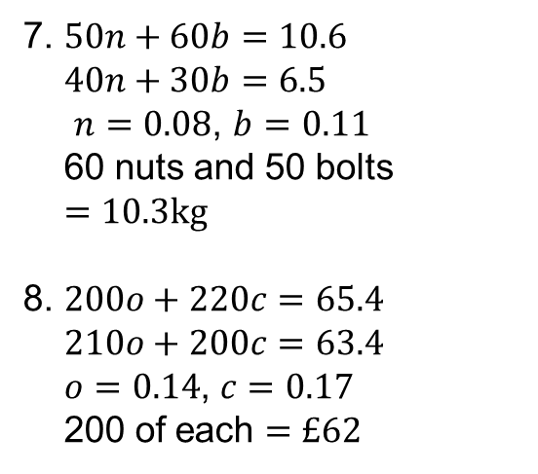
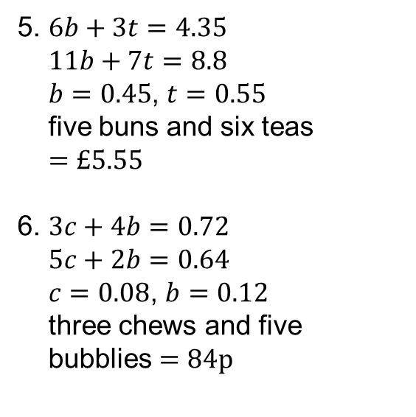
Answers
5. $6b+3t=4.35$
$11b+7t=8.8$
$b=0.45$, $t=0.55$
five buns and six teas
$=£5.55$
6. $3c+4b=0.72$
$5c+2b=0.64$
$c=0.08$, $b=0.12$
three chews and five
bubblies $=84p$
7. $50n+60b=10.6$
$40n+30b=6.5$
$n=0.08$, $b=0.11$
60 nuts and 50 bolts
$=10.3kg$
8. $200o+220c=65.4$
$210o+200c=63.4$
$o=0.14$, $c=0.17$
200 of each $=£62$

