Slide 1

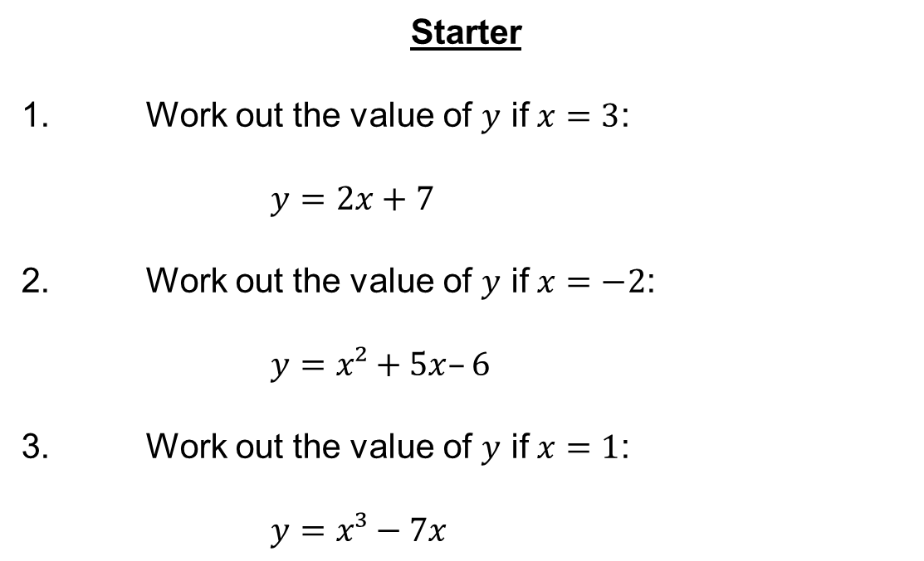
Starter
1. Work out the value of $y$ if $x=3$:
$y=2x+7$
2. Work out the value of $y$ if $x=−2$:
$y=x²+5x–6$
3. Work out the value of $y$ if $x=1$:
$y=x³−7x$
$6+7=13$
$4−10−6=−12$
$1−7=−6$

Slide 2





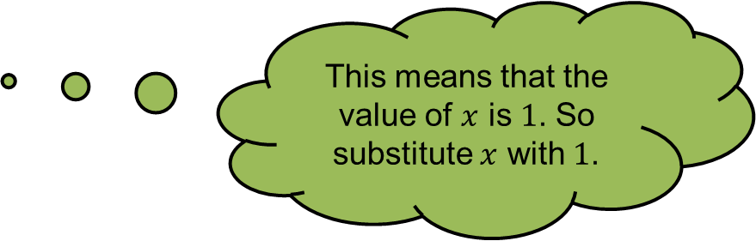








If $f(x) = 3x + 7$, find:
This means that the value of $x$ is $1$. So substitute $x$ with $1$.
(a) $f(1)$
$= 3(1) + 7$
$= 3 + 7$
$$= 10$$
(b) $f(4)$
$= 3(4) + 7$
$= 12 + 7$
$= 19$
(c) $f(−2)$
$= 3(−2) + 7$
$= −6 + 7$
$= 1$

Slide 3












Let $f\left(x\right)= 4x2−3$, find:
This means that the value of $x$ is $3$. So substitute $x$ with $3$.
(a) $f(3)$
$= 4\left(3\right)2−3$
$= 4(9) − 3$
$= 36 − 3$
$= 33$
(b) $f(−5)$
$= 4\left(−5\right)2−3$
$= 4(25) − 3$
$= 100 − 3$
$= 97$

Slide 4
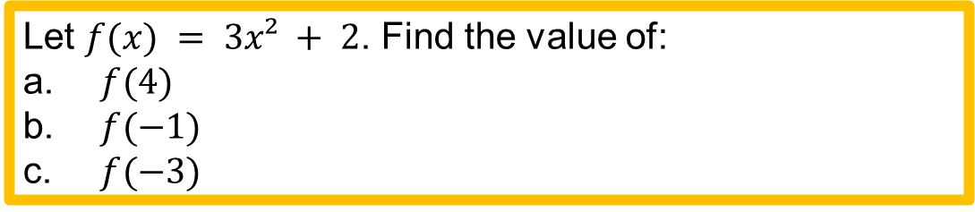
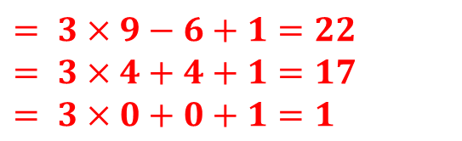
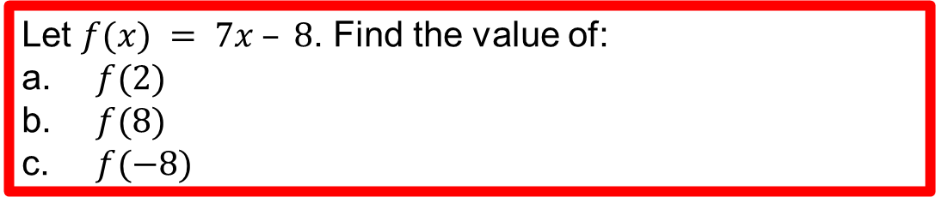


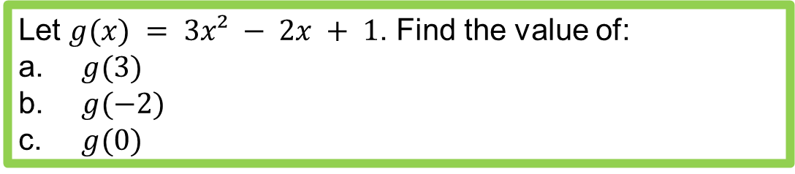
Let $f(x) = 7x – 8$. Find the value of:
$f(2)$
$f(8)$
$f(−8)$
$=14−8=6$
$=56−8=48$
$=−56−8 =−64$
Let $f(x) = 3x² + 2$. Find the value of:
$f(4)$
$f(−1)$
$f(−3)$
$= 3×16+2=50$
$= 3×1+2=5$
$= 3×9+2=29$
Let $g(x) = 3x² − 2x + 1$. Find the value of:
$g(3)$
$g(−2)$
$g(0)$
$= 3×9−6+1=22$
$= 3×4+4+1=17$
$= 3×0+0+1=1$

Slide 5





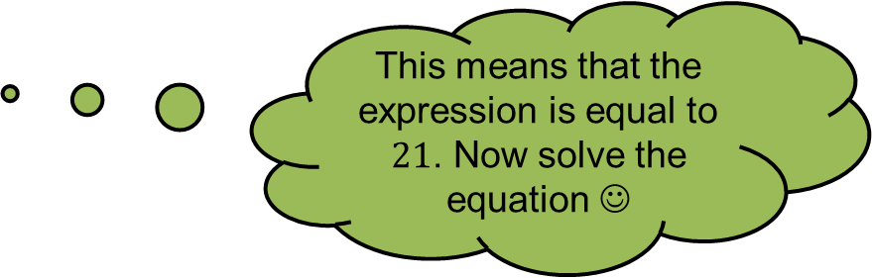




If $g(x) = 5x − 9$, then:
This means that the expression is equal to $21$. Now solve the equation ☺
(a) Solve $g(x) = 21$
$$5x – 9 = 21$$
$$5x = 30$$
$$x = 6$$
(b) Solve $g(x) = −64$
$$5x – 9 = −64$$
$$5x = −55$$
$$x = −11$$

Slide 6




If $f(x) = x2 – 3x$, then solve $f(x) = 4$.
$$x2 – 3x = 4$$
$$x2 – 3x – 4 = 0$$
$$(x − 4)(x + 1) = 0$$
$x = 4$or $x = −1$

Slide 7
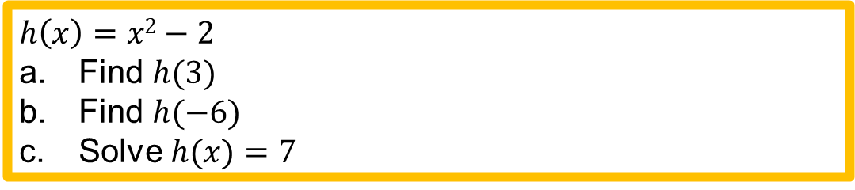
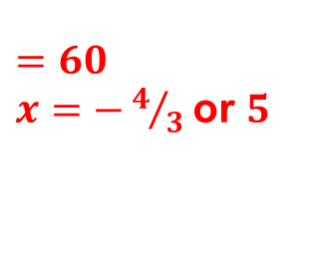
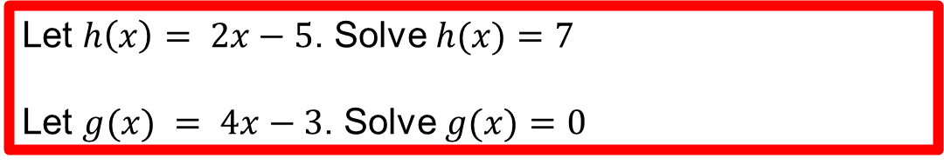
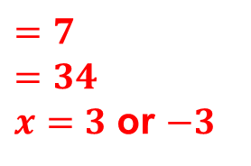

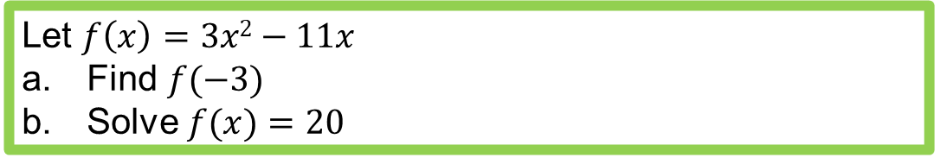
$x=6$
$x=¾$
Let $h\left(x\right)= 2x−5$. Solve $h(x)=7$
Let $g(x) = 4x−3$. Solve $g(x)=0$
$h\left(x\right)=x2−2$
Find $h(3)$
Find $h(−6)$
Solve $h(x)=7$
$=7$
$=34$
$x=3$ or $−3$
Let $f\left(x\right)=3x2−11x$
Find $f(−3)$
Solve $f(x)=20$
$=60$
$x=−4/3$or $5$

Slide 8












If $h(x)=2x+7$, then write an expression for:
(a) $h(3x)$
$=2(3x)+7$
This means that the value of $x$ is $3x$. So substitute $x$ with $3x$.
$=6x+7$
(b) $3h(x)$
$=3(2x+7)$
This means we are multiplying $h(x)$ by $3$.
$=6x+21$
$=4(2x+7)$
(c) $4h(x)$
This means we are multiplying $h(x)$ by $4$.
$=8x+28$

Slide 9



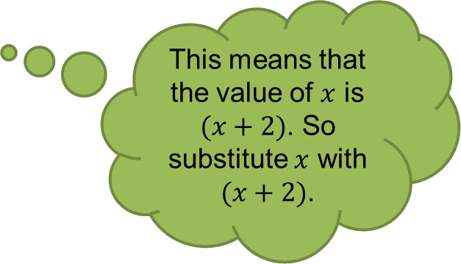






Let $f(x)=x2+7$, then write an expression for:
(a) $f(x)+2$
$=(x2+7)+2$
This means we add $2$ to $f(x)$.
$= x2+9$
This means that the value of $x$ is $(x+2)$. So substitute $x$ with $(x+2)$.
(b) $f(x+2)$
$=(x+2)2+7$
$=(x+2)(x+2)+7$
$=x2+4x+4+7$
$=x2+4x+11$

Slide 10
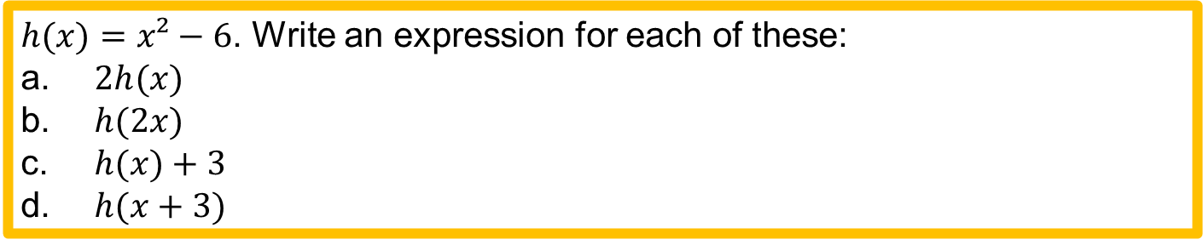

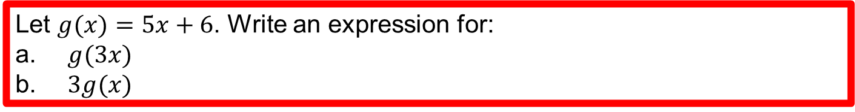


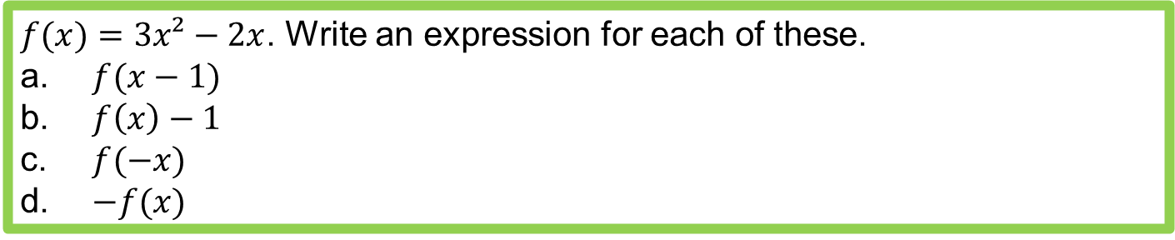
Let $g(x)=5x+6$. Write an expression for:
$g(3x)$
$3g(x)$
$= 15x+6$
$= 15x+18$
$h(x)=x²−6$. Write an expression for each of these:
$2h(x)$
$h(2x)$
$h(x)+3$
$h(x+3)$
$= 2x²−12$
$= 4x²−6$
$= x²−3$
$= x²+6x+3$
$f(x)=3x²−2x$. Write an expression for each of these.
$f(x−1)$
$f\left(x\right)−1$
$f(−x)$
$−f(x)$
$=3x²−8x+5$
$=3x²−2x−1$
$=3x²+2x$
$=−3x²+2x$

