Slide 1
Starter
What are £2 worth in Euros?
What about £5?
And £50?
If we were to plot these on axes, what shape would the graph be?
Where would the graph cross the axes?
What would we label the axes with?
£1 = €1.16

Slide 2
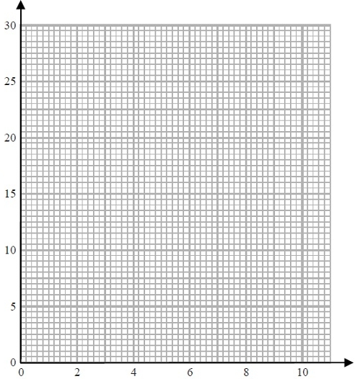
Example
The table shows some lengths in inches changed into lengths in centimetres.
Length in inches | 0 | 2 | 6 | 10
Length in cm | 0 | 5 | 15 | 25
x
a) On the grid, use this information to draw a line graph that can be used to change between inches and centimetres.
Kate's height is 62 inches.
Helen's height is 150 centimetres.
b) Who is the tallest?
x
Centimetres
15 cm = 6 inches
So 150 cm = 60 inches
Kate is tallest.
x
x
Inches

Slide 3
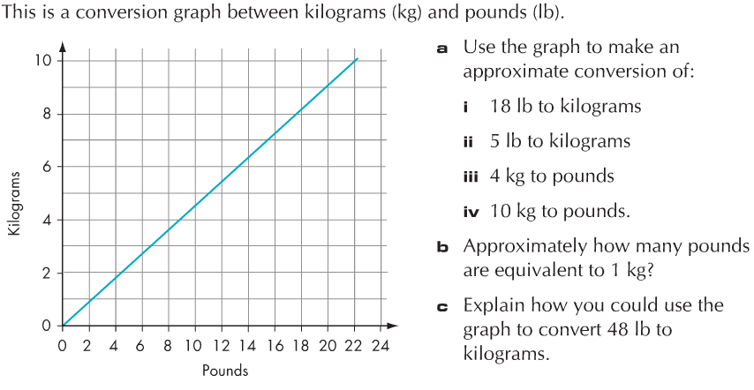
Example
This is a conversion graph between kilograms (kg) and pounds (lb).
a) Use the graph to make an approximate conversion of:
18 lb to kg
5 lb to kg
4 kg to lb
10 kg to lb
b) Approximately how many pounds are equivalent to 1 kg?
c) Explain how you could use the graph to convert 48 lb to kilograms.
8.25 kg
2.25 kg
9 lb
22 lb
2.2 lb
Read off the value for 12 lb (5.4kg), and multiply this by 4 (21.6kg).

Slide 4
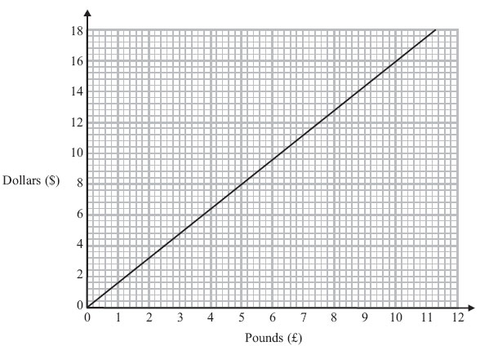
Example
We can use this conversion graph to change between pounds (£) and dollars ($).
a) Use the conversion graph to change £5 to dollars.
$8
Ella has $200 and £800 Her hotel bill is $600
Ella pays the bill with the $200 and some of the pounds.
b) Use the conversion graph to work out how many pounds she has left.
$200 = £125
Total left → £925
$600 = £375 to pay
£925 - £375 = £550 left

Slide 6
Answers
Question 1
20 km = 12 miles
24 km = 15 miles
15 miles is further
Question 2
64 g = 2.3 oz
45 g = 1.6 oz
(24 x 64) + 45 = 1581 g
or
(24 x 2.3) + 1.6 = 56.8 oz
Question 3
£6 = €6.50
$5 = €3.50
$65 = €45.50 = £42
Question 4
Total in London = £75 = 2250 KC
Total in Prague = 2010 KC = £68
London was more expensive than Prague.

