Slide 1
Starter
B
C
D
A
Follow the instructions on the starter sheet to transform this trapezium in a variety of ways.

Slide 2
Describing Transformations Flow Chart
Are the shapes the same size?
Yes
No
Are the shapes the same orientation?
Enlargement
No
Yes
Can you turn the tracing paper so the shapes look the same?
Translation
No
Yes
Reflection
Rotation

Slide 3
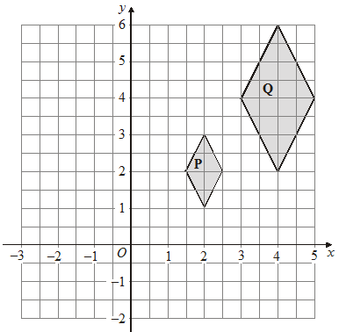
Describe fully the single transformation that maps shape P onto shape Q.
(3 marks)
Enlargement
Scale factor:
2
Centre of enlargement:
(0, 0)
Use the flow chart!

Slide 4
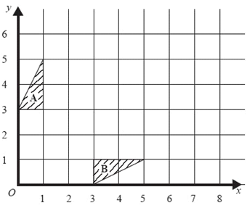

Describe fully the single transformation which will map triangle A onto triangle B.
(2 marks)
Reflection
Line of symmetry:
$$y=x$$
Use the flow chart!

Slide 5
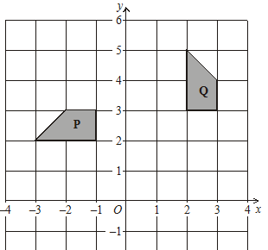
Describe fully the single transformation that maps shape P onto shape Q.
(3 marks)
Rotation
Degrees and direction:
Use the flow chart!

Slide 6
Describe fully the single transformation that maps shape P onto shape Q.
(3 marks)
Rotation
Degrees and direction:

Slide 7
Describe fully the single transformation that maps shape P onto shape Q.
(3 marks)
Rotation
Degrees and direction:
90° clockwise

Slide 8
Describe fully the single transformation that maps shape P onto shape Q.
(3 marks)
Rotation
Degrees and direction:
90° clockwise

Slide 9
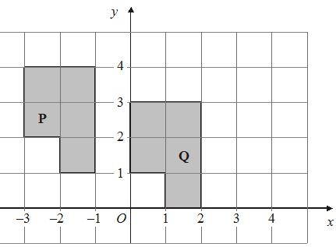

Describe fully the single transformation that will map shape P onto shape Q.
(2 marks)
Translation
Vector:
$$\left(\begin{matrix}3 \\ −1\end{matrix}\right)$$
Use the flow chart!

Slide 10
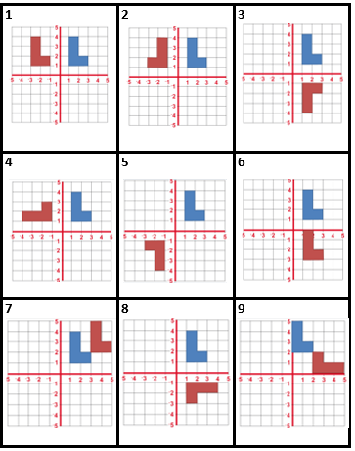
Pair Activity
Match the correct transformation to each diagram which maps the blue shape onto the red shape.

Slide 12
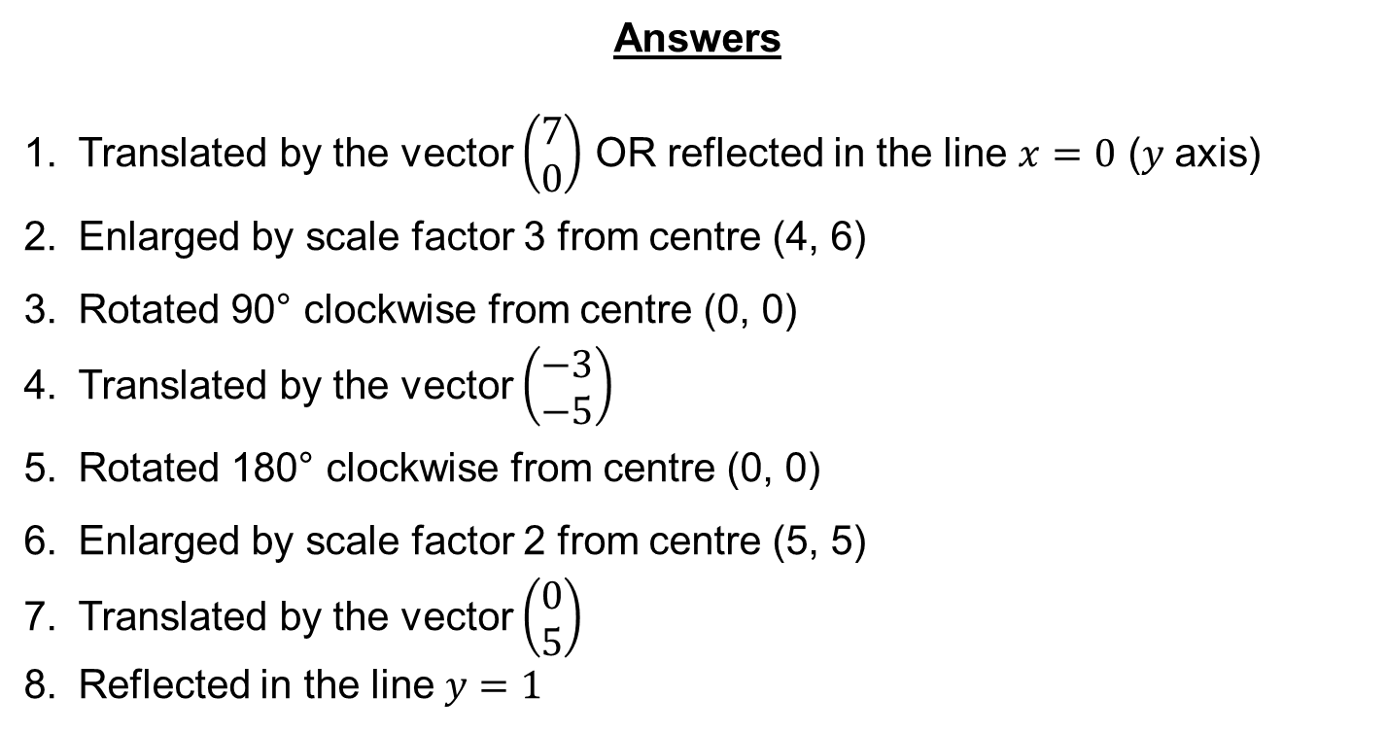
Answers
Translated by the vector $\left(\begin{matrix}7 \\ 0\end{matrix}\right)$ OR reflected in the line $x=0$ ($y$ axis)
Enlarged by scale factor 3 from centre (4, 6)
Rotated 90° clockwise from centre (0, 0)
Translated by the vector $\left(\begin{matrix}−3 \\ −5\end{matrix}\right)$
Rotated 180° clockwise from centre (0, 0)
Enlarged by scale factor 2 from centre (5, 5)
Translated by the vector $\left(\begin{matrix}0 \\ 5\end{matrix}\right)$
Reflected in the line $y=1$

