Slide 1
Starter
Lucy has a choice of five ties – 2 red, 1 black and 2 spotty. She also has a choice of five jumpers – 3 black, 1 red and 1 grey. The sample space diagram below shows the possible combinations she can have.
 | Red (r) | Red (r) | Black (b) | Spotty (s) | Spotty (s)
Black (B) | Br | Br | Bb | Bs | Bs
Black (B) | Br | Br | Bb | Bs | Bs
Black (B) | Br | Br | Bb | Bs | Bs
Red (R) | Rr | Rr | Rb | Rs | Rs
Grey (G) | Gr | Gr | Gb | Gs | Gs
Calculate the probability of Lucy wearing:
A red jumper b) A spotty tie
Something black d) Nothing red
e) Matching jumper and tie
$\frac{1}{5}$
$\frac{17}{25}$
$\frac{5}{25}$
$\frac{2}{5}$
$\frac{12}{25}$

Slide 2
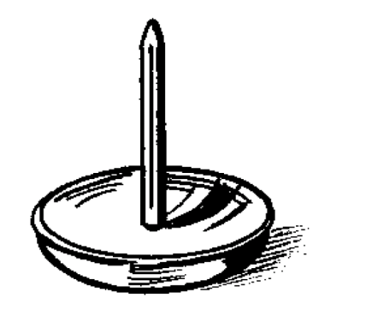
A drawing pin is repeatedly dropped in an experiment to see which way up it will land. Here are the results:
Outcome | Frequency
Point up | 15
Point down | 5
What is the probability that it will land point up?
$$\frac{10}{20}$$ | $$\frac{5}{20}$$
$$\frac{1}{4}$$ | $$\frac{15}{20}$$
A
B
C
D

Slide 3
A drawing pin is repeatedly dropped in an experiment to see which way up it will land. Here are the results:
Outcome | Frequency
Point up | 15
Point down | 5
What is the probability that it will land point up?
$$\frac{10}{20}$$ | $$\frac{5}{20}$$
$$\frac{1}{4}$$ | $$\frac{15}{20}$$
A
B
C
D

Slide 4
A drawing pin is repeatedly dropped in an experiment to see which way up it will land. Here are the results:
Outcome | Frequency
Point up | 15
Point down | 35
What is the probability that it will land point down?
$$\frac{35}{50}$$ | $$\frac{8}{10}$$
$$\frac{15}{50}$$ | $$\frac{35}{40}$$
A
B
C
D

Slide 5
A drawing pin is repeatedly dropped in an experiment to see which way up it will land. Here are the results:
Outcome | Frequency
Point up | 15
Point down | 35
What is the probability that it will land point down?
$$\frac{35}{50}$$ | $$\frac{8}{10}$$
$$\frac{15}{50}$$ | $$\frac{35}{40}$$
A
B
C
D

Slide 6
A coin is repeatedly thrown 60 times in an experiment to see which way up it will land. Here are the results of the experiment:
Outcome | Frequency
Heads | 27
Tails | 33
What is the probability that it will land head up?
$$\frac{33}{60}$$ | $$\frac{27}{60}$$
$$\frac{33}{50}$$ | $$\frac{27}{50}$$
A
B
C
D

Slide 7
A coin is repeatedly thrown 60 times in an experiment to see which way up it will land. Here are the results of the experiment:
Outcome | Frequency
Heads | 27
Tails | 33
What is the probability that it will land head up?
$$\frac{33}{60}$$ | $$\frac{27}{60}$$
$$\frac{33}{50}$$ | $$\frac{27}{50}$$
A
B
C
D

Slide 8
Here are the results of a survey of cars passing a school:
Colour | Number of cars
Red | 3
Black | 10
Silver | 15
Other | 2
What is the probability of the next car passing the school being silver?
$$\frac{3}{30}$$ | $$\frac{15}{30}$$
$$\frac{10}{30}$$ | $$\frac{27}{30}$$
A
B
C
D

Slide 9
Here are the results of a survey of cars passing a school:
Colour | Number of cars
Red | 3
Black | 10
Silver | 15
Other | 2
What is the probability of the next car passing the school being silver?
$$\frac{3}{30}$$ | $$\frac{15}{30}$$
$$\frac{10}{30}$$ | $$\frac{27}{30}$$
A
B
C
D

Slide 10
Here are the results of a survey of cars passing a school:
Colour | Number of cars
Red | 3
Black | 10
Silver | 15
Other | 2
What is the probability of the next car passing the school being black?
$$\frac{3}{30}$$ | $$\frac{15}{30}$$
$$\frac{10}{30}$$ | $$\frac{27}{30}$$
A
B
C
D

Slide 11
Here are the results of a survey of cars passing a school:
Colour | Number of cars
Red | 3
Black | 10
Silver | 15
Other | 2
What is the probability of the next car passing the school being black?
$$\frac{3}{30}$$ | $$\frac{15}{30}$$
$$\frac{10}{30}$$ | $$\frac{27}{30}$$
A
B
C
D

Slide 12
Here are the results of a survey of cars passing a school:
Colour | Number of cars
Red | 3
Black | 10
Silver | 15
Other | 2
What is the probability of the next car passing the school not being red?
$$\frac{3}{30}$$ | $$\frac{15}{30}$$
$$\frac{10}{30}$$ | $$\frac{27}{30}$$
A
B
C
D

Slide 13
Here are the results of a survey of cars passing a school:
Colour | Number of cars
Red | 3
Black | 10
Silver | 15
Other | 2
What is the probability of the next car passing the school not being red?
$$\frac{3}{30}$$ | $$\frac{15}{30}$$
$$\frac{10}{30}$$ | $$\frac{27}{30}$$
A
B
C
D

Slide 14
In most events, it is difficult to accurately predict the probability of an event happening.
When there is no theory behind the probability of an event happening, we use relative frequency to calculate probabilities.
Because it is often calculated after performing experiments, it is often called experimental probability.
The more trials there are, the more accurate that experimental probability becomes.

Slide 15
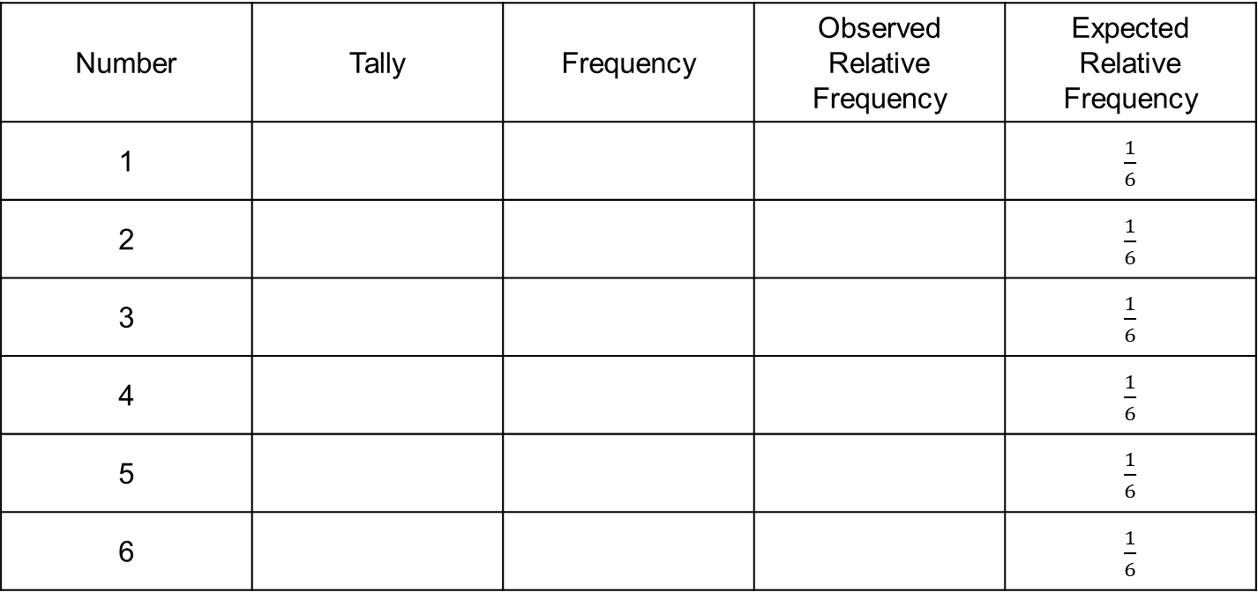
Pair Task
Roll your die 60 times and record your results in the table graph below.
Number | Tally | Frequency | Observed Relative Frequency | Expected Relative Frequency
1 |  |  |  | $\frac{1}{6}$
2 |  |  |  | $\frac{1}{6}$
3 |  |  |  | $\frac{1}{6}$
4 |  |  |  | $\frac{1}{6}$
5 |  |  |  | $\frac{1}{6}$
6 |  |  |  | $\frac{1}{6}$

Slide 16
Example
Fred records the colour of 100 cars that pass his house. His results are shown below.
Calculate the relative frequency/experimental probability of each colour.
What is the probability that the next car to pass his house will be:
red?
Blue?
Not black?
On an average day, 3500 cars pass Fred’s house. Based on his results, how many of these 3500 would we expect to be silver?
Colour | Red | Blue | Silver | Black | Other
Frequency | 10 | 15 | 38 | 32 | 5
Colour | Red | Blue | Silver | Black | Other
Frequency | 10 | 15 | 38 | 32 | 5
Relative Frequency | 0.1 | 0.15 | 0.38 | 0.32 | 0.05
$P$(red) = 0.1
$P$(blue) = 0.15
$P$(not black) = 1 – 0.32 = 0.68
0.38 $×$ 3500 = 1330 cars would be expected to be silver

Slide 18
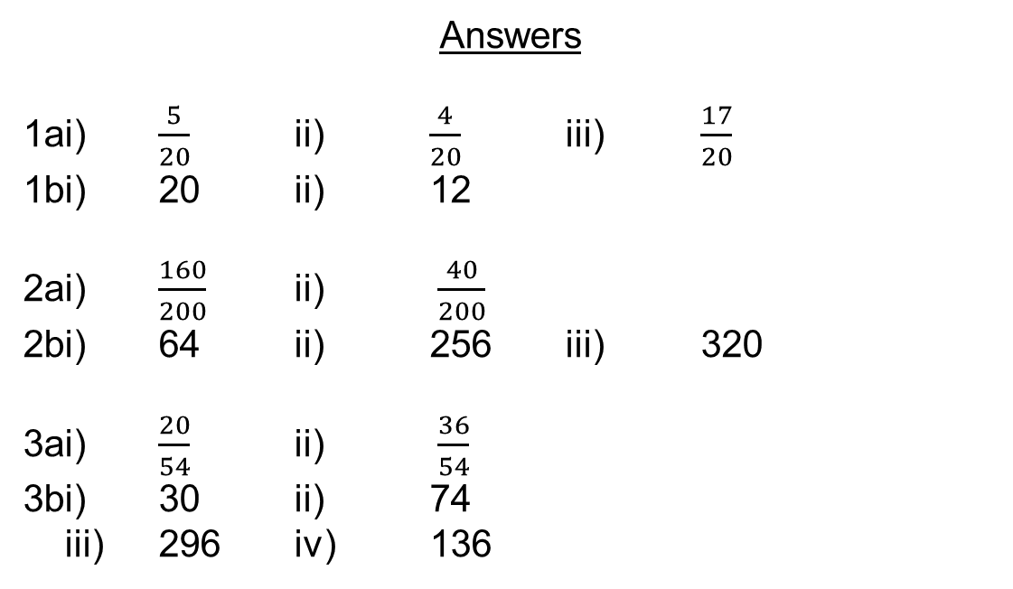
Answers
1ai) $\frac{5}{20}$ ii) $\frac{4}{20}$ iii) $\frac{17}{20}$
1bi) 20 ii) 12
2ai) $\frac{160}{200}$ ii) $\frac{40}{200}$
2bi) 64 ii) 256 iii) 320
3ai) $\frac{20}{54}$ ii) $\frac{36}{54}$
3bi) 30 ii) 74
iii) 296 iv) 136

