Slide 1

Starter
Calculate the following:
1) 3$×$2
2) 4$×$1.5
3) 6$×$2.5
4) 4$×$1.25
5) 7$×$2.5
= 6
= 6
= 15
= 5
= 17.5

Slide 2
Restaurants have to make money.
If too much food is made, it will be thrown away.
If not enough food is made, the customers won’t come again.
In either case, the restaurant will fail.
So, calculating the right amounts is essential!

Slide 3
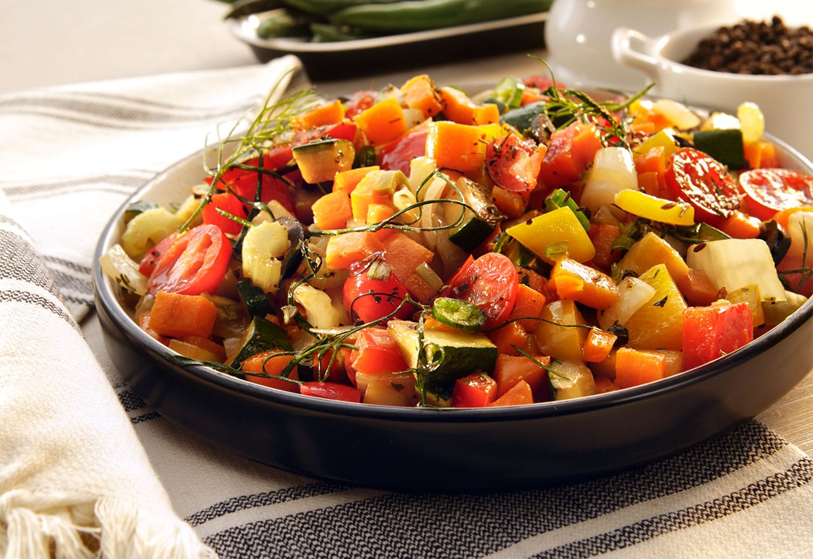
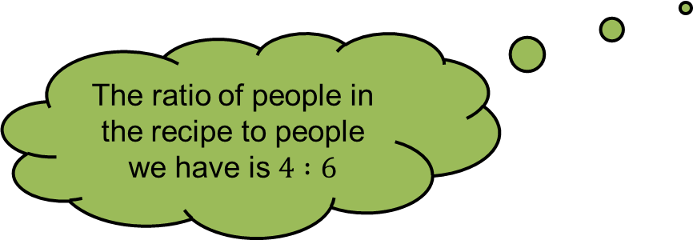
Example
Here are the ingredients needed to make ratatouille for 4 people.
To find out how much of each we’ll need to make it for 6 people, we need to use ratio.
Ratatouille
Serves 4
2 large aubergines
4 small courgettes
2 yellow peppers
4 large tomatoes
5 tbsp olive oil
1 onion
3 garlic cloves
The ratio of people in the recipe to people we have is $4 :6$
To calculate the scale factor, simplify so the ratio is in the form $1 :n$
The ratio is $1 :1.5$ so the scale factor is $1.5$

Slide 4
Example
Here are the ingredients needed to make ratatouille for 4 people.
To find out how much of each we’ll need to make it for 6 people, we need to use ratio.
1.5 × 2 = 3 large aubergines
1.5 × 4 = 6 small courgettes
1.5 × 2 = 3 yellow peppers
1.5 × 4 = 6 large tomatoes
1.5 × 5 = 7.5 tbsp olive oil
1.5 × 1 = 1.5 onions
1.5 × 3 = 4.5 garlic cloves
Ratatouille
Serves 4
2 large aubergines
4 small courgettes
2 yellow peppers
4 large tomatoes
5 tbsp olive oil
1 onion
3 garlic cloves

Slide 5
Your Turn
× 2.5
Shortbread fingers
Makes 20
120g butter
50g caster sugar
170g plain flour
300g
125g
425g
How much of each ingredient will be needed to make 50 fingers?
Hint → 20 : 50

Slide 6
Extension: Pancake day!

Slide 7
Answers
12 tomatoes 1200g prawns
2 potatoes 12 tsp mayonnaise
2 onions 12 tsp tomato sauce
4 tbsp olive oil 12 lettuce leaves
4 pints vegetable stock
2 carrots
8 slices of bread
1 ½ tsp olive oil 15 roast potatoes
1 ½ large onions 5 carrots
3 cloves of garlic 2 ½ cans of peas
375g minced beef 10 slices of beef
300g chopped tomatoes 5 Yorkshire puddings
4 ½ mushrooms
300g spaghetti
275g butter 3 ½ watermelons
275g sugar 7 bunches of grapes
5 medium eggs 14 bananas
2 ½ tsp vanilla essence 21 oranges
275g flour 28 apples
250g jam 2800g strawberries

Slide 8
Plenary – Exam Question
Rosa prepares the ingredients for pizzas.
She uses cheese, topping and dough in the ratio
2 : 3 : 5 Rose uses 70 grams of dough.
Work out the number of grams of cheese and the number of grams of topping Rosa uses.
Cheese ......................... g
Topping ....................... g
(Total 3 marks)
28
42
Notes:
8

