Slide 1
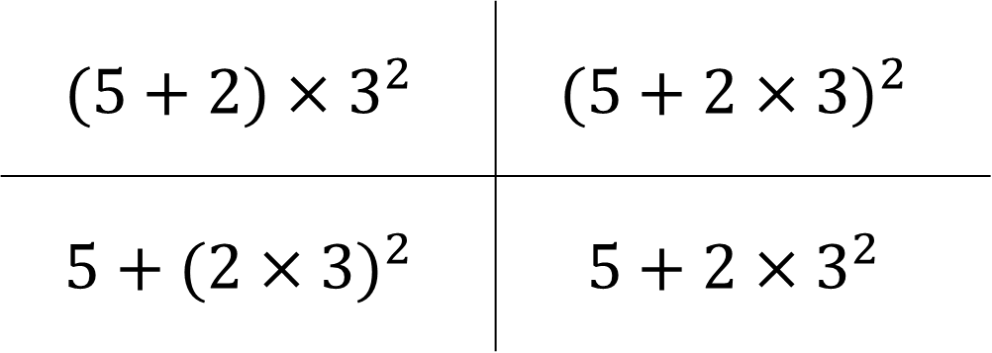
Starter What’s the same and what’s different?
$$(5+2)×3^{2}$$ | $$(5+2×{3)}^{2}$$
$$5+(2×{3)}^{2}$$ | $$5+2×3^{2}$$

Slide 2
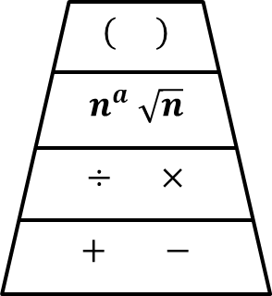

Slide 3

Examples
$2+3×4$
$7−2×6$ $3+5×4÷2$
$=2+12$
$=14$
$=7−12$
$=3+10$
$=−5$
$=13$

Slide 4
Examples
$2×3−(4+2)$
$4×3^{2}−(7+2)$
$=2×3−6$
$=6−6$
$=0$
$=4×3^{2}−9$
$=4×9−9$
$=36−9$
$=27$

Slide 5
Show me a problem where the answer is:
8
-6
45
Show me two questions that look similar but have different answers.

Slide 6
TRUE
FALSE

Slide 8
Answers
1. 31
2. 12
3. 35
4. 34
5. 5
6. 4
7. 90
8. 38
9. 12
10. 100
11. 0
12. 12

Slide 9
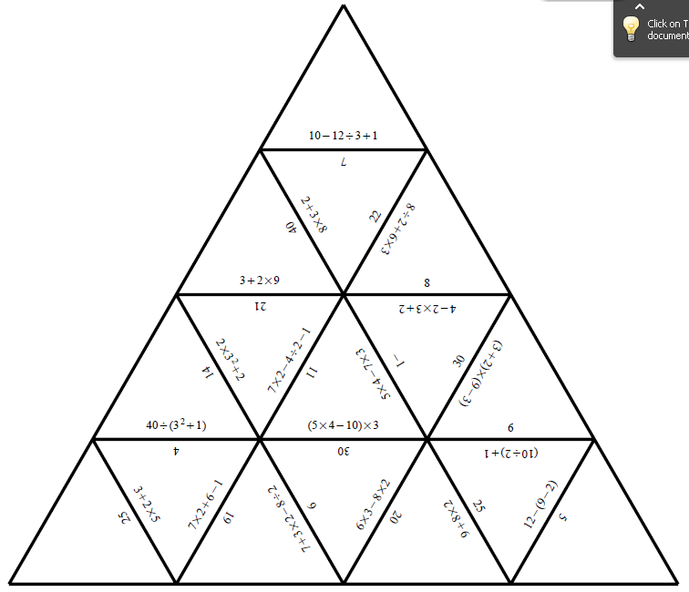
Pair Activity
Find 5!
Using the correct order of operations Find 5 mistakes in this Jigsaw!

Slide 10
Pair Activity
Find 5!
Using the correct order of operations Find 5 mistakes in this Jigsaw!

