Slide 1

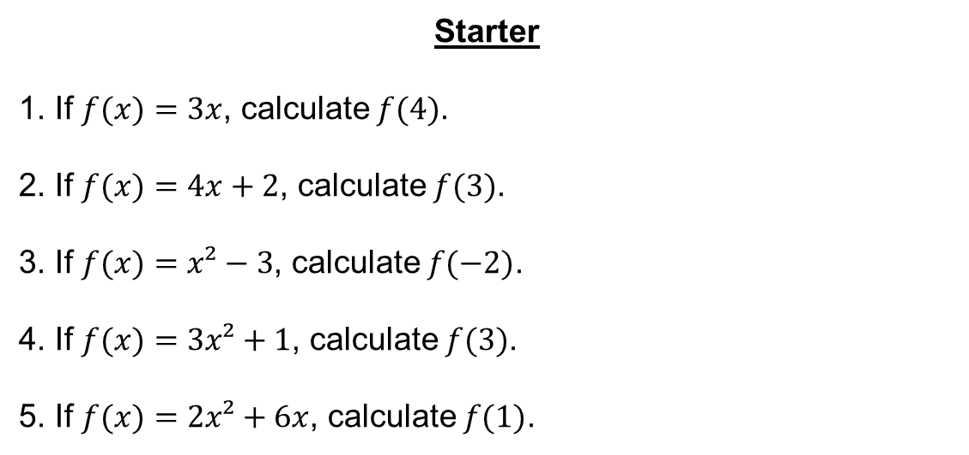
Starter
If $f(x)=3x$, calculate $f(4)$.
If $f(x)=4x+2$, calculate $f(3)$.
If $f(x)=x²−3$, calculate $f(−2)$.
If $f(x)=3x²+1$, calculate $f(3)$.
If $f(x)=2x²+6x$, calculate $f(1)$.
$f(4)=12$
$f(3)=14$
$f(−2)=1$
$f(3)=28$
$f(1)=8$

Slide 2
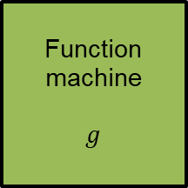
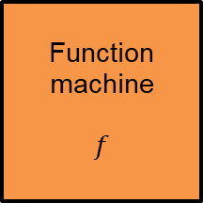
When a function is followed by another, the result is a composite function.
Function machine
$$g$$
Function machine
$$f$$
Input
Output

Slide 3
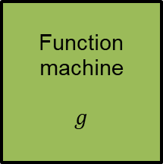
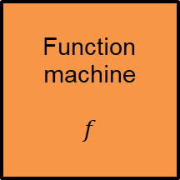


For example, if $g(x)=2x$ and $f(x)=x+3$, then
Function machine
$$g$$
Function machine
$$f$$
2
Input
4
Output
7
$$g(x)=2x$$
$$f(x)=x+3$$

Slide 4





If $x$ is the input,
Function machine
$$g$$
Function machine
$$f$$
$$x$$
Input
$$g(x)$$
Output
$$fg(x)$$
$$g(x)$$
$$f(x)$$
$fg(x)$means do $g$ first, followed by $f$

Slide 5
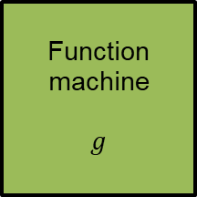
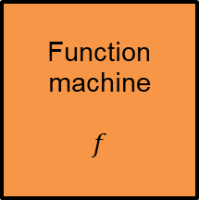


If the order of the functions changes,
Function machine
$$f$$
Function machine
$$g$$
2
Input
5
Output
10
$$f(x)=x+3$$
$$g(x)=2x$$

Slide 6





If $x$ is the input,
Function machine
$$f$$
Function machine
$$g$$
$$x$$
Input
$$f(x)$$
Output
$$gf(x)$$
$$f(x)$$
$$g(x)$$
$gf(x)$ means do $f$ first, followed by $g$

Slide 7
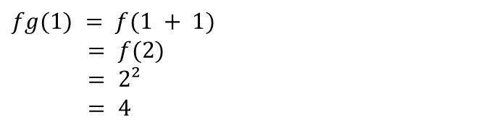
Given $f(x)=x²$ and $g(x)=x+1$, find:
a) $fg(1)$ b) $fg(3)$ c) $fg(x)$
$fg(1) = f(1 + 1)$
$= f(2)$
$= 2²$
$= 4$

Slide 8
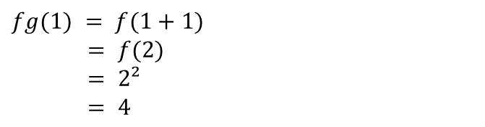

Given $f(x)=x²$ and $g(x)=x+1$, find:
a) $fg\left(1\right)=4$ b) $fg(3)$ c) $fg(x)$
$fg(3)=f(3+1)$
$=f(4)$
$=4²$
$=16$
$fg(1) = f(1+1)$
$= f(2)$
$= 2²$
$= 4$

Slide 9

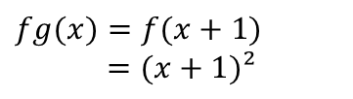
Given $f(x)=x²$ and $g(x)=x+1$, find:
a) $fg\left(1\right)=4$ b) $fg\left(3\right)=16$ c) $fg(x)$
$$=(x+1)²$$
$fg(3)=f(3+1)$
$=f(4)$
$=4²$
$=16$
$fg(x)=f(x+1)$
$=(x+1)²$
$fg(1) = f(1+1)$
$= f(2)$
$= 2²$
$= 4$

Slide 10
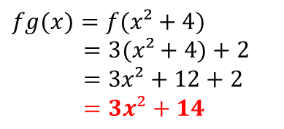
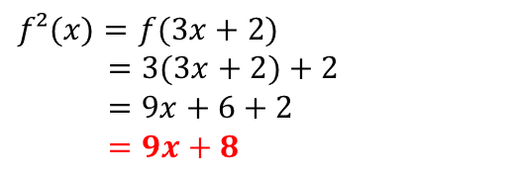
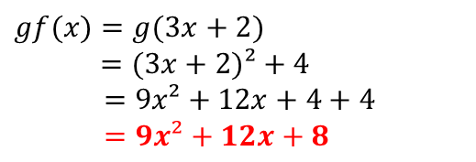
The functions $f$ and $g$ are defined by $f(x)=3x+2$ and $g(x)=x²+4$. Find:
a) $fg(x)$ b) $gf(x)$ c) $f²(x)$
$fg(x)=f(x²+4)$
$=3(x²+4)+2$
$=3x²+12+2$
$=3x²+14$
$gf(x)=g(3x+2)$
$=(3x+2)²+4$
$=9x²+12x+4+4$
$=9x²+12x+8$
$f²(x)=f(3x+2)$
$=3(3x+2)+2$
$=9x+6+2$
$=9x+8$

Slide 12
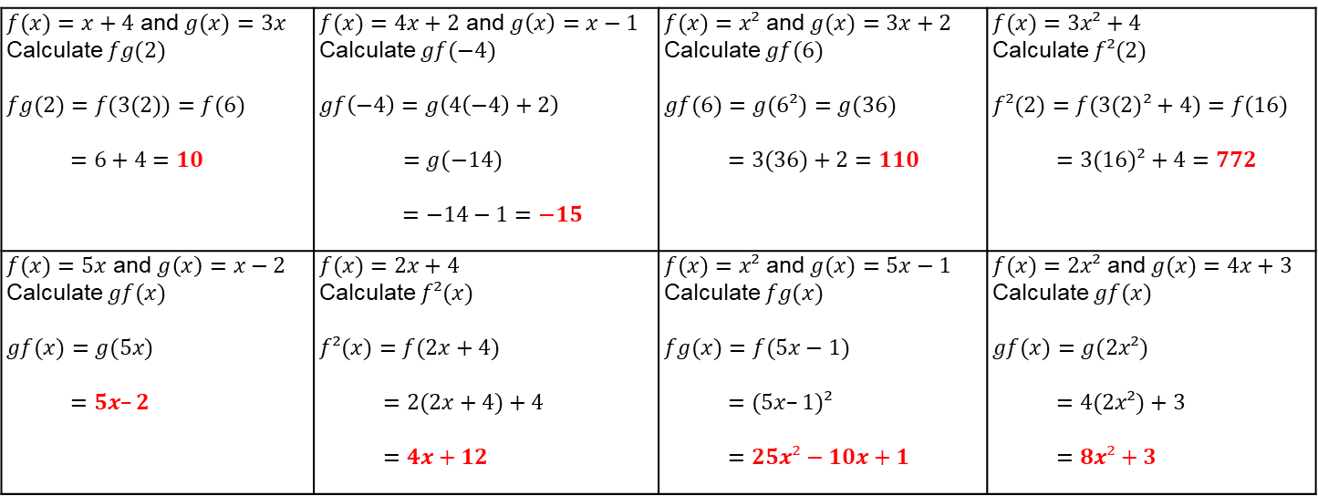
Answers
$f(x)=x+4$ and $g(x)=3x$ Calculate $fg(2)$ $fg(2)=f(3(2))=f(6)$ $=6+4=10$ | $f(x)=4x+2$ and $g\left(x\right)=x−1$ Calculate $gf(−4)$ $gf\left(−4\right)=g\left(4\left(−4\right)+2\right)$ $=g(−14)$ $=−14−1=−15$ | $f(x)=x²$ and $g(x)=3x+2$ Calculate $gf(6)$ $gf(6)=g(6²)=g(36)$ $=3(36)+2=110$ | $f(x)=3x²+4$ Calculate $f²(2)$ $f²(2)=f(3(2)²+4)=f(16)$ $=3(16)²+4=772$
$f(x)=5x$ and $g\left(x\right)=x−2$ Calculate $gf(x)$ $gf(x)=g(5x)$ $=5x–2$ | $f(x)=2x+4$ Calculate $f²(x)$ $f²(x)=f(2x+4)$ $=2(2x+4)+4$ $=4x+12$ | $f(x)=x²$ and $g(x)=5x−1$ Calculate $fg(x)$ $fg(x)=f(5x−1)$ $=(5x–1)²$ $=25x²−10x+1$ | $f(x)=2x²$ and $g(x)=4x+3$ Calculate $gf(x)$ $gf(x)=g(2x²)$ $=4(2x²)+3$ $=8x²+3$

