Slide 1
Assess your starting points…
Complete the fractions booklet. For each objective:
Decide how confident you are and complete a question from red, amber or green.
If it’s too easy, move on. If it’s too hard, go back.
How easy is this objective - ☺ 😐 or ☹ ?
Go onto the next objective and go back to (1)

Slide 2
Answers…

Slide 3
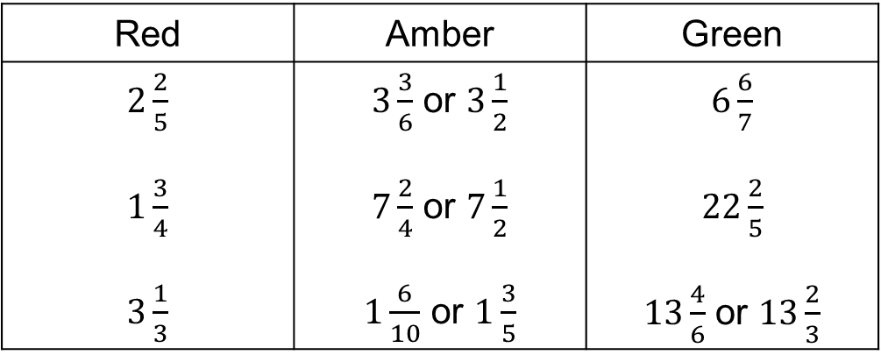
I can convert improper fractions to mixed numbers.
Red | Amber | Green
$2\frac{2}{5}$ $1\frac{3}{4}$ $3\frac{1}{3}$ | $3\frac{3}{6}$ or $3\frac{1}{2}$ $7\frac{2}{4}$ or $7\frac{1}{2}$ $1\frac{6}{10}$ or $1\frac{3}{5}$ | $6\frac{6}{7}$ $22\frac{2}{5}$ $13\frac{4}{6}$ or $13\frac{2}{3}$
What went well?
Even better if?

Slide 4
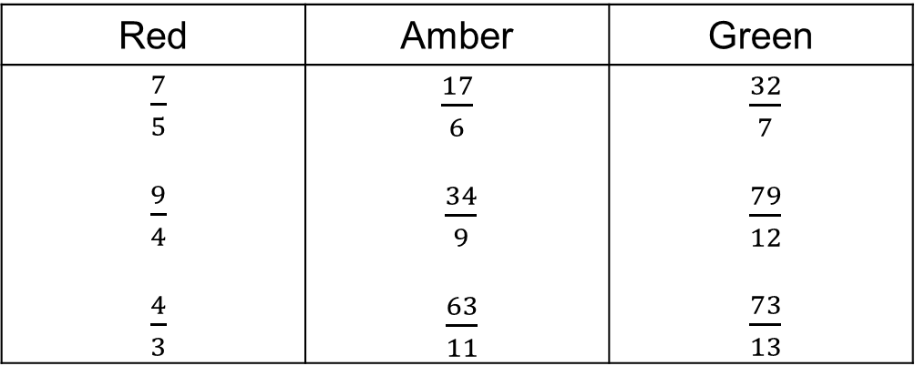
I can convert mixed numbers to improper fractions.
Red | Amber | Green
$\frac{7}{5}$ $\frac{9}{4}$ $\frac{4}{3}$ | $\frac{17}{6}$ $\frac{34}{9}$ $\frac{63}{11}$ | $\frac{32}{7}$ $\frac{79}{12}$ $\frac{73}{13}$
What went well?
Even better if?

Slide 5
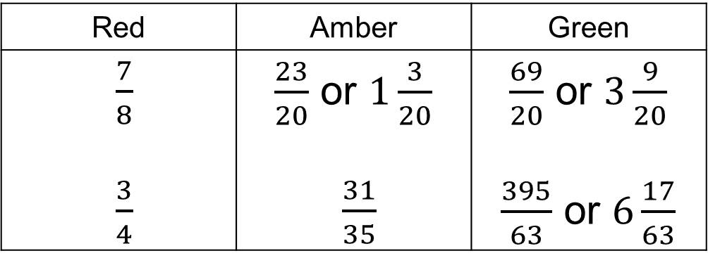
I can add fractions and mixed numbers.
Red | Amber | Green
$\frac{7}{8}$ $\frac{3}{4}$ | $\frac{23}{20}$ or $1\frac{3}{20}$ $\frac{31}{35}$ | $\frac{69}{20}$ or $3\frac{9}{20}$ $\frac{395}{63}$ or $6\frac{17}{63}$
What went well?
Even better if?

Slide 6
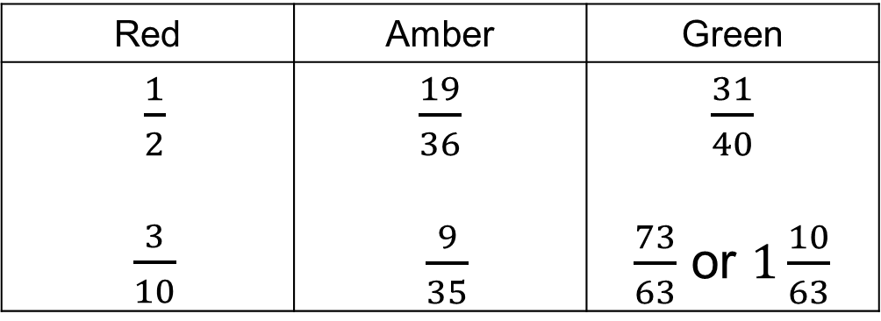
I can subtract fractions and mixed numbers.
Red | Amber | Green
$\frac{1}{2}$ $\frac{3}{10}$ | $\frac{19}{36}$ $\frac{9}{35}$ | $\frac{31}{40}$ $\frac{73}{63}$ or $1\frac{10}{63}$
What went well?
Even better if?

Slide 7
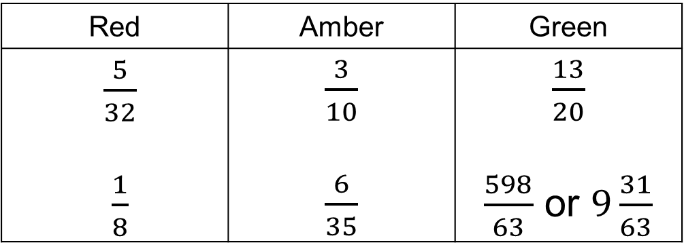
I can multiply fractions and mixed numbers.
Red | Amber | Green
$\frac{5}{32}$ $\frac{1}{8}$ | $\frac{3}{10}$ $\frac{6}{35}$ | $\frac{13}{20}$ $\frac{598}{63}$ or $9\frac{31}{63}$
What went well?
Even better if?

Slide 8
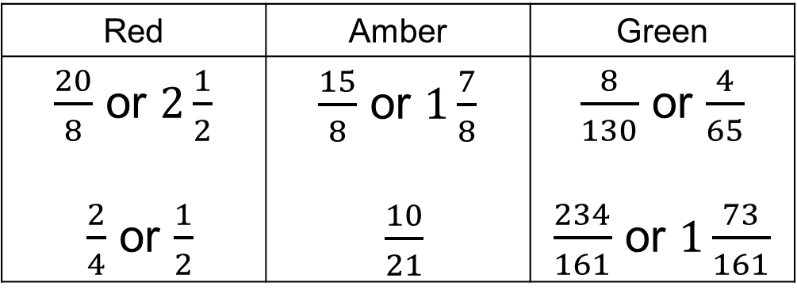
I can divide fractions and mixed numbers.
Red | Amber | Green
$\frac{20}{8}$ or $2\frac{1}{2}$ $\frac{2}{4}$ or $\frac{1}{2}$ | $\frac{15}{8}$ or $1\frac{7}{8}$ $\frac{10}{21}$ | $\frac{8}{130}$ or $\frac{4}{65}$ $\frac{234}{161}$ or $1\frac{73}{161}$
What went well?
Even better if?

Slide 9
Progress in your learning journey
Use the scaffolded sheets to help you with the objectives you struggled with
I can convert improper fractions to mixed numbers
I can convert mixed numbers to improper fractions
I can add/subtract fractions and mixed numbers
I can multiply fractions and mixed numbers
I can divide fractions and mixed numbers

