Slide 1
Starter
Where do these graphs cross the x-axis?
Expand the brackets
Where do these graphs cross the y-axis?
y = (x – 4)(x + 2)
y = (x – 7)(x – 3)
y = (x + 5)²

Slide 2
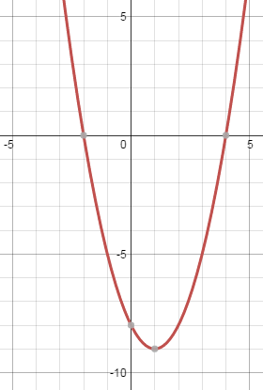
Where do these graphs cross the x-axis?
Expand the brackets
Where do these graphs cross the y-axis?
1. y = (x – 4)(x + 2)
x = 4 or -2
y = x² - 2x - 8
y-intercept at -8

Slide 3
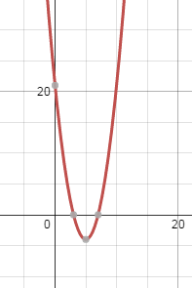
Where do these graphs cross the x-axis?
Expand the brackets
Where do these graphs cross the y-axis?
2. y = (x – 7)(x - 3)
x = 7 or 3
y = x² - 10x + 21
y-intercept at +21

Slide 4
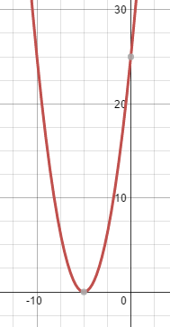
Where do these graphs cross the x-axis?
Expand the brackets
Where do these graphs cross the y-axis?
3. y = (x + 5)²
x = -5
y = x² + 10x + 25
y-intercept at +25

Slide 5
If the greatest power of x is 1, the equation is linear.
Eg: y = 4x - 1
If the greatest power of x is 2 (x²), the equation is quadratic.
Eg: y = x² + 6x – 2
If the greatest power of x is 3 (x³), the equation is cubic.
Eg: y = x³ - 5x² + 4x - 9

Slide 6
True or False:
y = 3x² + 6x – 2 is a cubic equation
y = 2x³ - 9x is a cubic equation
y = 5 – 3x is a linear equation
y = 3 – 7x³ is a quadratic equation

Slide 7
Show me:
A linear equation where x = 2 and y = 7
A quadratic equation where x = 2 and y = 7
A cubic equation where x = 2 and y = 7

Slide 8
Where does the graph y = (x + 4)(x + 1)(x – 2) cross the x-axis and the y-axis?
✓
Remember the solutions of x are where the graph crosses the x-axis!
If (x + 4)(x + 1)(x – 2) = 0,
x = -4, -1 or 2
To find where the graph crosses the y-axis, we’ll need to expand the brackets…

Slide 9
(x + 4)(x + 1)(x – 2)
Start by expanding one pair of brackets.
x | x | +1
x
-2
x²
+x
-2x
-2
= x² - 2x + x - 2
= x² - x - 2
So (x + 4)(x + 1)(x – 2) = (x + 4)(x² - x – 2)

Slide 10
(x + 4)(x + 1)(x – 2) = (x + 4)(x² - x – 2)
Now we can expand the rest.
x | x² | -x | -2
x
+4
x³
-x²
-2x
+4x²
-4x
-8
= x³ + 4x² - x² - 4x – 2x - 8
= x³ + 3x² - 6x - 8
So (x + 4)(x + 1)(x – 2) = x³ + 3x² - 6x - 8

Slide 11
Where does the graph y = (x + 4)(x + 1)(x – 2) cross the x-axis and the y-axis?
✓
✓
If (x + 4)(x + 1)(x – 2) = 0,
x = -4, -1 or 2
(x + 4)(x + 1)(x – 2) = x³ + 3x² - 6x - 8
The y-intercept is -8.

Slide 12
Where does the graph y = (2x - 1)(x + 3)(x + 5) cross the x-axis and the y-axis?
✓
✓
If (2x - 1)(x + 3)(x + 5) = 0,
x = ½, -3 or -5
Start by expanding one pair of brackets.
So (2x - 1)(x + 3)(x + 5) = (2x - 1)(x² + 8x + 15)
Now we can expand the rest.
So (2x - 1)(x + 3)(x + 5) = 2x³ + 15x² + 22x - 15
The y-intercept is -15.
Notes:
Show expansion of brackets on whiteboard to model working

Slide 13
Where does the graph y = 5x(2x - 3)(x - 2) cross the x-axis and the y-axis?
✓
✓
If 5x(2x - 3)(x - 2) = 0,
x = 0, 3/2 or 2
Start by expanding one pair of brackets.
So 5x(2x - 3)(x - 2) = 5x(2x² - 7x + 6)
Now we can expand the rest.
So 5x(2x - 3)(x - 2) = 10x³ - 35x² + 30x
The y-intercept is 0.
Notes:
Show expansion of brackets on whiteboard to model working

Slide 15
Answers

Slide 16
Answers
3. Expand the following expressions.
a. (x + 2)(x + 5)(x + 1) b. (x – 3)(x + 4)(x – 2)
= x³ + 8x² + 17x + 10 = x³ - x² - 14x + 24
c. x(x + 5)(x – 4) d. (x + 3)³
= x³ + x² - 20x = x³ + 9x² + 27x + 27
4. What equations do these graphs represent?
y = (x + 3)(x + 1)(x – 1), y = (x + 1)(x – 1)(x – 2), y = (x + 1)(x – 2)(x – 3)
5. How many solutions does each cubic equation have?
a. 3 b. 1
c. 3 d. 2
e. 3 f. 3

