Slide 1
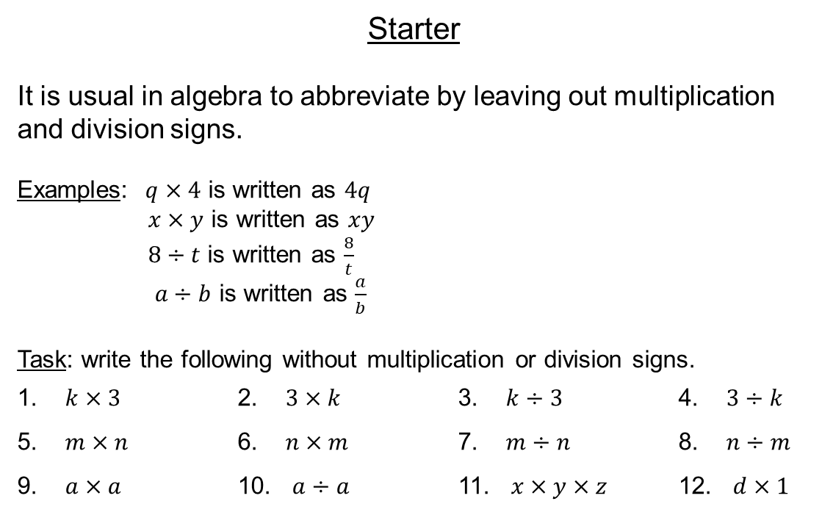
Starter
It is usual in algebra to abbreviate by leaving out multiplication and division signs.
Examples: $q×4$ is written as $4q$
$x×y$ is written as $xy$
$8÷t$ is written as $\frac{8}{t}$
$a÷b$ is written as $\frac{a}{b}$
Task: write the following without multiplication or division signs.
1. $k×3$ 2. $3×k$ 3. $k÷3$ 4. $3÷k$
5. $m×n$ 6. $n×m$ 7. $m÷n$ 8. $n÷m$
9. $a×a$ 10. $a÷a$ 11. $x×y×z$ 12. $d×1$
When multiplying, the number is always placed first, and the letters in alphabetical order

Slide 2
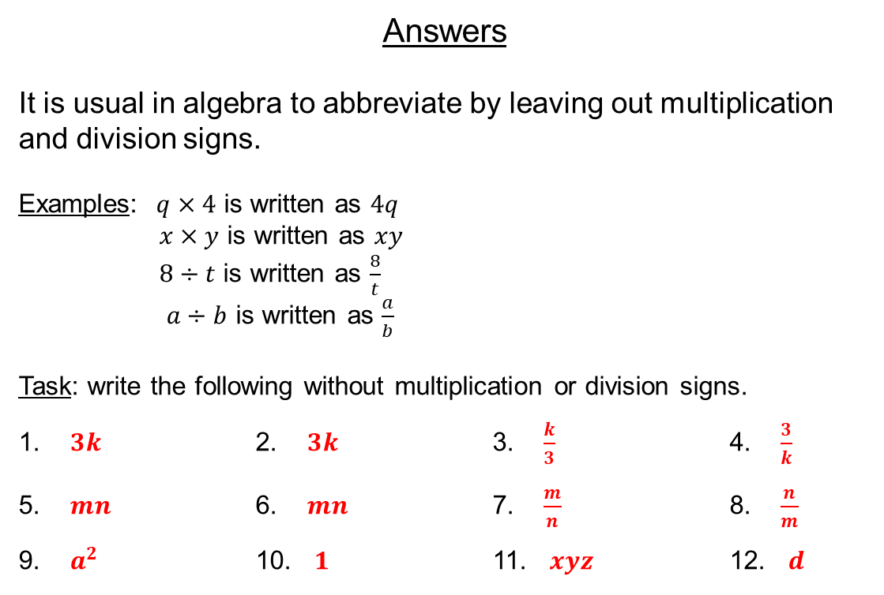
Answers
It is usual in algebra to abbreviate by leaving out multiplication and division signs.
Examples: $q×4$ is written as $4q$
$x×y$ is written as $xy$
$8÷t$ is written as $\frac{8}{t}$
$a÷b$ is written as $\frac{a}{b}$
Task: write the following without multiplication or division signs.
1. $3k$ 2. $3k$ 3. $\frac{k}{3}$ 4. $\frac{3}{k}$
5. $mn$ 6. $mn$ 7. $\frac{m}{n}$ 8. $\frac{n}{m}$
9. $a^{2}$ 10. $1$ 11. $xyz$ 12. $d$
When multiplying, the number is always placed first, and the letters in alphabetical order

Slide 3
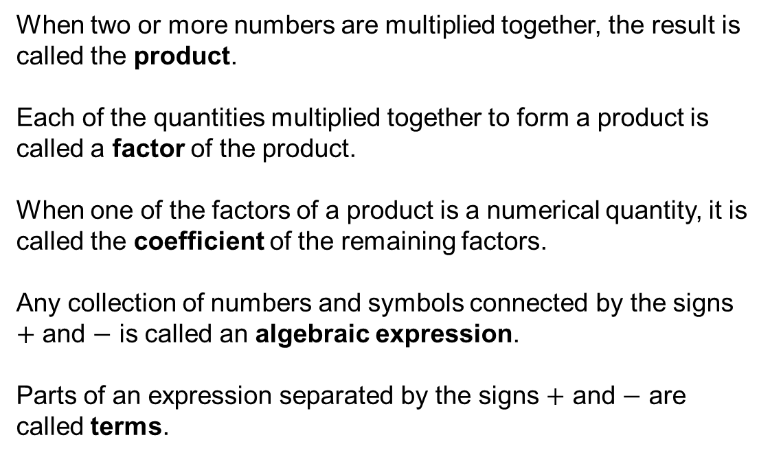
When two or more numbers are multiplied together, the result is called the product.
Each of the quantities multiplied together to form a product is called a factor of the product.
When one of the factors of a product is a numerical quantity, it is called the coefficient of the remaining factors.
Any collection of numbers and symbols connected by the signs $+$ and $−$ is called an algebraic expression.
Parts of an expression separated by the signs $+$ and $−$ are called terms.

Slide 4
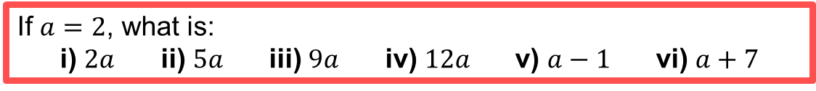
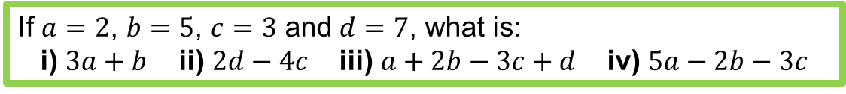
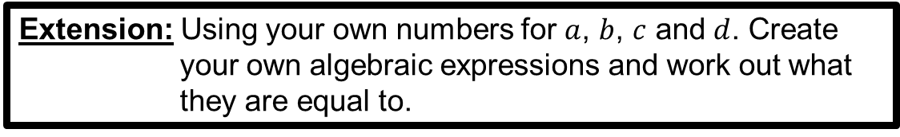
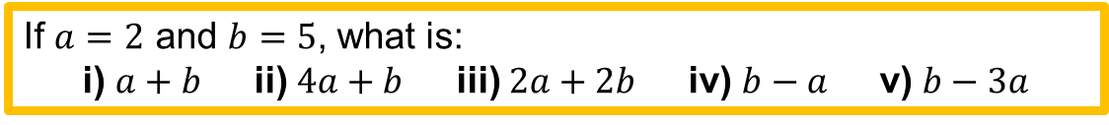
Substitution
If $a=2$, what is:
i) $2a$ ii) $5a$ iii) $9a$ iv) $12a$ v) $a−1$ vi) $a+7$
If $a=2$ and $b=5$, what is:
i) $a+b$ ii) $4a+b$ iii) $2a+2b$ iv) $b−a$ v) $b−3a$
If $a=2$, $b=5$, $c=3$ and $d=7$, what is:
i) $3a+b$ ii) $2d−4c$ iii) $a+2b−3c+d$ iv) $5a−2b−3c$
Extension: Using your own numbers for $a$, $b$, $c$ and $d$. Create your own algebraic expressions and work out what they are equal to.

Slide 5
Answers
i) 4 ii) 10 iii) 18 iv) 24 v) 1 vi) 9
i) 7 ii) 13 iii) 14 iv) 3 v) -1
i) 11 ii) 2 iii) 10 iv) -9

Slide 6
Substitution Bingo
Pick 9 numbers (no repeats!)
2 81 25 -18
3 4 -2 7
30 16 19 -8
32 6 55 34

Slide 7
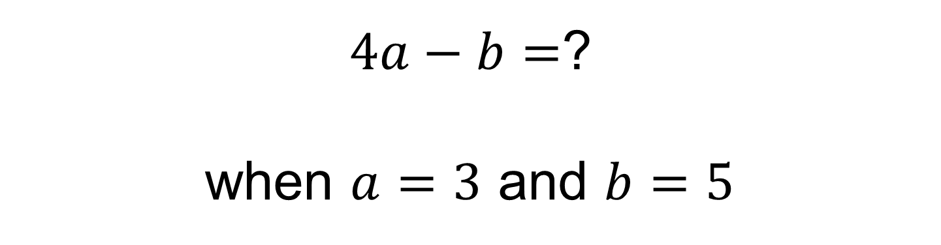
$4a−b=$?
when $a=3$ and $b=5$

Slide 8
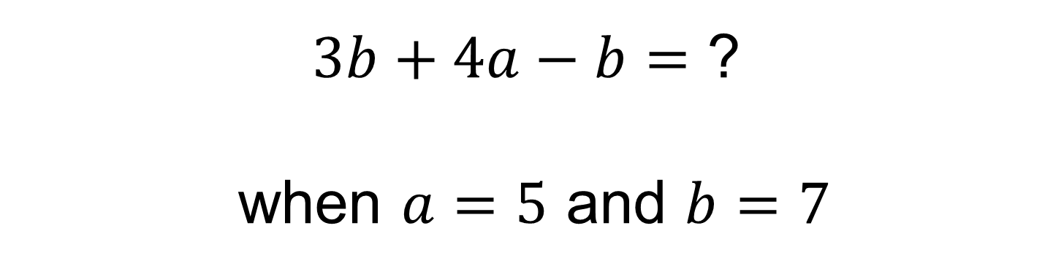
$3b+4a−b=$ ?
when $a=5$ and $b=7$

Slide 9
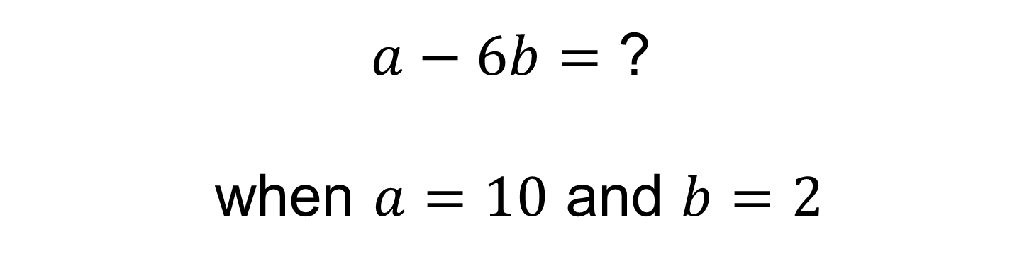
$a−6b=$ ?
when $a=10$ and $b=2$

Slide 10
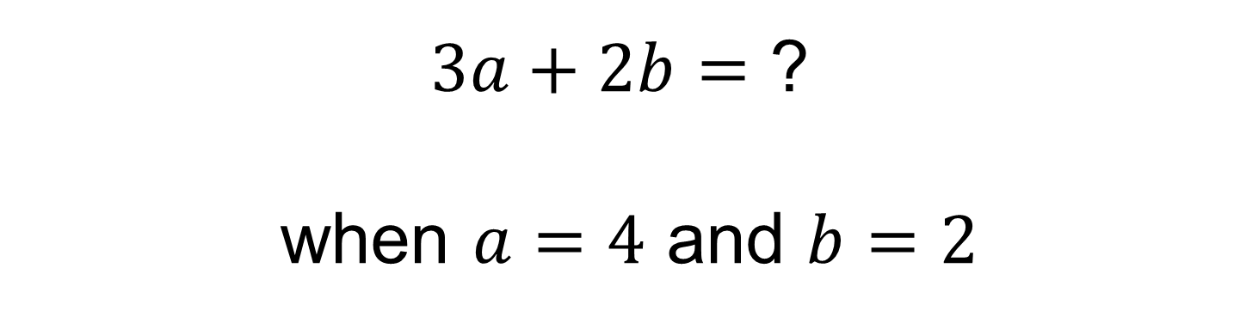
$3a+2b=$ ?
when $a=4$ and $b=2$

Slide 11
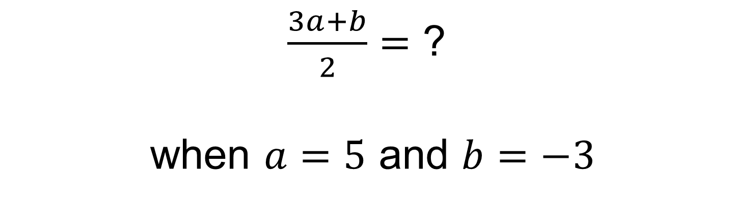
$\frac{3a+b}{2}=$ ?
when $a=5$ and $b=−3$

Slide 12
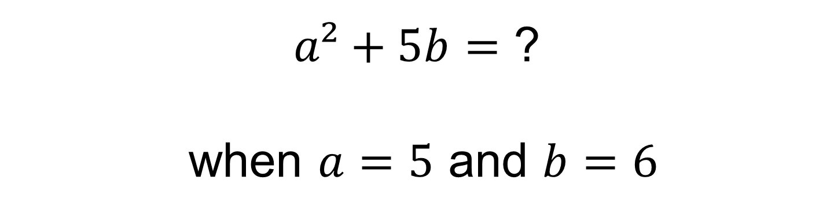
$a²+5b=$ ?
when $a=5$ and $b=6$

Slide 13
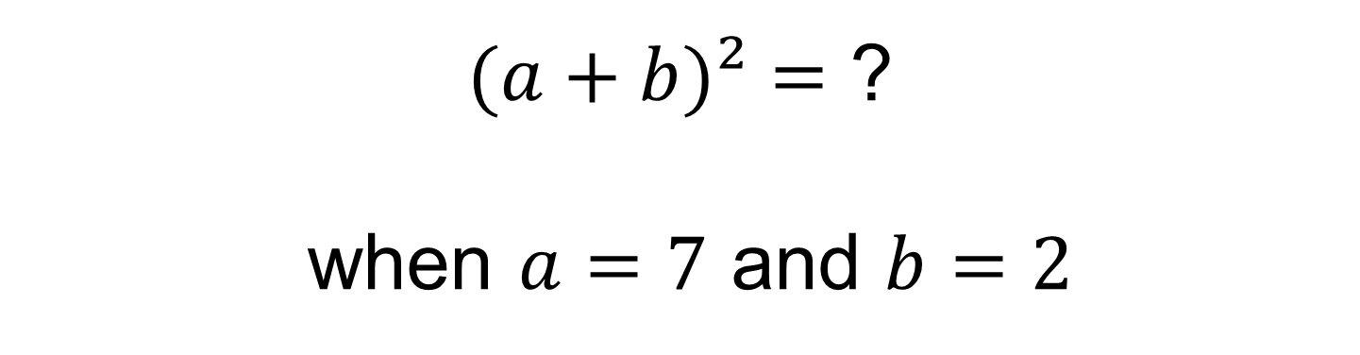
$(a+b)²=$ ?
when $a=7$ and $b=2$

Slide 14
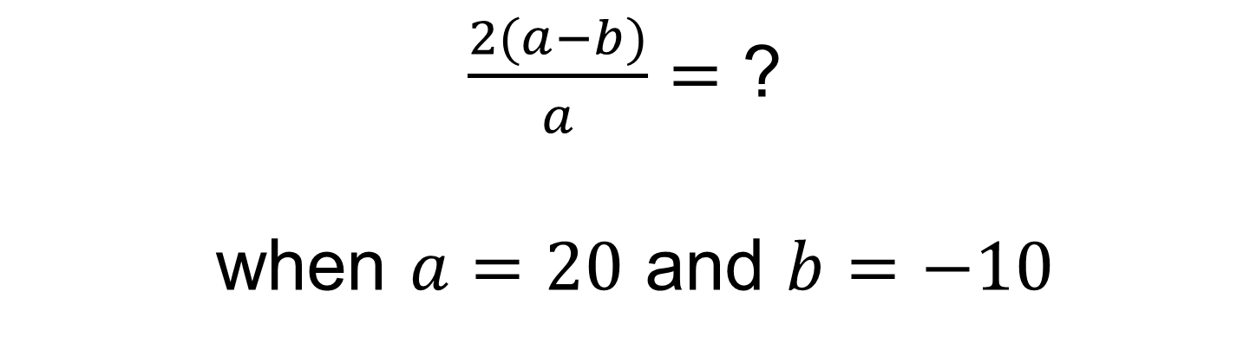
$\frac{2(a−b)}{a}=$ ?
when $a=20$ and $b=−10$

Slide 15
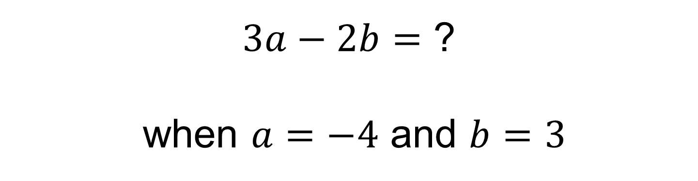
$3a−2b=$ ?
when $a=−4$ and $b=3$

Slide 16

Don’t forget to use the correct order of operations!
$2a²=$ ?
when $a=4$

Slide 17
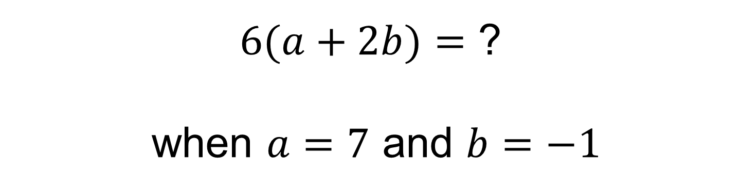
$6(a+2b)=$ ?
when $a=7$ and $b=−1$

Slide 18
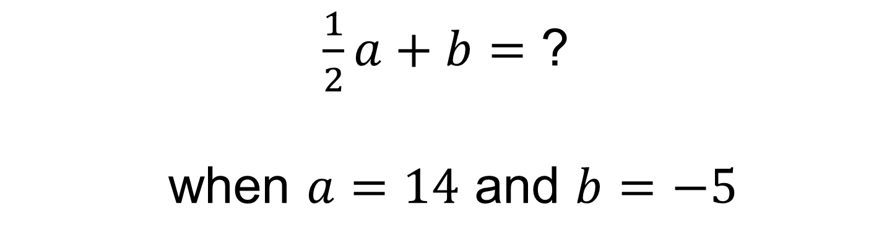
$\frac{1}{2}a+b=$ ?
when $a=14$ and $b=−5$

Slide 19

$a³=$ ?
when $a=−2$

Slide 20
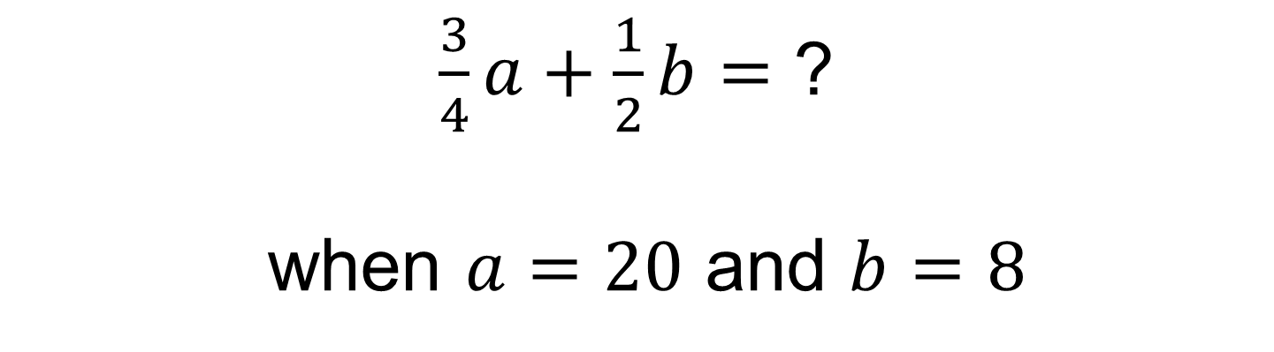
$\frac{3}{4}a+\frac{1}{2}b=$ ?
when $a=20$ and $b=8$

Slide 21
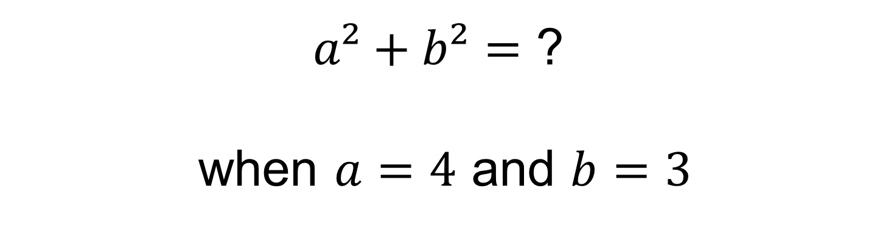
$a²+b²=$ ?
when $a=4$ and $b=3$

Slide 22
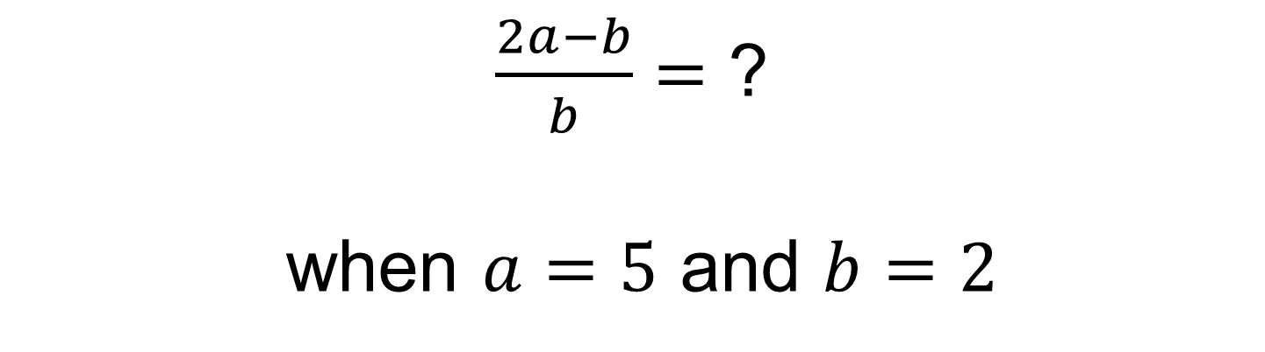
$\frac{2a−b}{b}=$ ?
when $a=5$ and $b=2$

Slide 23
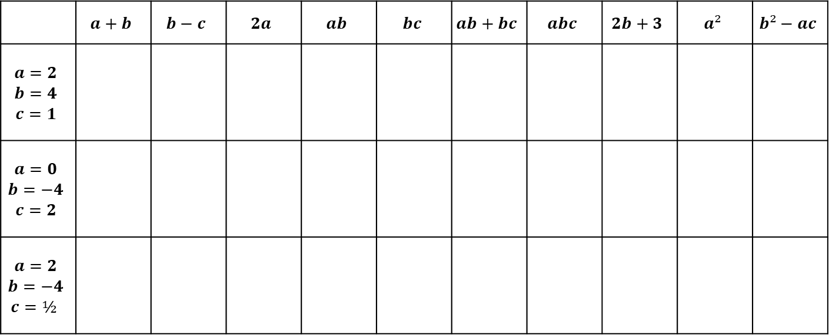
Task
Copy and complete the table using the three different set of values that need substituting. Show your working in your book to help you.
 | $$a+b$$ | $$b−c$$ | $$2a$$ | $$ab$$ | $$bc$$ | $$ab+bc$$ | $$abc$$ | $$2b+3$$ | $$a²$$ | $$b²−ac$$
$$a=2$$ $$b=4$$ $$c=1$$
$$a=0$$ $$b=−4$$ $$c=2$$
$$a=2$$ $$b=−4$$ $$c=½$$

Slide 24
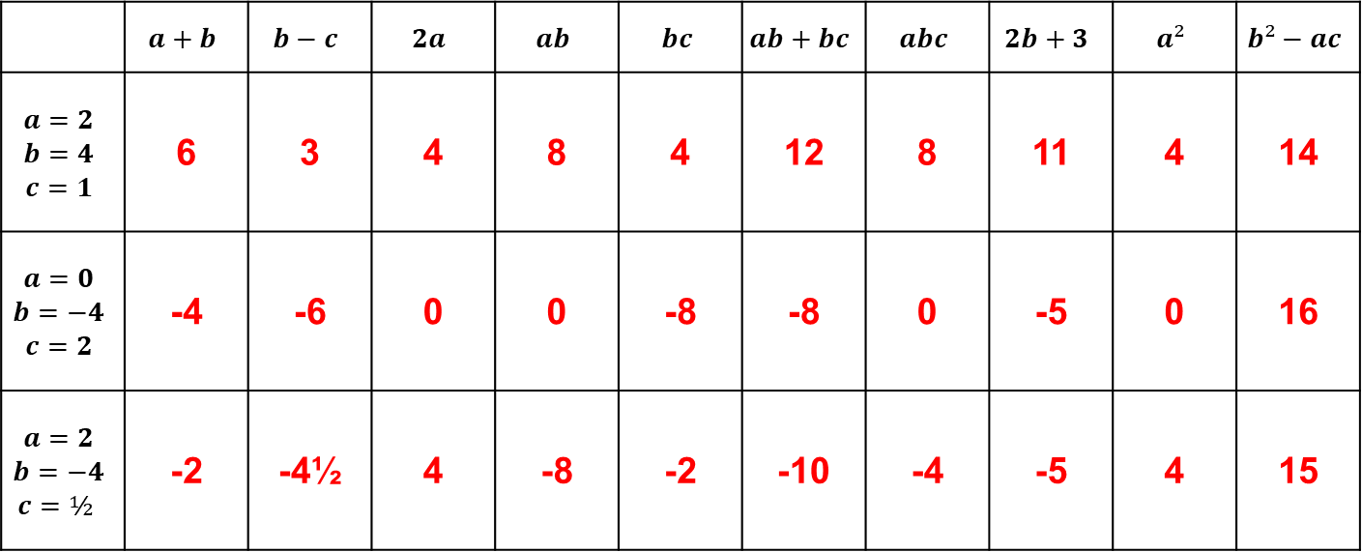
Task
Copy and complete the table using the three different set of values that need substituting. Show your working in your book to help you.
 | $$a+b$$ | $$b−c$$ | $$2a$$ | $$ab$$ | $$bc$$ | $$ab+bc$$ | $$abc$$ | $$2b+3$$ | $$a²$$ | $$b²−ac$$
$$a=2$$ $$b=4$$ $$c=1$$ | 6 | 3 | 4 | 8 | 4 | 12 | 8 | 11 | 4 | 14
$$a=0$$ $$b=−4$$ $$c=2$$ | -4 | -6 | 0 | 0 | -8 | -8 | 0 | -5 | 0 | 16
$$a=2$$ $$b=−4$$ $$c=½$$ | -2 | -4½ | 4 | -8 | -2 | -10 | -4 | -5 | 4 | 15

Slide 25
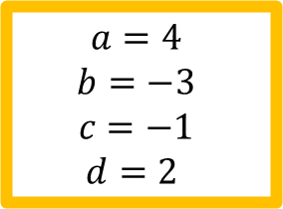
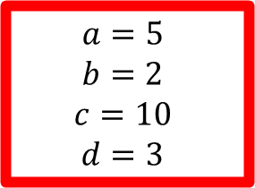
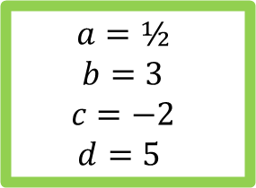
Superhero Top Trumps
$$a=5$$
$$b=2$$
$$c=10$$
$d=3$
$$a=4$$
$$b=−3$$
$$c=−1$$
$$d=2$$
$$a=½$$
$$b=3$$
$$c=−2$$
$$d=5$$
All the cards are dealt between the two players. The starting player chooses a category from his or her topmost card and reads out its value after substituting in the values. The other player then reads out the value of the same category from their top card. The largest value(or the most recent date) wins the "trick", and the winner takes both the cards of the trick and places them at the bottom of his or her pile. That player then looks at their new topmost card, and chooses the category for the next round.
In the event of a draw, the cards are placed in the center and a new category is chosen from the next card by the same person as in the previous round. The winner of that round obtains all of the cards in the center as well as the top card from each player.
The winner is the player who obtains the whole pack.

Slide 26


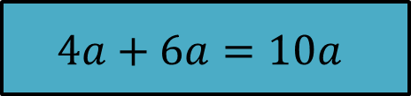


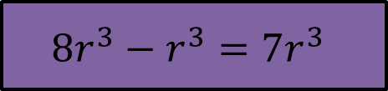

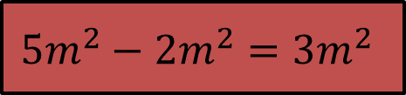

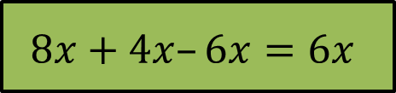
When the terms of an algebraic expression either do not differ or differ only in their coefficients, they are called like. Otherwise they are called unlike.
$$4a+6a$$
$$4a+6a=10a$$
$$8x+4x–6x$$
$$8x+4x–6x=6x$$
$$8r³−r³$$
$$8r^{3}−r^{3}={7r}^{3}$$
$$5m²−2m²$$
$$5m^{2}−2m^{2}={3m}^{2}$$
$$7d–5d$$
$$7d–5d=2d$$
An expression consisting only of like terms can be reduced to a single term.

Slide 27


Task
Match up the original expressions with their simplified partners.
One of the answers is missing. What should it be?
$3a+5a$ $9a$
$3a−5a$ $5a$
$5a−3a$ $3a$
$3a+2a+4a$ $2a$
$6a+2a−3a$ $a$
$7a−4a−2a$ $8a$
$\frac{1}{2}a+\frac{5}{2}a$
$$−2a$$

Slide 28


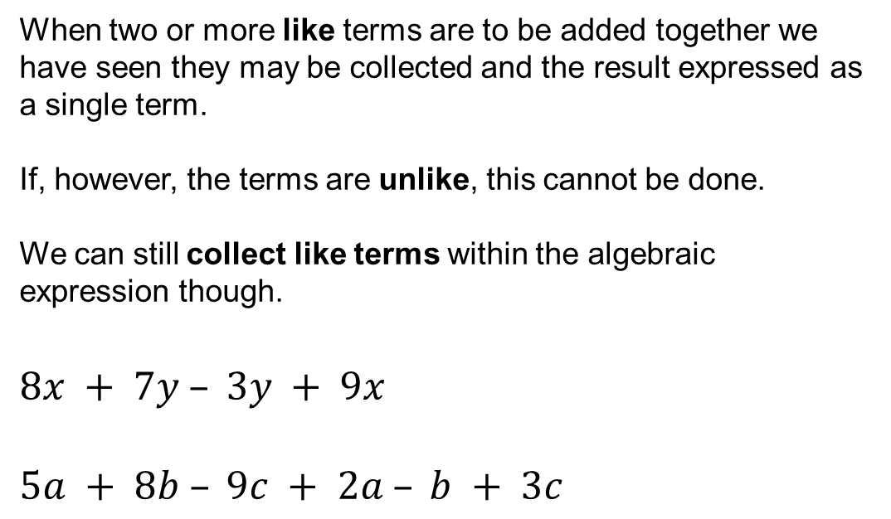



When two or more like terms are to be added together we have seen they may be collected and the result expressed as a single term.
If, however, the terms are unlike, this cannot be done.
We can still collect like terms within the algebraic expression though.
$8x + 7y – 3y + 9x$
$5a + 8b – 9c + 2a – b + 3c$
$$=17x$$
$$+4y$$
$$=7a$$
$$+7b$$
$$−6c$$

Slide 29
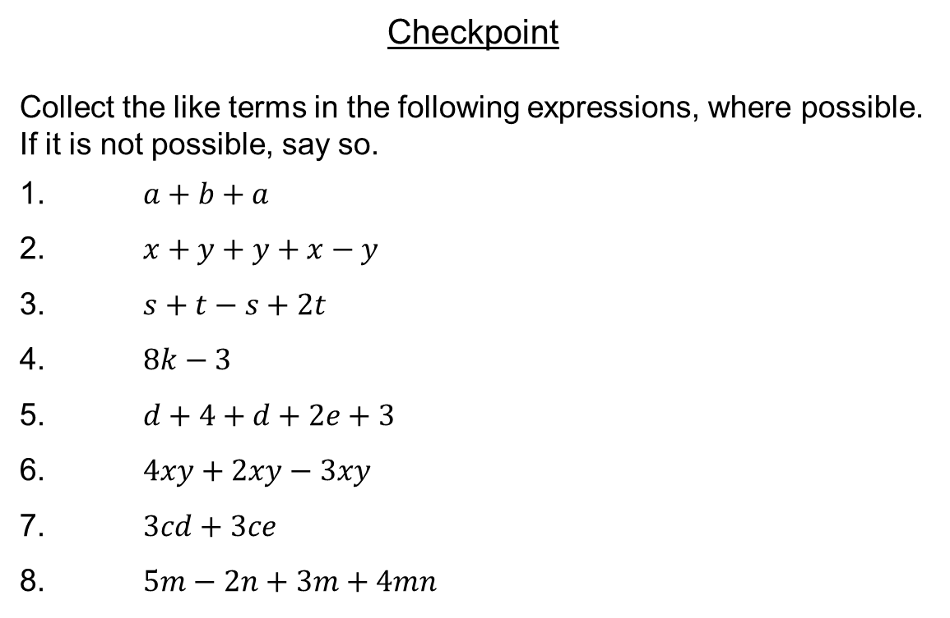
Checkpoint
Collect the like terms in the following expressions, where possible. If it is not possible, say so.
1. $a+b+a$
2. $x+y+y+x−y$
3. $s+t−s+2t$
4. $8k−3$
5. $d+4+d+2e+3$
6. $4xy+2xy−3xy$
7. $3cd+3ce$
8. $5m−2n+3m+4mn$

Slide 30
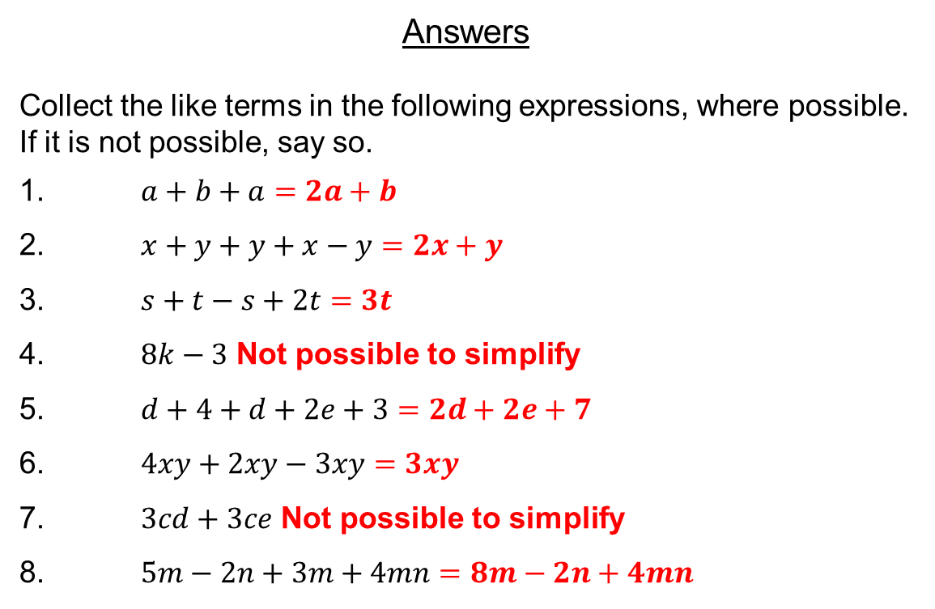
Answers
Collect the like terms in the following expressions, where possible. If it is not possible, say so.
1. $a+b+a=2a+b$
2. $x+y+y+x−y=2x+y$
3. $s+t−s+2t=3t$
4. $8k−3$ Not possible to simplify
5. $d+4+d+2e+3=2d+2e+7$
6. $4xy+2xy−3xy=3xy$
7. $3cd+3ce$ Not possible to simplify
8. $5m−2n+3m+4mn=8m−2n+4mn$

Slide 31
Pair Activity
Work together to complete the Tarsia jigsaw.
Show all your working in your books and make sure you understand every question.
Extension: Complete the exam questions.

