Slide 1
Starter
Think back to last lesson…
Which of the below are metric and which are imperial units of measure?
Millimetre
Gallon
Mile
Ounce
Yard
Kilogram
Centimetre
Inch
Litre
Stone

Slide 2
Answers
Think back to last lesson…
Which of the below are metric and which are imperial units of measure?
Millimetre
Gallon
Mile
Ounce
Yard
Kilogram
Centimetre
Inch
Litre
Stone

Slide 3
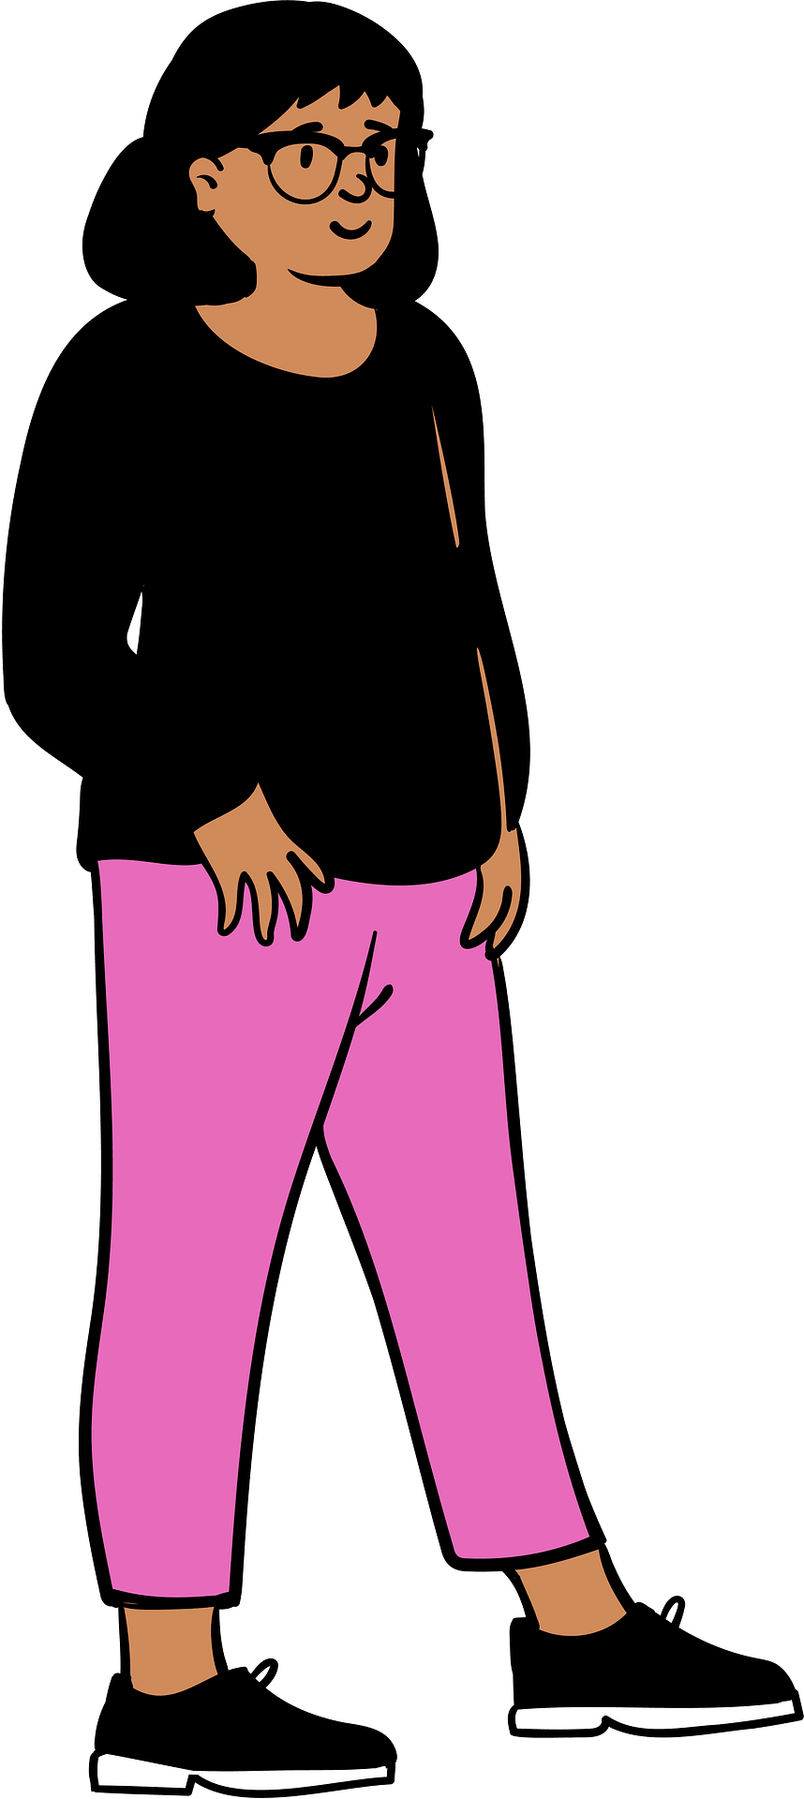
Items used to be measured using every day objects…

Slide 4
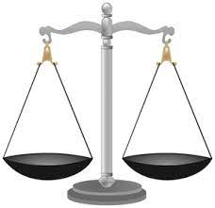
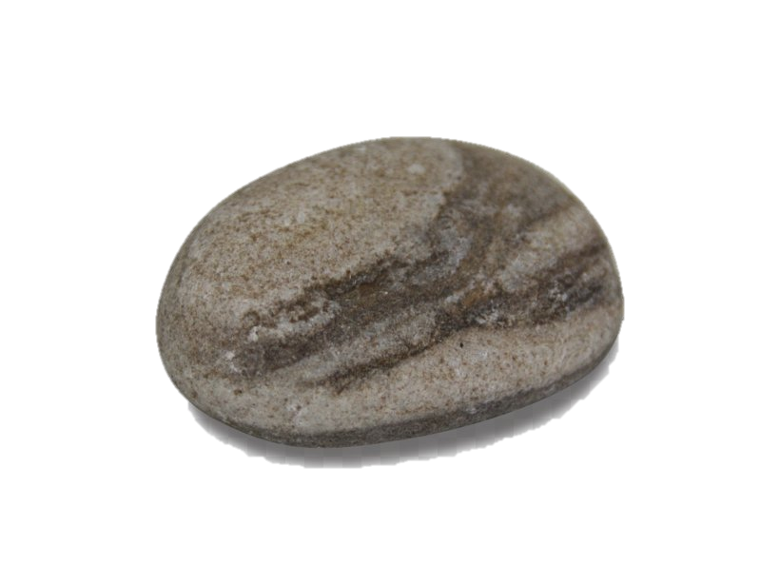
Items used to be measured using every day objects…

Slide 5
But this wasn’t always uniform or consistent.
Length
1 foot | 12 inches
1 yard | 3 feet
1 mile | 1760 yards
Mass
1 pound | 16 ounces
1 stone | 14 pounds
1 ton | 143 stones
Capacity
1 pint | 20 fluid ounces
1 gallon | 8 pints
If imperial units come up in exams, you’ll be given the conversions ☺

Slide 6
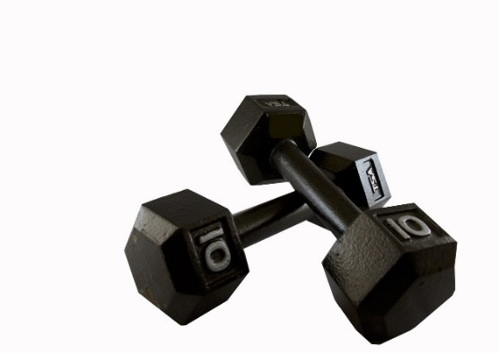
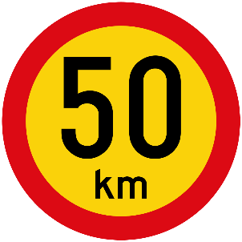
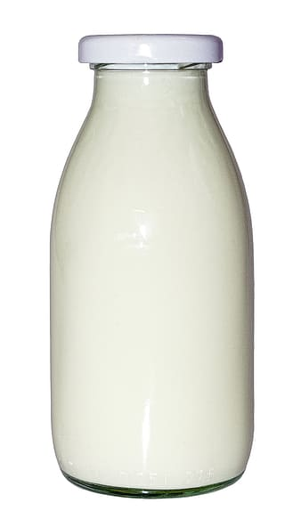
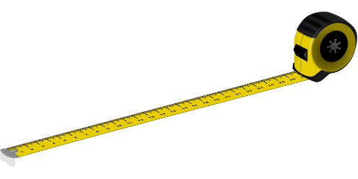
Metric to Imperial Unit Conversions
Metric | Imperial
1 kilogram | 2.2 pounds
1 litres | 1.76 pints
4.5 litres | 1 gallon
8 kilometres | 5 miles
2.52 centimetres | 1 inch
30 centimetres | 1 foot
If imperial units come up in exams, you’ll be given the conversions ☺

Slide 7
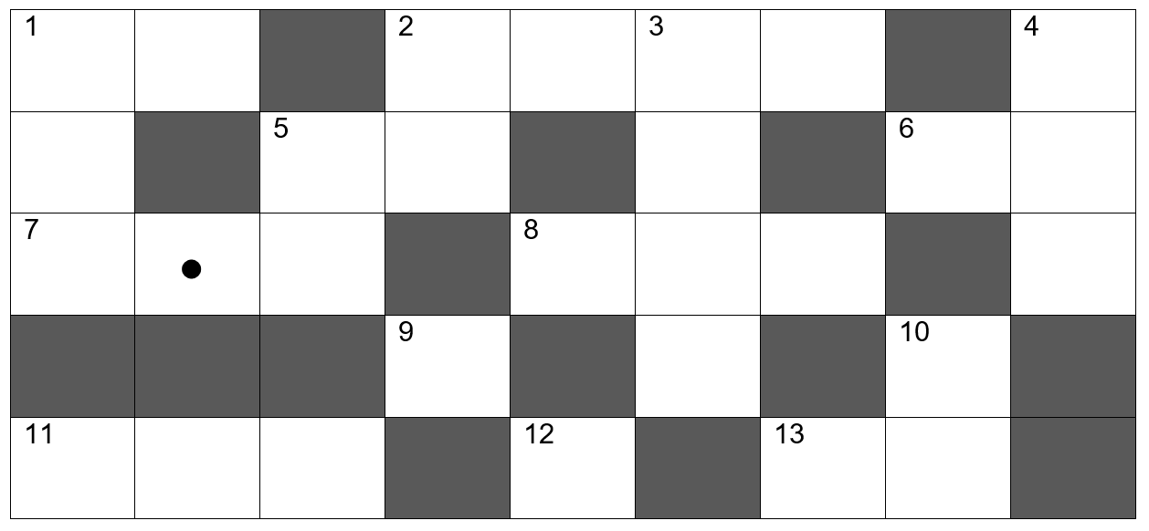
Metric to Imperial Unit Conversions
Use the clues to complete the cross-number.
Solve like a crossword puzzle, except that numbers replace words.
Notes:
Source: nottcl on TES

Slide 8
Answers
Notes:
Source: nottcl on TES

Slide 9
Write a sensible unit of metric and imperial measure for each of the following situations:
 | Metric | Imperial
The weight of a bicycle
The length of a exercise book
The volume of fuel in a fuel tank
The height of the London Eye
The weight of a dog
The volume of water in a sports bottle
The weight of a leaf
The distance from Bristol to Bath

Slide 10
Answers
 | Metric | Imperial
The weight of a bicycle | Kilograms | Pounds
The length of a exercise book | Centimetres | Inches
The volume of fuel in a fuel tank | Litres | Gallons
The height of the London Eye | Metres | Feet
The weight of a dog | Kilograms | Pounds
The volume of water in a sports bottle | Millilitres | Pints
The weight of a leaf | Grams | Ounces
The distance from Bristol to Bath | Kilometres | Miles

Slide 11
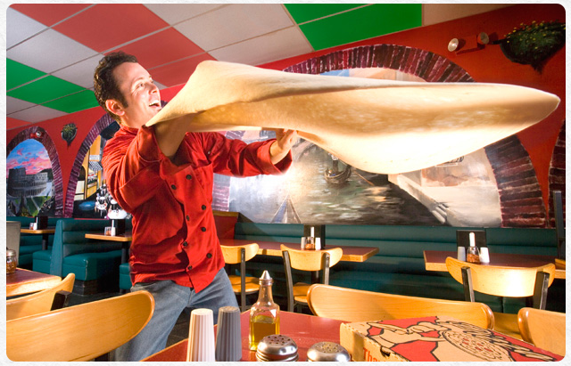
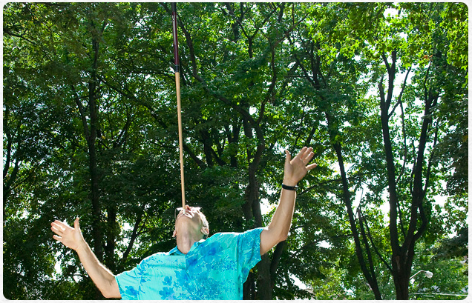
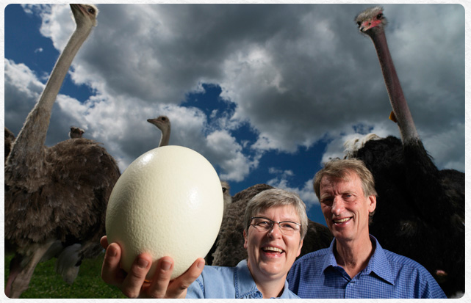
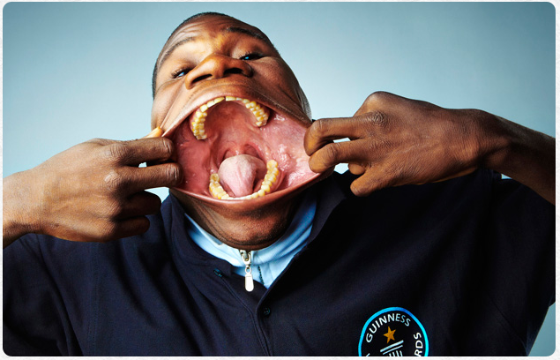
Task
Use the conversions that you wrote in your book earlier in the lesson to help you answer the Guinness World Record Book questions!
Notes:
Source: JellyMaths on TES

Slide 12
Answers
1. 26.4 pounds
2. 85.68 cm
3. 5.5 pounds
4. 17.136 cm
5. 155.6 litres
6. 11.9 inches
7. 20.8 km
8. 115.1 inches
9. 180 kg
10. 1 mile

