Slide 1
Measuring lines
This is a ruler. We use it to measure straight lines.
For example:
This line is 9.7 cm long.
Always start from zero!
Notes:
What do we use to measure angles?

Slide 2
Your Turn
Draw and measure the lines on the worksheet.
Make sure you look at the ruler carefully.

Slide 3
What’s Gone Wrong?
For example:
This line is 18.4 cm long.
Always start from zero!
Keep this in mind when we move on to look at drawing and measuring angles

Slide 4
What is an angle?
A corner
A measure of turn
A space between two lines
It is measured in degrees °

Slide 5
What is an angle?
A full turn is 360°

Slide 6
What is an angle?
A half turn is 180°
This is a straight line

Slide 7
What is an angle?
A quarter turn is 90°
We call it a ‘right angle’
We use a square rather than an arc

Slide 8
What is an angle?
A three quarter ( ¾ ) turn is 270°

Slide 9
Acute angles are less than 90º
14°
28°
83°

Slide 10
Obtuse angles are between 90° and 180°
108°
123°
144°

Slide 11
Reflex angles are between 180° and 360°
349°
193°
278°

Slide 12
Acute
Obtuse
Acute
What types of angles are these?
Right
Reflex
Notes:
Ask pupils to name the different angles.

Slide 13
Show me:
An obtuse angle
A half turn
A reflex angle
An acute angle
A ¾ turn
A right angle

Slide 14
Extension: Find examples of each type of angle around the room.

Slide 15
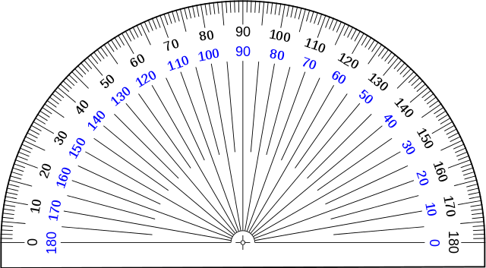
Measuring lines
This is a protractor.
It’s like a curved ruler that we use for measuring angles.
The numbers are degrees ( ° ).
Notes:
What do we use to measure angles?

Slide 16
Measuring lines
For example:
This angle is 42°.
Always start from zero!

Slide 17
Measuring lines
For example:
This angle is 124°.
Always start from zero!

Slide 18
Task
On the worksheet from before, measure the angles using your protractor.
Were your estimates close?

Slide 19
Extension
Copy the pictures as accurately as you can. You will need to measure the lengths of the lines and the size of the angles. Most accurate copy wins!

Slide 20
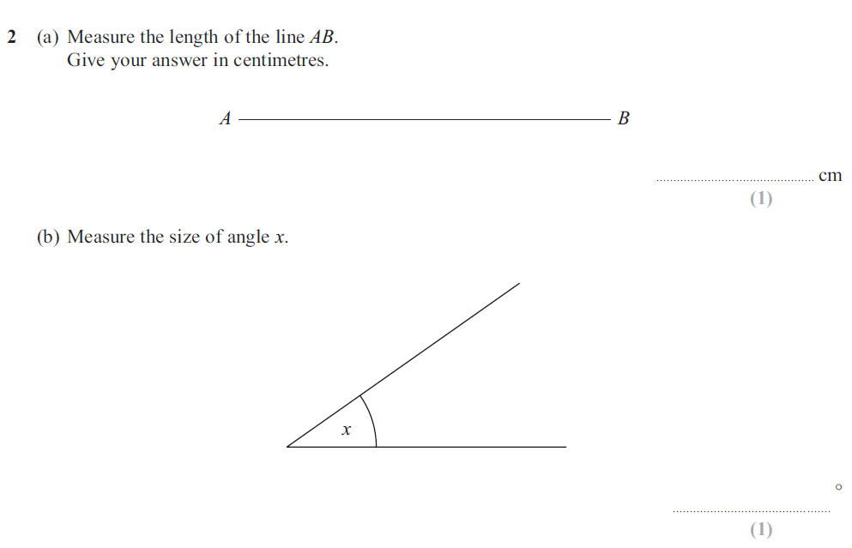
Plenary – Exam Question

