Slide 1
Instructions
Five rounds of five questions
Combination of maths and Christmas (Christmaths?)
No calculators allowed (you won’t need them anyway ☺)
Think of a (sensible) team name and write it at the top of your answer sheet
Write your answers clearly in the correct places
Have fun!

Slide 2
Round 1
(Fairly easy)

Slide 3
R1 Q1
The sum of two square numbers is 157.
What are the two square numbers?

Slide 4
R1 Q2
What is the cosine rule?

Slide 5
R1 Q3
What is the minimum point of
$$y=x^{2}−8x+15$$

Slide 6
R1 Q4
Solve
$$2^{6}=4^{2x−5}$$

Slide 7
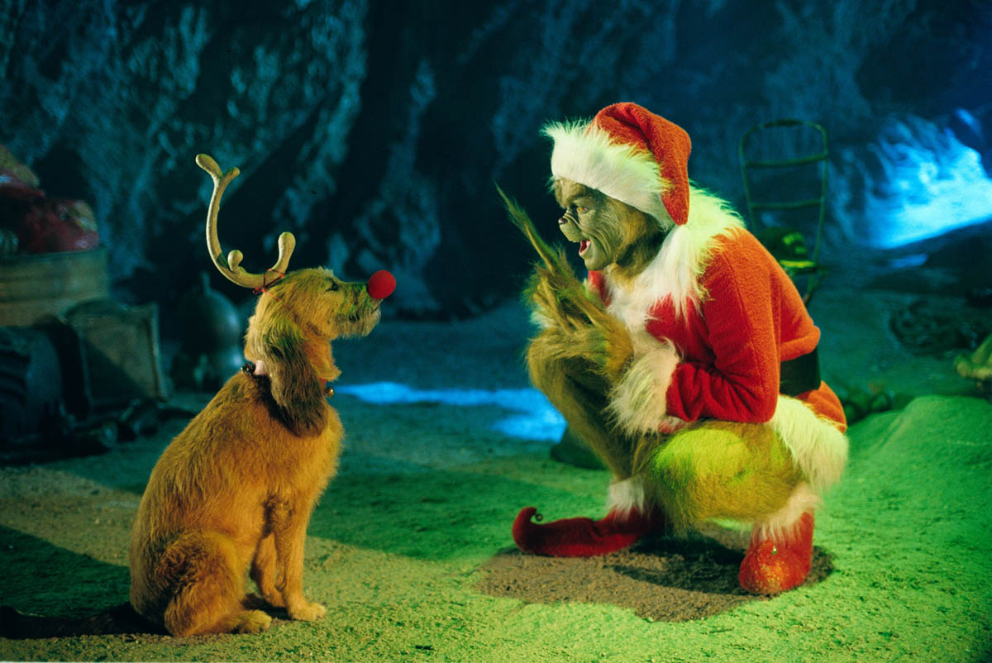
R1 Q5
Name the movie:

Slide 8
Round 1 Answers
Swap your answer sheet with a neighbouring team!
Q1: $121$ and $36$
Q2: $a^{2}=b^{2}+c^{2}−2bccosA$ or $cosA=\frac{b^{2}+c^{2}−a^{2}}{2bc}$
Q3: $(4,−1)$
Q4: $x=4$
Q5: The Grinch (Who Stole Christmas)
Swap back to see how you did ☺

Slide 9
Round 2
(Not too bad)

Slide 10
R2 Q1
Calculate $\frac{dy}{dx}$
$$y=2x^{4}+x^{2}−7x+12$$

Slide 11
R2 Q2
What is the periodicity of $y=tanx$?

Slide 12
R2 Q3
Find a factor of $x^{3}−3x^{2}−10x+24$

Slide 13
R2 Q4
What is the centre of the circle given by the equation
$$x^{2}+y^{2}−4x+12y+24=0$$

Slide 14
R2 Q5
Name the song featuring the lyrics:
“Snow is falling
All around me
Children playing
Having fun”

Slide 15
Round 2 Answers
Swap your answer sheet with a neighbouring team!
Q1: $y=8x^{3}+2x−7$
Q2: $180°$ or $π$ radians
Q3: $(x−2)$, $(x−4)$ or $(x+3)$
Q4: $(2,−6)$
Q5: Merry Christmas Everyone
Swap back to see how you did ☺

Slide 16
Round 3
(A little tricky)

Slide 17
R3 Q1
Solve the inequality
$$2x^{2}+5x−3<0$$

Slide 18
R3 Q2
Describe the transformation that maps $f\left(x\right)=x^{2}$ onto $f\left(x\right)={(x−2)}^{2}+3$.

Slide 19
R3 Q3
Calculate the equation of the perpendicular bisector of the line $AB$ where $A(3,−4)$ and $B(9,6)$.
Express your answer in the form
$ax+by+c=0$ where $a$, $b$ and $c$ are integers.

Slide 20
R3 Q4
What is the coefficient of $x^{3}$ in the binomial expansion of ${(2x−3)}^{7}$?

Slide 21
R3 Q5
Who played the Prime Minister in ‘Love Actually’?

Slide 22
Round 3 Answers
Swap your answer sheet with a neighbouring team!
Q1: $−3<x<\frac{1}{2}$
Q2: Translation by vector $\left(\begin{matrix}2 \\ 3\end{matrix}\right)$
Q3: $3x+5y−23=0$
Q4: $22680$
Q5: Hugh Grant
Swap back to see how you did ☺

Slide 23
Round 4
(Pretty tough)

Slide 24
R4 Q1
Calculate the remainder when
${2x}^{3}−x^{2}+3x+15$ is divided by $(x−4)$

Slide 25
R4 Q2
Rationalise the denominator
$$\frac{3+\sqrt{2}}{\sqrt{2}−1}$$

Slide 26
R4 Q3
Determine how many distinct real roots the equation $y=3x^{2}+4x−2$ has.

Slide 27
R4 Q4
Calculate
$$\int_{4}^{7}{\left({2x}^{3}−26x−24\right)dx}$$

Slide 28
R4 Q5
Can you name all eight original reindeer?

Slide 29
Round 4 Answers
Swap your answer sheet with a neighbouring team!
Q1: $139$
Q2: $4\sqrt{2}+5$
Q3: $2$
Q4: $571.5$
Q5: Dasher, Dancer, Prancer, Vixen, Comet, Cupid, Donner and Blitzen
Swap back to see how you did ☺

Slide 30
Round 5
(Hard as nails)

Slide 31
R5 Q1
Simplify $5\sin^{2}θ+5\cos^{2}θ$

Slide 32
R5 Q2
The curve with equation $y=f(x)$ passes through the point $(−1,0)$. Given that $f^{′}\left(x\right)=12x^{2}−8x+1$, find $f(x)$.

Slide 33
R5 Q3
The curve $C$ has equation
$y=\frac{(x+3)(x−8)}{x}$, $x>0$
Find $\frac{dy}{dx}$ in its simplest form.

Slide 34
R5 Q4
Given that $2\log_{k}x−\log_{k}5=1$, express $k$ in terms of $x$. Give your answer in a form not involving logarithms.

Slide 35
R5 Q5
What is Father Christmas’ actual name in ‘Miracle on 34th Street’?

Slide 36
Round 5 Answers
Swap your answer sheet with a neighbouring team!
Q1: $5$
Q2: $f\left(x\right)=4x^{3}−4x^{2}+x+9$
Q3: $\frac{dy}{dx}=1+\frac{24}{x^{2}}$
Q4: $k=\frac{x^{2}}{5}$
Q5: Kris Kringle
Swap back to see how you did ☺

