Slide 1
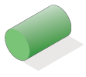
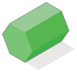
Starter
How many 3D shapes can you list?

Slide 2
A solid can be drawn from various view points.
Plan view
2 cm
7 cm
2 cm
3 cm
Side elevation
Front elevation
7 cm
3 cm
3 cm
2 cm
7 cm

Slide 3
What solid shape could produce this shadow?
The obvious answer is a cuboid, although any prism could be orientated to produce this shadow. We could also have a pyramid with a rectangular base.

Slide 4
What solid shape could produce this shadow?
Possible answers include a tetrahedron, any pyramid (including a cone) or a triangular prism.

Slide 5
What solid shape could produce this shadow?
Possible answers include a sphere, a cylinder or a cone.

Slide 6
What solid shape could produce this shadow?
Possible answers include a cube, a cuboid with a square cross-section, a square-based pyramid or any prism whose length is equal to its height.

Slide 7
Plan View
Side Elevation
Front Elevation
Plan
Front Elevation
Side Elevation

Slide 8
Plan View
Front Elevation
Side Elevation
Front Elevation
Plan
Side Elevation

Slide 9
Plan View
Front Elevation
Side Elevation
Plan
Front Elevation
Side Elevation

Slide 10
Front elevation:
Side elevation:
Plan view:
A:
A:
B:
C:

Slide 11
Front elevation:
Side elevation:
Plan view:
A:
B:
C:
C:

Slide 12
Front elevation:
Side elevation:
Plan view:
A:
A:
B:
C:

Slide 13
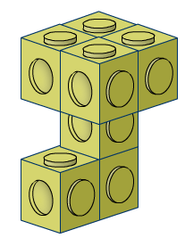
Front elevation:
Side elevation:
Plan view:
A:
B:
B:
C:

Slide 15
Answers

Slide 16
Answers

Slide 17
Answers

Slide 18
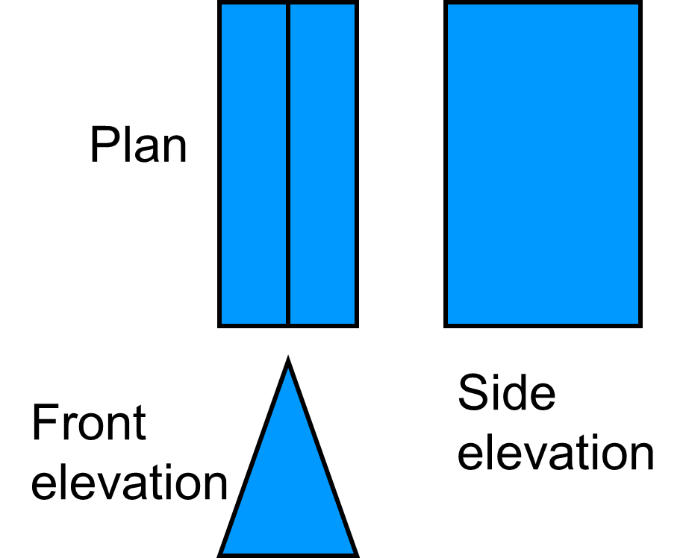
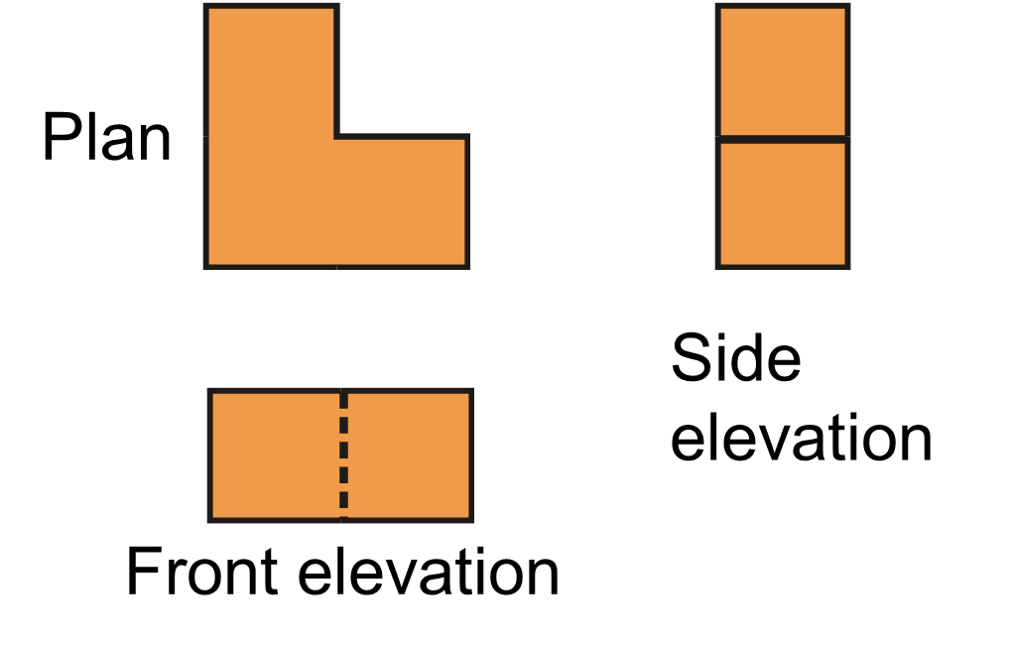
Sketch the 3D shapes that have the following plans and elevations:
Bonus: With arrows, label the directions of the front elevation, side elevation and plan…

Slide 19
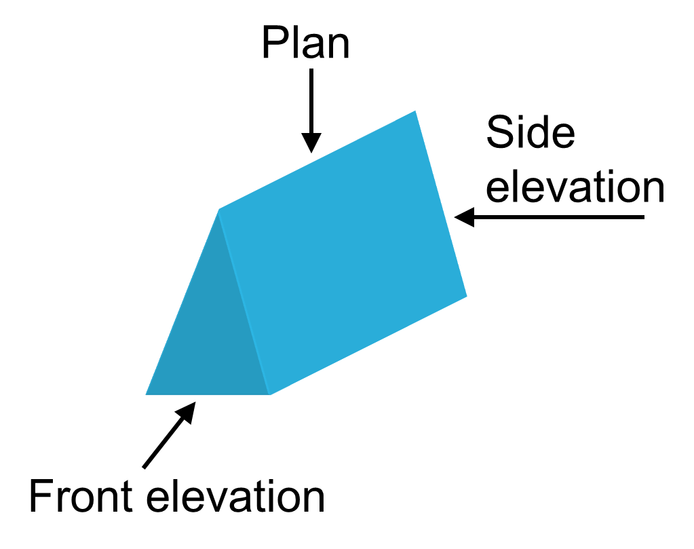
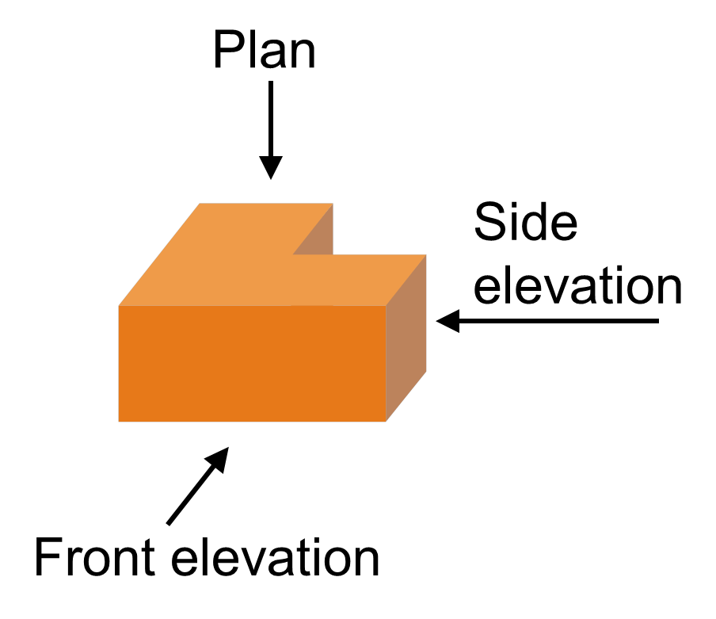
Did you get something that looks like this?

