Slide 1
Starter
Match the questions to the answers! Show your working in your book.
Work out 40% of £500 £700
Increase £500 by 40% £520
Decrease £500 by 40% £200
Increase £500 by 4% £480
Decrease £500 by 4% £300

Slide 2
Answers
Work out 40% of £500 £700
Increase £500 by 40% £520
Decrease £500 by 40% £200
Increase £500 by 4% £480
Decrease £500 by 4% £300
500 × 1.4
500 × 0.4
500 × 1.04
500 × 0.6
500 × 0.96

Slide 3
Interest
If you put money into a bank or building society they will pay you interest on this money.
If you have borrowed money, from a bank or building society for a mortgage or other loan, you have to pay them interest.
Simple interest is calculated on a yearly basis (annually) and depends on the interest rate. The rate is often given per annum (p.a.) which means per year.
Compound interest is interest added to the principal of a deposit or loan so that the added interest also earns interest from then on. This addition of interest to the principal is called compounding.

Slide 4
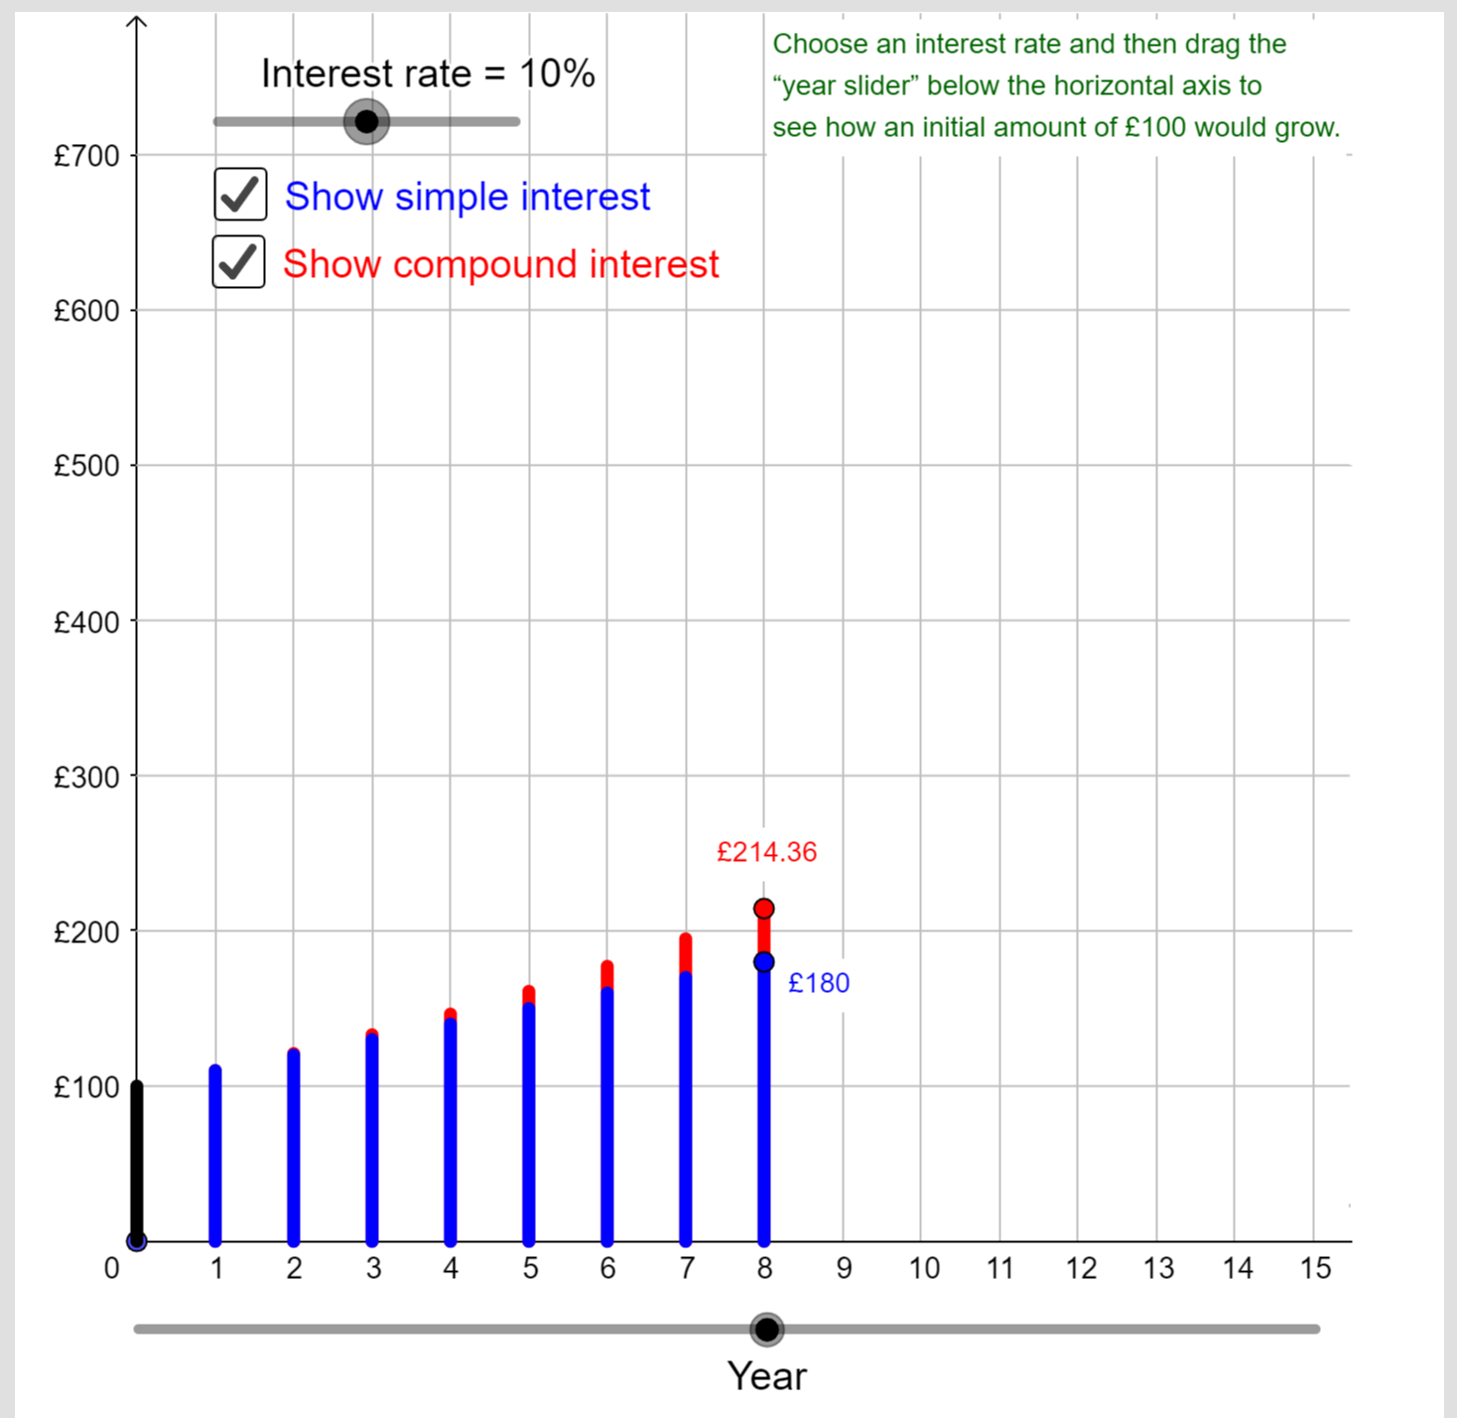
Use Boss Maths’ Geogebra applet to compare how simple and compound interest compare over 15 years.
Click here!

Slide 5
Example
Jess wants to invest £2000 for 3 years.
Two different banks are willing to offer 10% interest p.a., one simple and one compound.
Compare the investment options.
Simple interest
 | Start | Interest | End
Year 1 | £2000
Year 2
Year 3
Compound interest
 | Start | Interest | End
Year 1 | £2000
Year 2
Year 3
£200
£2200
£200
£2200
£2200
£200
£2400
£2200
£220
£2420
£2400
£200
£2600
£2420
£242
£2662
Interest stays the same each year
Interest builds year on year

Slide 6
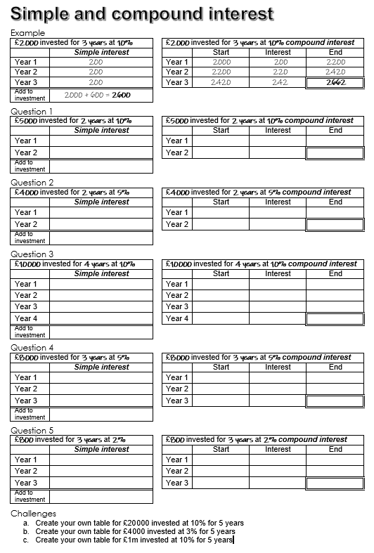
Task
Complete the sheet to practice calculating simple and compound interest.
Notes:
Source: madalien on TES

Slide 7
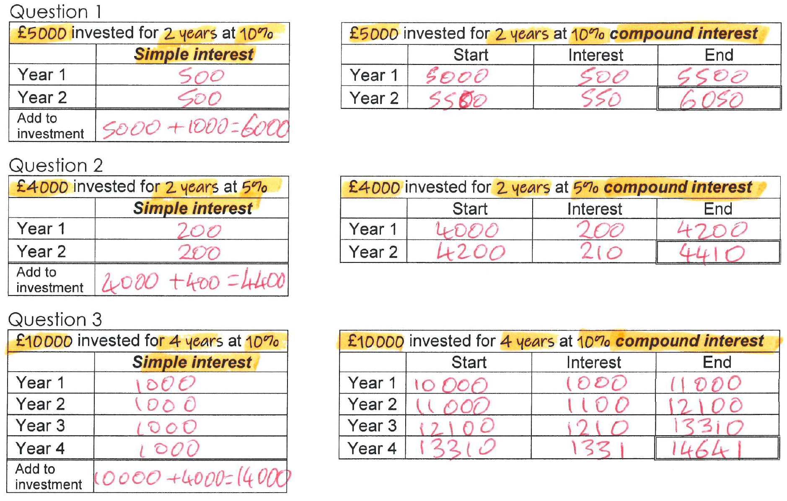
Answers
Notes:
Source: madalien on TES

Slide 8
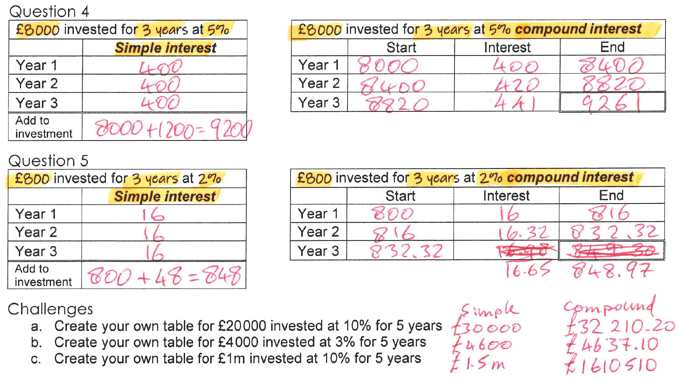
Answers
Notes:
Source: madalien on TES

Slide 9
Example
Jack has £15 000 to invest in a savings account for 3 years.
He finds information about two savings accounts.
Jack wants to have as much money as possible in his savings account at the end of the 3 years.
Which of these two savings accounts should he choose?
2.3% = 0.023
£15 000 × 0.023 = £345
£15 000 + 3 × £345 = £16 035
2.15% = 0.0215
£15 000 × 1.0215³ = £15 988.45
Jack should choose the simple interest savings account

Slide 10
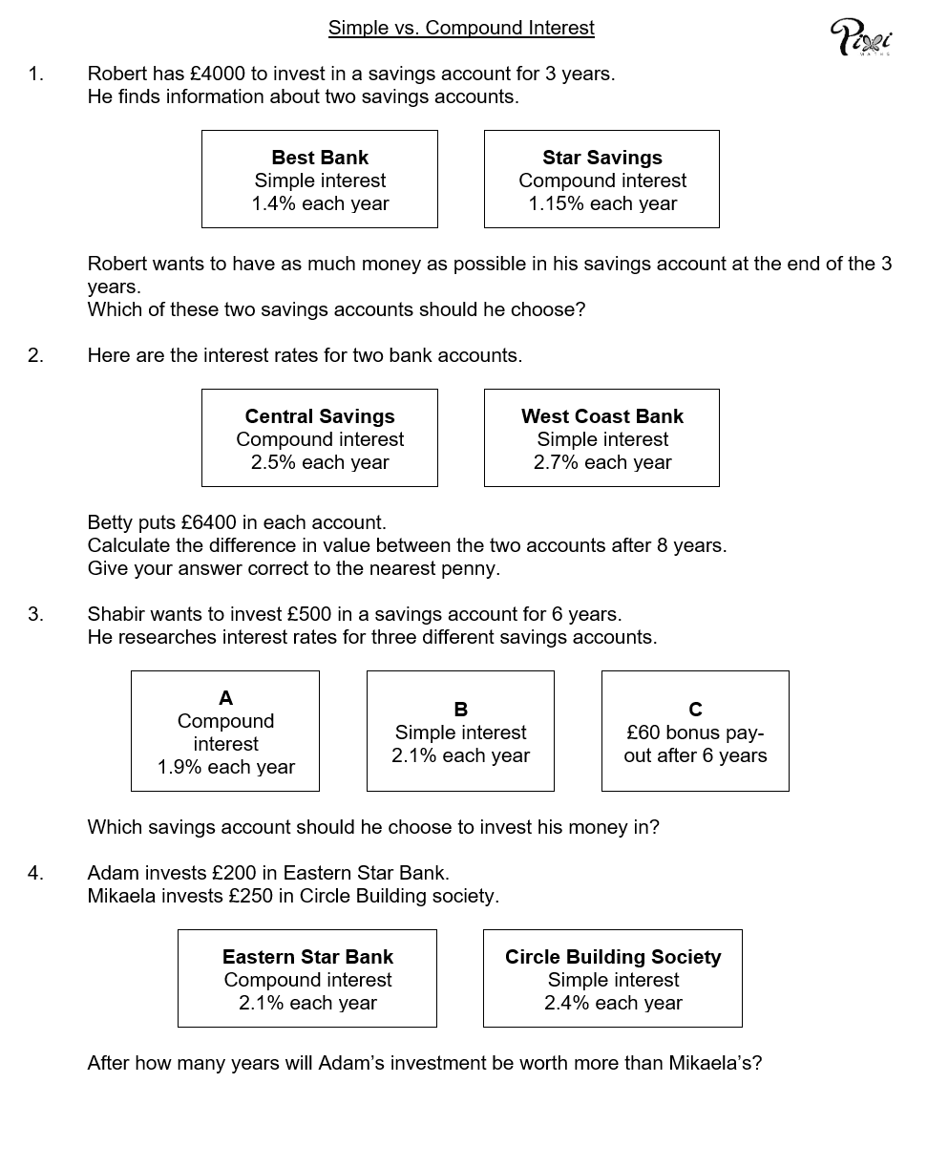
Task
Answer the exam style questions to compare simple and compound interest rates
Notes:
Source: madalien on TES

Slide 11
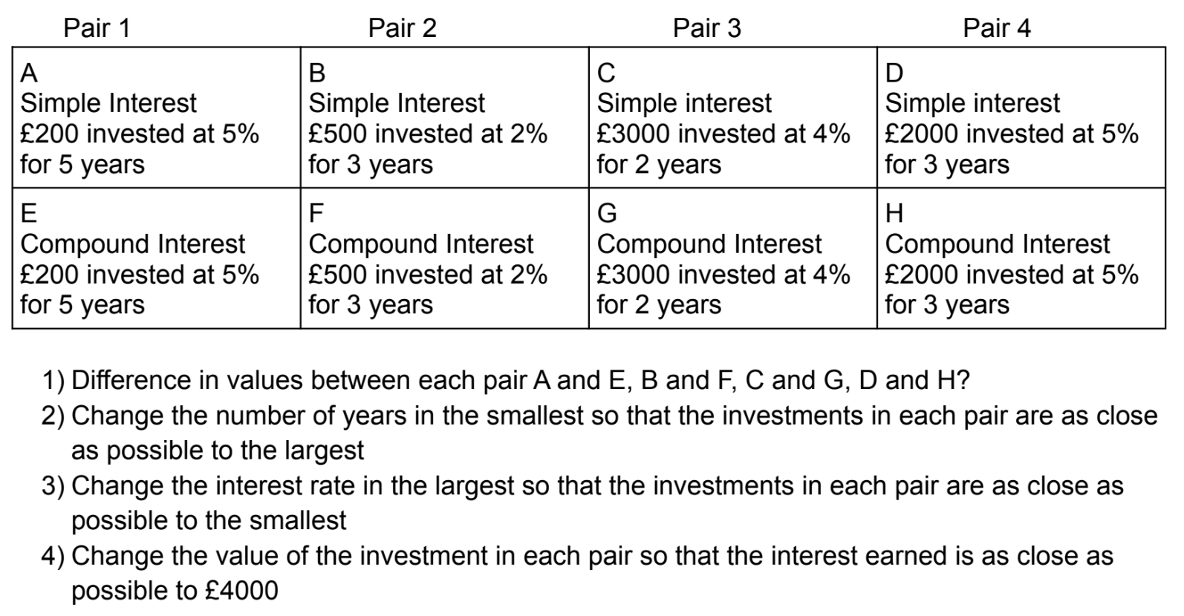
Extension Task
Notes:
Source: WebMaths https://webmathscouk.wordpress.com/

Slide 12
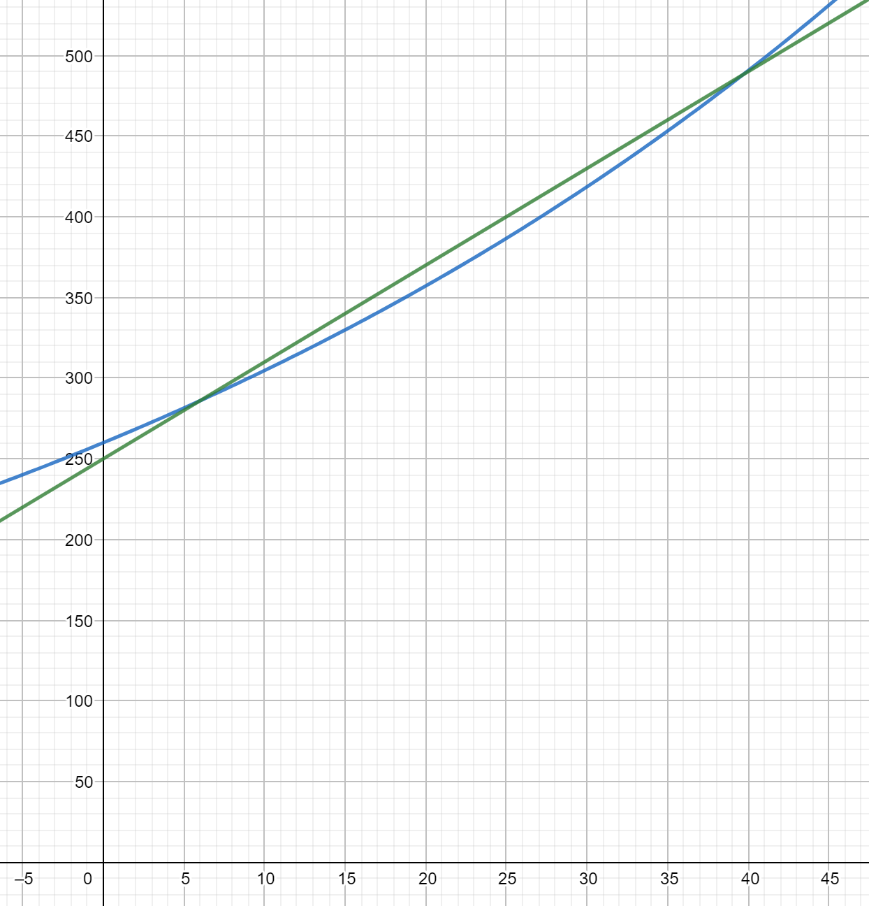
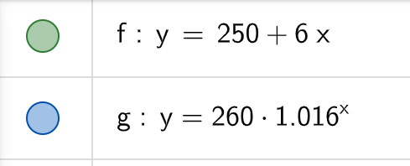
Answers
1. Best Bank: £4168 Star Savings: £4182.71
2. Central Savings: £7797.78 West Coast Bank: £7782.40
£7797.78 - £7782.40 = £15.38
3. A: £559.78 B: £563 C: £560
4. 6 years… until 40 years when
Adam’s is worth more again!
Notes:
Source: madalien on TES

Slide 13
Plenary
1 question about today’s topic
2 things you learnt today
3 things you knew already

