Slide 1
Starter
What’s the same and what’s different?
$\sqrt{2}$ $\sqrt{81}$
$9$ $\sqrt{9}$

Slide 2
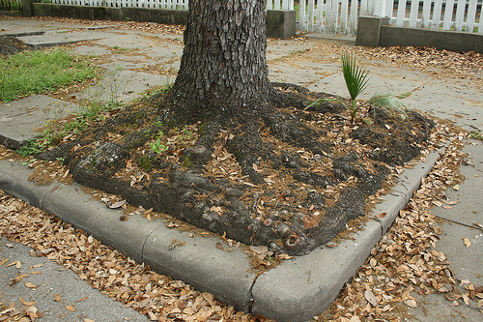
What is a surd?
A surd is a square root which cannot be reduced to a whole number.
Examples:
$\sqrt{2}$ is a surd.
$\sqrt{5}$ is a surd.
$\sqrt{81}$ looks like a surd, but isn't really...

Slide 3
Multiplication of Surds
$\sqrt{4}×\sqrt{9}=\sqrt{36}=6$
$\sqrt{2}×\sqrt{8}=\sqrt{16}=4$
General rule: $\sqrt{a}×\sqrt{b}=\sqrt{ab}$

Slide 4
Multiplication of Surds
$\sqrt{3}×\sqrt{12}$
$\sqrt{3}×\sqrt{4}$
$\sqrt{2}×\sqrt{5}$
$\sqrt{5}×\sqrt{5}$
$\sqrt{6}×\sqrt{9}$
$\sqrt{5}×\sqrt{20}$
$\sqrt{3}×\sqrt{27}$
$\sqrt{2}×\sqrt{3}×\sqrt{12}$
General rule: $\sqrt{a}×\sqrt{b}=\sqrt{ab}$
$=6$
$=\sqrt{12}$
$=\sqrt{10}$
$=5$
$=\sqrt{54}$
$=10$
$=9$
$=\sqrt{72}$
2-minute challenge:
How many can you do?
Simplify answers where possible.
NO CALCULATORS!

Slide 5
Division of Surds
$\sqrt{36}÷\sqrt{9}=\sqrt{4}=2$
$\sqrt{54}÷\sqrt{6}=\sqrt{9}=3$
General rule: $\sqrt{a}÷\sqrt{b}=\sqrt{\frac{a}{b}}$

Slide 6
Division of Surds
$\sqrt{12}÷\sqrt{3}$
$\sqrt{44}÷\sqrt{4}$
$\sqrt{100}÷\sqrt{4}$
$\sqrt{25}÷\sqrt{5}$
$\sqrt{81}÷\sqrt{9}$
$\sqrt{75}÷\sqrt{25}$
$\sqrt{28}÷\sqrt{7}$
$(\sqrt{2}×\sqrt{9})÷\sqrt{3}$
General rule:$\sqrt{a}÷\sqrt{b}=\sqrt{\frac{a}{b}}$
$=2$
$=\sqrt{11}$
$=5$
$=\sqrt{5}$
$=3$
$=\sqrt{3}$
$=2$
$=\sqrt{6}$
2-minute challenge:
How many can you do?
Simplify answers where possible.
NO CALCULATORS!

Slide 7
Addition and Subtraction of Surds
$\sqrt{9}+\sqrt{16}=3+4=7$
$\sqrt{(9+16)}=\sqrt{25}=5$
General rule: there is no rule!

Slide 8
Examples
Simplify:
$\sqrt{12}$ $\sqrt{72}$ $\sqrt{12}×\sqrt{27}$
$=\sqrt{4}×\sqrt{3}$
$=\sqrt{36}×\sqrt{2}$
$=\sqrt{4}×\sqrt{3}×\sqrt{9}×\sqrt{3}$
$=2×\sqrt{3}$
$=6×\sqrt{2}$
$=2×\sqrt{3}×3×\sqrt{3}$
$=2\sqrt{3}$
$=6\sqrt{2}$
$=6\sqrt{9}$
$=6×3$
$=18$

Slide 9
Examples
Expand ${\left(5−\sqrt{3}\right)}^{2}$. Write your answer in the form $a+b\sqrt{3}$.
$25−5\sqrt{3}−5\sqrt{3}+3$
$=28−10\sqrt{3}$
$$×$$ | $$5$$ | $$−\sqrt{3}$$
$$5$$
$$−\sqrt{3}$$
$$25$$
$$−5\sqrt{3}$$
$$−5\sqrt{3}$$
$$3$$

Slide 11
Answers
1. 3√2 2. 2√14 9. 33 + 11√3
3. 4√6 4. 2√15 10. 44
5. 3√6 11. 34 - 25√2
6. 12 12. 9
7. 8
8. 6

Slide 12
Plenary
The answer is
$$3\sqrt{5}$$
What was the question?

