Slide 1
Starter
Whiteboards ready!
Describe the single transformations…

Slide 2
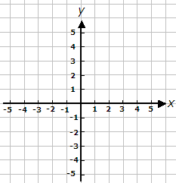
Describe the single transformation that maps the blue triangle onto the orange triangle.
Translation by the vector $\left(\begin{matrix}3 \\ −3\end{matrix}\right)$

Slide 3
Describe the single transformation that maps the blue triangle onto the orange triangle.
Rotation $90°$ clockwise, centre $(0, 0)$

Slide 4
Describe the single transformation that maps the blue triangle onto the orange triangle.
Enlargement by scale factor $3$, centre $(−5, −4)$

Slide 5
Describe the single transformation that maps the blue triangle onto the orange triangle.
Reflection in the line $y=1$

Slide 6
Describe the single transformation that maps the blue triangle onto the orange triangle.
Enlargement by scale factor $\frac{1}{2}$, centre $(4, −4)$

Slide 7
Describe the single transformation that maps the blue triangle onto the orange triangle.
Translation by the vector $\left(\begin{matrix}−4 \\ 0\end{matrix}\right)$

Slide 8
Describe the single transformation that maps the blue triangle onto the orange triangle.
Reflection in the line $y=x$

Slide 9
Describe the single transformation that maps the blue triangle onto the orange triangle.
Rotation $180°$, centre $(2, 1)$

Slide 10
Invariant point
Invariant point
A co-ordinate is invariant if it does not change position after a transformation.
Invariant point
Invariant point

Slide 11
How can you ensure that a point is invariant after a single reflection?
Reflect in $x=2$
Invariant point
Reflect in $y=2$
Reflect in $y=x$
Reflect in $y=2x−2$
Reflect in any line that goes through the invariant point!

Slide 12
How can you ensure that a point is invariant after a single rotation?
Rotate $90°$ clockwise, centre $(2, 2)$
Invariant point
Rotate $180°$, centre $(2, 2)$
Rotate $90°$ anticlockwise, centre $(2, 2)$
Rotate $45°$ clockwise, centre $(2, 2)$
Any rotation around the invariant point!

Slide 13
How can you ensure that a point is invariant after a single enlargement?
Enlarge by scale factor $2$, centre $(2, 2)$
Invariant point
Enlarge by scale factor $\frac{1}{2}$, centre $(2, 2)$
Enlarge by scale factor $−3$, centre $(2, 2)$
Any enlargement from the invariant point!

Slide 14
How can you ensure that a point is invariant after a single translation?
Not possible – a translation slides the whole shape so no point will be left unchanged.
Invariant point

Slide 15
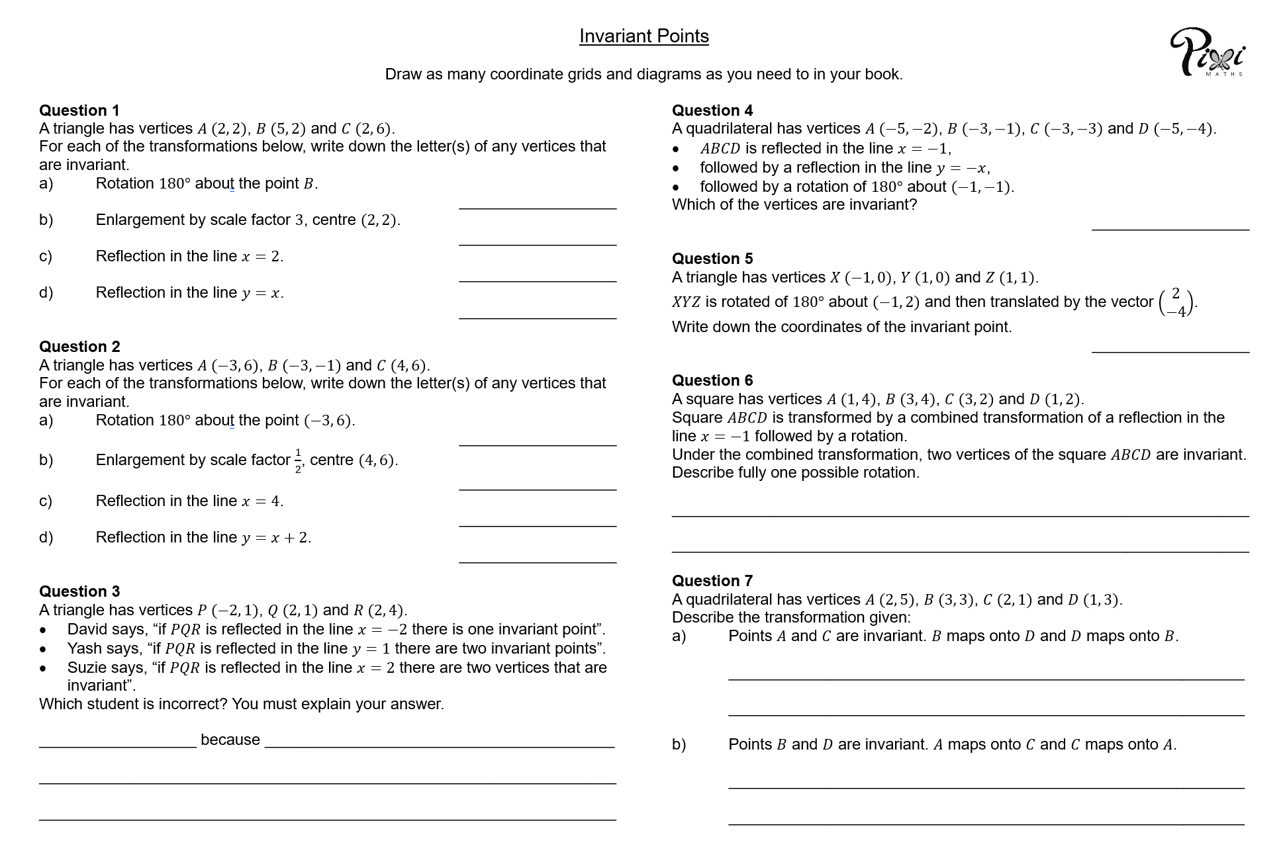
Task
Complete the worksheet on transformations and invariant points.
Draw as many diagrams as you need to in your book ☺
Extension
Break the code to find the punchline to the joke.
Notes:
Extension link: https://www.tes.com/teaching-resource/transformations-invariant-points-codebreaker-12557100

Slide 16
Answers
Q1 a) $B$ b) $A$ c) $A$ and $C$ d) $A$
Q2 a) $A$ b) $C$ c) $C$ d) $B$ and $C$
Q3 Yash because there are an infinite number of points between $P$ and $Q$ (only two vertices)
Q4 $B$ Q5 $(0, 0)$
Q6 Rotated $180°$ about $(−1, 2)$ or $(−1, 4)$
Q7 a) Reflected in the line $x=2$ b) Reflected in the line $y=3$
Extension
Exceled!

Slide 17
Plenary
Complete the exit ticket, making sure you justify each emoji.

