Slide 1
Starter
Sort the numbers 1 – 10 into this Venn diagram.
$$ε$$
7
Even
(A)
Square
(B)
2
1
8
4
6
9
10
3
5
Notes:
Print starter task to save drawing time.

Slide 2
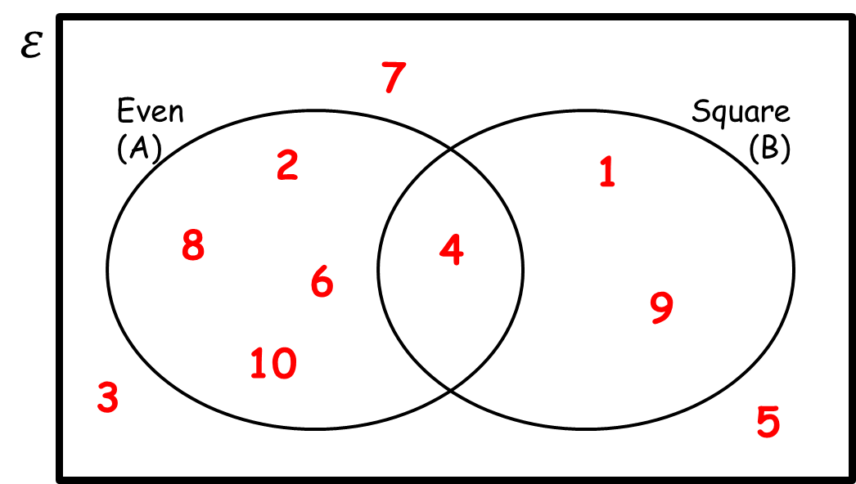
Sets come with strange notation, but a set is just a word for a collection of things.
Each thing in a set is called an element or member.
Capital letters represent a set, and lower case letters represent elements.
Notation
$A=\{…\}$ $A$ is the set of…
$x∈A$ $x$ is an element of $A$
$y∉A$ $y$ is not an element of $A$
$n(A)$ the number of elements in set $A$
$ξ$ the universal set
$∅$ or the empty set (a set containing no elements)

Slide 3
We can describe sets using numbers and symbols.
If a set is described using numbers and symbols, work out what the description means in words before you start working with the set.
$\left\{x:x<0\right\}$ describes the set of negative numbers.
$\left\{\left(x,y\right):y=2x+2\right\}$ describes the set of coordinates that lie on the line $y=2x+2$.
The colon means ‘such that’

Slide 4
Examples
List the members of $A=\{x:x<15\}$ if $ξ=\{x:x is a square number\}$
$A$ is the set of numbers $x$, such that $x$ is less than $15$
Elements of $A$ must be in the universal set
So $A=\{square numbers less than 15\}$
$A=\{1,4,9\}$
List the members of $A=\{x:x<15\}$ if $ξ=\{x:x is a prime number\}$
$A=\{prime numbers less than 15\}$
$A=\{2,3,5,7,11,13\}$
List the members of $A=\{x:x<15\}$ if $ξ=\{x:x>15\}$
$A=\{numbers that are both greater than 15 and less than 15\}$
No elements of $ξ$ fit the definition of an element of $A$, so $A$ is empty.
$A=∅$
Task – complete the set notation worksheet.

Slide 5
Answers
1. a) $A=\{2,3,5,7,11,13,17,19\}$ $B=\{1,4,9,16\}$
$C=\{1,8\}$ $D=\{4,8,12,16\}$
b) i) $n\left(A\right)=8$ ii) $n\left(B\right)=4$
iii) $n\left(C\right)=2$ iv) $n\left(D\right)=4$
c) i) $n\left(E\right)=0$
ii) $n\left(F\right)=2$
iii) $n\left(G\right)=2$
iv) $n\left(H\right)=5$
2. a) i) $C=\{0,1,2,3,4\}$
ii) $D=\{1,3\}$
iii) $E=\{0,−1,−2,−3\}$
b) i) $F=\{\left(1,0\right),\left(2,0\right),\left(3,0\right),\left(1,2\right),(2,2)\}$
ii) $G=\{\left(1,0\right),\left(2,0\right),\left(3,0\right),\left(4,0\right),\left(1,2\right),\left(2,2\right),(1,4)\}$

Slide 6
Venn diagrams are can be used to show sets and when they overlap.
A
B
The intersection is where two sets overlap.
This means A and B.
AND rule
A
B
If you put two sets together, you get the union.
This means A or B.
OR rule
A
B
The complement of A is the region that is not A.
This means not A.
Notes:
Print this slide for students to stick in books for reference (or ask them to copy).

Slide 7
Use your pieces of tracing paper to correctly shade the Venn diagrams.
Don’t forget to keep looking at that exam question too ☺

Slide 8
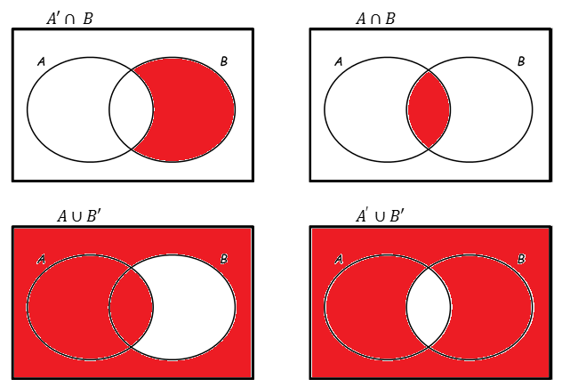
Answers

Slide 9
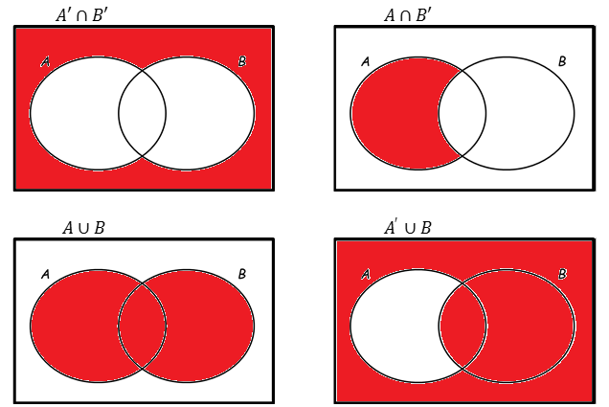
Answers

Slide 10
Task
Complete the worksheet on set notation and Venn diagrams.
Remember: if it’s tricky, draw a piccy! (ideally a Venn diagram)

Slide 11
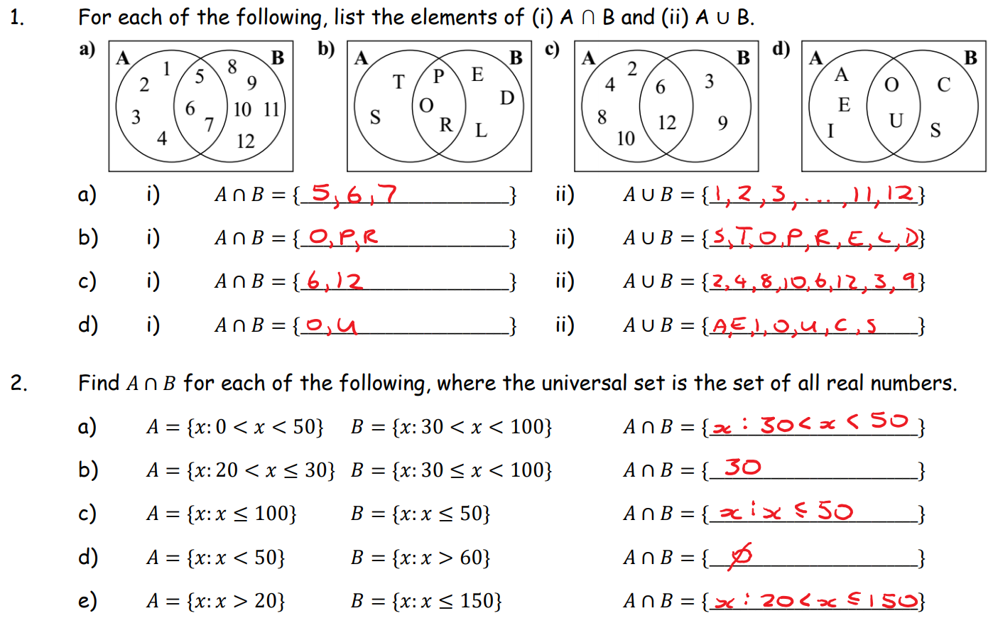
Answers

Slide 12
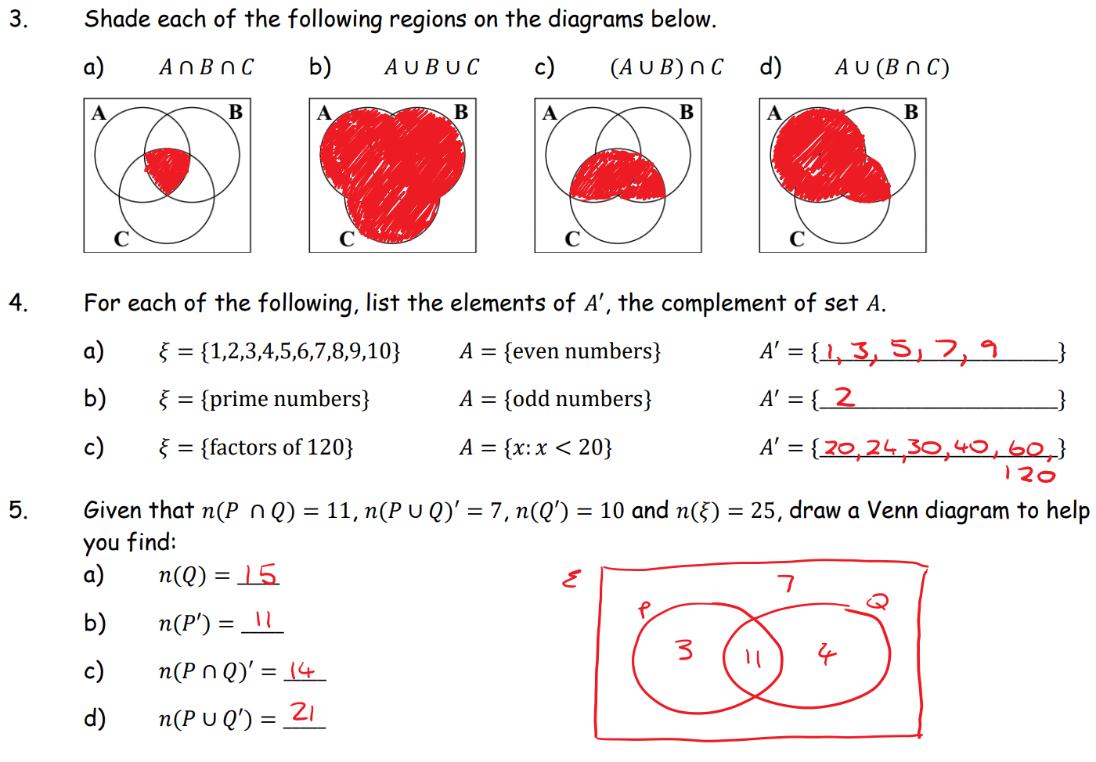
Answers

Slide 13
Subsets
$L⊆M$
$L$ is a subset of $M$ → all of the elements of set $L$ are also in set $M$
$L⊂M$
$L$ is a proper subset of $M$ → $L$ is a subset of $M$, but is not equal to $M$
$N⊄M$
$N$ is not a proper subset of $M$ → some elements of $N$ are not in $M$
For all sets:
The empty set is a subset of any set, i.e. for any set $A$, $∅⊆A$
2. Every set is a subset of itself, i.e. for any set $A$, $A⊆A$
For any two sets $A$ and $B$, if $A⊆B$ and $B⊆A$, then $A=B$

Slide 14
Remember to include the empty set and set $A$ itself in the list
Examples
1. List the subsets of $A=\{x,y\}$
$∅,\{x\},\{y\},\{x,y\}$
2. List the proper subsets of $B=\{1,2,3\}$
$∅,\{1\},\{2\},\{3\},\{1,2\},\{1,3\},\{2,3\}$
Proper subsets of $B$ include the empty set, but not set $B$ itself

Slide 15
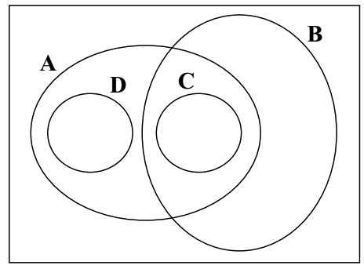
Your Turn
The diagram shows the relationship between four sets $A$, $B$, $C$ and $D$.
Each area of the diagram contains at least one element.
a) State whether each of the following statements is true or false.
i) $C⊂A$ ii) $D⊄B’$ iii) $(A∩B)⊂B$
iv) $(A∩B)⊂C$ v) $B′⊂C’$ vi) $C⊄(A∪B)$ vii) $B⊄D’$ viii) $(C∪D)⊂A$
b) Copy the following statements and complete them by placing either $⊂$ or $⊄$ in each of the gaps.
i) $A____(A∩B)$ ii) $(B∩C)____(A∩C)$
iii) $A’____B’$ iv) $C____(A∪C)$
v) $B____D’$ vi) $A’____D′$

Slide 16
Your Turn
The diagram shows the relationship between four sets $A$, $B$, $C$ and $D$.
Each area of the diagram contains at least one element.
a) State whether each of the following statements is true or false.
i) $C⊂A$ ii) $D⊄B’$ iii) $(A∩B)⊂B$
iv) $(A∩B)⊂C$ v) $B′⊂C’$ vi) $C⊄(A∪B)$ vii) $B⊄D’$ viii) $(C∪D)⊂A$
b) Copy the following statements and complete them by placing either $⊂$ or $⊄$ in each of the gaps.
i) $A____(A∩B)$ ii) $(B∩C)____(A∩C)$
iii) $A’____B’$ iv) $C____(A∪C)$
v) $B____D’$ vi) $A’____D′$








$$⊄$$
$$⊄$$
$$⊄$$
$$⊂$$
$$⊂$$
$$⊂$$

