Slide 1
Starter
What’s the value of one orange bar in each of the diagrams below?
5
5
5
4
= 19
4
4
4
4
6
= 22
9
9
5
= 23

Slide 2
Simultaneous equations are two equations with two unknowns. They are called simultaneous because they must both be solved at the same time.

Slide 3
Solve: $4x+y=17$
$2x+y=11$
Subtract
$$x$$
$$x$$
$$x$$
$$x$$
$$y$$
$$=17$$
$$x$$
$$x$$
$$y$$
$$=11$$
$$x$$
$$x$$
$$=6$$
$$x=3$$
$$x$$
$$x$$
$$x$$
$$x$$
$$y$$
$$=17$$
$$3$$
$$3$$
$$3$$
$$3$$
$$y$$
$$=17−12$$
$$y=5$$

Slide 4
Solve: $2x+5y=23$
$2x+3y=17$
Subtract
$$x$$
$$x$$
$$y$$
$$y$$
$$y$$
$$y$$
$$y$$
$$=23$$
$$x$$
$$x$$
$$y$$
$$y$$
$$y$$
$$=17$$
$$y$$
$$y$$
$$=6$$
$$y=3$$
$$x$$
$$x$$
$$y$$
$$=23$$
$$3$$
$$y$$
$$3$$
$$y$$
$$3$$
$$y$$
$$3$$
$$y$$
$$3$$
$$x$$
$$x$$
$$=23−15$$
$$x=4$$
$$=8$$

Slide 5
Solve: $2x+5y=23$
$2x+3y=17$
Algebraic Method
$$−$$
Subtract if the signs are the same, add if the signs are different
Same signs
$$2y=6$$
$$\overline{2} \overline{2}$$
$$y=3$$
Solve for first variable
Substitute into first equation
$$2x+5y=23$$
Solve for second variable
$$2x+15=23$$
$$−15 −15$$
$$2x =8$$
$$x =4$$

Slide 6
Solve: $4x−3y=−7$
$2x+3y=19$
Algebraic Method
$$+$$
Subtract if the signs are the same, add if the signs are different
$$6x =12$$
$$\overline{6} \overline{6}$$
Different signs
$$x =2$$
Solve for first variable
Substitute into first equation
$$4x−3y=−7$$
Solve for second variable
$$8−3y=−7$$
$$−8 −8$$
$$−3y=−15$$
Have a go at the questions ☺
$$\overline{−3} \overline{−3}$$
$$y=5$$

Slide 7
Questions:
https://minimallydifferent.com/2018/03/20/simultaneous-equations-1/

Slide 8
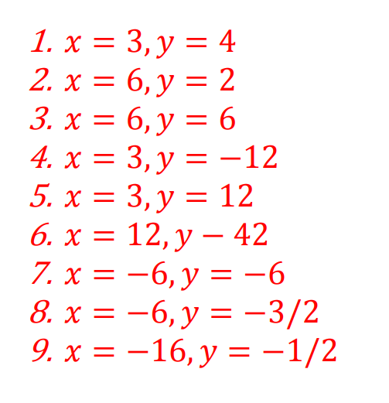
Answers

Slide 9
Plenary
Circle three emojis that reflect how you got on this lesson. Explain why below.

