Slide 1
Starter
What is a ratio?

Slide 2
1 : 4
This is a ratio.
This example tells us that for every 1 part of something we need, we need 4 parts of something else.

Slide 3
1 : 6
For example, orange squash.
For every 1 part of cordial, we need 6 parts water.

Slide 4
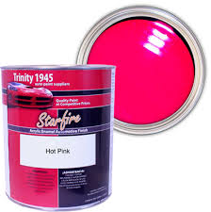
2 : 5
Or pink paint.
For every 2 parts of red paint, we need 5 parts of white paint.

Slide 5
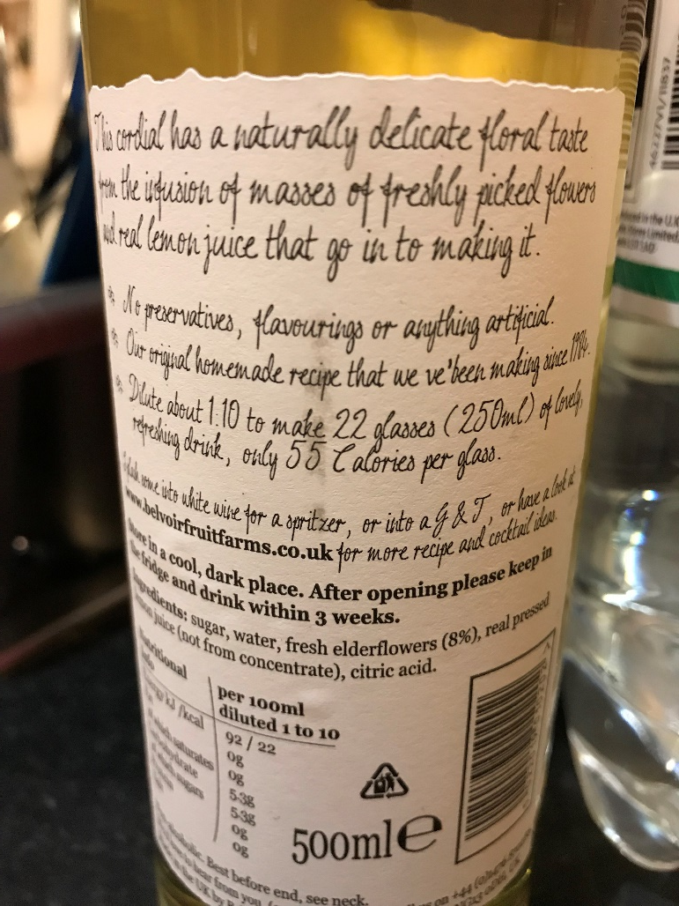
For example, elderflower cordial.
For every 1 part of cordial, we need 10 parts water.

Slide 6
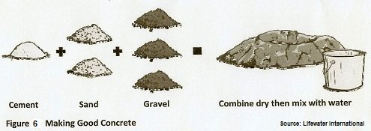
1 : 2 : 3
Or concrete.
This image shows we need 1 part of cement, 2 parts of sand and 3 parts of gravel.

Slide 7
What is the highest common factor (HCF) of 6 and 8?
12
2
A
C
10
4
B
D

Slide 8
What is the highest common factor (HCF) of 6 and 8?
12
2
A
C
10
4
B
D

Slide 9
What is the highest common factor (HCF) of 12 and 16?
48
12
A
C
4
24
B
D

Slide 10
What is the highest common factor (HCF) of 12 and 16?
48
12
A
C
4
24
B
D

Slide 11
What is the highest common factor (HCF) of 10 and 25?
5
10
A
C
50
2.5
B
D

Slide 12
What is the highest common factor (HCF) of 10 and 25?
5
10
A
C
50
2.5
B
D

Slide 13
What is the highest common factor (HCF) of 24 and 36?
6
12
A
C
8
24
B
D

Slide 14
What is the highest common factor (HCF) of 24 and 36?
6
12
A
C
8
24
B
D

Slide 15
To simplify or cancel down ratios, we need to divide by the highest common factor (HCF) of both parts.

Slide 16
Simplify:
What’s the highest common factor of 16 and 20?
16 : 20
4
So divide both numbers by 4

Slide 17
Simplify:
16 : 20
÷ 4
÷ 4
4 :
5

Slide 18
Simplify:
What’s the highest common factor of 6 and 27?
6 : 27
3
So divide both numbers by 3

Slide 19
Simplify:
6 : 27
÷ 3
÷ 3
2 :
9

Slide 20
Show me a ratio which simplifies to 2:7
What is wrong: To simplify the ratio 32:48 keep dividing both sides by 2 until you can’t do it any more
True / Never / Sometimes:
To simplify the ratios keep dividing both sides by 2 until you can’t do it any more

Slide 21
What is the same / different:
4:5 and £4:500p
2:3, 34:51 and 3:2
Convince me that 19:95 is equivalent to 1:5

Slide 22
Pair Task
What is the hidden message?
“I am Batman”
…But shhhh don’t tell anyone!

Slide 24
Simplify the following:
1) 3 : 6 2) 10 : 15 3) 9 : 12 4) 5 : 10
5) 12 : 6 6) 25 : 10 7) 12 : 16 8) 6 : 30
Leave all ratio answers in their simplest form:
This month there were 14 sunny days and 16 wet days. Find the ratio of sunny days to wet days.
In a bag of sweets, 10 are yellow and 15 blue. Find the ratio of yellow sweets to blue sweets.
A coach has room for 28 sitting and 16 standing passengers Find the ratio of sitting to standing passengers.
In a class there are 12 girls and 18 boys. Find the ratio of girls to boys in the class.
Simplify the following:
1) 6 : 15 : 21 2) 8 : 16 : 32 3) 9 : 12 :21
4) 9 : 18 : 45 5) 16 : 32 : 56 6) 36 : 48 : 72

Slide 25
Answers
1) 1 : 2 2) 2 : 3 3) 3 : 4 4) 1 : 2
5) 2 : 1 6) 5 : 2 7) 3 : 4 8) 1 : 5
1) 7 : 8 2) 2 : 3 3) 7 : 4 4) 2 : 3
1) 2 : 5 : 7 2) 1 : 2 : 4 3) 3 : 4 : 7
4) 1 : 2 : 5 5) 2 : 4 : 7 6) 3 : 4 : 6

