Slide 1
Starter
Simplify the following fractions:
$\frac{8}{12}$ $\frac{8}{6}$ $\frac{10}{15}$
$\frac{24}{12}$ $\frac{6}{16}$ $\frac{6}{9}$

Slide 2
Answers
Simplify the following fractions:
$\frac{2}{3}$ $\frac{8}{6}$ $\frac{10}{15}$
$\frac{24}{12}$ $\frac{6}{16}$ $\frac{6}{9}$

Slide 3
Answers
Simplify the following fractions:
$\frac{2}{3}$ $\frac{4}{3}$ $\frac{10}{15}$
$\frac{24}{12}$ $\frac{6}{16}$ $\frac{6}{9}$

Slide 4
Answers
Simplify the following fractions:
$\frac{2}{3}$ $\frac{4}{3}$ $\frac{2}{3}$
$\frac{24}{12}$ $\frac{6}{16}$ $\frac{6}{9}$

Slide 5
Answers
Simplify the following fractions:
$\frac{2}{3}$ $\frac{4}{3}$ $\frac{2}{3}$
$2$ $\frac{6}{16}$ $\frac{6}{9}$

Slide 6
Answers
Simplify the following fractions:
$\frac{2}{3}$ $\frac{4}{3}$ $\frac{2}{3}$
$2$ $\frac{3}{8}$ $\frac{6}{9}$

Slide 7
Answers
Simplify the following fractions:
$\frac{2}{3}$ $\frac{4}{3}$ $\frac{2}{3}$
$2$ $\frac{3}{8}$ $\frac{2}{3}$

Slide 8
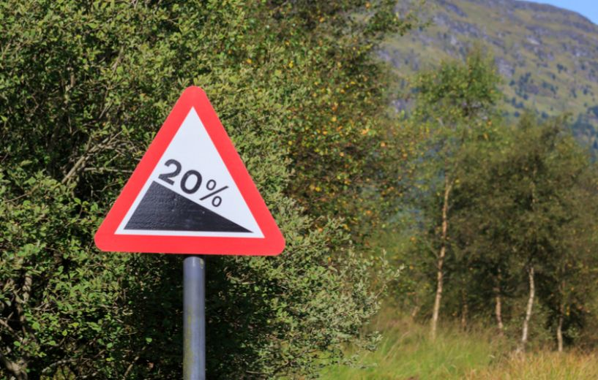
Think – Pair – Share
Define: gradient
Hint: do you recognise this road sign?
This means for every 100 units across, we move 20 units down

Slide 9
Copy into your books please ☺
Define: gradient
“Gradient is the steepness and direction of a line as read from left to right.”
Change in $y$
$$Gradient =\frac{change in y}{change in x}$$
Change in $x$
Notes:
Why is right angle relevant?
Why left to right?

Slide 10
Think – Pair – Share
Define: gradient
“Gradient is the steepness and direction of a line as read from left to right.”
This line segment has a positive gradient. Why?
This line segment has a negative gradient. Why?
Notes:
Discuss left to right.

Slide 11
Examples
What is the gradient of each line segment?
$$Gradient =\frac{change in y}{change in x}$$
Notes:
Why line ‘segment’?
Assume each square on the grid is one unit – does this matter?

Slide 12
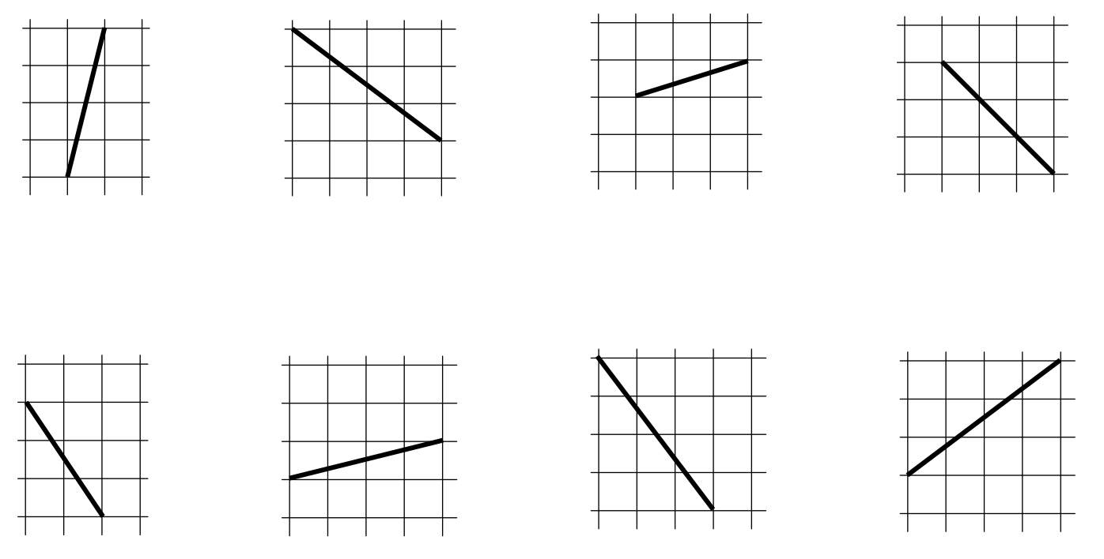
Your Turn
What is the gradient of each line segment?
$$Gradient =\frac{change in y}{change in x}$$
$$4$$
$$\frac{1}{3}$$
$$−1$$
$$−\frac{3}{4}$$
$$\frac{1}{4}$$
$$−\frac{4}{3}$$
$$−\frac{3}{2}$$
$$\frac{3}{4}$$
Notes:
Assume each square on the grid is one unit
Fractions, not decimals – more accurate, easier to calculate with later on!

Slide 13
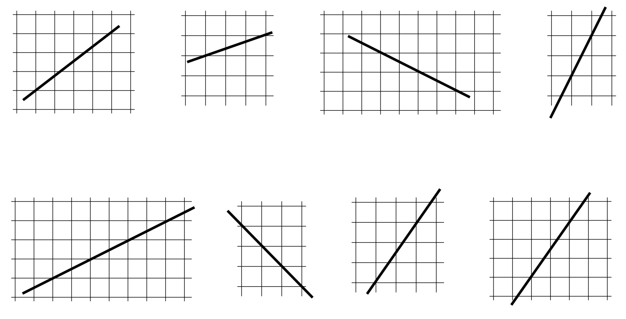
Your Turn - Worksheet
Look for points where each line passes through corners on the grid. Use those points to draw a gradient triangle. Work out the gradient of each line.
$$Gradient =\frac{change in y}{change in x}$$
Notes:
Assume each square on the grid is one unit

Slide 14
Answers
Look for points where each line passes through corners on the grid. Use those points to draw a gradient triangle. Work out the gradient of each line.
$$Gradient =\frac{change in y}{change in x}$$
$$−\frac{1}{2}$$
$$2$$
$$\frac{3}{4}$$
$$\frac{1}{3}$$
$$−1$$
$$\frac{1}{2}$$
$$\frac{3}{2}$$
$$\frac{3}{2}$$
Notes:
Assume each square on the grid is one unit
Does it matter where on the line segment you draw the triangle?
Easier with integer values!

Slide 15
$$Gradient =\frac{change in y}{change in x}$$
If
…and
Notes:
Use units to help: mph, km/h, m/s

Slide 16
$$Gradient =\frac{change in y}{change in x}$$
If
…and
how could we calculate the speed of a part of a journey on a distance-time graph?
$$Speed =\frac{distance}{time}$$
Distance
Time
Notes:
Discuss velocity

Slide 17
One Minute Work Out!
Express the following as fractions of an hour:
Example: 50 minutes = $\frac{5}{6}$ of an hour
a) 30 minutes
b) 20 minutes
c) 12 minutes
d) 48 minutes
e) 22.5 minutes
Time’s up!
1

Slide 18
Answers!
Express the following as fractions of an hour:
Example: 50 minutes = $\frac{5}{6}$ of an hour
a) 30 minutes = $\frac{1}{2}$ of an hour
b) 20 minutes = $\frac{1}{3}$ of an hour
c) 12 minutes = $\frac{1}{5}$ of an hour
d) 48 minutes = $\frac{4}{5}$ of an hour
e) 22.5 minutes = $\frac{3}{8}$ of an hour
Notes:
Discuss simplifying fractions will make our calculations easier

Slide 19
Dividing Fractions
$$30 ÷ \frac{2}{3}$$
Remember: dividing by fractions is the same as multiplying by their reciprocal!
$$30 × \frac{3}{2}$$
Notes:
Discuss ‘reciprocal’ – inverse, product is 1, etc

Slide 20
This distance-time graph represents a car journey from Oakham to Wellingborough, a distance of 50 km, and back again.
Distance (km)
Time (minutes)
Notes:
Displacement vs distance
Speed vs velocity

Slide 21
What is each square on the grid now?
Will this affect any calculations we do?
Does it matter which axis is labelled as ‘time’?
Distance (km)
Time (minutes)

Slide 22
Task
Calculate the average speed for each part of the journey.
AB: $\frac{16 km}{20 mins}$
Distance (km)
Time (minutes)
Notes:
Discuss average speed vs actual speed
EF why isn’t’ speed negative?

Slide 23
Task
Calculate the average speed for each part of the journey.
AB: $\frac{16 km}{1/3 hour}$
$16 ÷ \frac{1}{3}$
Distance (km)
Time (minutes)
Notes:
Discuss average speed vs actual speed
EF why isn’t’ speed negative?

Slide 24
Task
Calculate the average speed for each part of the journey.
AB: $\frac{16 km}{1/3 hour}$
$16 ÷ \frac{1}{3}=16 ×3$
$=$ 48 km/h
Distance (km)
Time (minutes)
Notes:
Discuss average speed vs actual speed
EF why isn’t’ speed negative?

Slide 25
Task
Calculate the average speed for each part of the journey.
AB: 48 km/h
BC: 114 km/h
CD: 45 km/h
DE: Stationary
EF: 50 km/h
Distance (km)
Time (minutes)
Notes:
Discuss average speed vs actual speed
Stationary spelling!
EF why isn’t’ speed negative?

Slide 27
Answers
a) 30 km
b) 40 km
c) 20 km/h
d) 40 km/h
e) 200 km/h

