Slide 1
Starter
Find the order of rotation of these shapes.
Extension: Find the centre of rotation on each of these shapes
Complete these so that they have rotational symmetry about the centre.

Slide 2
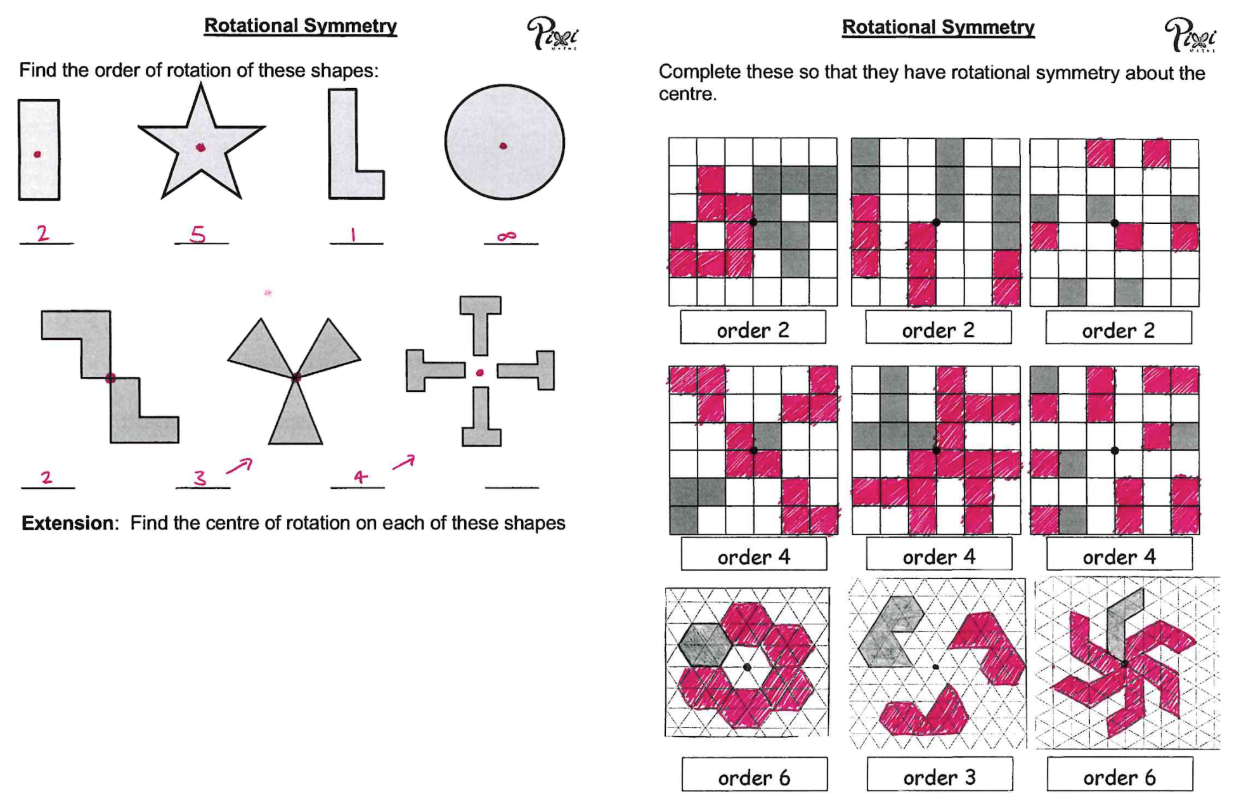

Slide 3
Rotation is a type of transformation.
A rotation turns an object. The size and shape stay exactly the same but the orientation changes.
We describe rotations with an angle, a direction and a centre.

Slide 4
10
Transform this triangle by the rotation:
90° clockwise around (4, 5)
9
Identify the centre of rotation.
8
7
6
5
4
3
2
1
0
0
1
2
3
4
5
6
7
8
9
10

Slide 5
10
Transform this triangle by the rotation:
90° clockwise around (4, 5)
9
Place the tracing paper over the top of the object and centre of rotation.
8
7
6
5
4
3
2
1
0
0
1
2
3
4
5
6
7
8
9
10

Slide 6
10
Transform this triangle by the rotation:
90° clockwise around (4, 5)
9
Draw the object and the centre of rotation on the tracing paper.
8
7
6
5
4
3
2
1
0
0
1
2
3
4
5
6
7
8
9
10

Slide 7
10
Transform this triangle by the rotation:
90° clockwise around (4, 5)
9
Put your pencil on the centre of rotation to act as a pivot.
8
7
6
5
4
3
2
1
0
0
1
2
3
4
5
6
7
8
9
10

Slide 8
10
Transform this triangle by the rotation:
90° clockwise around (4, 5)
9
Hold your pencil still and rotate the tracing paper 90º clockwise.
8
7
6
5
4
3
2
1
0
0
1
2
3
4
5
6
7
8
9
10

Slide 9
10
Transform this triangle by the rotation:
90° clockwise around (4, 5)
9
Gradually lift the tracing paper and draw the image in its correct place.
8
7
6
5
4
3
2
1
0
0
1
2
3
4
5
6
7
8
9
10

Slide 10
Extension: What word do the rotations make?

Slide 11
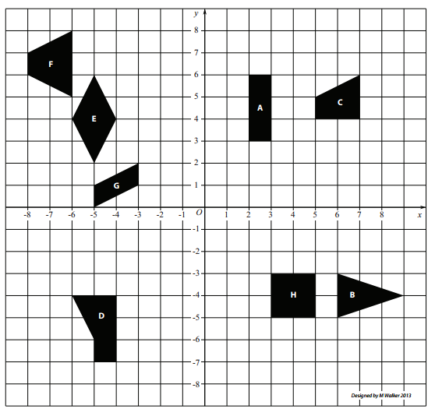

Answers
Ext) Rotate shape G 90° clockwise about the origin
Ext) Translation shape A by the vector $\left(\begin{matrix}−1 \\ −3\end{matrix}\right)$
Ext) Reflect shape H in the line $x=2$ and then $y=1$ (or vice versa)

Slide 12
Describing Rotations
To describe a rotation we need to know three things:
The angle of the rotation. For example, ½ turn = 180°, ¼ turn = 90°, ¾ turn = 270°
The direction of the rotation. For example, clockwise or anticlockwise.
The centre of rotation. This is the fixed point about which an object moves.

Slide 13
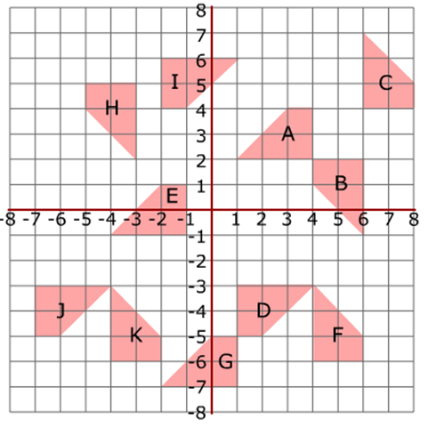
Task
Fully describe the transformations on the sheet.

Slide 14
Answers
Rotation | 90° or 180° | Clockwise or anticlockwise | Centre of rotation
A to B | 90° | Anticlockwise | (5, 3)
B to C | 180° | - | (6, 3)
C to D | 90° | Clockwise | (0, 3)
D to E | 180° | - | (0, -2)
E to F | 90° | Clockwise | (-1, -6)
F to G | 90° | Anticlockwise | (3, -8)
G to H | 90° | Anticlockwise | (-7, 3)
H to I | 90° | Anticlockwise | (-3, 6)
I to A | 180° | - | (1, 4)

