Slide 1
Starter: Think – Pair – Share
Can you match the graph to the description?
Distance
Distance
Distance
Time
Time
Time
A runner runs at a steady pace to the end of a track, turns around then runs at the same speed back.
A motorbike travels away from home at a steady speed.
A car remains parked in a car park.

Slide 2
Task
The graph below shows the variation in the depth of water as Archie takes his early morning bath. Match the different parts of the graph to the statements shown.
5
Relaxes in bath.
Pulls the plug.
4
6
2
3
Depth of
Water
7
1
Gets into bath.
Cold tap turned off, gets undressed.
Time
Gets out of bath.
Turns off hot tap.
Hot and cold taps turned on.

Slide 3
Pair Activity
Complete the ‘Bathtime’ match-up task.
Match each graph to its corresponding description.
Justify each line segment in relation to the description.

Slide 5
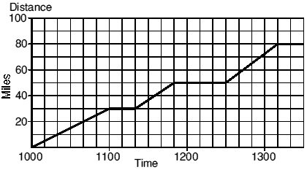
Example
The graph shows a car journey of 80 miles, which Tricia and Mike took when they were in Yorkshire on holiday. They stopped twice to visit places of interest.
At what times did they stop?
How long did they spend at the second place of interest?
How long in total did they spend travelling?
1100 and 1150

Slide 6
Example
The graph shows a car journey of 80 miles, which Tricia and Mike took when they were in Yorkshire on holiday. They stopped twice to visit places of interest.
At what times did they stop?
How long did they spend at the second place of interest?
How long in total did they spend travelling?
1100 and 1150
40 minutes

Slide 7
Example
The graph shows a car journey of 80 miles, which Tricia and Mike took when they were in Yorkshire on holiday. They stopped twice to visit places of interest.
At what times did they stop?
How long did they spend at the second place of interest?
How long in total did they spend travelling?
1100 and 1150
40 minutes
130 minutes

Slide 8
Pair Activity
Complete the ‘Distance-Time’ match-up task.
Match each graph to its corresponding description.
Justify each line segment in relation to the description.

Slide 9
He runs at a constant speed to the pub and half way back has a rest.
He runs at a constant speed to the pub and back without stopping.
He runs at a constant speed to the pub, has a drink, and runs at a constant speed back.
He runs at a constant speed to the pub, having a rest on the way, and then runs at a constant speed back.
He runs to the pub, having a rest on the way, and then stays at the pub all day.

Slide 11
Answers
Usain Bolt’s Race
a) 60 m
b) 9.5 secs
c) 110 m
d) He hasn’t run anywhere
at zero seconds
Bungee Jump
a) 100 m
b) Bouncing up and down
c) 1 sec
d) So they don’t hit the
floor!
e) 4 secs
Taxi Journey
a) £2 starting fare
b) £10
c) 6 miles
d) £13
e) Fare no longer increases
f) y = 4/3 x + 2
g) y = 13
Running a Bath
a) 6 inches
b) y = 2x
c) Depth not increasing
(taps turned off)
d) y = 11

Slide 12
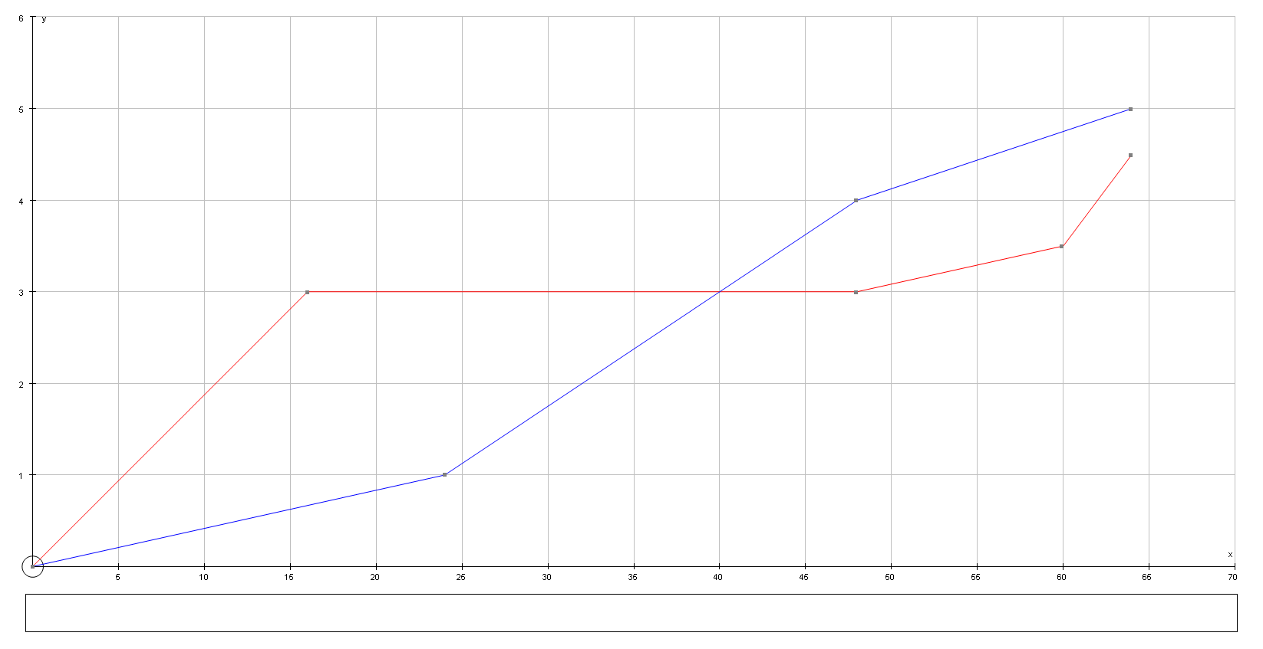
Plenary
The graph below shows the distance-time graph of the race between the hare and the tortoise.
Decide which line represents the hare and which one represents the tortoise.
Write a commentary for the race!

