Slide 1
Starter
Write down the first 10…
Odd numbers
Even numbers
Square numbers
Prime numbers
Triangular numbers
1, 3, 5, 7, 9, 11, 13, 15, 17, 19
2, 4, 6, 8, 10, 12, 14, 16, 18, 20
1, 4, 9, 16, 25, 36, 49, 64, 81, 100
2, 3, 5, 7, 11, 13, 17, 19, 23, 29
1, 3, 6, 10, 15, 21, 28, 36, 45, 55

Slide 2
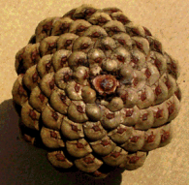
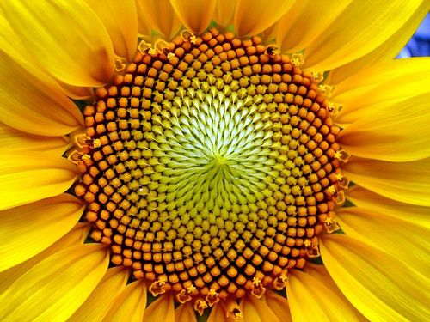
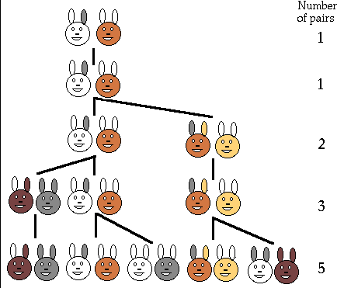
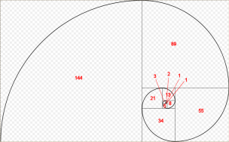
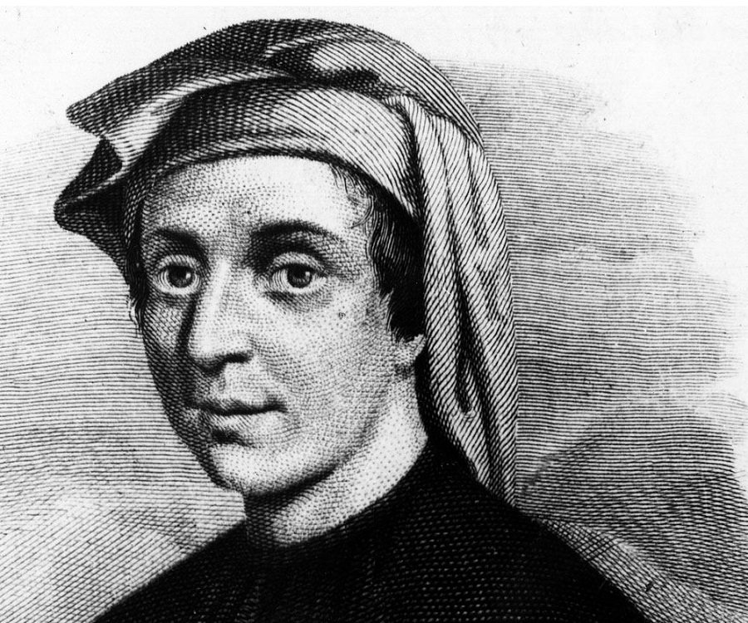
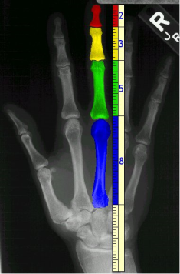
Have you ever wondered how many spirals a sunflower centre has?
So did an Italian mathematician called Leonardo Fibonacci! He discovered a number sequence over 800 years ago that can be used to describe lots of patterns in nature.

Slide 3
The Fibonacci numbers are the numbers in the following sequence, called the Fibonacci sequence.
0, 1, 1, 2, 3, 5, 8, 13, 21, 34, 55, 89…
Think, pair, share: Can you spot the pattern?
The next number is found by adding up the two numbers before it.
Formally:
$$x_{n}=x_{n−1}+x_{n−2}$$
Fibonacci Day is November 23rd, as it has the digits "1, 1, 2, 3" which is part of the sequence.

Slide 4
The Fibonacci numbers are the numbers in the following sequence, called the Fibonacci sequence.
0, 1, 1, 2, 3, 5, 8, 13, 21, 34, 55, 89…
What are the next three terms in the Fibonacci sequence?
$$1+1$$
$$1+2$$
$$0+1$$
$$2+3$$
$$3+5$$
…and so on!
…144, 233, 377…

Slide 5
Fibonacci numbers can be used to approximately convert from miles to kilometres and back.
0, 1, 1, 2, 3, 5, 8, 13, 21, 34, 55, 89…
Fibonacci numbers have a property that the ratio of two consecutive numbers tends to the Golden Ratio as numbers get bigger and bigger.
The Golden Ratio is $\frac{1+\sqrt{5}}{2}=1.6180339887…$
Coincidentally, there are 1.609 kilometres in a mile!
The Golden Ratio appears in many places in nature and has been used in artwork for centuries!
Homework: bring three examples of the Golden Ratio to your next maths lesson.

Slide 6
Fibonacci numbers can be used to approximately convert from miles to kilometres and back.
0, 1, 1, 2, 3, 5, 8, 13, 21, 34, 55, 89…
For example: 3 miles = 5 kilometres
5 miles = 8 kilometres …and so on.
Task
a) Use the pattern to change 13 kilometres to miles.
b) Use the pattern to change 42 miles to kilometres.
c) Use two values in the pattern to change 18 miles to kilometres.
8 miles
68 km
29km

Slide 7
We can calculate next terms in Fibonacci-like sequences using the same method.
Task: Calculate the first 10 terms of the following Fibonacci sequences:
a) 2, 5, 7, __, __, __, __, __, __, __...
b) 4, -2, 2, __, __, __, __, __, __, __...
c) -3, -1, -4, __, __, __, __, __, __, __...
d) $1, \frac{1}{2}, \frac{3}{2}$, __, __, __, __, __, __, __...
e) $a$, $b$, $a+b$, __, __, __, __, __, __, __...

Slide 8
We can calculate next terms in Fibonacci-like sequences using the same method.
Task: Calculate the first 10 terms of the following Fibonacci sequences:
a) 2, 5, 7, 12, 19, 31, 50, 81, 131, 212
b) 4, -2, 2, 0, 2, 2, 4, 6, 10, 16
c) -3, -1, -4, -5, -9, -14, -23, -37, -50, -87
d) $1, \frac{1}{2}, 1\frac{1}{2}, 2, 3\frac{1}{2}, 5\frac{1}{2}, 9, 14\frac{1}{2}, 23\frac{1}{2}, 38$
e) $a, b, a+b, a+2b, 2a+3b, 3a+5b, 5a+8b, 8a+13b, 13a+21b, 21a+34b$

Slide 9
This is a Fibonacci sequence with some numbers missing.
$4$, _____, _____, _____, $35$
How could you work out the missing numbers?
By guessing? Trial and error?
This could take a while. We need to be more methodical.

Slide 10
This is a Fibonacci sequence with some numbers missing.
$4$, _____, _____, _____, $35$
$$a$$
$$4+a$$
$$4+2a$$
Let’s call the first missing number $a$.

Slide 11
This is a Fibonacci sequence with some numbers missing.
$4$, _____, _____, _____, $35$
$$a$$
$$4+a$$
$$4+2a$$
We know that 35 is the sum of the two previous numbers

Slide 12
This is a Fibonacci sequence with some numbers missing.
$4$, _____, _____, _____, $35$
$\left(4+a\right)+\left(4+2a\right)=35$
$8+3a=35$
$−8$ $−8$
$3a=27$
$\overline{3}$ $\overline{3}$
$a=9$
$4$, $9$, $13$, $22$, $35$

Slide 13
This is a Fibonacci sequence with some numbers missing.
$2$, _____, _____, _____, _____, _____, $106$
$$a$$
$$2+a$$
$$2+2a$$
$$4+3a$$
$$6+5a$$
$\left(4+3a\right)+\left(6+5a\right)=106$
$10+8a=106$
$−10$ $−10$
$8a=96$
$\overline{8}$ $\overline{8}$
$a=12$
$2$, $12$, $14$, $26$, $40$, $66$, $106$

Slide 15
Answers
a) 1, 7, 8, 15,
b) 3, 4, 7, 11,
c) 1, 10, 11, 21, 32
d) 4, 9, 13, 22, 35,
e) 1, 8, 9, 17, 26, 43
f) 10, 11, 21, 32, 53, 85
g) 4, 4, 8, 12, 20, 32
h) 15, 16, 31, 47, 78, 125

Slide 16
The first three terms of a Fibonacci sequence are
$a$ $b$ $a+b$
a) Show that the 6th term of this sequence is $3a+5b$
Given that the 3rd term is 7 and the 6th term is 29,
b) find the values of $a$ and $b$.
$a+2b$
$2a+3b$
$$3a+5b$$
$a+b=7$
Solve these simultaneous equations!
$3a+5b=29$
$$−$$
$3a+3b=21$
$2b=6$
Task:
A Fibonacci sequence has second term 20 and fifth term 80. Find the first term.
The sixth and seventh terms of a Fibonacci sequence are 31 and 50. What are the first two terms of the sequence?
$b=3$
If $b=3$ and $a+b=7$,
$$a=10$$
$a=4$
$$a=2, b=5$$

Slide 17
Plenary
Prove that the sum of the first 10 terms of any Fibonacci sequence will be a multiple of 11.
Hint: use $a$ and $b$ as the first two terms
Hint: add the first 10 terms together.

