Slide 1
Settler
What’s the same and what’s different?
$$2^{6}$$ | $${\left(2^{2}\right)}^{3}$$
$$2^{3}×2^{3}$$ | $${(−2)}^{6}$$

Slide 2
Starter
Example: $\frac{2}{3}×\frac{3}{2}=1$
Task – Find the reciprocals of the following numbers:
1. $\frac{1}{2}$ 2. $\frac{1}{3}$ 3. $6$
4. $\frac{3}{4}$ 5. $5$ 6. $1$
$$→2$$
$$→3$$
$→\frac{1}{6}$
$→\frac{4}{3}$
$→\frac{1}{5}$
$$→1$$

Slide 3
Zero Index
$$\frac{2^{3}}{2^{3}}$$
$$=\frac{2×2×2}{2×2×2}$$
$$=\frac{8}{8}$$
$$=1$$
$$\frac{2^{3}}{2^{3}}$$
$$=2^{3−3}$$
$$=2^{0}$$
We have two correct answers, but they are different to each other. This means that the following must be true:
$$2^{0}=1$$

Slide 4
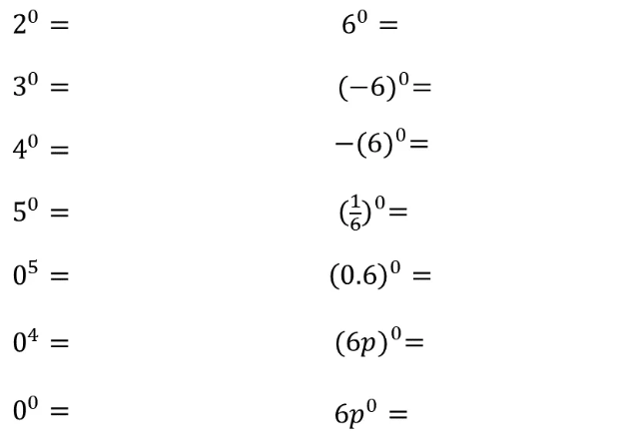
Zero Index
Notes:
Craig Barton – variationtheory.com

Slide 5
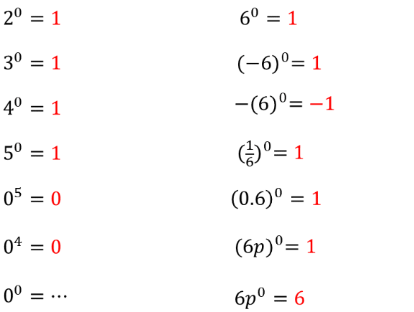
Zero Index
Notes:
Craig Barton – variationtheory.com

Slide 6
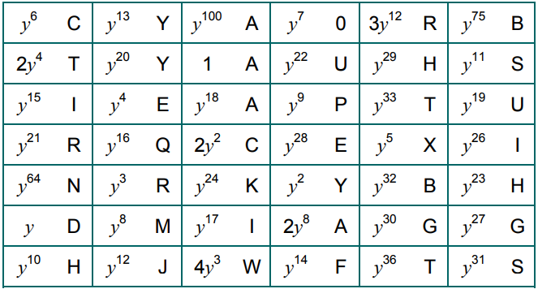
Task
Simplify the expressions on the worksheet.
“You are right”
Notes:
https://www.teachitmaths.co.uk/resources/ks4/number/powers-of-y-eliminator/22255

Slide 7
Negative Index
${10}^{4}=10 000$
${10}^{3}=1 000$
${10}^{2}=100$
${10}^{1}=10$
${10}^{0}=1$
${10}^{−1}=\frac{1}{10}$
${10}^{−2}=\frac{1}{100}$
$2^{4}=16$
$2^{3}=8$
$2^{2}=4$
$2^{1}=2$
$2^{0}=1$
$2^{−1}=\frac{1}{2}$
$2^{−2}=\frac{1}{4}$
$$÷10$$
$$÷2$$
$$÷10$$
$$÷2$$
$$÷10$$
$$÷2$$
$$÷10$$
$$÷2$$
$$÷10$$
$$÷2$$
$$÷10$$
$$÷2$$

Slide 8
Negative Index
$$=\frac{1}{3^{2}}$$
$$=\frac{1}{9}$$
$$3^{−2}$$
$$=\frac{1}{a^{m}}$$
$$a^{−m}$$
A negative index denotes the power’s reciprocal

Slide 9
Negative Indices
1. $3^{−1}$
2. $3^{−2}$
3. $3^{−3}$
4. ${\left(\frac{1}{3}\right)}^{−3}$
5. ${\left(\frac{1}{3}\right)}^{−2}$
6. ${\left(\frac{1}{3}\right)}^{−1}$
7. ${\left(\frac{2}{3}\right)}^{−1}$
8. ${\left(\frac{2}{3}\right)}^{−2}$
$=\frac{1}{3}$
$=\frac{1}{9}$
$=\frac{1}{27}$
$=27$
$=9$
$=3$
$=\frac{3}{2}$
$=\frac{9}{4}$
9. $a^{−1}$
10. $a^{−2}$
11. $a^{−3}$
12. ${\left(\frac{1}{a}\right)}^{−3}$
13. ${\left(\frac{1}{a}\right)}^{−2}$
14. ${\left(\frac{1}{a}\right)}^{−1}$
15. ${\left(\frac{b}{a}\right)}^{−1}$
16. ${\left(\frac{b}{a}\right)}^{−2}$
$=\frac{1}{a}$
$=\frac{1}{a^{2}}$
$=\frac{1}{a^{3}}$
$=a^{3}$
$=a^{2}$
$=a$
$=\frac{a}{b}$
$=\frac{a^{2}}{b^{2}}$

Slide 11
Answers
1a. 4⁵ b. 7⁴ c. a⁴
d. f² x g³
2a. 9 b. 32 c. 1000
d. 5 e. 1 f. 1
3a. 3¹³ b. 2⁹ c. m⁹
d. 4⁴ e. 3⁵ f. h²
g. 6¹² h. b¹⁰ i. 9⁰ = 1
j. 8⁴ k. y⁴ l. r²
4a. $\frac{1}{3}$ b. $\frac{1}{4^{2}}$ c. $\frac{1}{f^{4}}$
d. $\frac{1}{5^{3}}$ e. $\frac{1}{g^{2}}$ f. $y$

Slide 12
Answers
5a. 2 b. 3 c. 5
d. 0 e. 4 f. 4
6a. 4 b. 3 c. 3
7a. 3⁶ b. 2¹⁴ c. 7⁰ = 1
d. 2⁻² = $\frac{1}{2^{2}}$
8a. 10a⁷ b. 12y⁰ = 12
c. 14g d. 4r⁴
e. 10d⁻¹ = $\frac{10}{d}$ f. 12c⁰ = 12

