Slide 1












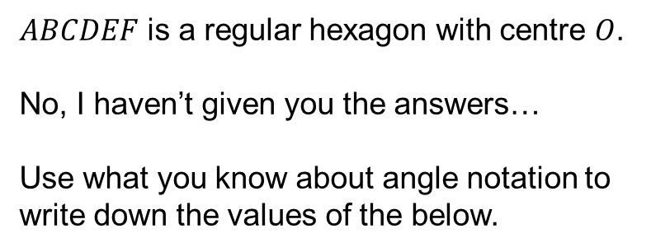





Starter
$$B$$
$$C$$
$ABCDEF$ is a regular hexagon with centre $O$.
No, I haven’t given you the answers…
Use what you know about angle notation to write down the values of the below.
$$120°$$
$$30°$$
$$30°$$
$$60°$$
$$A$$
$$D$$
$$O$$
$$60°$$
$$60°$$
$A\hat{B}C=$
$A\hat{D}C=$
$B\hat{A}C=$
$C\hat{A}D=$
$A\hat{C}D=$
$O\hat{D}E=$
$E\hat{O}D=$
$120°$
$60°$
$30°$
$30°$
$90°$
$60°$
$60°$
$$F$$
$$E$$

Slide 2


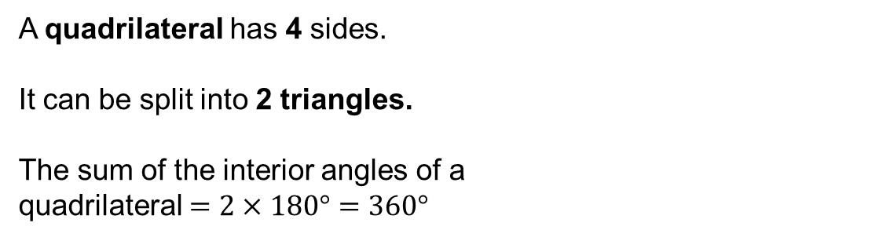



A quadrilateral has 4 sides.
It can be split into 2 triangles.
The sum of the interior angles of a
quadrilateral $=2×180°=360°$
$$p$$
$$q$$
$$r$$
$p+q+r+s=360°$
$$s$$

Slide 3



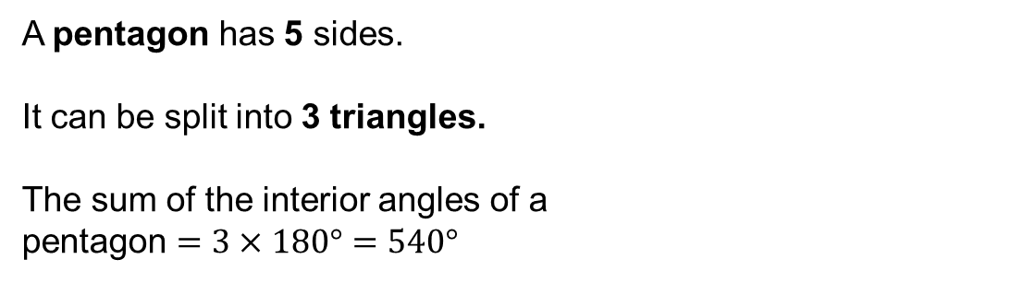



A pentagon has 5 sides.
It can be split into 3 triangles.
The sum of the interior angles of a
pentagon $=3×180°=540°$
$$b$$
$$a$$
$$c$$
$$e$$
$a+b+c+d+e=540°$
$$d$$

Slide 4

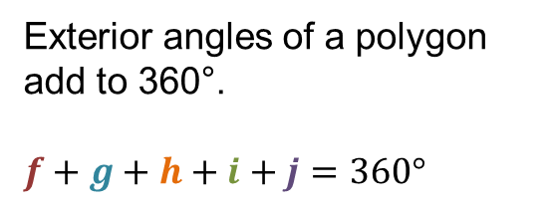




$$f$$
$$g$$
Exterior angles of a polygon add to 360°.
$f+g+h+i+j=360°$
$$h$$
$$j$$
$$i$$
At each vertex, interior angle $+$ exterior angle $=180°$

Slide 5
Extension: Complete the extra questions

Slide 6
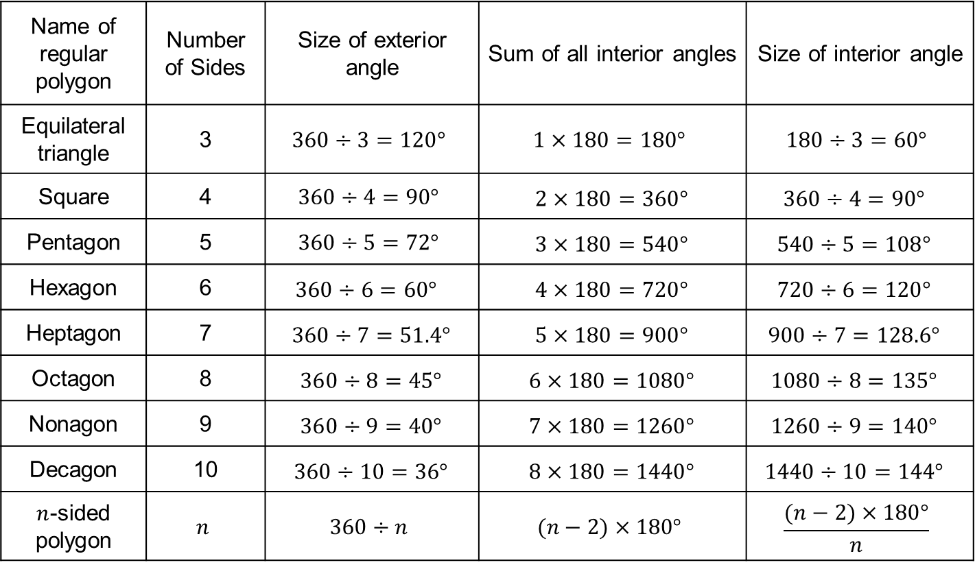
Answers
Name of regular polygon | Number of Sides | Size of exterior angle | Sum of all interior angles | Size of interior angle
Equilateral triangle | 3 | $$360÷3=120°$$ | $$1×180=180°$$ | $$180÷3=60°$$
Square | 4 | $$360÷4=90°$$ | $$2×180=360°$$ | $$360÷4=90°$$
Pentagon | 5 | $$360÷5=72°$$ | $$3×180=540°$$ | $$540÷5=108°$$
Hexagon | 6 | $$360÷6=60°$$ | $$4×180=720°$$ | $$720÷6=120°$$
Heptagon | 7 | $$360÷7=51.4°$$ | $$5×180=900°$$ | $$900÷7=128.6°$$
Octagon | 8 | $$360÷8=45°$$ | $$6×180=1080°$$ | $$1080÷8=135°$$
Nonagon | 9 | $$360÷9=40°$$ | $$7×180=1260°$$ | $$1260÷9=140°$$
Decagon | 10 | $$360÷10=36°$$ | $$8×180=1440°$$ | $$1440÷10=144°$$
$n$-sided polygon | $$n$$ | $$360÷n$$ | $$(n−2)×180°$$ | $$\frac{(n−2)×180°}{n}$$

Slide 7
Extension: Exam question on next slide

Slide 8

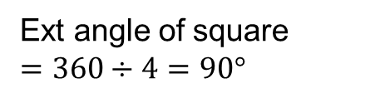


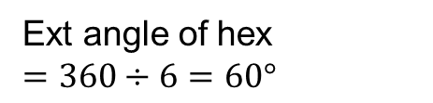


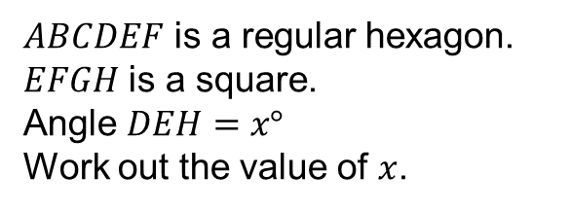




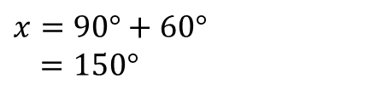
Extension exam question
$$B$$
$$C$$
$ABCDEF$ is a regular hexagon. $EFGH$ is a square.
Angle $DEH=x°$
Work out the value of $x$.
$$A$$
$$D$$
Ext angle of hex
$=360÷6=60°$
$$E$$
$$F$$
$$x°$$
Ext angle of square
$=360÷4=90°$
$$G$$
$$H$$
$x=90°+60°$
$=150°$

Slide 9
Answers
1a. 1440° b. 1800° c. 1980°
2a. 12 b. 20 c. 9
3. 154.3°
4. 30
5. 3600°
6. James – it is not possible to draw a polygon with 2.3 sides
7. 60°
8a. 120° b. 240°

