Slide 1
Starter
3 cakes cost £1.50. How much will 5 cakes cost?
A 6-pack of pop costs £2.40. How much will a 10-pack cost?
A plumber works for 8 hours for £120. How much will he earn in 5 hours?
A builder can lay 200 bricks in 5 hours. How many can he lay in 7 hours?
£2.50
£4.00
£75
280 bricks

Slide 2
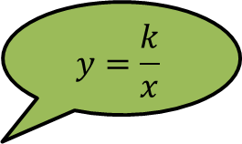
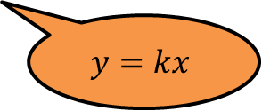
When two quantities are in direct proportion, as one increases the other does too.
We can display this relationship in a graph. Two quantities that are in direct proportion will always produce a straight-line graph that passes through the origin.
£1.50
£1.20
Cost
90p
$$y=kx$$
60p
30p
$$y=\frac{k}{x}$$
0
1
2
3
4
5
Number of packets
$p$
1.0
0.8
When two quantities are in inverse proportion, as one increases the other decreases.
When we graph this relationship we get a curved graph.
0.6
0.4
0.2
0
1
2
3
4
5
6
7
8
9
10
$g$

Slide 3
Explain how you know that $y$ is not directly proportional to $x$:
$y$
$$0$$
$$x$$

Slide 4
Example
$Y$ is directly proportional to $X$.
Draw a graph by completing the table of values
Use the graph to estimate the value of $X$ when $Y=32$.
$Y=kX$
$14=k×2$
$k=7$
$Y=7X$
When $Y=32$, $X=4.5$
$Y$
120
100
80
$$×$$
8
$$×$$
$$X$$ | 2 | 4 |  | 10
$$Y$$ | 14 |  | 56
60
28
70
Substitute the values into the proportion equation
40
$$×$$
20
$$×$$
0
1
2
3
4
5
6
7
8
9
10
11
12
$X$

Slide 5
Example
$Y$ is inversely proportional to $X$.
Draw a graph by completing the table of values
Use the graph to estimate the value of $X$ when $Y=15$.
$Y=\frac{k}{X}$
$10=k÷2$
$k=20$
$Y=\frac{20}{X}$
When $Y=15$, $X=1.3$
$Y$
30
25
$$×$$
$$X$$ | 1 | 2 | 4 | 5
$$Y$$ |  | 10
20
20
5
4
15
Substitute the values into the proportion equation
$$×$$
10
$$×$$
$$×$$
5
0
1
2
3
4
5
$X$

Slide 7
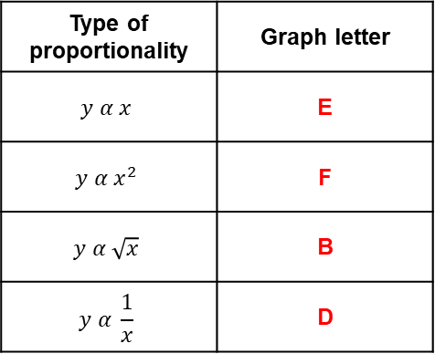
Answers
Question 1 Question 2
$Y=4X$ $N=\frac{2}{M}$
Question 3
When $Y=20$, $X=5$ When $M=3$,
$N=0.7±0.1$
$d$
$v$
$$X$$ | 2 | 4 | 8 | 10
$$Y$$ | 8 | 16 | 32 | 40
$$M$$ | 1 | 2 | 4 | 5
$$N$$ | 2 | 1 | 0.5 | 0.4
$$0$$
$$c$$
$$0$$
$$u$$
$$Y$$
$$N$$
$$×$$
$$×$$
40
2
$$×$$
Type of proportionality | Graph letter
$$y α x$$ | E
$$y α x^{2}$$ | F
$$y α \sqrt{x}$$ | B
$$y α \frac{1}{x}$$ | D
30
20
1
$$×$$
$$×$$
10
$$×$$
$$×$$
$$×$$
0
2
4
6
8
10
$$X$$
0
1
2
3
4
5
$$M$$
Graph A
Graph B
Graph C
$$y$$
$$y$$
$$y$$
$$0$$
$$x$$
$$0$$
$$x$$
$$0$$
$$x$$
Graph D
Graph E
Graph F
$$y$$
$$y$$
$$y$$
$$0$$
$$x$$
$$0$$
$$x$$
$$0$$
$$x$$

